Slide 1
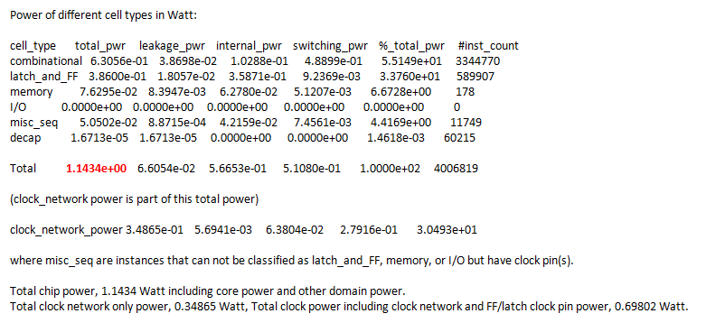
HEVC Power Consumption Estimation
Condition
based on SAIF File ( 357M )
Number of nets covered in saif file = 3087110(Total# = 4148819, 74.409368%).
Data Base : intermediate version after post-route, pre hold fix
Lib corner: TT_85
RC corner: Cworst_85
Default Data Toggle rate : 0.1
Default Clock Toggle rate : 1.5

