Slide 1
CevaXM4_Subsystem in Sirius
Name: Cong Liu
Date : 2017.01.20

Slide 3
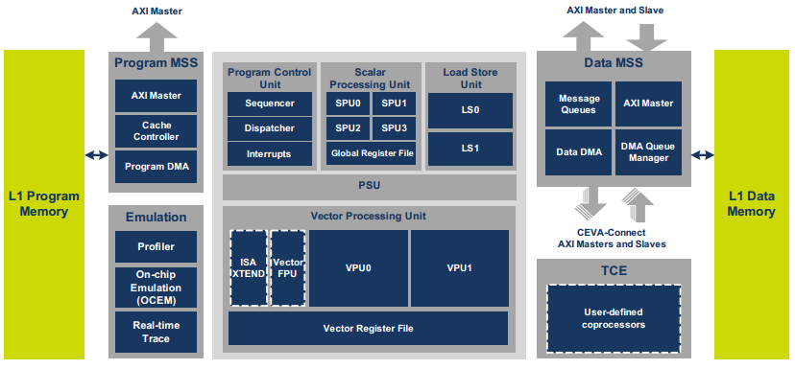
CevaXM4 Core
Instruction set: 16-bits 32-bits 48-bits 64-bits
Up to 8 instructions → Instruction packet
Vector Register File: num=40, width=256bit

Slide 4
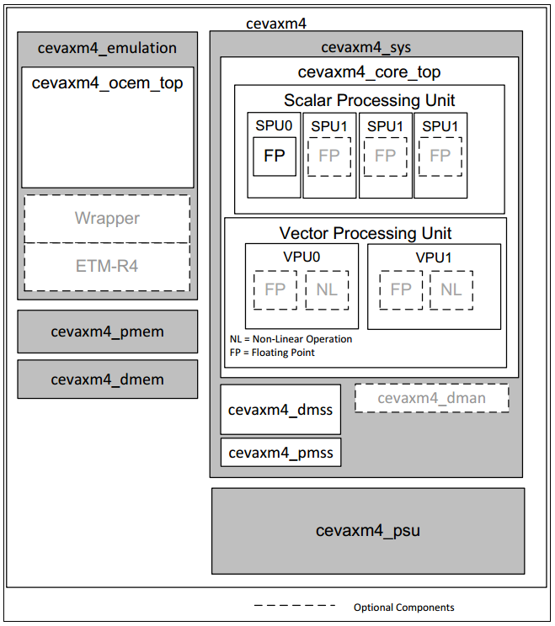
CevaXM4 Configuration
Name | Config | Name | Config
AXI_masters_num | 2 ( EDP EPP ) | nff | on
AXIM_width | 128 bit
AXI_slave_num | 1 ( EDAP ) | non_linear_units | 32
AXIS_width | 128 bit | qman_num | 8
DTCM_size | 128KB | sflp | 4
PTCM_size | 32KB | spu_xtend | off
PCACHE_size | 32KB | vflp | 16
 |  | vpu_xtend | off
mem_power_gating | off
memory_ecc | off | real_time_trace | off

Slide 5
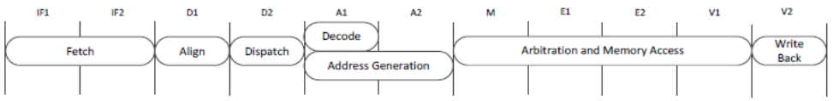
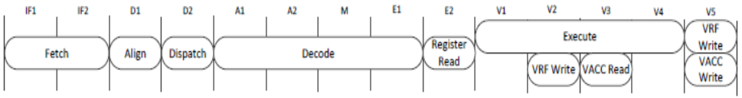
Pipeline
SPU
IF – Instruction Fetch
D – Dispatch/Decode
A – Address Generation
M – Memory Access
E – Scalar Execution
V – Vector Execution
LSU
VPU

Slide 6
Diagram of Architecture

Slide 7
CGU and RGU
RGU
CGU
MODULE | RESET | Description
APB | apb_rstn | software reset. auto released
cevaxm4_core0 | global_rstn sys_rstn core_rstn ocem_rstn | software reset
cevaxm4_core1 | global_rstn sys_rstn core_rstn ocem_rstn | software reset
cevaxm4_core2 | global_rstn sys_rstn core_rstn ocem_rstn | software reset
cevaxm4_core3 | global_rstn sys_rstn core_rstn ocem_rstn | software reset
Four cores, four clock domain?

Slide 8
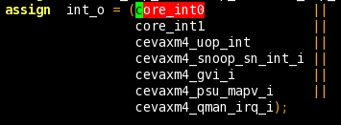

Control Register and IGU
IGU
control register

Slide 9
Interrupt List

Slide 10
Verification Environment
1. LOCAL
2. SOC
simulation environment
veloce environment
simulation environment
3. FPGA

Slide 11
Synthesis Report

