Slide 1
CORETEXA7 subsystem
ARTOSYN
Peng Chen
2016.11.22

Slide 2
contents
ARTOSYN
Design diagram
Configuratons
Software
Synthesis report
Register space
Interrupt

Slide 3
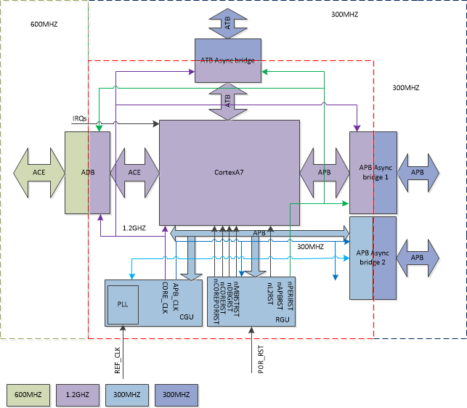
Subsystem diagram - clock domain
ARTOSYN

Slide 4
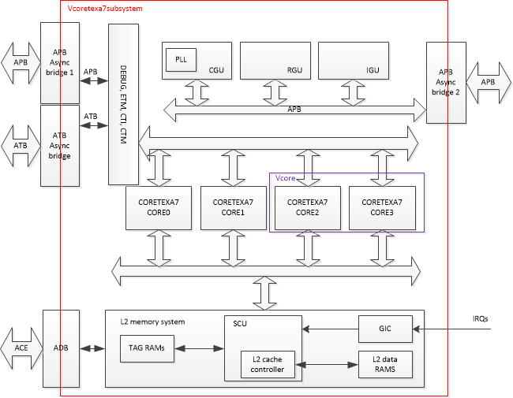
Subsystem diagram – power domain
ARTOSYN

Slide 5
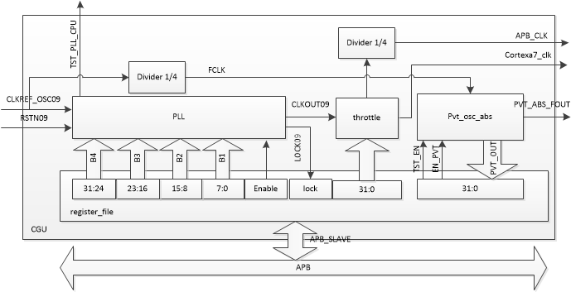
CGU diagram
ARTOSYN

Slide 6
CGU register
ARTOSYN
IP_Name | SUB_IP_Name | Address | Register Name | Type (B/H/W) | Width | Default | R/W | Description
CGU | CGU | 0x6061_0000 | CGU_PLL_CONFIG | W | 31:0 | 0X0000_0000 | R/W | [7:0]->B1; [15:8]->B2; [23:16]->B3; [31:24]->B4.
CGU | CGU | 0x6061_0004 | CGU_PLL_CTRL_1 | W | 31:0 | 0X0000_0000 | R | [0]->PLL lock status. Other bits are reserved.
CGU | CGU | 0x6061_0008 | CGU_PLL_CTRL_2 | W | 31:0 | 0X0000_0001 | R/W | [0]->PLL switch select. Other bits are reserved.
CGU | CGU | 0x6061_000C | CGU_TRT_CONFIG | W | 31:0 | 0XFFFF_FFFF | R/W | [31:0]-> throttle configure data. Other bits are reserved.
CGU | CGU | 0x6061_0010 | CGU_TRT_CTRL | W | 31:0 | 0X0000_0000 | R/W | [0]->throttle enable bit. Other bits are reserved.
CGU | CGU | 0x6061_0014 | CGU_PVT_DATA | W | 31:0 | 0X0000_0000 | R/W | [15:0]-> PVT_OUT_ABS. Other bits are reserved.
CGU | CGU | 0x6061_0018 | RESERVED1 | W | 31:0 | 0X0000_0000 | R/W | reserved registers
CGU | CGU | 0x6061_001C | RESERVED2 | W | 31:0 | 0X0000_0000 | R/W | reserved registers

Slide 7
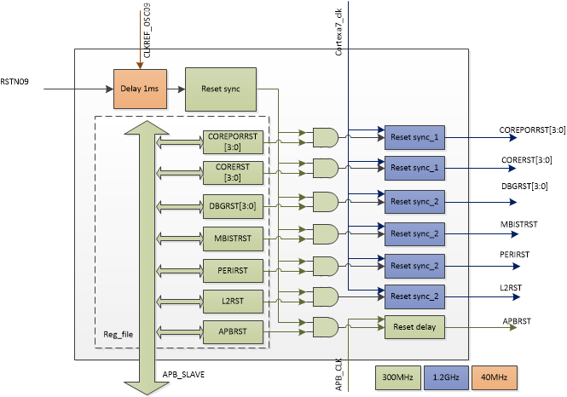
RGU diagram
ARTOSYN

Slide 8
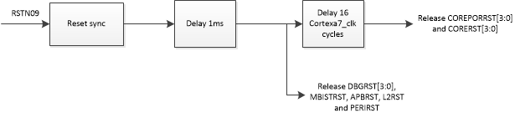
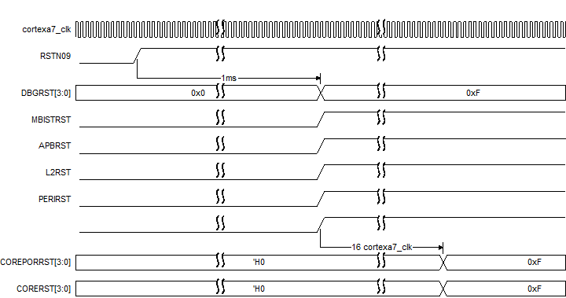
Reset sequence
ARTOSYN

Slide 9
RGU register
ARTOSYN
IP_Name | SUB_IP_Name | Address | Register Name | Type (B/H/W) | Width | Default | R/W | Description
CGU | CGU | 0x6061_0020 | RESET_CTRL | W | 31:0 | 0XFFFF_FFFF | R/W | [3:0]->COREPORRST[3:0]; [7:4]->CORERST[3:0]; [11:8]->DBGRST[3:0]; [12]->MBISTRST;[13]->PERIRST;[14]->L2RST;[15]->APBRST.
CGU | CGU | 0x6061_0024 | RESERVED1 | W | 31:0 | 0X0000_0000 | R/W | reserved registers
CGU | CGU | 0x6061_0028 | RESERVED2 | W | 31:0 | 0X0000_0000 | R/W | reserved registers

Slide 10
A7 Configurations
ARTOSYN
Configurations | Value
L2_CACHE_PRESENT | 1
NUM_CPUS | 4
GIC_PRESENT | 1
NUM_SPIS | 480
L1_ICACHE_SIZE | 32KB
L1_DCACHE_SIZE | 32KB
L2_CACHE_SIZE | 512KB
L2_LATTENCY | 2 cycles
FPU 0/1/2/3 | 1
NEON 0/1/2/3 | 1
ETM_PRESENT | 1
Take care

Slide 11
SOFTWARE
ARTOSYN
Software | Status
Software compile environment | Ready (gcc)
Booting from 0x0000_0000 | Ready
GIC | Ready
MMU | Not ready
CACHE | Not ready
FPU | Not ready
NEON | Not ready
Multi-core | Not ready

Slide 12
Synthesis report
ARTOSYN
Period: 0.82ns (1.2Ghz)
Uncertainty: 0.1ns
Input delay: 0.6ns
Output delay: 0.6ns
Setup timing check: pass.
Worst slack: 0ns
Total cell area: 2732572um^2
LVT percentage: 0.34%

Slide 13
Interrupts
ARTOSYN
0~31: used for PPI SGI
32~1000: used for SPIs(any core receives)
Int_func type: void int_func (void)
Use:
register_interrupt(irq_id,int_func);
enable_interrupt();

Slide 14
ARTOSYN
THANKS

