Slide 1
Status of M7 subsystem and CoreSight for Sirius
Zhang Hao
2016-11-22

Slide 2
Contents
M7 Subsystem
Diagram
Configuration
QSPI flash controller
Pad list
Synthesis report
Need to do
CoreSight SoC
Diagram
ROM table
Synthesis report

Slide 3
M7 Subsystem
Diagram

Slide 4
M7 Subsystem
Configuration
Name | Value | Description
ITCM | 256KB | itcm size
DTCM | 128KB | dtcm size
ICACHE | 16KB | icache size
DCACHE | 16KB | dcache size
FPU | 2 | Single and double precision
IRQNUM | 110 | Number of IRQs
ETM | 2 | Instruction and data trace

Slide 5
M7 Subsystem
QSPI flash controller

Slide 6
M7 Subsystem
QSPI flash controller
Support 4-byte addr mode
Support speed up to 100MHz
Support quad output/IO mode
Support QPI mode

Slide 7
M7 Subsystem
QSPI flash controller

Slide 8
M7 Subsystem
QSPI flash controller

Slide 9
M7 Subsystem
Pad list
IP Name | Pad Name
SPI | SPI_RXD SPI_TXD SPI_SCLK_OUT SPI_SS_0_N
I2C | I2C_SDA I2C_SCLK
CAN | CAN_RXD CAN_TXD
UART | UART_SIN UART_SOUT
TIMER | PWM
QSPI Flash controller | QSPI_SCK QSPI_CS_N QSPI_DATA[0] QSPI_DATA[1] QSPI_DATA[2] QSPI_DATA[3]
I2S | I2S_SCK I2S_WS I2S_SD0 I2S_SD1 I2S_SD2 I2S_SD3

Slide 10
M7 Subsystem
Synthesis report
Constrain | Clk_m7 | Period = 2.22ns Frequency = 450MHz Setup uncertainty = 0.6
 | Clk_multi | Period = 4.0ns Frequency = 250MHz Setup uncertainty = 1.0
 | Clk_flash | Period = 5.0ns Frequency = 200MHz Setup uncertainty = 1.2
report | Area = 1310789.36
 | Memory = 932842.17
 | Worst slack =0
 | Number of negative slack = 0

Slide 11
M7 Subsystem
Need to do

Slide 12
CoreSight SoC
Diagram

Slide 13
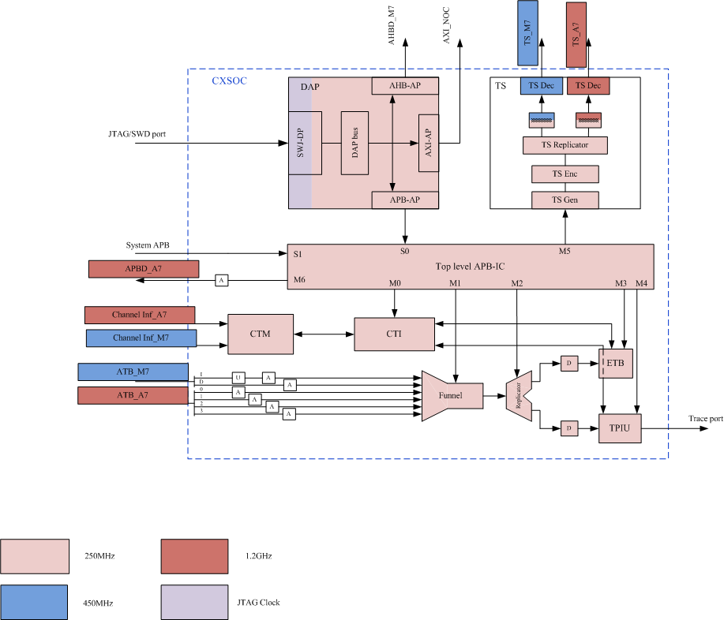
CoreSight SoC
Diagram

Slide 14
CoreSight SoC
ROM table
Componnent Name | Start address | End address | Size | Description
APB IC ROM | 0x6040_0000 | 0x6040_0FFF | 4KB | Access via APB-AP by external debugger, MSB=1 and [1:0]=0x3, that is 0xE0400003
CTI0 | 0x6040_1000 | 0x6040_1FFF | 4KB
Funnel | 0x6040_2000 | 0x6040_2FFF | 4KB
Replicator | 0x6040_3000 | 0x6040_3FFF | 4KB
ETB | 0x6040_4000 | 0x6040_4FFF | 4KB
TPIU | 0x6040_5000 | 0x6040_5FFF | 4KB
TimeStamp | 0x6040_6000 | 0x6040_6FFF | 4KB
Reserved | 0x6040_7000 | 0x6040_FFFF | 32KB
Coretex-A7 | 0x6041_0000 | 0x6041_FFFF | 128KB

Slide 15
CoreSight SoC
Synthesis report
Constrain | Clk_m7 | Period = 2.0ns Frequency = 500MHz Setup uncertainty = 0.4
 | Clk_a7 | Period = 0.833ns Frequency = 1200MHz Setup uncertainty = 0.16
 | Clk_jtag | Period = 6.67ns Frequency = 150MHz Setup uncertainty = 1.3
report | Area = 56006.49697
 | Memory = 36742.44
 | Worst slack =0
 | Number of negative slack = 0

