Slide 1
Sirius MIPI Review
Zheng xie

Slide 2
CONTENT
MIPI CSI-2
License IP
Application&&Arch
Integration
Simulation
Backend
Ate Test
Bring Up
Opt
Reference

Slide 3
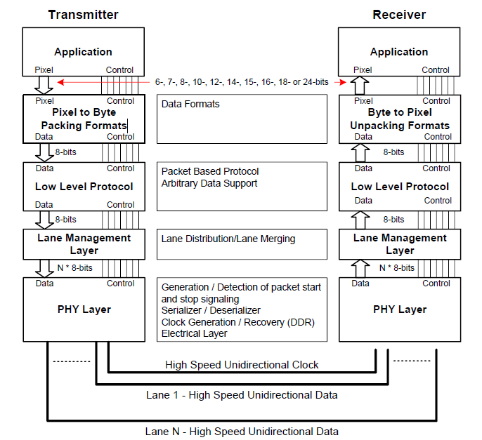
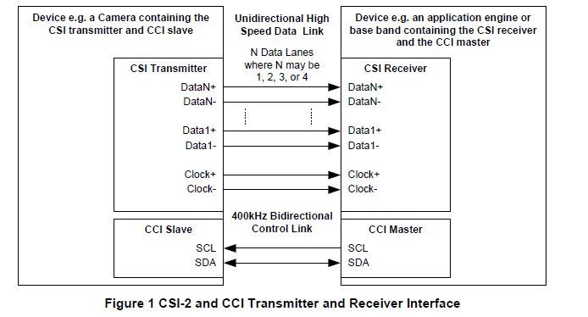
MIPI CSI-2
CSI-2 Protocol
TX&RX Interface
Notes:
CSI/DSI/

Slide 4
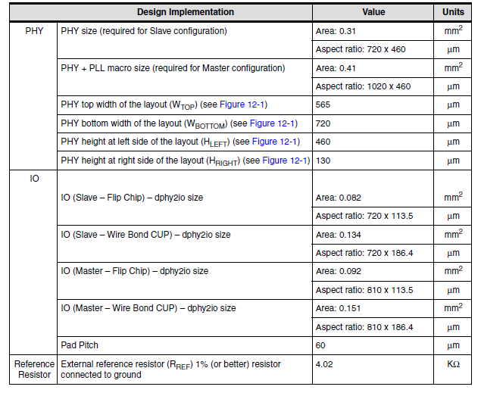
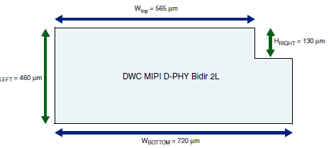
License IP: Synopsys DPHY
Features
Complies with the MIPI D-PHY interface specification, revision 1.1.
Support two data lanes and up to 1.5Gbps/lane.
Notes:
CPHY/DPHY/MPHY

Slide 5
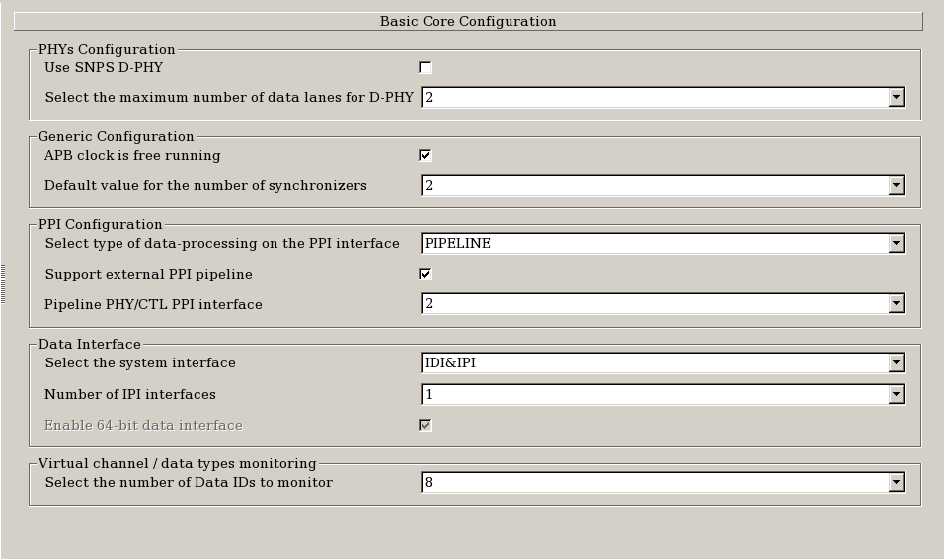
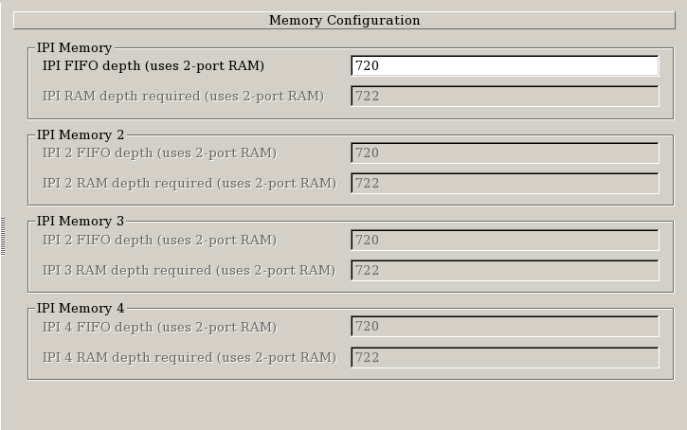
License IP: Synopsys Host Controller
Features
Complies with CSI-2, Version 1.2.
Support up to eight D-PHY RX data lanes and Up to 2.5 Gbps/lane
Notes:
CUT Through Mode

Slide 6
Application Analysis
Application
For 4K video, DPHY of four data lanes is needed.
Up to eight cameras are need to support.
Video output.

Slide 7
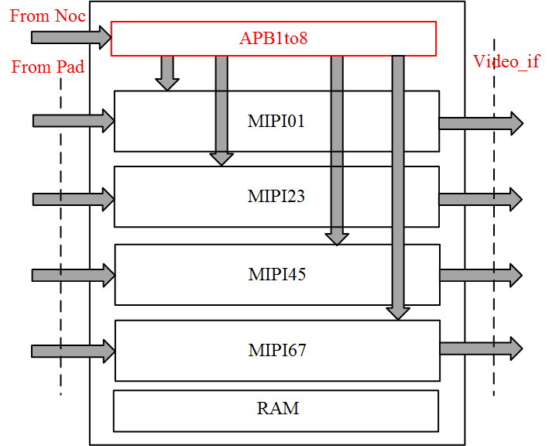
Architecture
Camera_support: 4~8

Slide 8
Integrator Logic
Top Diagram
Four lane RX&&TX
Four lane RX
Host Controller
PLL
PAD

Slide 9
Integrator Logic: Top Diagram
Camera_support: 4~8

Slide 10
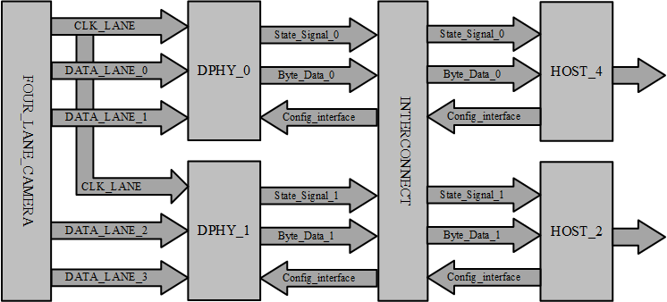
Integrator Logic: Four lane RX

Slide 11
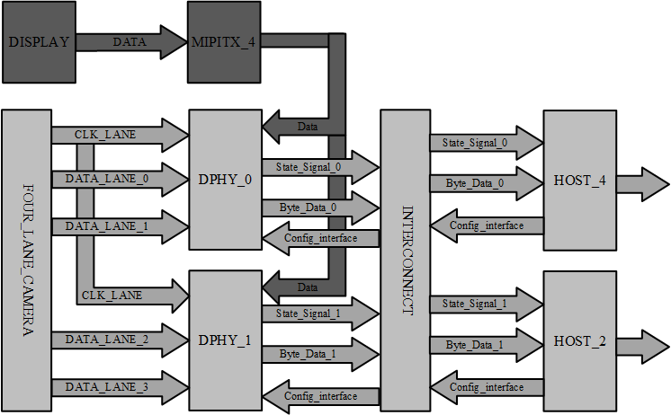
Integrator Logic: Four lane RX&&TX

Slide 12
Integrator Logic: Four lane RX
PHY Connect：Clock lane (100Ω differential impedance) is split at PCB or Package into 200Ω differential impedance traces for matched impedance to the two RX2L clock lanes.
PPI Connect: The PPI Signal can be classified into three part:
State signal: sync and mux to host controller.
Byte data: lane data align through FIFO.
Configure Interface: Selected based on scenarios.

Slide 13
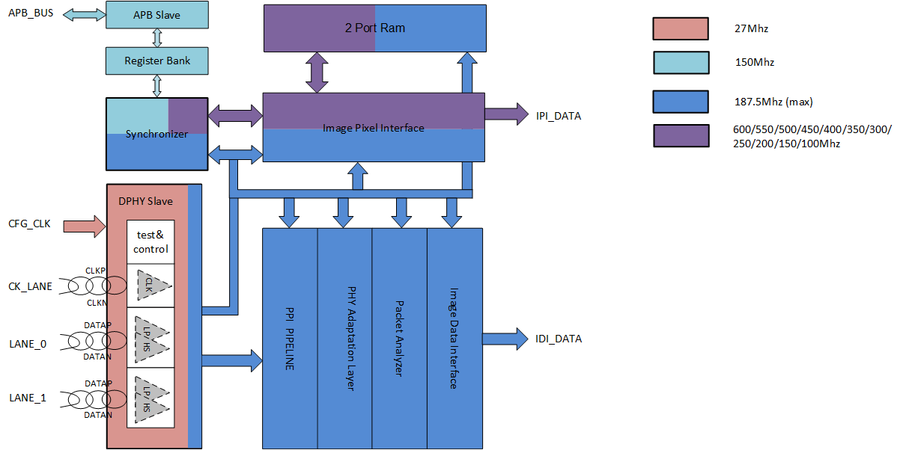
Integrator Logic: CSI2 Host Controller

Slide 14
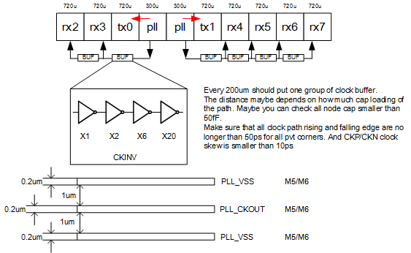
Integrator Logic: PLL
PLL: ATE_TEST &&TX Function
Test the clock quality of PLL through PAD
1, Lock mismatch; data align through fifo;
2, Frequency mismatch; 1080p@1Ghz;1bit mismath
1Ghz – 1/(1 + 1/1920/(24/6)) = 1MHZ
3, The frequency mismatch between PLL1/PLL2;

Slide 15
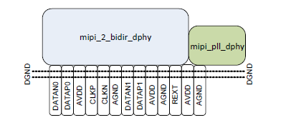
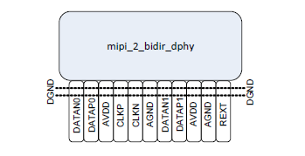
Integrator Logic: PAD
dwc_dphy2bio: master mode, include one pair of AVDD&AGND of PLL; DPHY0, DPHY1;
dwc_dphy2sio: slave mode, DPHY2 ~~ DPHY7;

Slide 16
SIMULATION
LOCAL SIM
SOC SIM
EMU SIM

Slide 17
SIMULATION: Local Sim
SYNP VTB <SYNP DPHY Model>
MOVE The Env To local.
Add some parameter.

Slide 18
SIMULATION: SOC Sim
SYNP VTB <SYNP DPHY Model>
Image test

Slide 19
SIMULATION: EMU Sim
PPI Connect between TX&RX Controller.
Veloce SV Model
Image test.

Slide 20
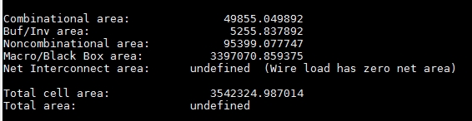
BACKEND: SYN
Constrain of DPHY&Controller
Release from SYNP;
The DPHY area is calculated as follows: (PHY+ PLL) X2 + (PHY) X6 + (dphy2io_master) X2 + (dphy2io_slave) X6 =(0.31+0.1) X2 + 0.31X6 + 0.092X2 + 0.082X6 = 3.356

Slide 21
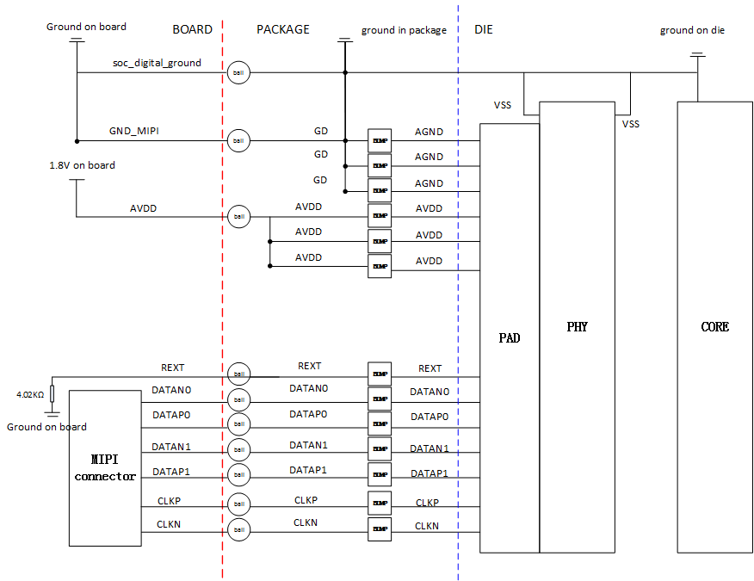
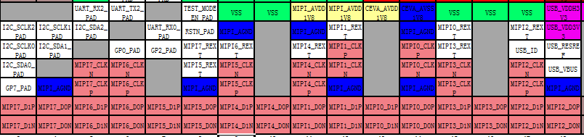
BACKEND: BUMP&&BALL
The length match between diff pairs are guaranteed by substrate and PCB design

Slide 22
ATE_TEST
High Speed Bist test

Slide 23
Bring Up
Sensor bring up
MIPI | function validation | register default value check and read/write
 |  | Patten_gen mode test (raw8, 1280x720@30fps)
 |  | IDI interface test(raw8, 1280x720@30fps)
 |  | IPI interface test(raw8, 1280x720@30fps)
 |  | Two_lane mode test (raw8, 1280x720@30fps)
 |  | four_lane mode test (raw8, 1280x720@30fps)
 |  | Hsync generate test (raw8, 1280x720@30fps)
 |  | video Interface Timing test: raw8, 1280x720@30fps
 |  | video Interface Timing test: raw8, 1920x1080@30fps
 |  | video Interface Timing test: raw8, 3840x2160@30fps
 |  | video Interface timing test: raw10, 1920x1080@30fps
 |  | video Interface timing test: raw12, 1920x1080@30fps
 |  | video Interface timing test: raw14, 1920x1080@30fps
 |  | video Interface timing test: yuv422_8bit, 1920x1080@30fps
 |  | video Interface timing test: yuv422_10bit, 1920x1080@30fps
 |  | video Interface Timing test: raw8, 1920x1080@30fps, SBS mode
 |  | video Interface Timing test: yuv422_8, 1920x1080@30fps, SBS mode
 |  | Inter Bist test
 | performance validation | MIPI electrical test
Monitor out logic
IDI Interface
IPI Interface
Image test with VIF

Slide 24
OPT
CSI TX → DSI TX;
SYNP 2lane_DPHY → In house 1lane_DPHY;
Interweaved mode; HDR based on frame;
Low frequency clock output;

Slide 25
Reference
About IP
${git_server}/pub_doc/IP_doc/mipi_1.20a
About CSI spec
${git_server}/pub_doc/standard/MIPI
About doc
${git_server}/sirius_doc/IP/mipi

