Slide 1
DDR Subsystem Review
IP Owner: Ma Ji

Slide 2
Content
Introduction
Subsystem Block Diagram
DDR_CLK_GEN Diagram
DDR controller Diagram
DDR PHY Diagram
Clock
Reset
IP Configuration
DDR Initialization
Port Arbiter
Virtual Channel
DDR state Diagram
Recommended Operation Conditions
PHY Test
Verification Plan
Check List

Slide 3
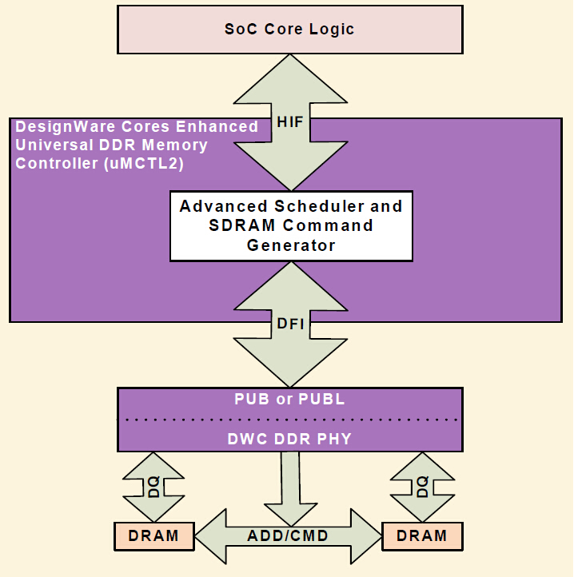
Introduction

Slide 4
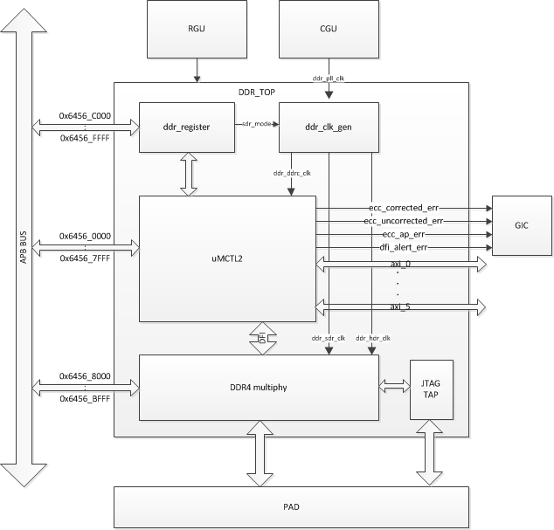
Subsystem Block Digram

Slide 5
DDR_CLK_GEN Diagram

Slide 6
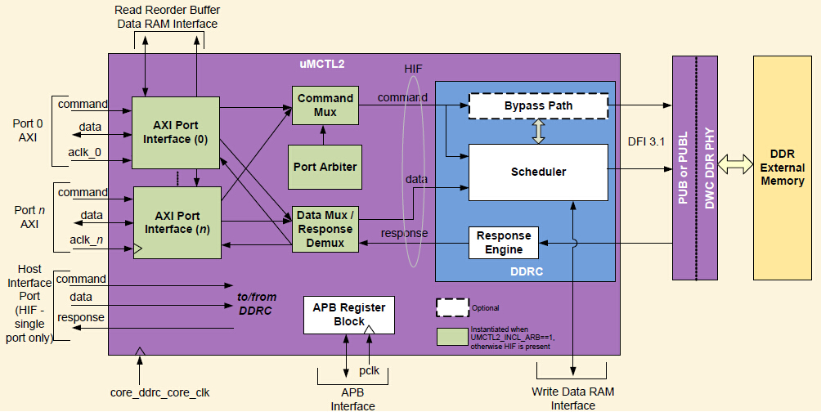
DDR controller Diagram

Slide 7
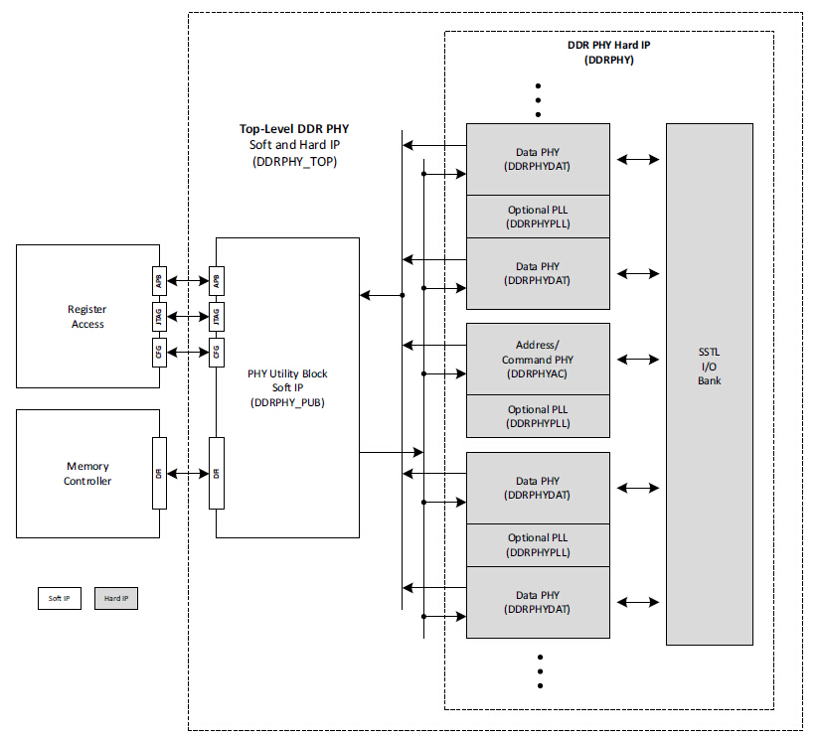
DDR PHY Diagram

Slide 8
Clock
◆ddr_pll_clk
to ddr_clk_gen
◆ddr_pll_bypass_clk
used for phy pll bypass mode
◆aclk_0
axi0 clk
◆aclk_1
axi1 clk
◆aclk_2
axi2 clk
◆aclk_3
axi3 clk
◆aclk_4
axi4 clk
◆aclk_5
axi5 clk
◆pclk
apb clk

Slide 9
Reset
◆ddrc_rstn
umctl2 reset, add software reset
◆aresetn
axi port reset, split to 6, add software reset respectively
◆presetn
apb port reset, no software
◆phy_rst_n
phy reset, add software reset

Slide 10
IP Configuration
DDR2,LPDDR2,DDR3,DDR3U,DDR3L,LPDDR3,DDR4 supported
64bits DQ,half data width and quarter data width mode supported
Inline ECC supported
1:2 frequency ratios only
2 ranks supported
4 group register for fast frequency change
6 AXI4 ports
2 system address regions supported

Slide 11
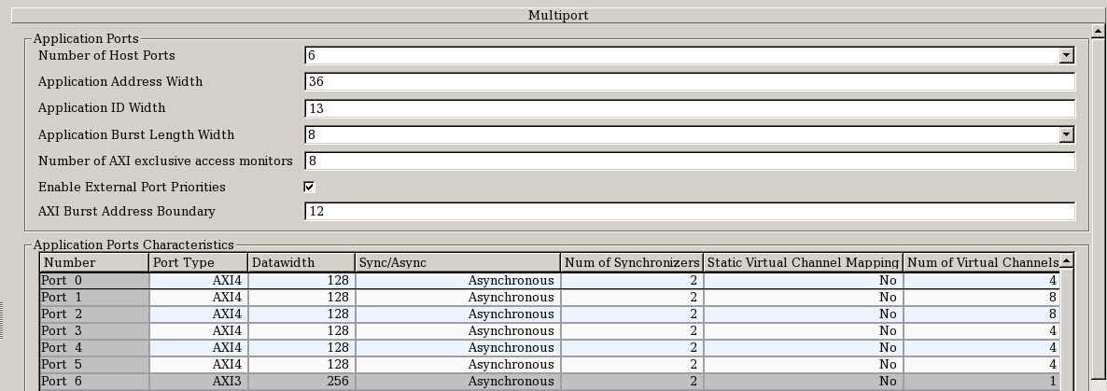
IP Config
AXI ports config

Slide 12
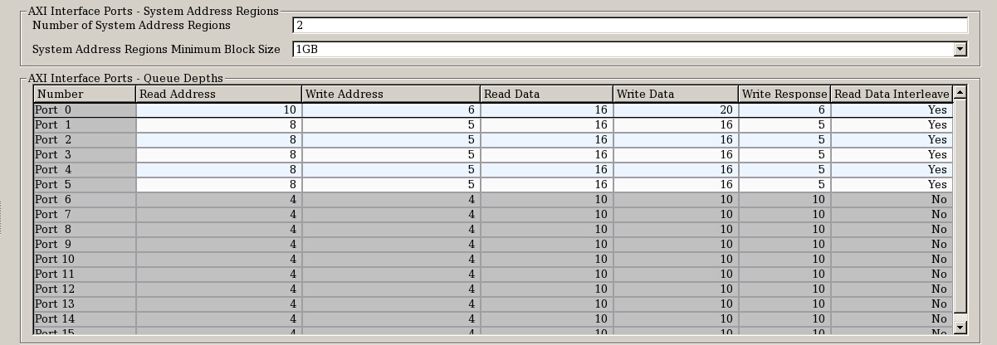
IP Config
AXI ports config

Slide 13
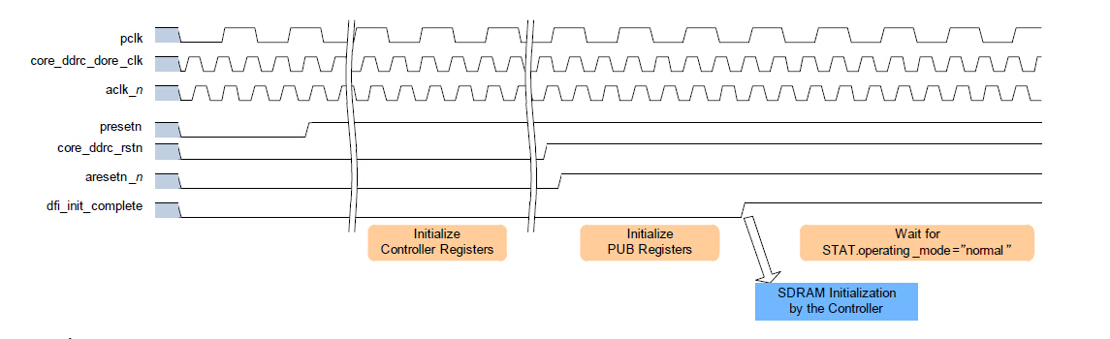
DDR Initialization

Slide 14
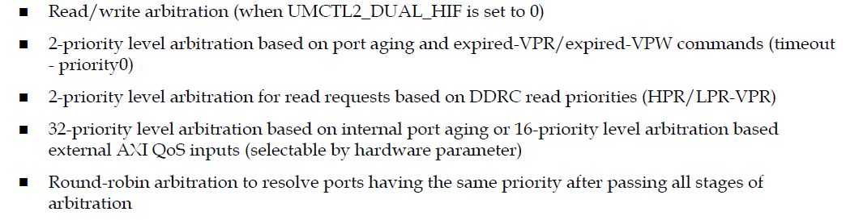
Port Arbiter

Slide 15
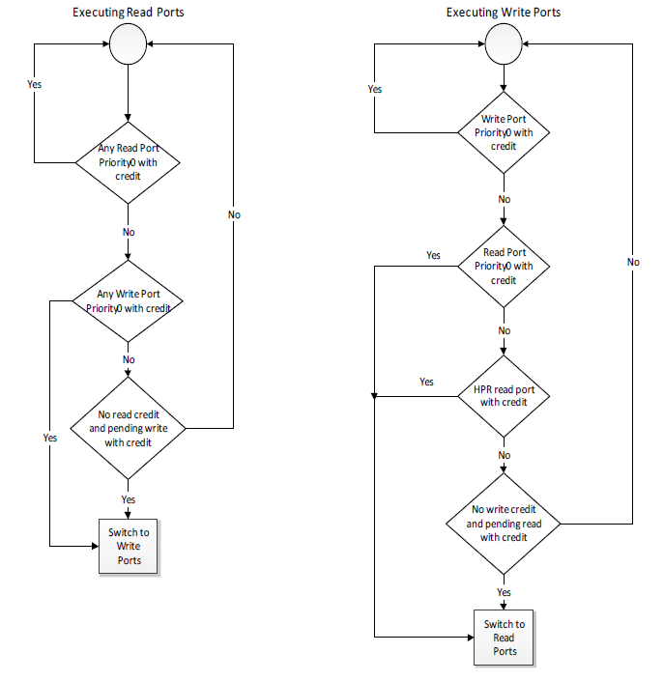
Read/Write Arbitration

Slide 16
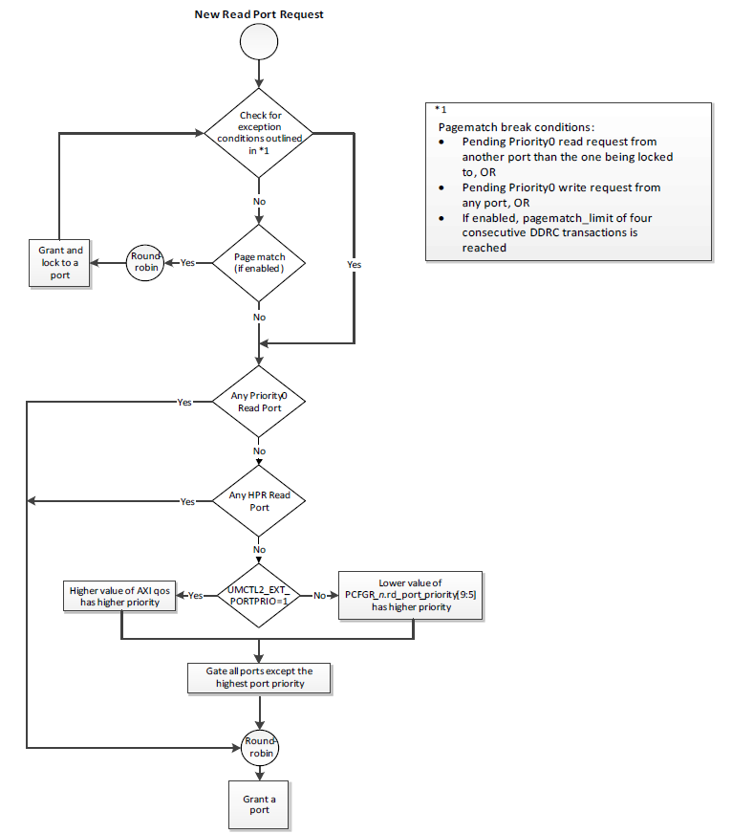
Read Arbitration

Slide 17
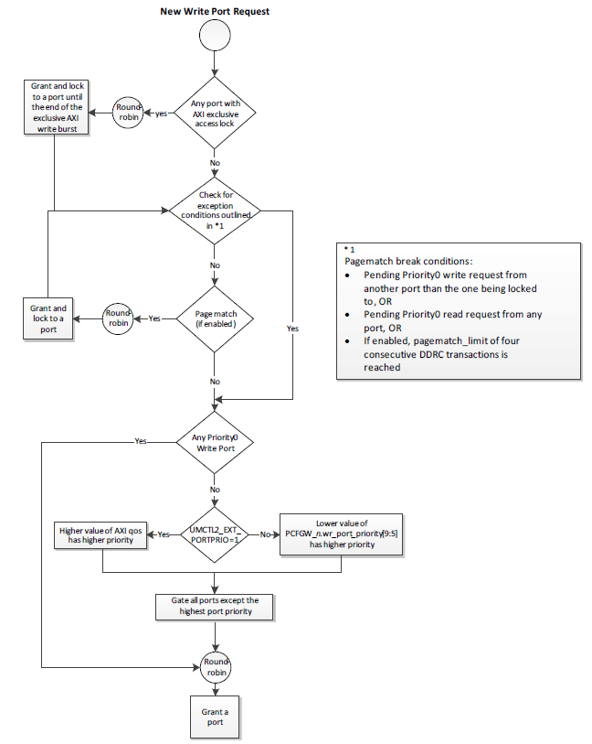
Write Arbitration

Slide 18
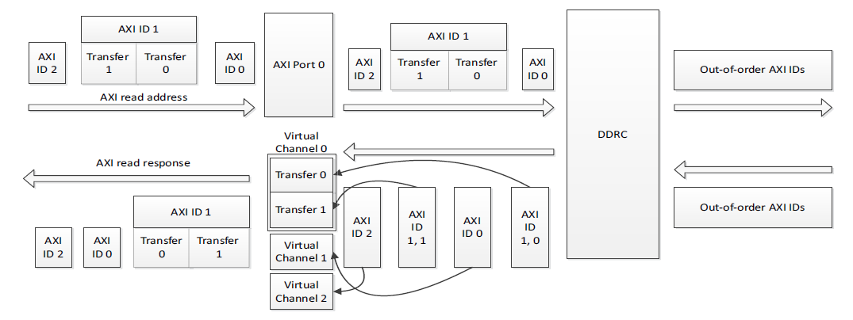
Virtual Channels

Slide 19
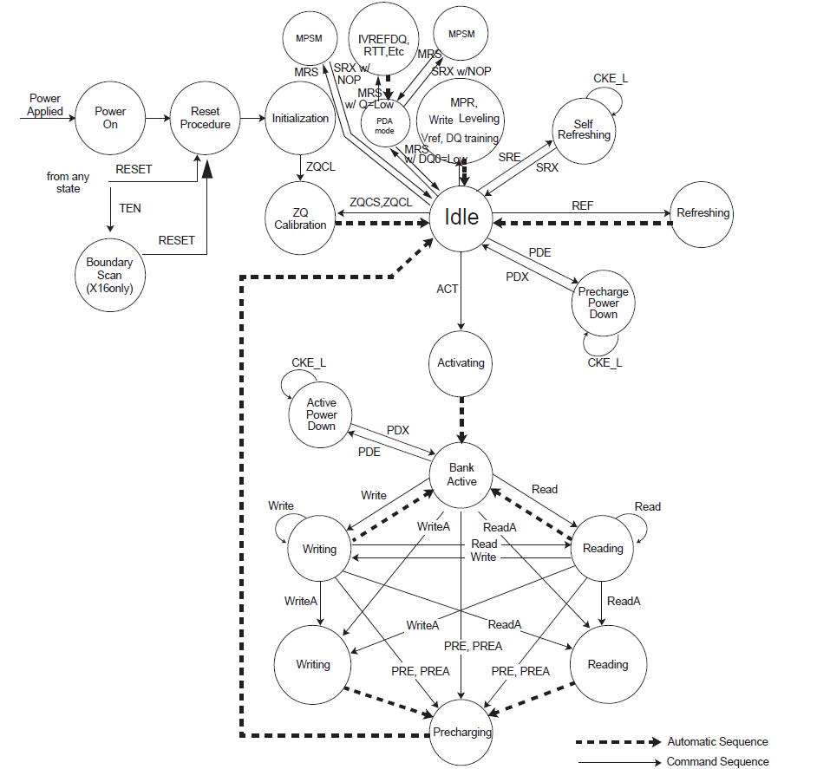
DDR State Diagram

Slide 20
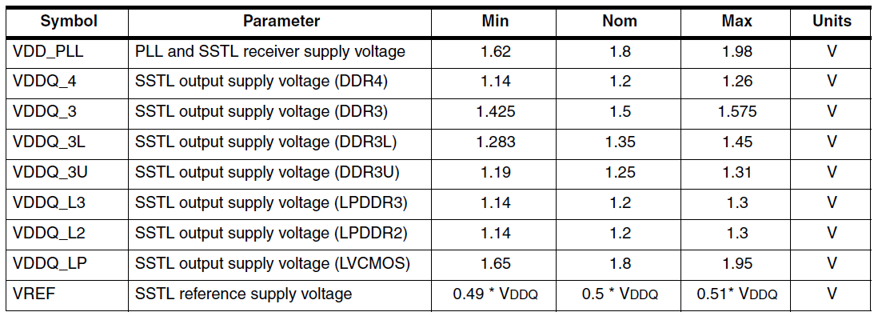
Recommended Operation Conditions

Slide 21
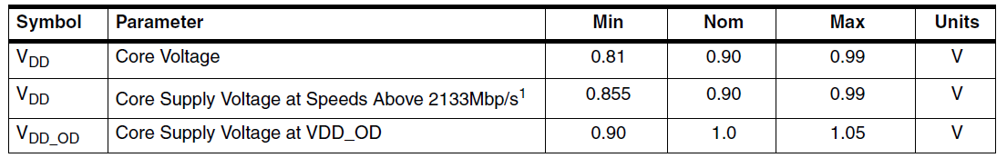
Recommended Operation Conditions

Slide 22
PHY Test
BIST Loopback
ATPG Test Mode
DDL Testing
PLL Testing
STLL I/O Testing

Slide 23
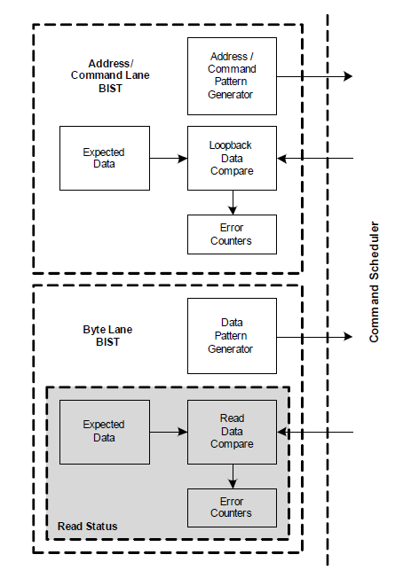
PHY BIST Loopback

Slide 24
Verification Plan
Half bus mode access
Quarter bus mode access
ECC error correct
Rank0,Rank1 access
System address region 0 access, region 1 access
Fast frequency change
DDR4 sdram access
DDR3 sdram access
LPDDR3 sdram access

Slide 25
Synthesis Result
Formality
PHY only: pass Controller only: pass Top: pass
sub system name | total area | memory | phy | inst number | tech lib | note
DDR_TOP | 6.9702 | 0 | 5.3161 | 1,077,586 | 12T | svt w phy/pad

Slide 26
Check List
Items | Description | Status | Comment
IP Release Note | Describes the content of IP package,and the updates to last version. | done | DWC_ddr_umctl2_relnotes.pdf
 |  |  | dwc_ddr4_multiphy_tsmc28hpc18_databook.pdf
IP datasheet | Must include full register map and description, I/O structures, block description and sub IP partitioning. | done | DWC_ddr_umctl2_databook.pdf
 |  |  | dwc_ddr4_multiphy_tsmc28hpc18_databook.pdf
IP DFT/ATE test spec (mostly for AMS IPs) | Must define what it contains (must include description of test protocol for special test modes) | pending
IP integration Manual | Requiremnt for IO/Clock/Rest/DFT; IP block digarm; Port descriptions and connections in SOC | done
IP verfication spec and report | Bench and test cases descriptions; code coverage; functional coverage | pending | code coverage and functional coverage ???
IP programing guide | Description of IP bring up, Register settings for different modes | done | DWC_ddr_umctl2_user.pdf
IP data flow /floorplan/TOP diagram | Description of connections among sub-blocks, memories, backend floorplan | done | dwc_ddr4_multiphy_tsmc28hpc18_databook.pdf
IP package/PCB guide | Description of Ball assignment/PCB layout | done | dwc_ddr4_multiphy_ig.pdf
IP configure | Include IP feature configure | done
RTL | RTL code, netlist, behavior models | done | 1
Design File List | File list for Chip test bench build. | done
Memory list | Memory configure list | done
IP fake model | dummy IP subsystem top | done
IP unit verification environment | Bench,test cases, scripts ,logs, coverage reports, failed case,issue | pending | coverage reports?????
IP synthesis environment | Scripts,SDC,netlist,logs, report | done
IP Formal check environment | Scripts, report | done
IP ATPG environment | Scripts, report | pending
IP verification Plan | Include SOC level/Veloce/FPGA verification test report. | pending
IP NLS Maturity Check | release netlist, chiplevel backend SDC | pending
IP SW driver | Software driver for application | pending

