Slide 1
TypeC IP review
Jinfeng.Huang
2017/01/18

Slide 2

SoC Architecture
PCB Solution
Modes of Operation
TCPC Diagram
DP Diagram
USB Diagram
Status
Checklist
Questions

Slide 3
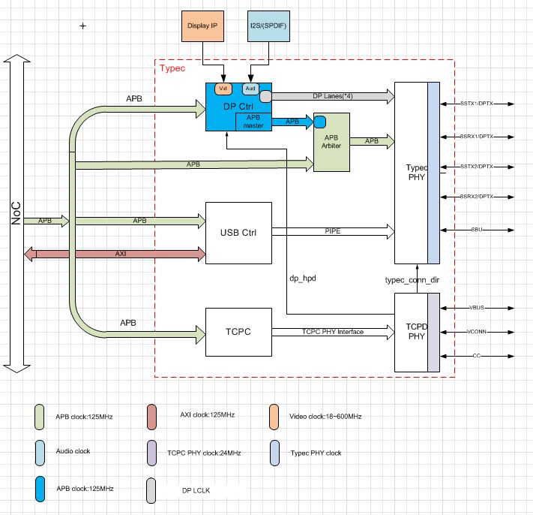
SoC Architecture

Slide 4
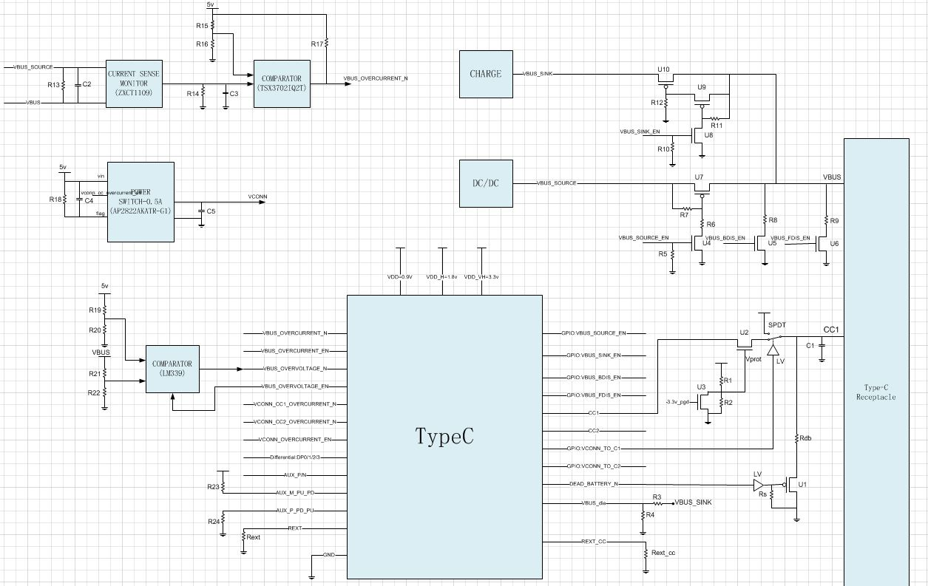
PCB Solution

Slide 5
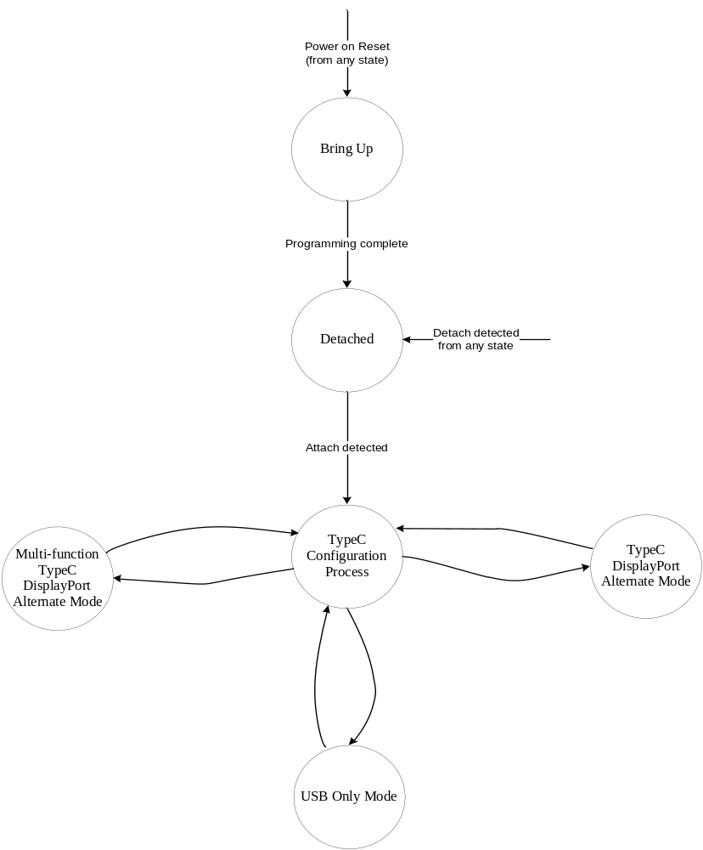
Modes of Operation
TCPC mode:
strap pin: DFP/UFP/DRP
USB mode:
mode_strap: Host/Device

Slide 6
Modes of Operation--Bring Up Phase
Enter after Power On Reset
Initialize the subcomponent IPs
Loading embedded FW for DP xtensa and TCPC xtensa
Pre-configuring the DPTX, but not enabling
Pre-configuring the Type-C PHY for non-mode related setup, but not enabling
Pre-configuring the USB Controller, but not enabling
Ensuring that the Type-C high speed ports and sideband default to a safe state

Slide 7
Modes of Operation--Detached State
TCPC looking for an attach event by monitoring the CC pins
When attached, it informs the TCPM
Initial configuration process begin

Slide 8
Modes of Operation--TypeC Configuration Process state
Type-C high speed ports and sideband must be held within a safe state during this state
TCPC monitors the CC pins and informs the TCPM of the plug orientation
TCPM tell the TCPC to advertise, via CC pins, the available VBUS current source options
TCPC establishs initial power and data roles by controlling and monitoring the CC pins and then informs the TCPM of these initial roles
TCPD may send PD messages on the CC pins to establish a power contract, perform power and data role swaps
PD communications used for detecting and negotiating Type-C DP Alternate mode

Slide 9
Modes of Operation--USB Only Mode and DP Alternate Mode
USB Only Mode
Dual Role USB Controller is configured to the chosen Host role
Configured total slots supported (maximum of 64)
32 EPs per slot
xHCI Dynamic and Static Low Power Management Support
xHCI DMA engine with 64-bit @ 125MHz Full Duplex Data Path
Dual Role USB Controller is configured to the chosen Device role
Control transfers supported by EP #0
Up to 15 IN and 15 OUT configurable/programmable EPs
DP Alternate Mode
Established via PD communications
Option1: DP Alternate Mode with up to 4-lanes
Option2: Multi-Function DP Alternate Mode (2-lanes for DP and 2 lanes for USB SS based on cable orientation)

Slide 10
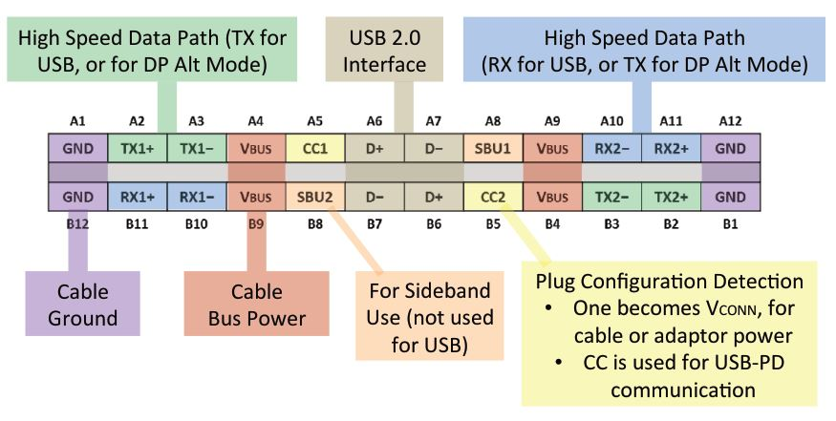
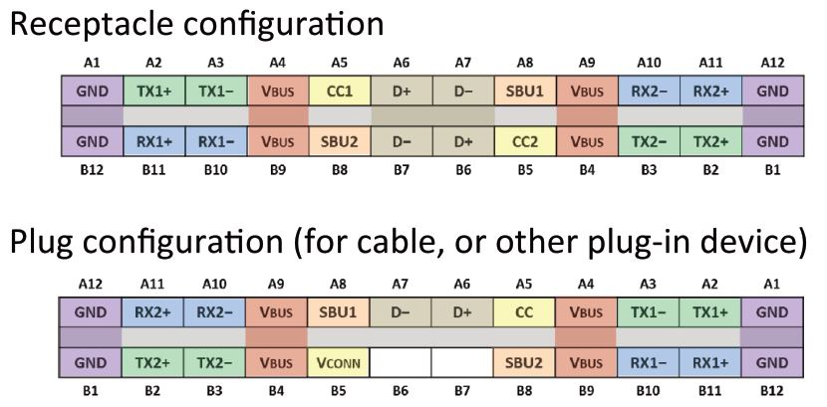
Modes of Operation--USB Only Mode and DP Alternate Mode

Slide 11
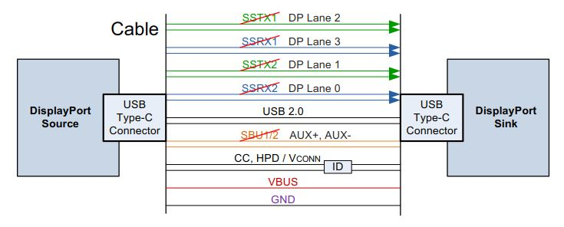
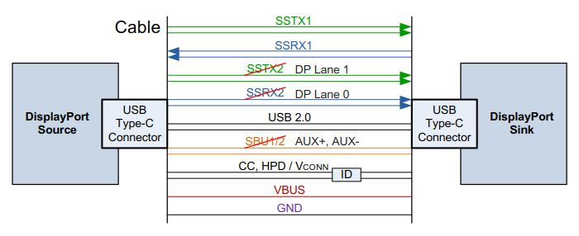
Modes of Operation--USB Only Mode and DP Alternate Mode

Slide 12
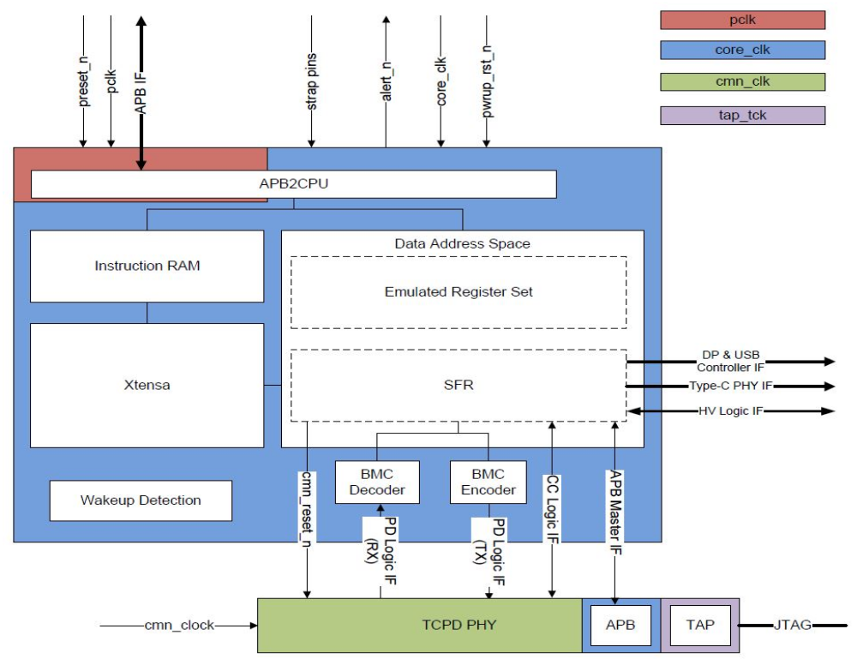
TCPC Diagram

Slide 13
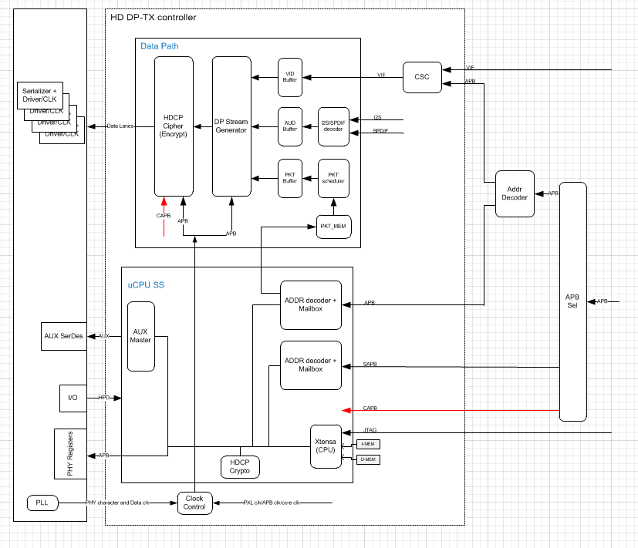
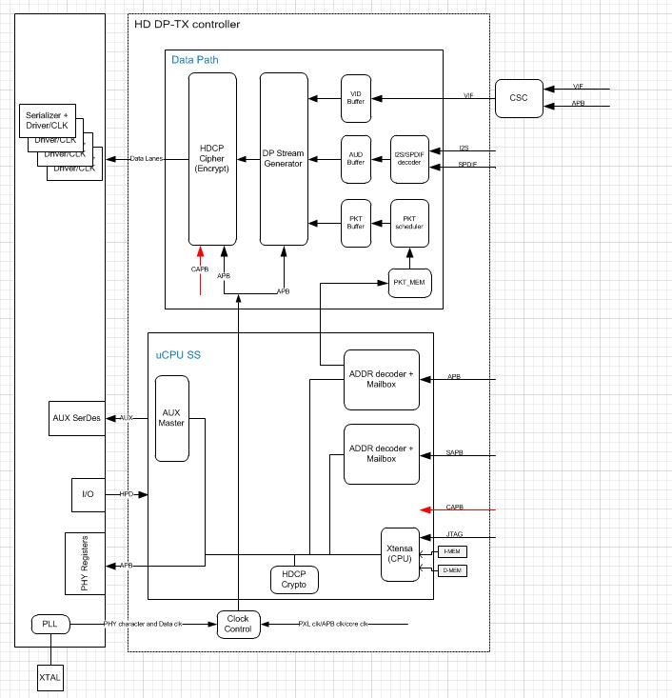
DP Diagram

Slide 14
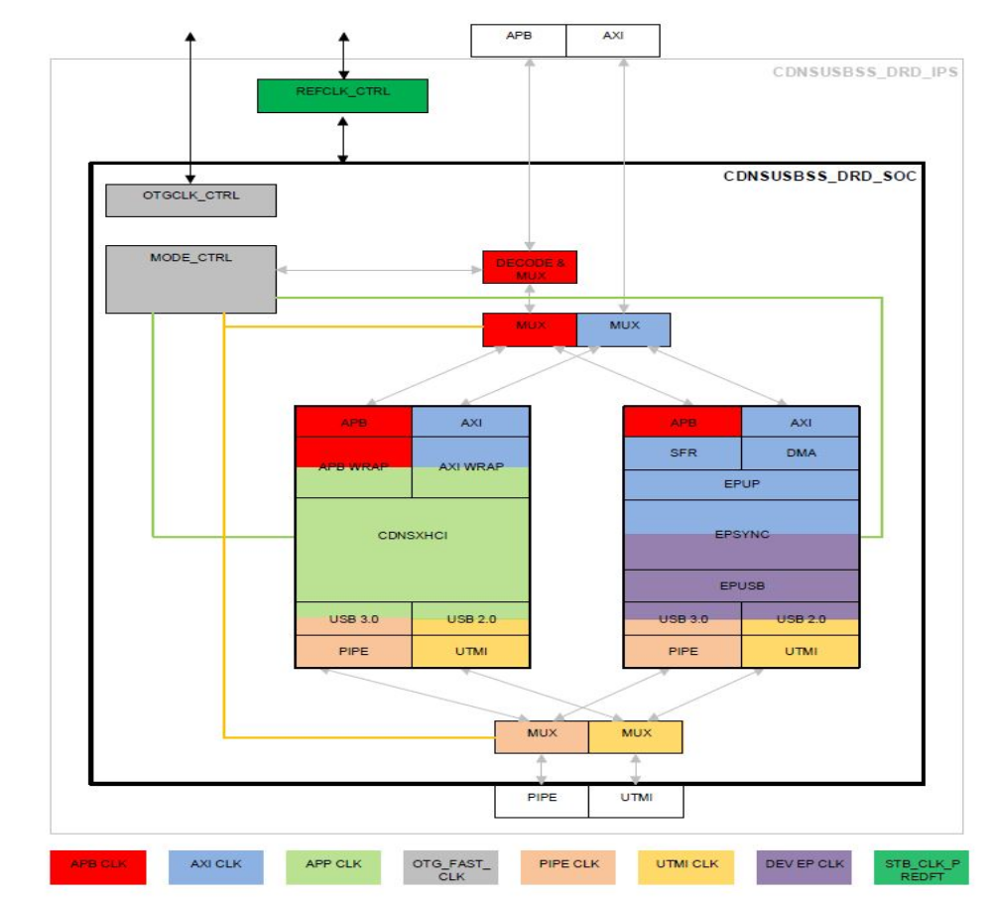
USB Diagram

Slide 15
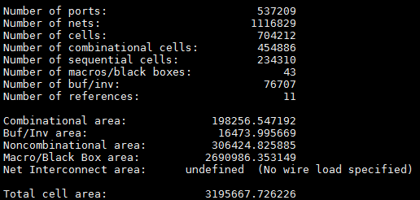
Status
Separate IPs are verified by simulation with provided DV Env.
DP veloce emulation still debugging
TypeC top level simulation env. is building
Verification in SoC level: not start now
Design Compiler pass, result shows below
Formality debugging
Refer to the IP_TypeC_checklist.xlsx for more info.

Slide 16
Questions
Latest version of FW
Backend floorplan
IDDQ testing in common PHY
Check against revocation list during HDCP authentication process

Slide 17
Thanks.
Q&A

