Slide 1
USB3.0 Subsystem Review
IP Owner: Hao Sun

Slide 2
Content
Introduction
SoC Connection
IP check

Slide 3
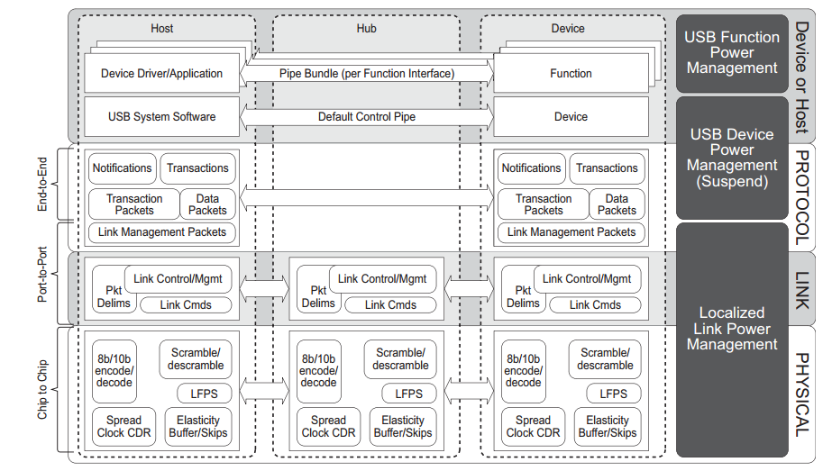
Introduction

Slide 4
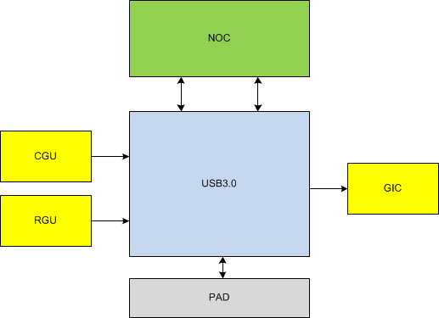
SoC Connection

Slide 5
IP check
Subsystem Block Diagram
Register map & Port description
IP Config
DDR Band Width & Access latency
Verification
Synthesis & Formality
Board
PHY ATE test
Conformance test
IP bring up
Check list

Slide 6
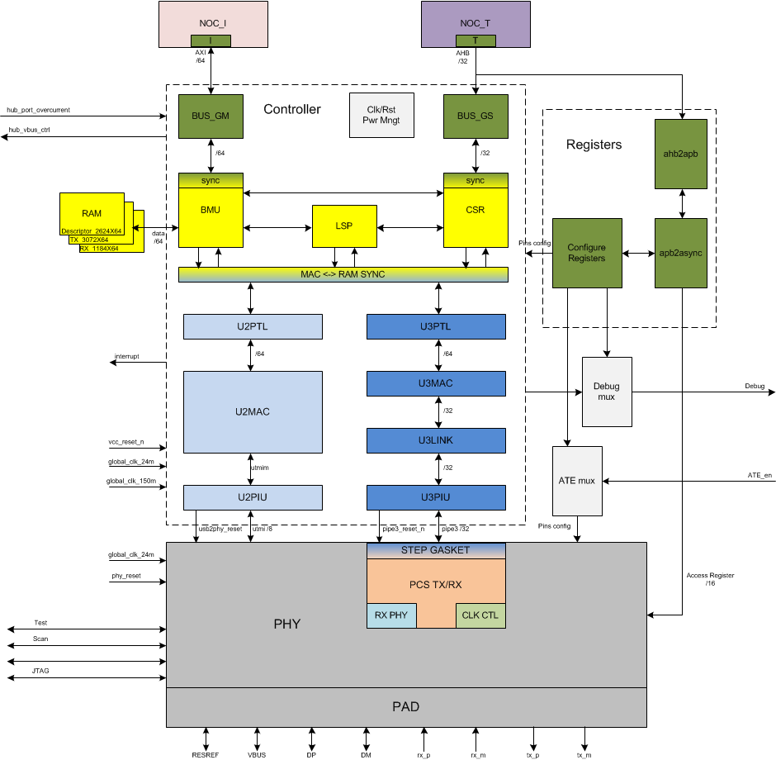

Slide 7
Register map
Base Address | Controller CSR address index | Register Type | 1MB
0x6050_0000 | 0x0_0000 to 0x0_7FFF | xHCI Registers(Xxxxx) | 32KB
 | 0 to CAPLENGTH -1 | eXtensible Host Controller Capability Reg
 | CAPLENGTH to RTSOFF -1 | HOST Controller Operational Reg
 | RTSOFF to BDOFF -1 | Controller Runtime Reg
 | DBOFFF to (xECP*4-1) | Doorbell Reg
 | xECP*4 to 0x0_7FFF | xHCI Extended Capabilities
 | 0x0_C100 to 0x0_C6FF | Global Registers (Gxxxx) | 1.5KB
 | 0x0_C700 to 0x0_CBFF | Device Registers (Dxxxx) | 1.25KB
 | 0x0_CC00 to 0x0_CCFF | USB 20 OTG and Battery Charger Register | 256B
 | 0x0_CD00 to 0x0_CFFF | Unused/Aliased | 0.75KB
 | 0x4_0000 to 0x7_FFFF | Internal RAM0 - Debug Access | 256KB
 | 0x8_0000 to 0xB_FFFF | Internal RAM1 - Debug Access | 256KB
 | 0xC_0000 to 0xF_FFFF | Internal RAM2 - Debug Access | 256KB
 | Subsystem Slave Address index | Register Type | 64KB
0x6060_0000 |  | PHY CR address index | 36KB
 | 0x0000 << 2 to 0x1N42 << 2 | SS Function Control Registers
 | 0x0000 to 0x7D08
 | 0x2000 << 2 to 0x200D << 2 | HS Function RO Control Registers
 | 0x8000 to 0x8034
 | 0x2010 << 2 to 0x201F << 2 | HS Function R/W Control Registers
 | 0x8040 to 0x807c
 |  | USB30 subsys registerfile index | 28KB
 | 0x9000 to 0x901c | USB30 Controller Pins Ctrl Registers
 | 0x9020 to 0x902c | Memory Pins Control Registers
 | 0x9030 to 0x906c | femtoPHY Pins Control Registers
 | 0x9070 to 0x9074 | Debug Control Registers

Slide 8
Top port
IO name | IO | Width | Connection
ate_test_en | I | 1 | TOP TEST
dut_scan_mode | I | 1 | TOP TEST
dut_dft_en_bus_clk_gated | I | 1 | TOP TEST
dut_dft_en_ram_clk_gated | I | 1 | TOP TEST
ram_0_test | I | 1 | TOP TEST
ram_1_test | I | 1 | TOP TEST
ram_2_test | I | 1 | TOP TEST
Scan Interface |  | BUS | TOP TEST
JTAG |  | BUS | TOP TEST
Boundary Scan |  | BUS | TOP TEST
ID0 | IO | 1 | TOP ANALOG PAD
ref_pad_clk_p | I | 1 | TOP ANALOG PAD
ref_pad_clk_m | I | 1 | TOP ANALOG PAD
resref | IO | 1 | TOP ANALOG PAD
rx0_m | I | 1 | TOP ANALOG PAD
rx0_p | I | 1 | TOP ANALOG PAD
DM0 | IO | 1 | TOP ANALOG PAD
DP0 | IO | 1 | TOP ANALOG PAD
VBUS0 | IO | 1 | TOP ANALOG PAD
tx0_m | O | 1 | TOP ANALOG PAD
tx0_p | O | 1 | TOP ANALOG PAD
IO name | IO | Width | Connection
globa_clk_150m | I | 1 | CGU
globa_clk_24m | I | 1 | CGU
dut_vcc_reset_n | I | 1 | RGU
apb_preset_n | I | 1 | RGU
phy_phy_reset | I | 1 | RGU
dut_interrupt | O | 1 | GIC
dut_host_system_err | O | 1 | GIC
AHB SLAVE |  | BUS | NOC
AXI MASTER |  | BUS | NOC
dut_hub_vbus_ctrl | O | 1 | TOP DIGITAL PAD
dut_hub_port_overcurrent | I | 1 | TOP DIGITAL PAD
DVDD | I | 1 | Power Supply
VDD330 | I | 1 | Power Supply
VDDH0 | I | 1 | Power Supply
VSSA0 | I | 1 | Power Supply
gd | I | 1 | Power Supply
vp | I | 1 | Power Supply
vph | I | 1 | Power Supply
vptx0 | I | 1 | Power Supply
vss | I | 1 | Power Supply

Slide 9
IP Config
Dual-Role Device
Support large DMA bus latency(larger than 2.1us for 1KB SS)
2.0 PHY: 8bit UTMI+
3.0 PHY: 32bit PIPE3
Device: Max 16 endpoints
Rx/Tx MaxPacket Size 1024 Byte
Host: USB2.0/USB3.0 root hub ports 1
Support max 64 device
Support max 32 periodic endpoint

Slide 10
DDR Band Width & Access latency
System latency | Time
ddr4 switch bank max delay | 45ns
1KB data store/read time when ddr4 operates at 1833MHz | 1KB/64bit * 1s/1833MHz = 69.83ns
NOC access latency(600MHz idle) | 50 * 1s/600MHz = 83.33ns
Total access latency | 45ns + 69.83ns + 83.33ns = 198.16ns
 | AXI master
Clk | 150Mhz
Bandwidth | 9.6Gbit
Interface | AXI RW
Data width | 64bit
Burst length | INCR,INCR4,…,INCR256

Slide 11
Verification
Synthesis
Formality
PHY only: pass Controller only: debug Top: debug
Verification Status |  | Pattern Number
 |  | Planned | Executed | Passed | Failed | Complete Rate
RTL Simulation | Local Sim | 154 | 154 | 154 | 0 | 100.00%
 | SoC-level Sim | 5 |  |  |  | 0.00%
Gate-level Simulation
Gate-level w/ sdf Sim
FPGA |  | 2
Veloce |  | 2
sub system name | total area | memory | phy | inst number | tech lib | note
USB30_TOP | 0.8630 | 0.0999 | 0.5649 | 271,719 | 7T | w phy/pad

Slide 12
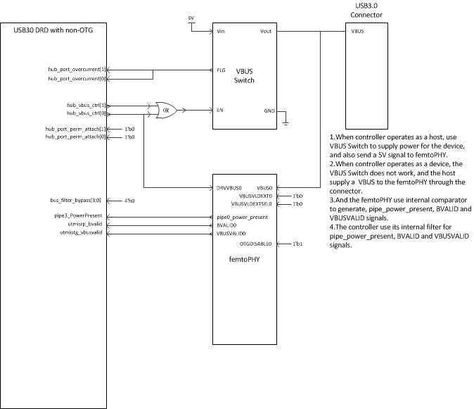
Board

Slide 13
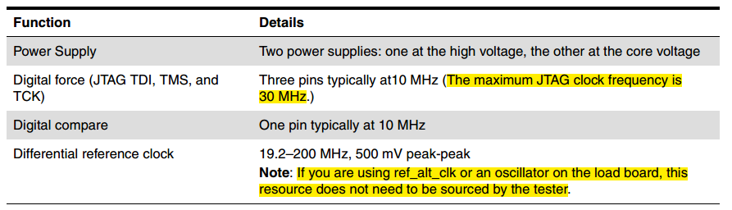
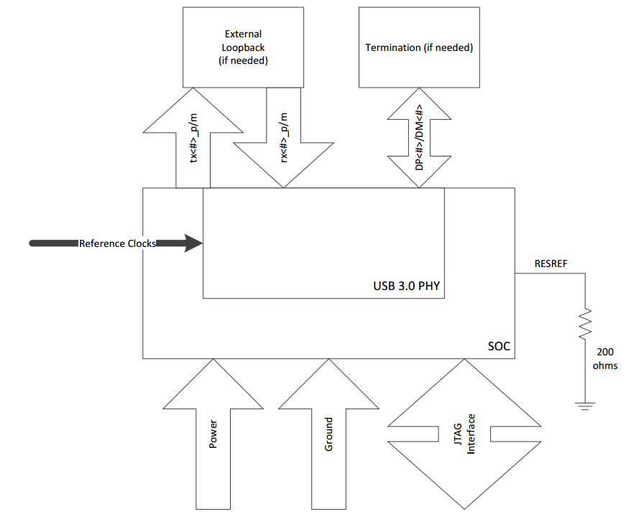
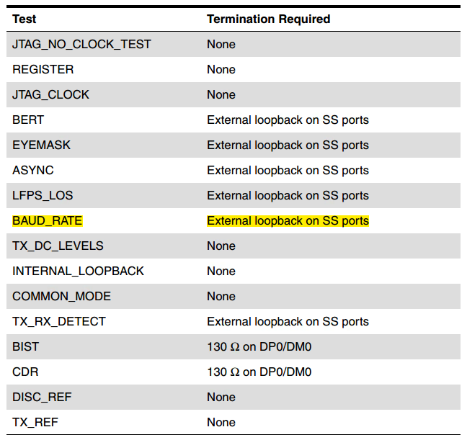
PHY ATE test

Slide 14
Conformance test
Use Keysight’s solution
Change PHY’s parameter to meet the requirement

Slide 15
IP bring up
PHY Power on Reset
Controller mode switch
Host mode initial
Device mode initial

Slide 16
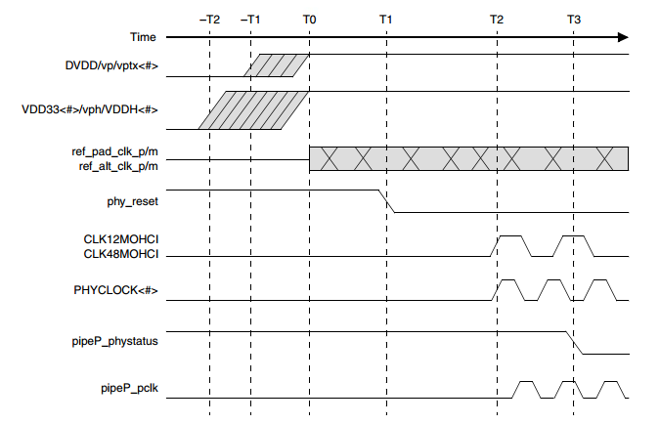
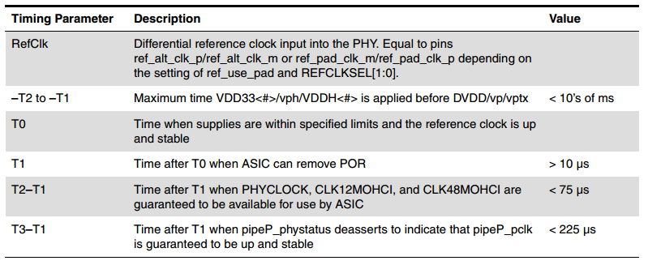
PHY Power on Reset

Slide 17
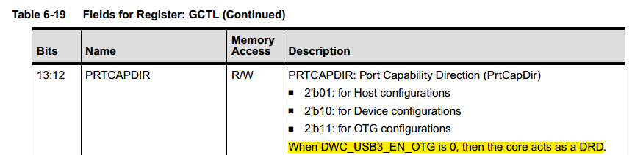
Controller mode switch
Register GCTL[13:12]
Switching from Device to Host
1.Reset the controller using GCTL[11](CoreSoftReset).
2.Set GCTL[13:12](PrtCapDir) to 2’b01(Host mode).
3.Reset the host using USBCMD.HCRESET.
4. Host mode initial.
Switching from Host to Device
1.Reset the controller using GCTL[11](CoreSoftReset).
2.Set GCTL[13:12](PrtCapDir) to 2’b10(Device mode).
3.Reset the device by setting DCTL[30](CSftRst).
4. Device mode initial.

Slide 18
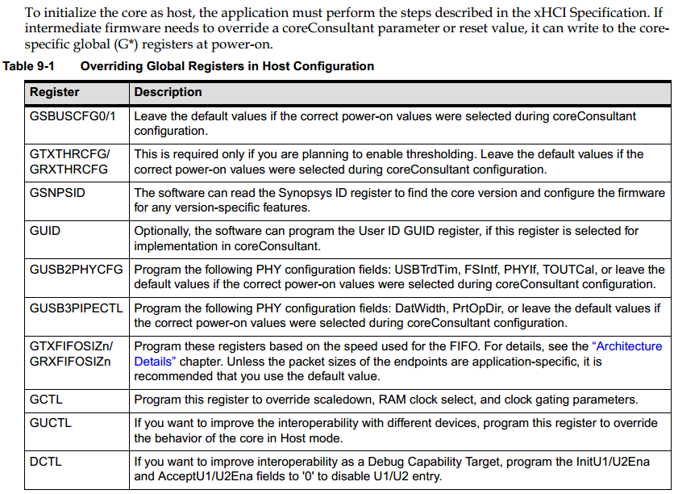
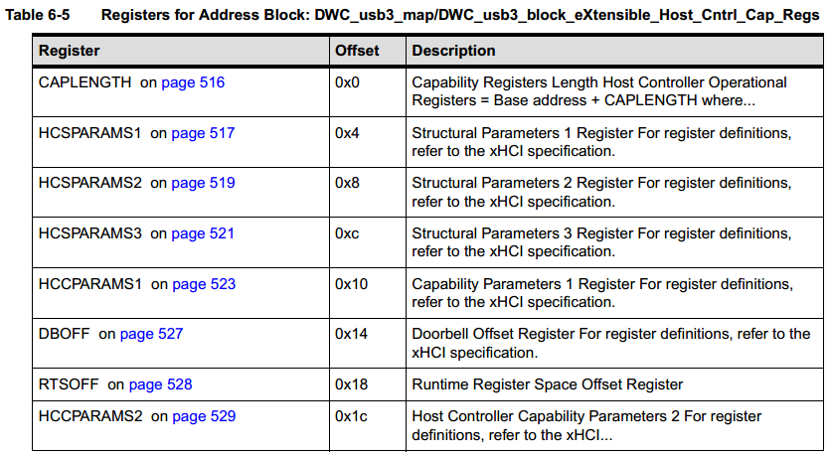
Host mode initial

Slide 19
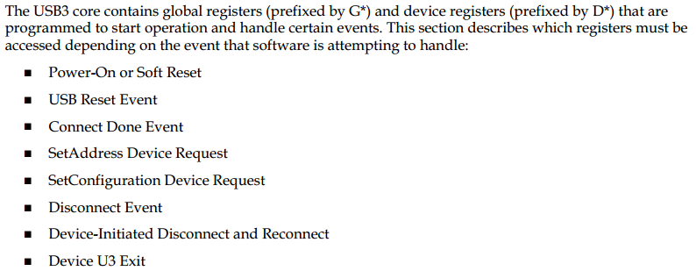
Device mode initial

Slide 20
Check List
Sub-CLASS | Items | Description | Status | Comment
Document | IP Release Note | Describes the content of IP package,and the updates to last version. | done | Controller 3.10a, femtophy 4.04a
 | IP datasheet | Must include full register map and description, I/O structures, block description and sub IP partitioning. | done
 | IP DFT/ATE test spec (mostly for AMS IPs) | Must define what it contains (must include description of test protocol for special test modes) | done | ate app note
 | IP integration Manual | Requiremnt for IO/Clock/Rest/DFT; IP block digarm; Port descriptions and connections in SOC | done
 | IP verfication spec and report | Bench and test cases descriptions; code coverage; functional coverage | pending | CASE:8000976677 no code coverage,functional coverage
 | IP programing guide | Description of IP bring up, Register settings for different modes | pending | CASE:8000976636
 | IP data flow /floorplan/TOP diagram | Description of connections among sub-blocks, memories, backend floorplan | done
 | IP package/PCB guide | Description of Ball assignment/PCB layout | done | CASE:8000975825,synopsys offer PCB guidline and visual review when it is near completion , but no PCB reference design,
Design | IP configure | Include IP feature configure | done
 | RTL | RTL code, netlist, behavior models | pending | netlist not ready
 | Design File List | File list for Chip test bench build. | done
 | Memory list | Memory configure list | done
 | IP fake model | dummy IP subsystem top | done
 | IP unit verification environment | Bench,test cases, scripts ,logs, coverage reports, failed case,issue | done
 | IP synthesis environment | Scripts,SDC,netlist,logs, report | pending | netlist not ready
 | IP Formal check environment | Scripts, report | pending | formality fail
 | IP ATPG environment | Scripts, report | pending | only have phy atpg
 | IP verification Plan | Include SOC level/Veloce/FPGA verification test report. | pending | soc level old version 1 case pass, new version doing
 | IP NLS Maturity Check | release netlist, chiplevel backend SDC | pending | netlist not ready
Software | IP SW driver | Software driver for application | pending | CASE: 8000976297

