Slide 1

Building recommendation system to predict user preferences for entertainment product
Group : 3

Slide 2
Recommendation System?
A list of items on which a user might be interested, in the context of his current choice of an item.
Predict the ‘rating’ or ‘preference’ to a user.
Helps to decide in what to watch, what to buy etc.
Applied in variety of applications like movies, books, research articles.
Recommendation systems has mainly two elements Item and User.

Slide 3
Data overview
Problem: Build Recommendation System To Predict User Preferences For Entertainment Product.
We have a data from MovieLens Dataset provided by Grouplens.org.
Source of dataset - https://grouplens.org/datasets/movielens/
3 different datasets: 1,000,209 user ratings of 3883 movies Given by 6,040 users.
Ratings : UserID, MovieID, Ratings
Movies : MovieID, Titles, Genres
User: UserID, Gender, Age, Occupation, Zip Code, Timestamp

Slide 4
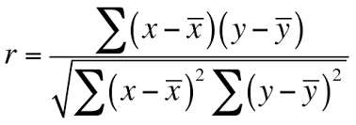
Feature Engineering
Data cleaning:
Handling missing values.
Detect and handling outliers
Feature Selection:
Pearson correlation - Pearson correlation coefficient (r) is a measure of the strength of the association between the two variables.

Slide 5
EXPLORATORY DATA ANALYSIS
Analysis-
Top 20 rated movies
Top popular movies genres
Top 20 least popular movies
Top 20 high rated movies
Univariate analysis on numerical feature gender, rating, occupation
Bivariate analysis {(gender, rating), (genres, rating), (occupation ,rating)}

Slide 6
Types of Recommendation system
Collaborative Filtering: Recommends movies which are rated highly by the similar users.
Memory based : Memory-based algorithms utilize the entire user-item data-base to generate a prediction.
Model-based : In this algorithms provide item recommendation by first developing a model of user ratings.
Advantages:
No domain knowledge necessary
Serendipity
Great starting point
Disadvantage
Cannot handle fresh items - cold start problem

Slide 7
Content-based Filtering:
Recommends other movies which are similar to that selected movie.
Doesn't need any data about other users

Slide 8
Collaborative Filtering
Item based collaborative filtering
Based on the similarity between items calculated using people's ratings of those items.
Similarity between two items computed by the cosine of the angle between two vectors.
Algorithms:
KNNWithMeans
KNNBasic
KNNBaseline

Slide 9

User based collaborative filtering
Compute the Similarity between Users , the rating for an item
Algorithms
Singular Matrix Decomposition (SVD)
Non-Negative Matrix Factorisation (NMF)
SVDpp

Slide 10
SVD(SINGULAR VALUE DECOMPOSITION)
Singular Value Decomposition (SVD) is a matrix factorization method.
Used as a dimensionality reduction
Finds factors of matrices from user-item-rating matrix.
A method of decomposing a matrix into three other matrices as given below:
Given as input an 𝑚×𝑛 matrix 𝑨, SVD computes matrices 𝑼,𝑺,𝑽 such that:
𝑨 = 𝑼 𝑺 𝑽 𝑇
Where:
𝑼 is an 𝑚×𝑚 square matrix.
𝑺 is an 𝑚×𝑛 diagonal matrix (only entries 𝑆 𝑖,𝑖 are non-zero).
𝑽 is an 𝑛×𝑛 matrix.

Slide 11
Content Based Filtering
Recommend items based on similarity between items and user's preferences
Uses Item Features
Recommend similar content.
No cold-start problem
Algorithms
TF-IDF Vectorizer
CountVectorizer

Slide 12
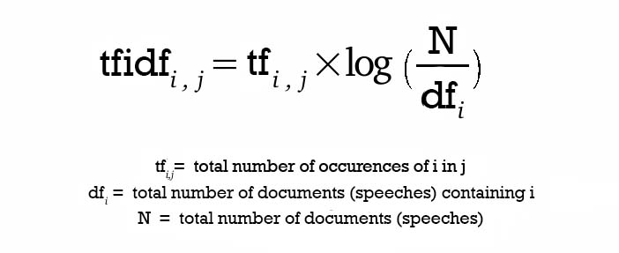
TF-IDF Vectorizer
Term Frequency (TF) and Inverse Document Frequency (IDF)
Consider overall document weightage of a word.
It helps us in dealing with most frequent words. Using it we can penalize them.
Tf-idf Vectorizer weights the word counts by a measure of how often they appear in the documents.
Equation to calculate the TF-IDF score:

Slide 13
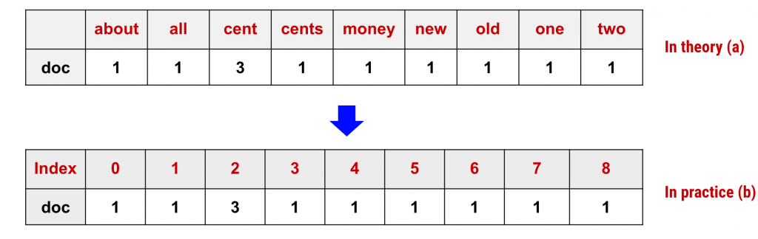
Count Vectorizer
Used to convert a collection of text documents to a vector of term/token counts.
Only count the number of times a word appears in the document
Which results in biasing in favor of most frequent words.
Ignoring rare words which could have helped is in processing our data more efficiently.

Slide 14
EVALUATION
To measure the performance of our model , we used following techniques.
MAE
It is the difference between the actual value(rating) and the predicted value
RMSE
Calculate the square difference between all predicted data points and actual data points
Calculate the mean of all these squared differences.
Calculate the square root of the mean.

Slide 15
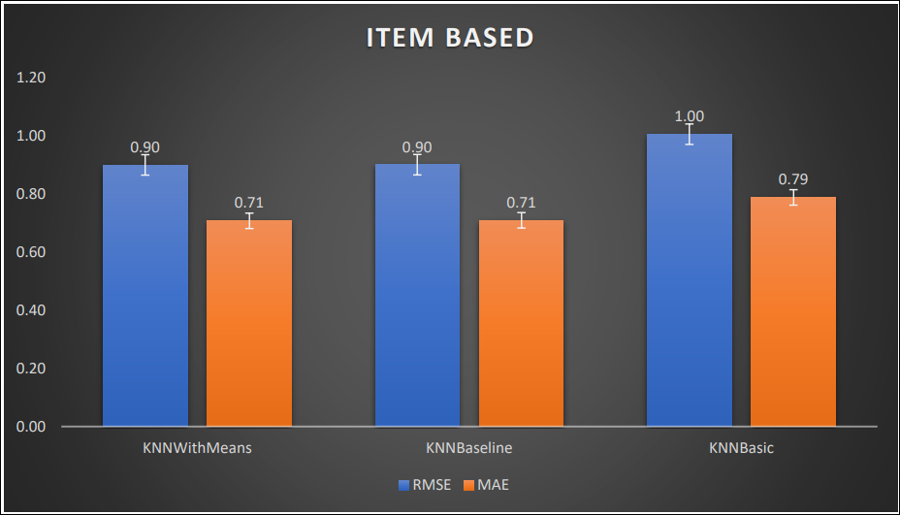
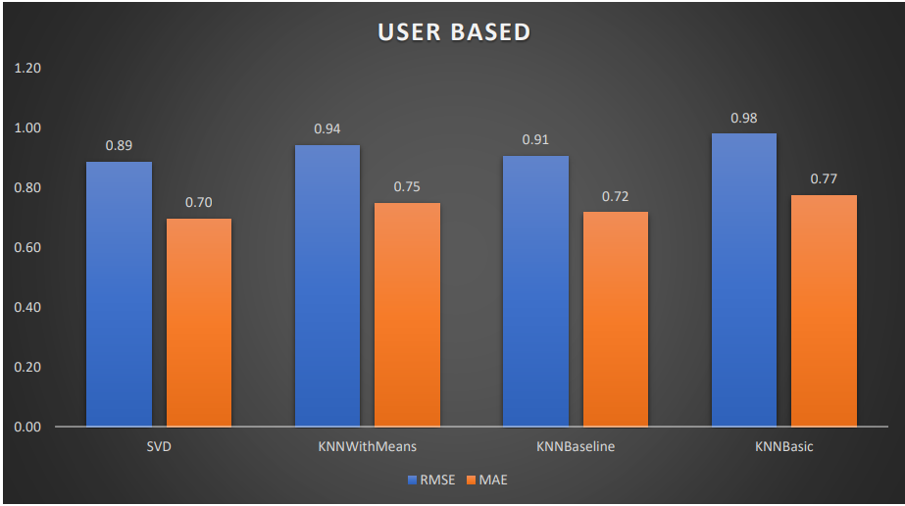
RMSE/MAE Comparison

Slide 16

Front-END

Slide 17
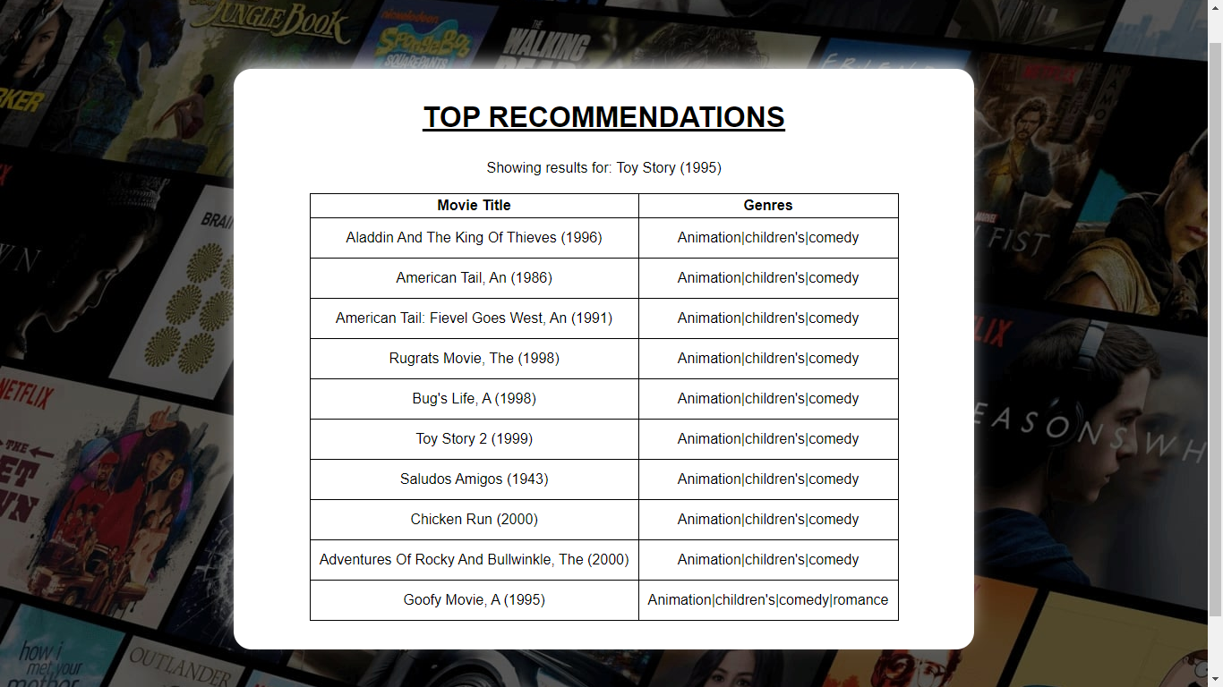
Recommendations

Slide 18

Thank you

