Slide 1
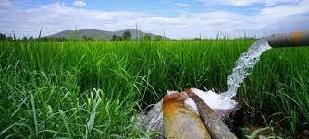
SMART IRRIGATION

Slide 2
Introduction
India is mainly an agricultural country.
In India Agriculture contributes 16% of GDP and 10% of total exports
Water is the main resource of Agriculture
_{Existing Solutions:}
we can observe the Smart Irrigation system which is based on the Humidity, Temperature and moisture values.
Based on the sensor readings, motor will automatically come into ON condition.
But this method is not that much efficient. Because different crops need different quantity of water and in the time of harvesting crops are not required even water moisture also. These are the Pros of the existing system

Slide 3
Proposed solution:
We are introducing a system such a way that irrigation process takes place based on crop, area of field and date of plantation along with the readings of Moisture sensor level sensor.
Different crops are required different amount of water at different intervals of time. We are giving solution for that problem based on Level Concept.
In the time of Harvesting our project works efficiently.
If temperature is high works based on that & If it is rainy our system again works based on the weather conditions

Slide 4
Problem Statement
Irrigation system is going to design which works based on the type of crop and based on the date of plantation and area of field. This system is works using IoT. We would to control this system using mobile Application. And water supply…
Iot based+Type of crop+ date of plantation+ Area of plantation+ data uploaded and collected from sensors+ Level of water based on the crop type and time+ data retrive+Mobiel application

Slide 5
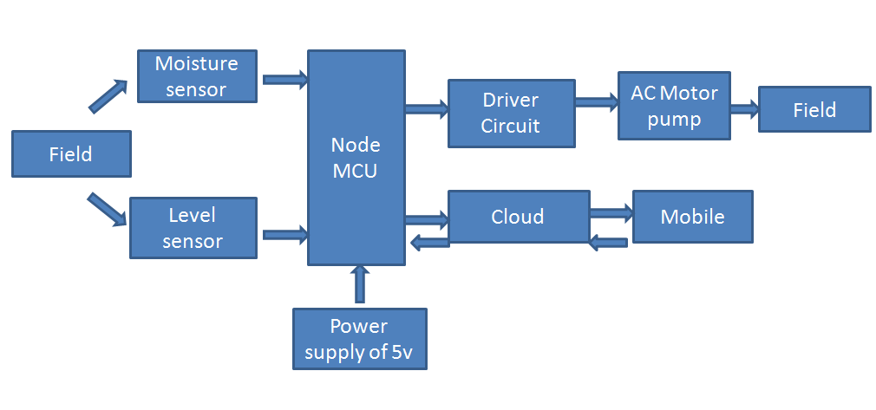
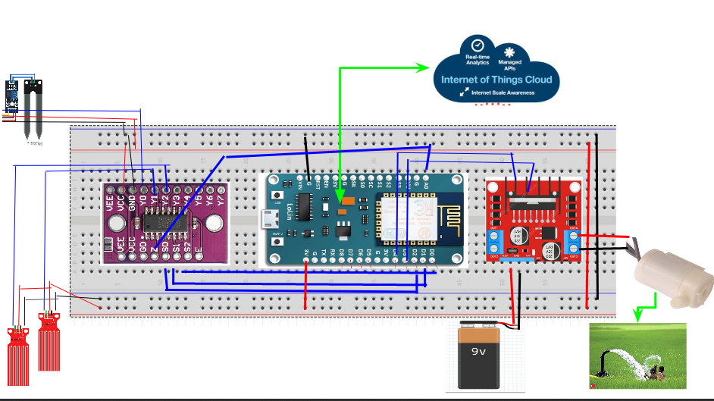
Block Diagram
Circuit Diagram

Slide 6
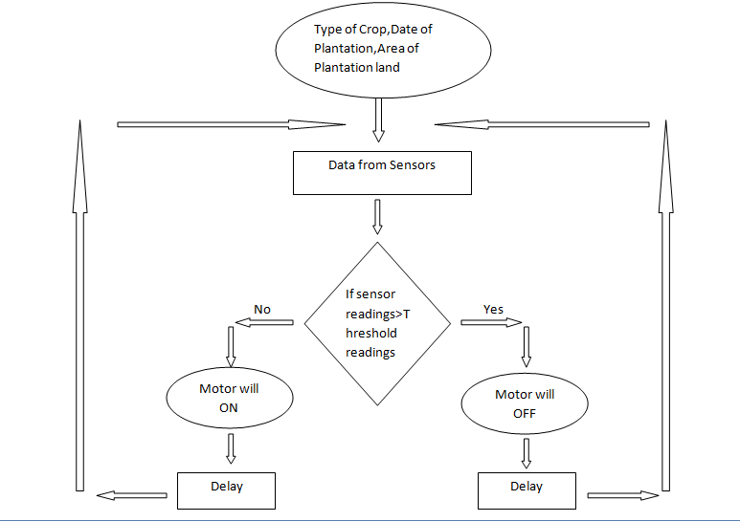
Working principal and flow chart
Works based on Type of Crop, Date
of plantation and area of Plantation
System was controlled by mobile
application
Moisture sensor and level sensors
are used.
These sensor values are uploaded
into cloud. For pre-defined crops, there
is already data stored in cloud, based on
that Motor will pump the water.
Manual ON/OFF given to the user by
mobile application.

Slide 7
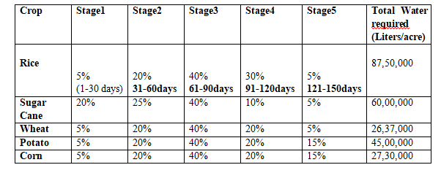
WATER REQURIMENT FOR DIFFERENT CROPS

Slide 8
DESIGN APPROACH
Problem Statement :
Irrigation system is going to design which works based on the type of crop,date
Of plantation and area of field. We would like to control this system using mobile application through IoT.
Selected Components :
Moisture Sensor,Level Sensors, Motor, Node MCU, Motor Driver, Analog Mux, Battery
Interfacing :
Using Arduino code run the 3 sensors with help of mux
Based on threshold value from readings fix the motor condition
Implement entire process through Firebase cloud
Design Android App for final process
Field Arrangement:
Created prototype field with soil of dimension 32*21*12 cm³
Run the above process using total setup through IoT
Pump the water to the field efficiently using this project

Slide 9
Practical approach
Our project pics as practicle implimentation

Slide 10
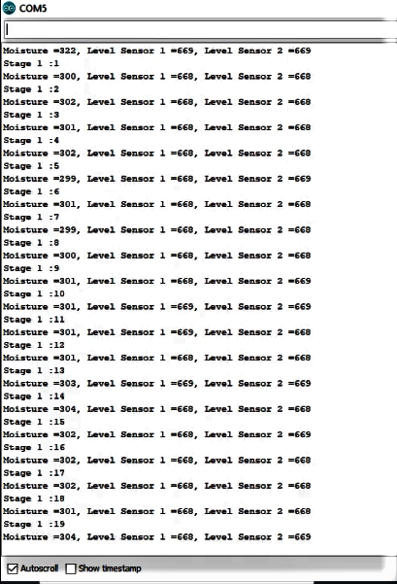
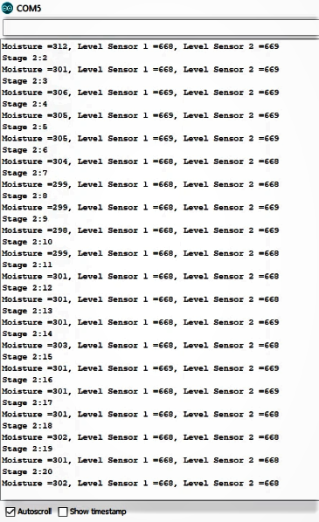
Modeling results
Fire base pics and mobile app pics

Slide 11
Cost analysis
S.No | Name of Component | Specification | Unit Cost | Quantity | Total Cost
1 | Moisture sensor |  | 90 | 1 | 90
2 | Level sensor |  | 80 | 2 | 160
3 | Motor | DC 3V-6V, 80L/H | 90 | 1 | 90
4 | Node MCU | Tensilica 32-bit RIS`C CPU Xtensa LX106 | 270 | 1 | 270
5 | Motor driver | L298N | 150 | 1 | 150
6 | Battery | 12V | 500 | 1 | 500
7 | Analog Mux | HC4051 | 15 | 1 | 15
8 | Bread board |  | 90 | 1 | 90
9 | Jumper wires |  | 80 | - | 80
10 | Connecting wires |  | 20 | - | 20
 | Total Cost |  |  | Rs 1465/-

Slide 12
Future scope
Fertilizer Suggestion
Disease Detection

Slide 13
conclusion

Slide 14
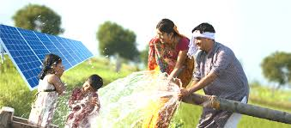
Happy Family With Smart Irrigation

