Slide 1
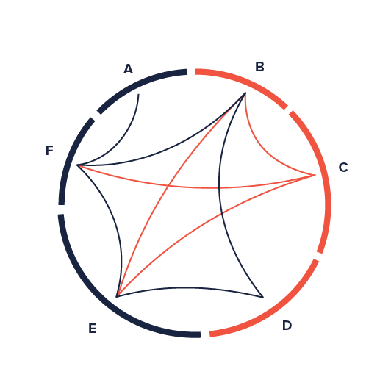
Harvard
Concept Search
Image source: http://datavizproject.com/data-type/non-ribbon-chord-diagram/

