Slide 1
Facial Expression Recognition for Sentiment Analysis
Derek Dolan, David Mansoir, Hans Broders, Yesul Song

Slide 2
Dataset Overview
With a goal of performing sentiment analysis through analyzing facial expression we landed on this dataset called Face Sentiment Data.
The dataset contains five categories of expressions: Agony, Happy, Neural, Sad, and Scared

Slide 3



Data Overview Continued
Each category contains ~8500 images of people with the corresponding expression which were collected by taking a video of a person making each expression for several seconds and then splitting the frames into individual images.
Agony Happy Sad

Slide 4
Data Pre-processing and Cleanup
Images were sized at 240x240
Data is numbered sequentially so a script was used to randomize the data into training, validation, and test. This ensures that we have a good mix of early and late photos in all sets.
Some images in the dataset were missing and workarounds were needed to handle errors created by this.

Slide 5
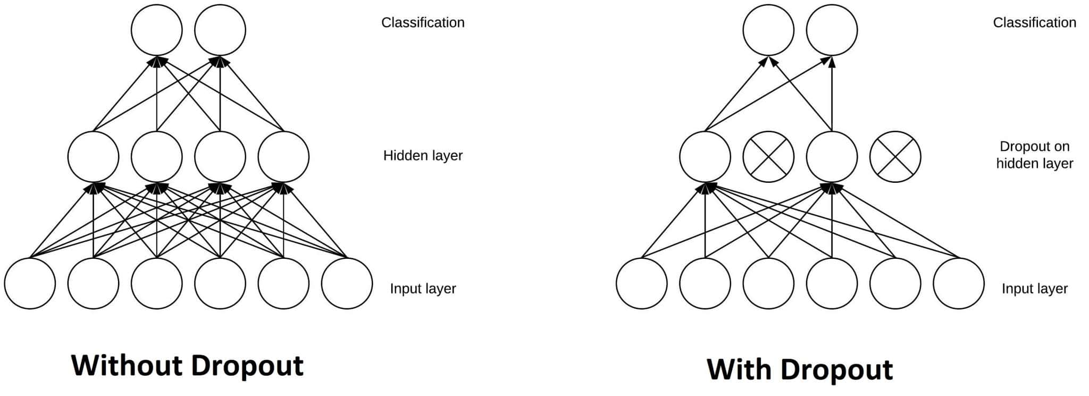
Initial Models
We started initially with large models before the script to randomize the data set was developed
We experienced overfitting within the first 25 epochs and accuracy could not exceed 80% with validation loss at 2.4.
This made it clear that something needed to change so we added dropouts to the model with little improvement and this lead to the reexamination of the data and ultimately led to the creation of the randomization script.

Slide 6
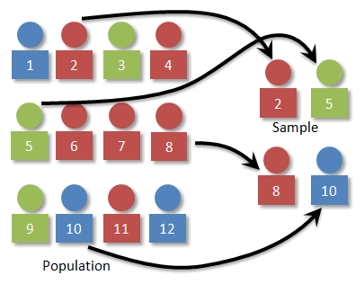
Randomization Script
Randomization script made use of random and shutil libraries which were used to generate random numbers and to manipulate files in windows respectively. Created random sequence for the training set, then excluded the used images, generated a sequence for the test set, excluded the images, and used the leftovers for the validation set. Following this the relevant images were copied to the appropriate training, validation, and test directories.

Slide 7
Final Model
The final model ran for 50 epochs
Achieved validation accuracy of 99.94% with a validation loss of .0052.
Training accuracy of 96.39% and loss of .1095
Test accuracy reached 99.71% with loss .0119

Slide 8
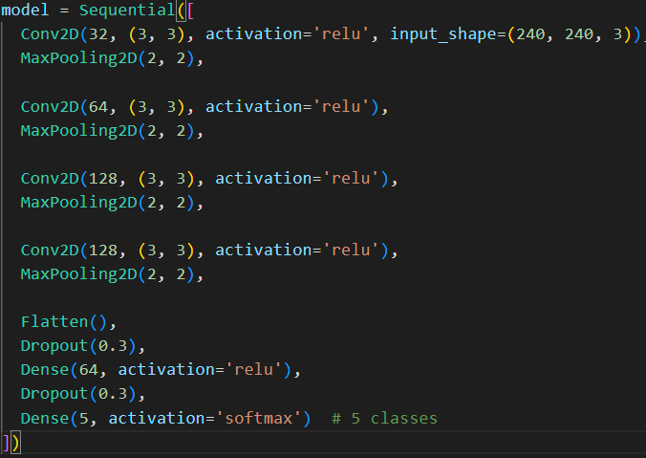

Final Model Code
This is the convolutional model that was able to achieve such impressive accuracy. While making use of dropouts before the final Dense layers to perform the sentiment analysis.
We considered using RMSprop but ultimately settled on using Adam.
The learning rate was left at the default value.

Slide 9
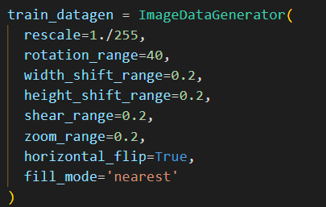
Augmentation
We included augmentation on the training data set.
This helps make the model more robust and able to handle a greater variety of input images.
This includes rotations and flipping of the image.

Slide 10
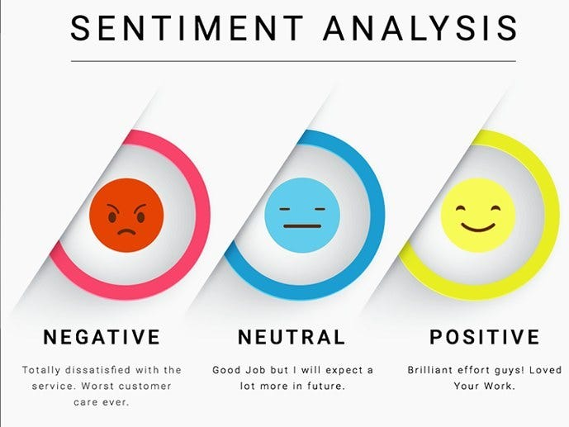
Potential Applications
Models of this type could conceivably be used for:
New product surveys such as perfume testing
Emotional Monitoring
Could be expanded to include sleep detection
Chatbots could use this to detect level of satisfaction

Slide 11
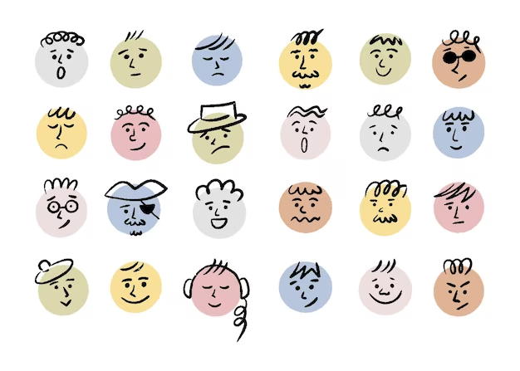
Limitations
There are more than 5 emotions so the model cannot capture the full range of human emotion.
Requires relatively high quality photos that are mostly head on.
Relatively small person set, may wish to expand the dataset
Training data is a small set of faces so it doesn't have data for other faces.
It can’t make you a donut

Slide 12
Ethical Concerns
Would require permissions in order to make use of or there would be privacy concerns.
Requires deletion of data
It may be difficult to effectively categorize the emotions of individuals who are not well represented in the dataset

Slide 13


Demonstration
Neutral Categorized Correctly
Sad Categorized Correctly

Slide 14


Demonstration
Happy Categorized as Neutral
Agony categorized as Happy

Slide 15
Conclusion
This was an exploration of facial sentiment analysis using convolutional modeling.
It was able to take our images and produce a model that could effectively determine facial expressions.
The model has proven very effective as a proof of concept.
We look forward to future usage of this technology to create new and exciting products.

Slide 16
References:
https://www.kaggle.com/datasets/abhinowww/face-sentiment-data
https://docs.python.org/3/library/shutil.html
Keras Documentation
Neural Networks and Deep Learning - Michael Nielsen - 281 pages Oct 2018
Glassner, A. (2021). Deep learning: A visual approach.

