Slide 1
Arthur Ricardo de Sousa Vitória
arthursvrr@gmail.com
2023
Comparison of VITS-based models for Singing Voice Conversion

Slide 2
Agenda
Introduction
Background
Study-Case
Results

Slide 3
Introduction

Slide 4
Introduction
Voice conversion is a technique that alters the voice of a source speaker to a target style, such as speaker identity, prosody and emotion, while keep the linguistic content unchanged.
While some VC systems uses a two-stage reconstruction pipeline, Variational Inference with adversarial learning for end-to-end Text-to-Speech (VITS)-based models uses a single-stage training process;

Slide 5
Introduction
The main idea of this work is to compare two VITS-based models in order to measure how some improvements affects the final results

Slide 6
Background

Slide 7
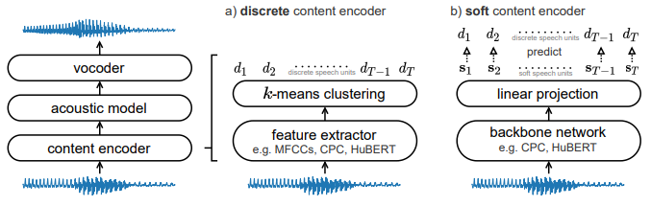
Soft-VC: predict a distribution over discrete speech units
Retain more content information
Improve intelligibility and naturalness

Slide 8
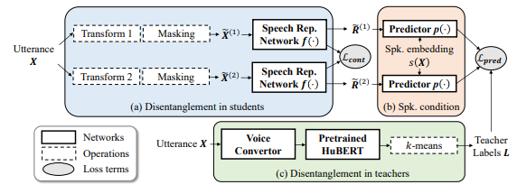
ContentVec: Disentangle speaker variations without significant content loss

Slide 9
Study-Case

Slide 10
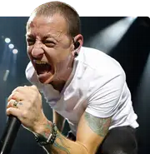
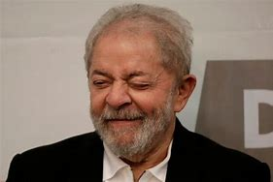

Dataset
Layout: Section title and description
Three target speakers were selected
Splits of ~10 minutes were used
High quality data were selected
Source separation and speaker-diarization

Slide 11
Experiments
Layout: Title and two columns
Three repositories were evaluated:
https://github.com/RVC-Project/Retrieval-based-Voice-Conversion-WebUI
https://github.com/voicepaw/so-vits-svc-fork
https://github.com/PlayVoice/so-vits-svc-5.0

Slide 12
Experiments
Layout: Title and two columns
Hyperparameters configuration:
epochs: 500-2000
batch-size: 8
learning-rate: {1e-5:5e-5}
sampling-rate: {32k; 48k}

Slide 13
Results

Slide 14

Experiments
Layout: Title and two columns
https://github.com/voicepaw/so-vits-svc-fork

Slide 15
Experiments
Layout: Title and two columns
https://github.com/RVC-Project/Retrieval-based-Voice-Conversion-WebUI

Slide 16
Experiments
Layout: Title and two columns
https://github.com/PlayVoice/so-vits-svc-5.0

Slide 17


Thanks
arthursvrr@gmail.com
Suggestions?

