Slide 1
Pedestrian Detection
Faster R-CNN vs RetinaNet
OSU Thermal Pedestrian Dataset (OTCBVS) · Arttu Kuitunen
Computer Vision · Spring 2026

Slide 2
Dataset and implementation
Dataset
Project used OSU_Thermal_Detection dataset (OTCBVS) which contains a collection of thermal infrared images showing pedestrians walk across the scene.
Images are grayscale converted to RGB channels with 360x240 resolution.
Images are annotated with ground truth boxes as xy -coordinates. Dataset is single class and 1 to many objects per image.
Data loading is handled by custom class OTCBVDataset that reads all subfolders and builds a list of annotated samples.
Data is converted to RGB and transformed to float tensors. Background is handled as class 0 and object class as label 1.
Dataset is split 80/20 train/val using random seed.
Implementation
Faster R-CNN is pretrained with ResNet-50 FPN and that backbone is frozen. Only the FastRCNNPredictor head is replaced to output 2 classes (background and pedestrian.
RetinaNet follows same pattern and both models are trained with given SGD optimizer values (lr=0.005, momentum=0.9, weight_decay=0,0005)
TorchVision detection models return losses that are summes and backpropagated.
Evaluation computes mAP, mAP@50 from accumulated predictions and inference timing is measured per image with warmup period discarded.
Faster R-CNN started at 0.41 loss · RetinaNet started at 0.56 loss · Both plateau by epoch 4

Slide 3
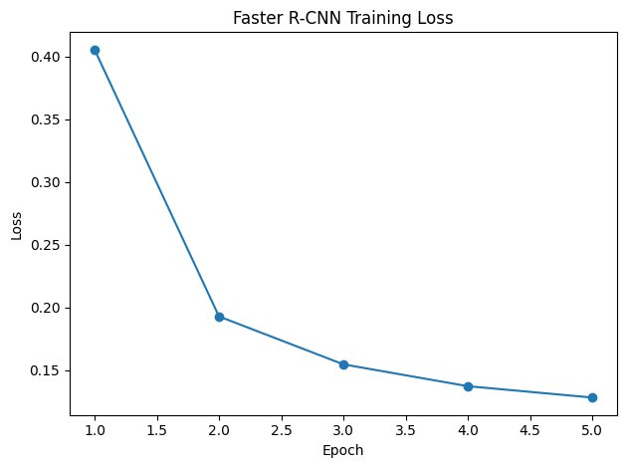
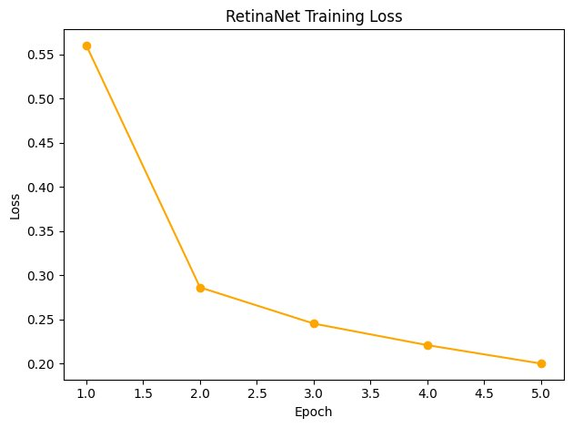
Training Loss
Both models converge smoothly over 5 epochs on the OTCBVS thermal dataset
Faster R-CNN started at 0.41 loss · RetinaNet started at 0.56 loss · Both start plateuing at epoch 4

Slide 4
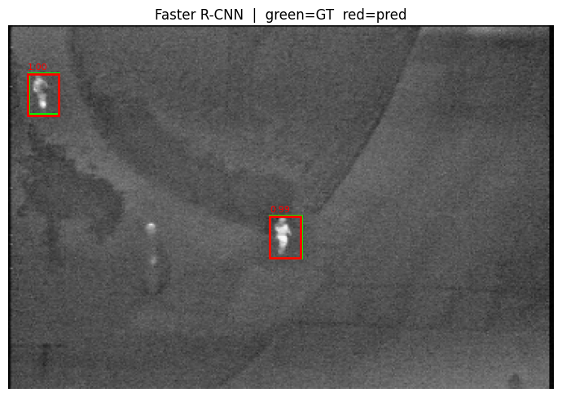
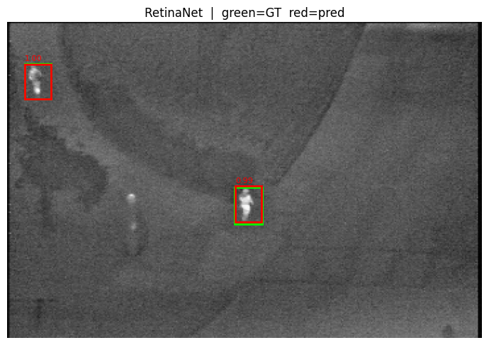
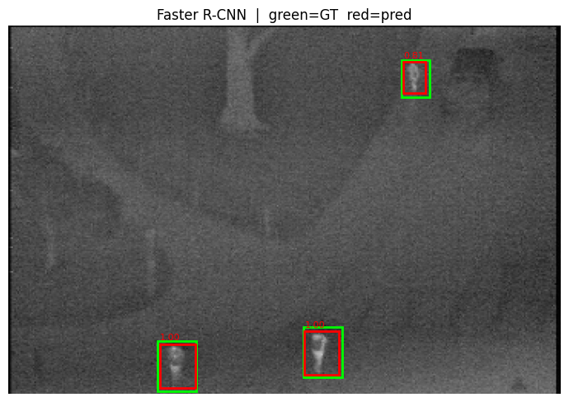
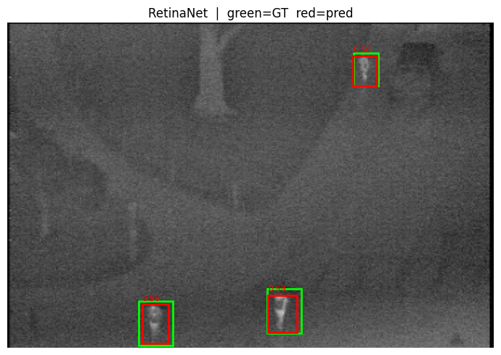
Prediction samples
Faster R-CNN
RetinaNet
Faster R-CNN (2nd sample)
RetinaNet (2nd sample)
green = ground truth red = prediction

Slide 5
Evaluation Results
Model | val mAP | val mAP@50 | Infer (ms)
Faster R-CNN | 0.7084 | 0.9988 | 91.1 ± 4.6
RetinaNet | 0.6372 | 0.9737 | 60.8 ± 2.8
Faster R-CNN achieved higher accuracy (mAP 0.708 vs 0.637) — the two-stage region-proposal step improves localisation on small thermal targets.
RetinaNet is 33% faster at inference (61 ms vs 91 ms) — ideal for real-time or embedded deployments where speed matters.
Both models reach near-perfect mAP@50 (>97%), confirming that transfer learning from ImageNet generalises well to thermal imagery even with frozen backbones.
For this dataset both models generalize well, but the images are very similar due to fixed camera position, conditions and nature of infrared image color profile. There is no training set in this split which could have made validating more reliable.

