Slide 1

DETECTING GUAVA DISEASES: A COMPARATIVE ANALYSIS OF MACHINE LEARNING AND DEEP LEARNING TECHNIQUES
Md. Mahfujur Rahman Khan
(ID: 191352)
Munadim Ahsan Uosmoy
(ID: 191361)
Anup Majumder
Associate Professor
Department of Computer Science and Engineering,
Jahangirnagar University
Tuesday, 28 May, 2024

Slide 2

Slide Outline
Background and Motivation
Objectives
Literature Review
Contribution
Methodology
Results & Discussion
Limitations and Future Scope
Conclusion
References

Slide 3
Background and Motivation
Early and accurate diagnosis of guava diseases is crucial due to the significant environmental and economic impacts of delayed detection
.
In Bangladesh, guava is a staple food, and the productivity of guava crops is essential for food security and economic stability.
Diseases like canker, mummification, dot, and rust can devastate crops, leading to substantial yield reductions and financial losses. Conventional visual inspections are time-consuming, costly, and often inaccurate.
Detecting guava diseases using machine learning and deep learning methods is important for effective outbreak management.

Slide 4
Background and Motivation(cont.)
This project will lead to higher yields and reduced economic losses by enabling early and precise disease detection. It will allow for targeted pesticide use, minimizing environmental damage. Additionally, it will enhance productivity and economic resilience for farmers, contributing to sustainable agricultural practices. By improving disease management, the project will ultimately support food security and economic stability in guava-producing regions.

Slide 5
Objectives
The objectives of this research are as follows:
Developing an Automated Disease Detection System
Utilizing Deep Learning Techniques
Improving Disease Management
Enhancing Agricultural Productivity
Addressing Environmental Concerns
Empowering Farmers
Knowledge Transfer and Capacity Building
Contributing to Scientific Knowledge

Slide 6
Literature Review
Work Done | Object(s) Dealt with | Problem Domain | Sample Size | Feature Set Size | Class ific ation | Algorithm | Accuracy
Hasan et al. (2022) [6] | Guava | Recognition | 550 | 10 | No | AlexNet | 83%
Tewari et al. (2023)[7] | Guava | Recognition | 527 | 5 | Yes | DenseNet201 Model | 96%
Assad S. et al. (2022)[1] | Guava (Leaf) | Recognition | 1834 | 5 | Yes | EfficientNet-B3 | 94%
Mostafa, A.M et al. (2022)[2] | Guava | Recognition | 321 | 5 | Yes | ResNet-101 | 97%
M. Abirami (2017)[3] | Guava (Leaf) | Recognition | 465 | 5 | Yes | GLD-Det | 97%
Table 1. Overview reviews of Guava disease detection.

Slide 7
Contribution
Our project focused on Guava Disease Detection, a pioneering effort in Bangladesh's agricultural sector. Employing both traditional machine learning techniques, like SVM, and advanced deep learning methods, including vision transformers and transfer learning, we aimed to develop a precise classification model.
In the absence of prior research in this area, we created a unique dataset comprising guava leaf images to drive our analysis. By comparing the accuracy and efficiency of different approaches, we aimed to provide actionable insights for improved disease management in guava crops.

Slide 8
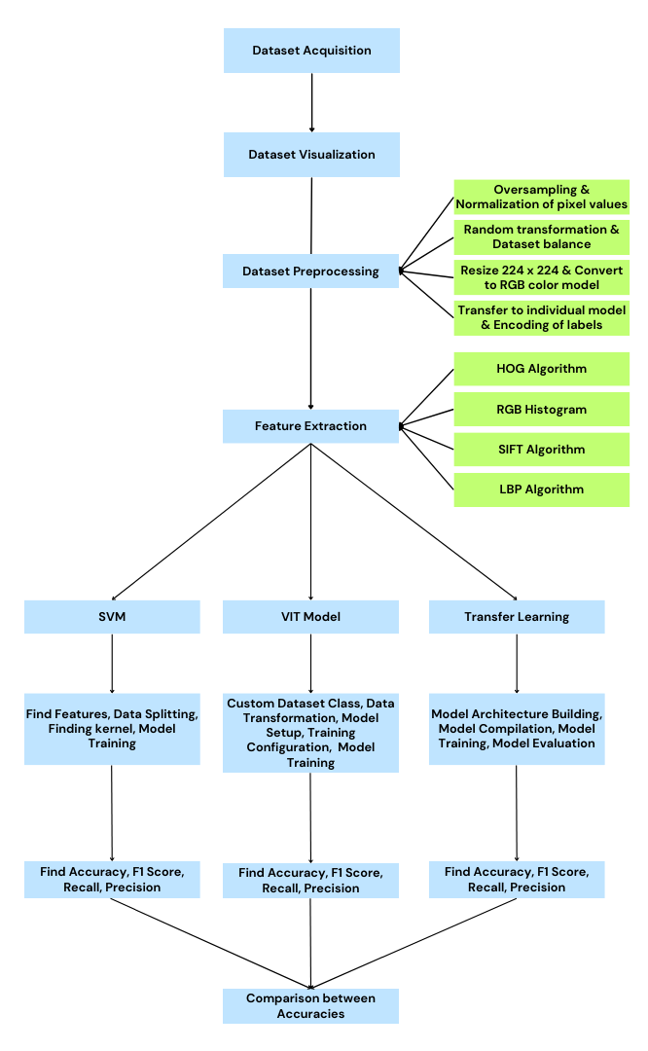
Methodology
Overview
Fig 1: Flow Chart of Our Methodology

Slide 9
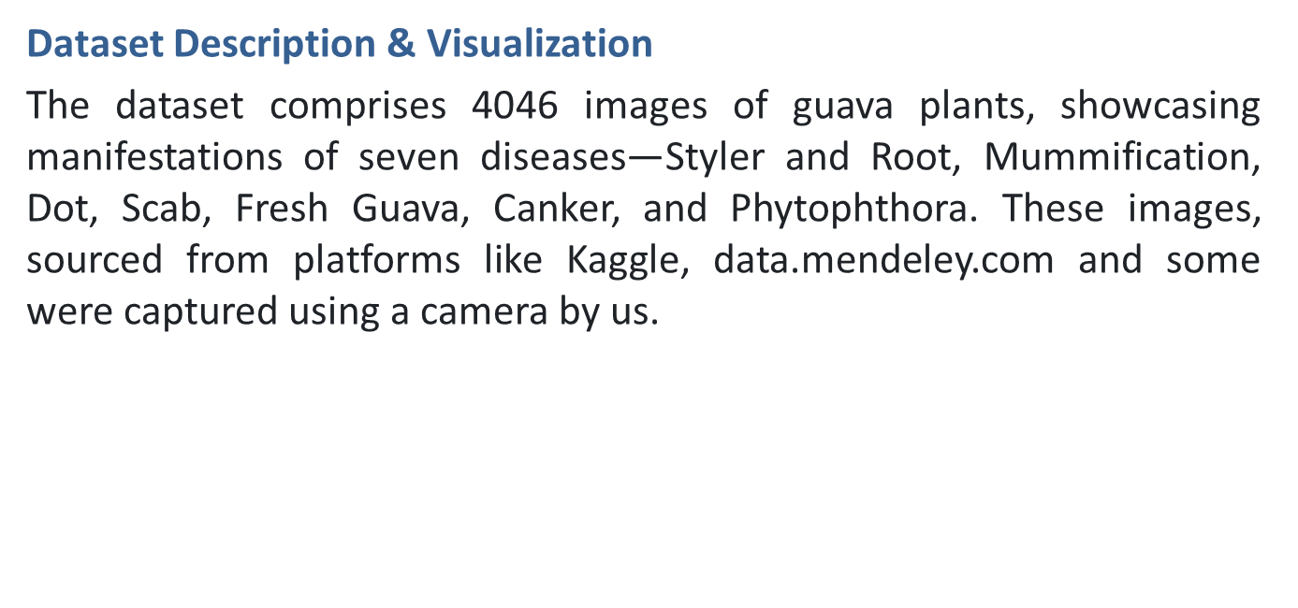
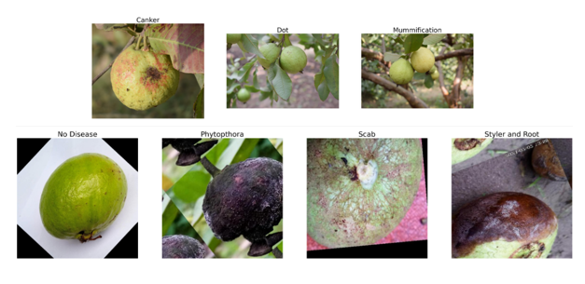
Methodology (cont.)
Fig 2: Set of Diseases and No Disease Guavas

Slide 10
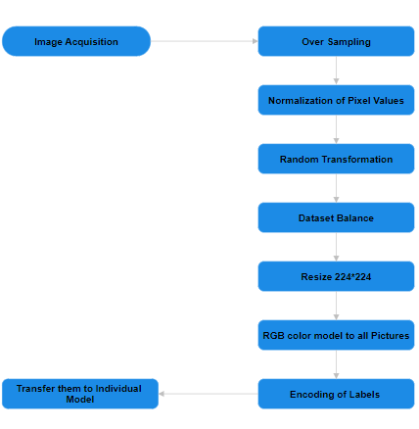
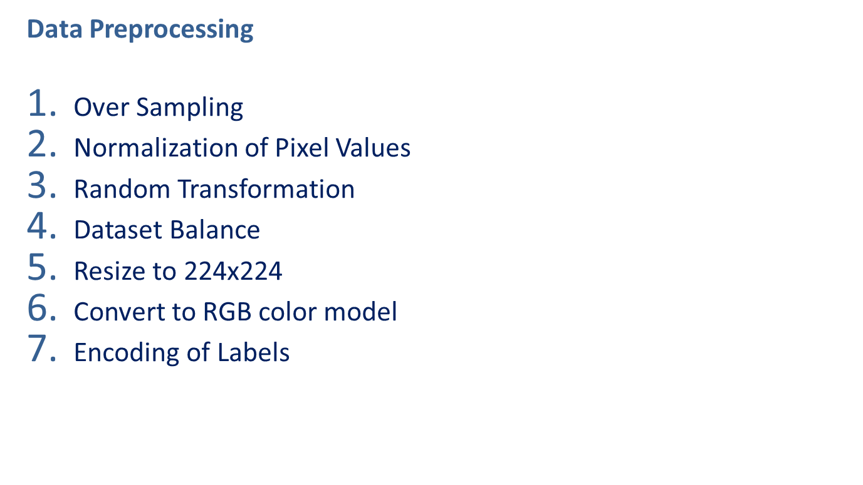
Methodology (cont.)
Fig 3: Flow Chart of Our Preprocessing Sector

Slide 11
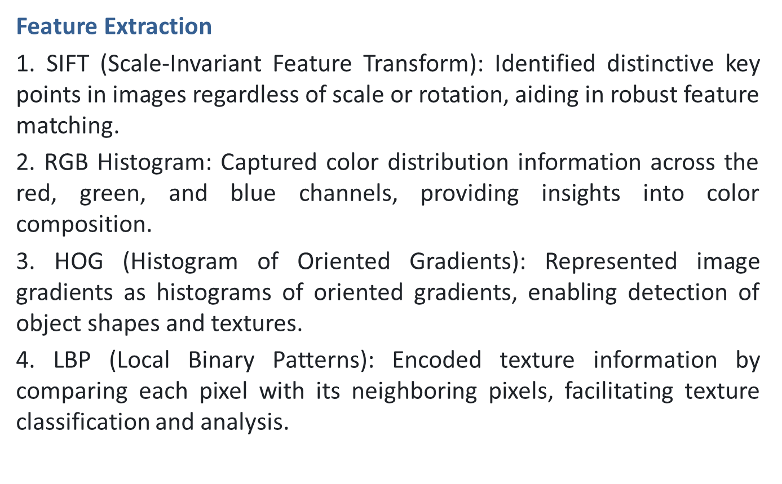
Methodology (cont.)

Slide 12
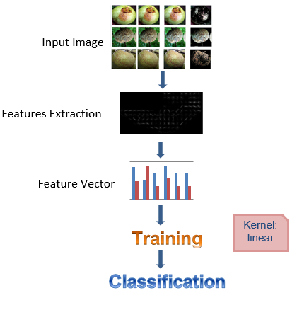
Methodology (cont.)
Support Vector Classifier
Input Image: Original image for classification.
Features Extraction: Extract relevant features like edges, shapes, or colors from the image.
Feature Vector: Convert extracted features into a numerical feature vector.
Training and Classification: Utilize the feature vector to train a model, and then classify them.
Fig 4: SVM Flow chart

Slide 13
Methodology (cont.)
Vision Transformers
Input: Guava images, categorized as healthy or the one of the given 7 diseases
Custom Dataset Class: It will be created to handle the loading, transformation, and label encoding of images.
Patching: Partition images into small squares
Embedding: Enhance squares with content and location information
Transformer: Analyze squares to discern disease patterns
Output: Classify image as healthy or diseased

Slide 14
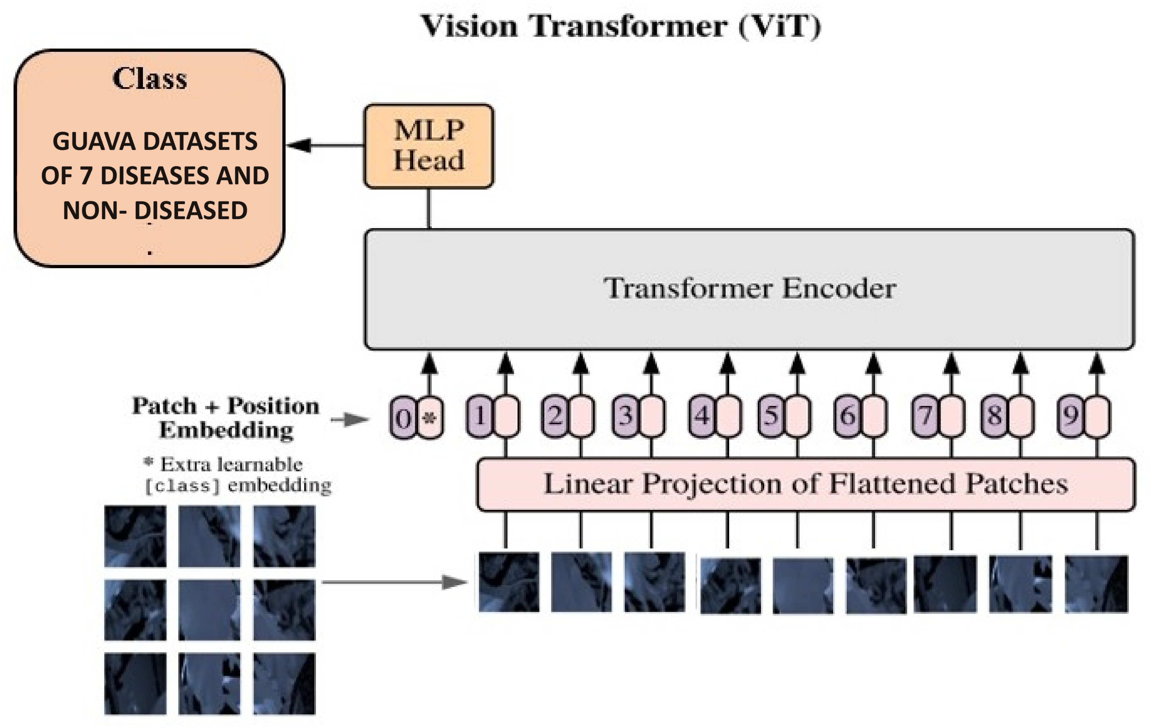
Methodology (cont.)
Vision Transformers
Fig 4: ViT Model

Slide 15
Methodology (cont.)
Transfer Learning
1. Pre-Trained Model: A model trained on generic images learns basic features.
2. Transfer Learning: Adapting a pre-trained model for guava disease detection.
3. Fine-Tuning: Adjusting model layers for disease-specific patterns.
4. Feature Extraction: Extracting basic image features.
5. Disease Detection Training: Training the model to recognize disease patterns.
6. Classification: Classifying new images.

Slide 16
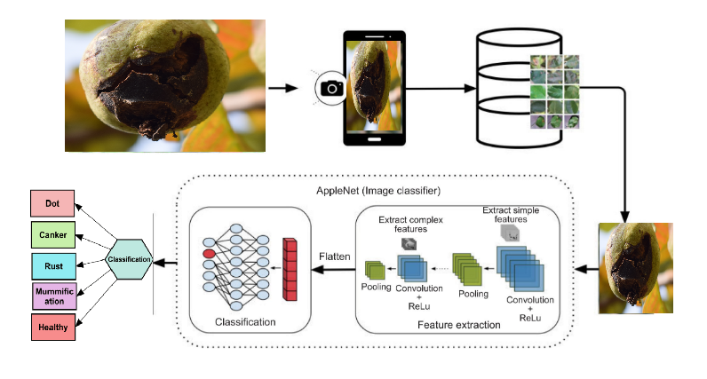
Methodology (cont.)
Transfer Learning
Fig 4: Transfer Learning Model

Slide 17
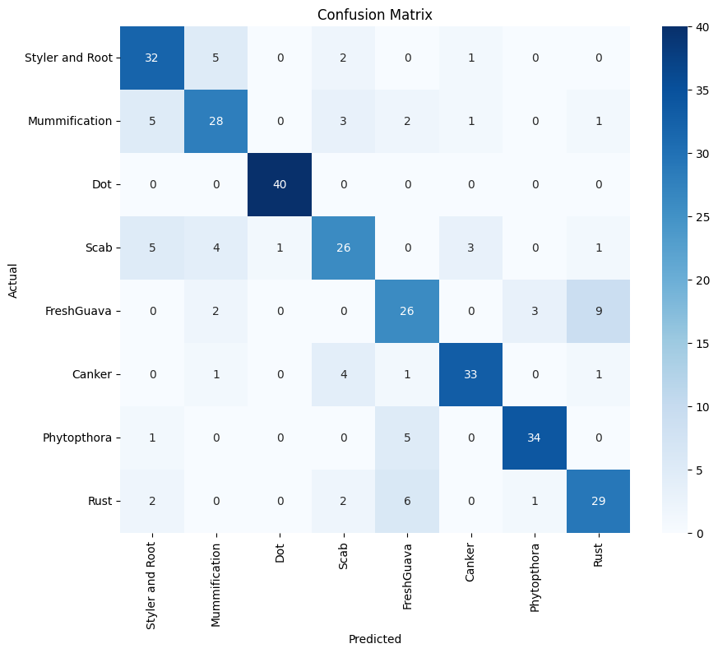
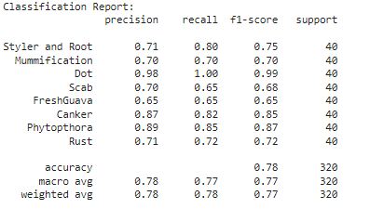
Results & Discussion
Support Vector Machine
Fig 5: SVM Classification Report
Fig 6: SVM Confusion Matrix

Slide 18
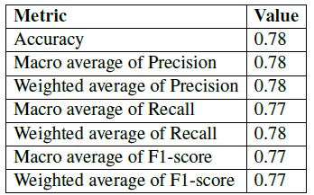
Results & Discussion (cont.)
Support Vector Machine
Due to training overfitting, the SVM hasn’t performed like the two deep learning models. Even though deep learning models usually perform way more than traditional machine learning, SVM does not very much. Actually, deep learning methods can handle overfitting and underfitting well.
Fig 7: SVM Performance

Slide 19
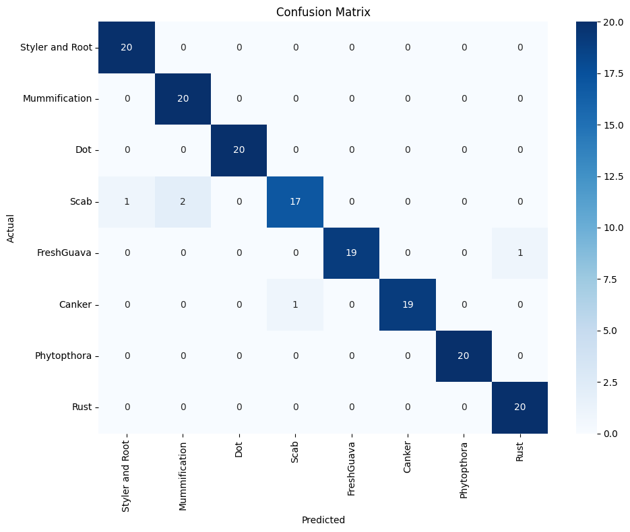
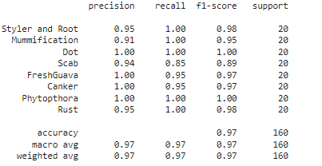
Results & Discussion (cont.)
Transfer Learning
Fig 12: Transfer Learning Classification Report
Fig 13: Transfer Learning Confusion Matrix

Slide 20
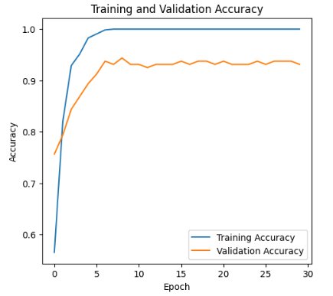
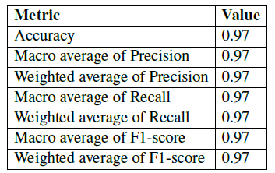
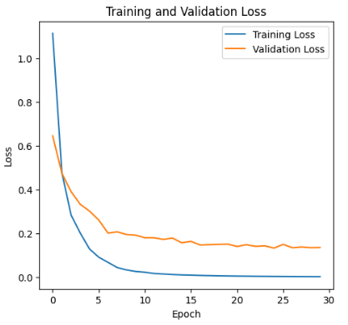
Results & Discussion (cont.)
Transfer Learning
Fig 14: Transfer Learning Performance
Fig 15: Accuracy & Loss Over Epochs

Slide 21
Results & Discussion (cont.)
Transfer Learning
Transfer learning achieved a high accuracy of 97% due to leveraging pre-trained models on large, diverse datasets. This approach allows the model to utilize already learned features, requiring less training data and computational resources. Fine-tuning these pre-trained models for guava disease detection enables the extraction of high-level features specific to the dataset, resulting in efficient and accurate classification.

Slide 22
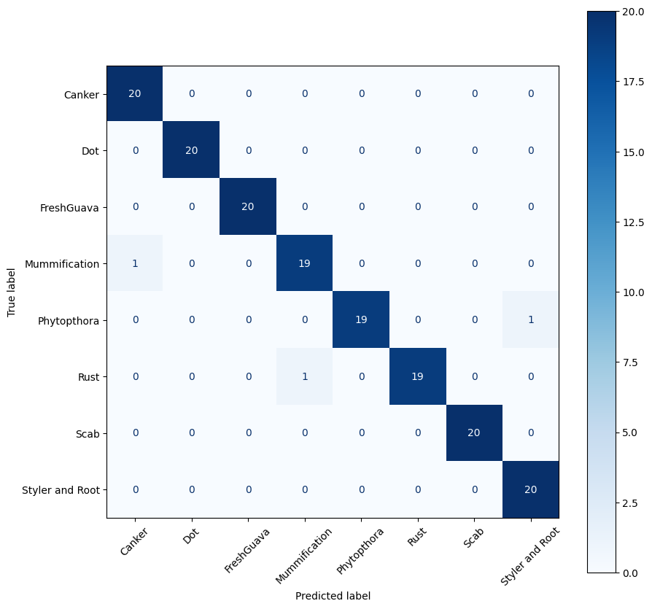
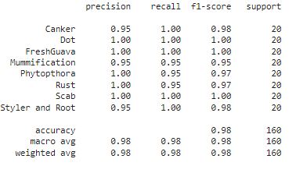
Results & Discussion (cont.)
Vision Transformers
Fig 8: ViT Classification Report
Fig 9: ViT Confusion Matrix

Slide 23
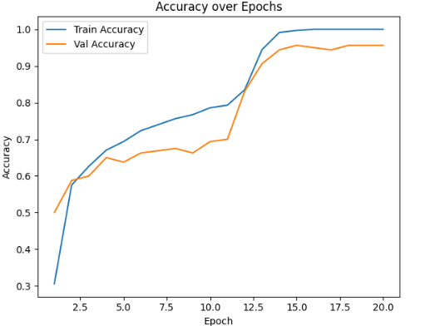
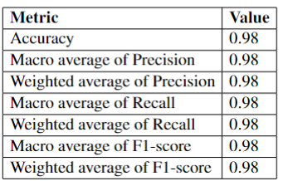
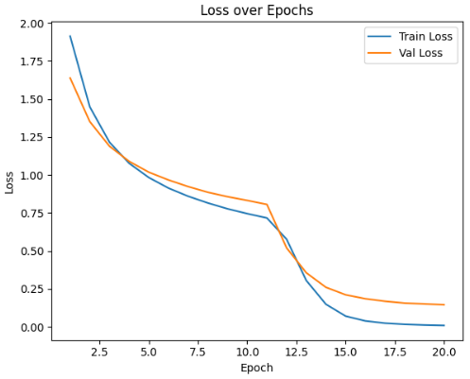
Results & Discussion (cont.)
Vision Transformers
Fig 10: ViT Performance
Fig 11: Accuracy & Loss Over Epochs

Slide 24
Results & Discussion (cont.)
Vision Transformers
Vision Transformers (ViTs) achieved the highest accuracy of 98% due to their ability to capture long-range dependencies and contextual information in images. The self-attention mechanism in ViTs allows the model to focus on the most relevant parts of an image, enhancing feature extraction. Additionally, ViTs can handle large-scale data effectively, leading to robust and generalizable models, making them particularly suited for tasks like guava disease detection.

Slide 25
Results & Discussion (cont.)
Comparison
We incorporated SVM, Vision Transformers, and transfer learning for guava disease detection. Vision Transformers, capturing spatial relations from raw image pixels, achieved the highest accuracy at 98%. Transfer learning, fine-tuning pre-trained models on large datasets, followed closely with 97% accuracy. SVM, with manually extracted features, attained 78% accuracy.
Algorithm | Accuracy (%)
Vision Transformers | 98%
Transfer Learning | 97%
SVM | 78%
Table 2. Comparison Table

Slide 26
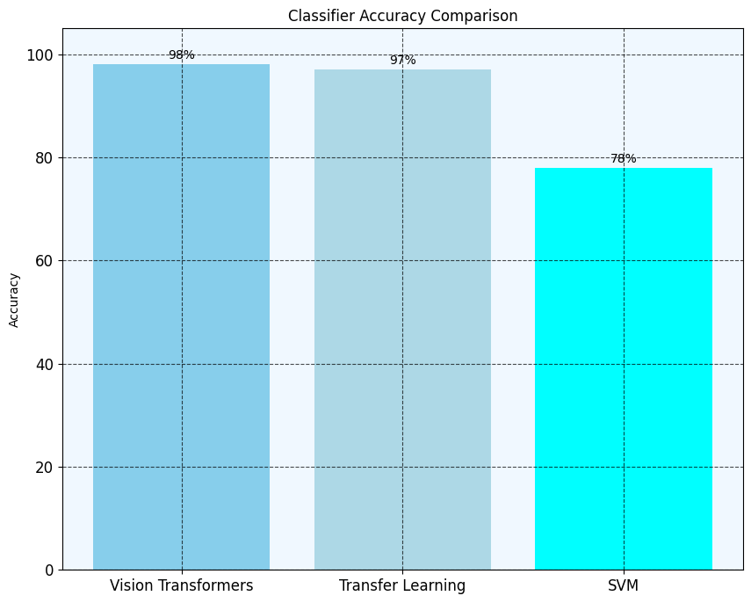
Results & Discussion (cont.)
Comparison
Fig 16: Comparison Histogram

Slide 27
Limitations and Future Scope
Limitations
Limited dataset size may hinder model generalization.
High computational requirements for training deep learning models.
Potential overfitting with insufficiently diverse data.
Difficulty in obtaining high-quality annotated data.
Limited availability of advanced imaging equipment for data collection.

Slide 28
Limitations and Future Scope (cont.)
Future Works
Enhance model architectures by improving deep learning techniques like Transfer Learning and Vision Transformers.
Implement fine-tuning strategies such as differential learning rates and layer adjustments.
Use advanced data augmentation techniques to improve the dataset and results.
Integrate multi-modal data sources like spectral and infrared imaging.
Optimize model architectures for real-time deployment on edge devices and IoT systems.
Develop compact deep learning models for mobile applications.

Slide 29
Conclusion
In agriculture, accurate and timely plant disease detection is crucial for preventing crop loss and economic damage. Our research highlights the effectiveness of advanced deep learning methods, particularly Vision Transformers (ViT) and transfer learning, in identifying guava diseases with accuracies of 98% and 97%, respectively. These models offer promising solutions for farmers and agricultural stakeholders. Traditional machine learning methods, achieving up to 78% accuracy, remain valuable for foundational insights. Continued research and development are essential for enhancing disease detection and ensuring food security.
Fig 16: Comparison Histogram

Slide 30
References
[1] A. Doutoum, R. Eryigit, and B. Tugrul, “Classification of guava leaf disease using deep˘ learning,” WSEAS TRANSACTIONS ON INFORMATION SCIENCE AND APPLICATIONS, vol. 20, pp. 356–363, 10 2023.
[2] K. S. Mostafa, A.M., R. H. A. A. Meraj, T., and M. Alkhayyal, “Guava disease detection using deep convolutional neural networks: A case study of guava plants,” Appl. Sci., vol. 12, p. 239, 2022.
[3] M. Abirami, “Application of image processing in diagnosing guava leaf disease,” International Journal of Scientific Research and Management, vol. 5, pp. 5927–5933, 2017.
[4] A. Rajbongshi, S. Sazzad, R. Shakil, B. Akter, and U. Sara, “A comprehensive guava leaves and fruits dataset for guava disease recognition,” Data in Brief, June 2022.

Slide 31
References (cont.)
[5] M. T. Habib, A. Majumder, A. Jakaria, M. Akter, M. S. Uddin, and F. Ahmed,
“Machine vision based papaya disease recognition,” Journal of King Saud University - Computer and Information Sciences, vol. 32, no. 3, pp. 300–309, 2020.
[6] A. M. Hashan, S. M. T. Rahman, K. Avinash, R. M. R. U. Islam, and S. Dey, “Guava fruit disease identification based on improved convolutional neural network,” International Journal of Electrical and Computer Engineering (IJECE), vol. 14, no. 2, pp. 1544–1551, 2022.
[7] V. Tewari, N. Azeem, and S. Sharma, “Automatic guava disease detection using different deep learning approaches,” Multimedia Tools and Applications, vol. 83, pp. 1–24, 06 2023.

Slide 32

THANK YOU ALL
HAVE A GOOD DAY

