Slide 1
Get weather model data and convert them to HEC-HMS Ready file input (.dss)
14-Aug-2019

Slide 2
Data Sources
The most convenient way on how to download the weather forecasting dataset is from THREDDS server of UCAR (University Corporation of Atmospheric Research) that is collected as Research Data Archive (RDA), managed by the Data Engineering and Curation Section (DECS) of the Computational and Information Systems Laboratory (CISL)
Benefit
Easy to access through Siphon Library
Responsive administrator

Slide 3
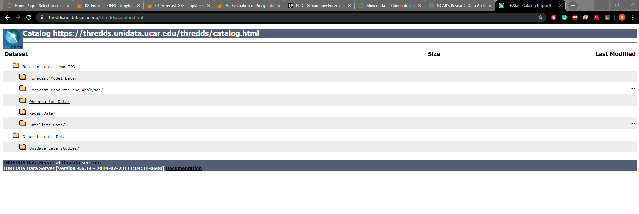
Data Sources
https://thredds.unidata.ucar.edu/thredds/catalog.html

Slide 4
Tools
Python 3.6 minimum
We highly recommend to use a powerful Anaconda or Miniconda package manager to use their virtual environment because most of the time if we install Python libraries they will messed up with existing Python system e.g. ArcGIS/QGIS Python.
Virtual environment is an isolated environment used by developer to test an application. It can be cloned. We can easily deploy exactly the same environment in another machine so that our apps run smoothly in any machine as long as it has the same OS because Anaconda/Miniconda will take care of dependencies installation, though there has to be some modifications if we want to transfer the apps from Win to UNIX/MacOS or vice-versa.
https://docs.conda.io/en/latest/miniconda.html

Slide 5
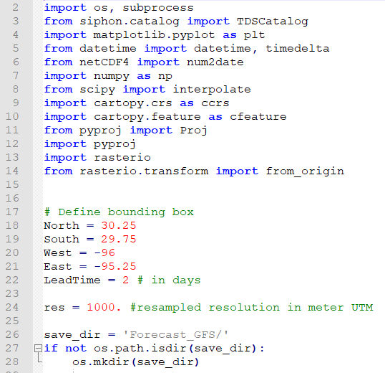
Tools (Forecast_GFS.py)
User may change this part. North, South, West, East are the coordinate points which contain Cypress Creek, and remember also the resolution in degree for each dataset. In this case, GFS has 0.25deg resolution then this bounding box will only contain 3x4 array. res is the data resampled Resolution.
Keep in mind that HEC-HMS only accept the input DSS grid that has the same dimension with Distributed Model Grid.
LeadTime is the lead time of weather forecasting

Slide 6
Main Steps to execute forecasting streamflow with HEC-HMS
Install Miniconda
Launch Anaconda prompt as Administrator (Right-Click, Open as Administrator)
3. Navigate to working folder (Flood_Forecasting)
4. Create Python environment based on environment specification “flood01.txt” by executing :
conda create --name flood01 --file flood01.txt
5. Execute Python script by executing below command. The GFS_Forecast.py automatically will target HEC-HMS working folder (CypressHMS)
python GFS_Forecast.py
6. Open HEC-HMS 4.3, make sure that computation time range is within GFS.dss. Execute!

Slide 7
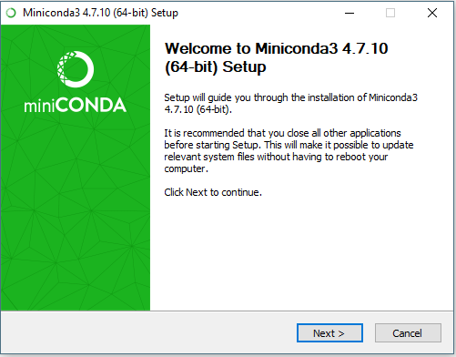
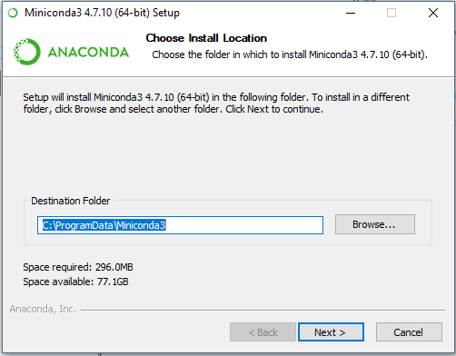
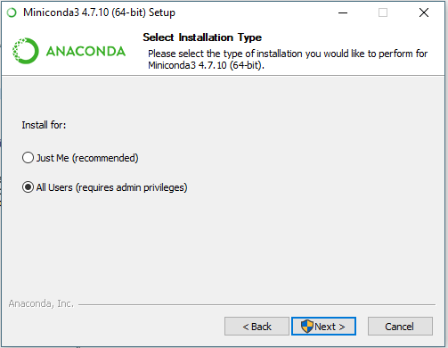
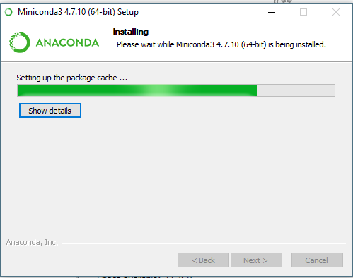
Install Miniconda

Slide 8
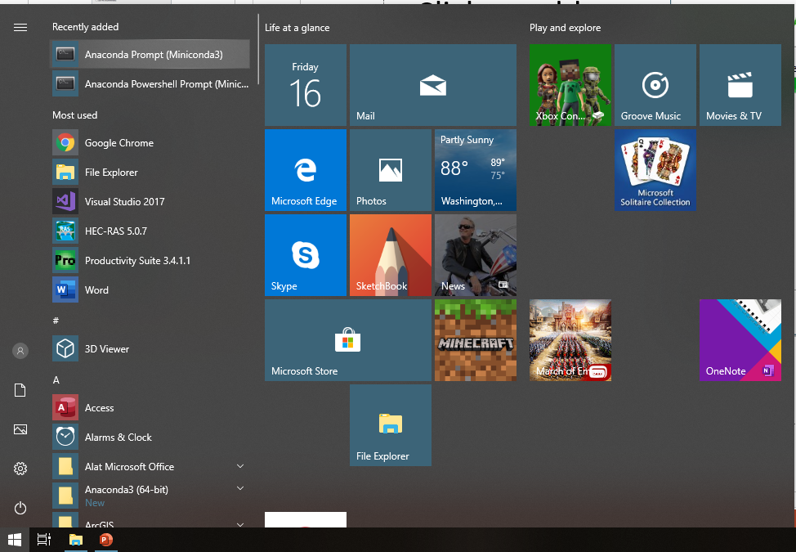
2. Launch Anaconda prompt as Administrator (Right-Click, Open as Administrator)

Slide 9
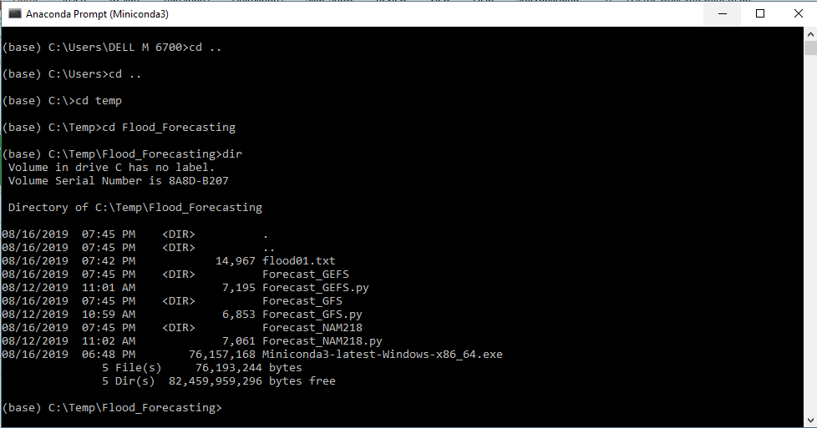
3. Navigate to working folder (Flood_Forecasting)

Slide 10
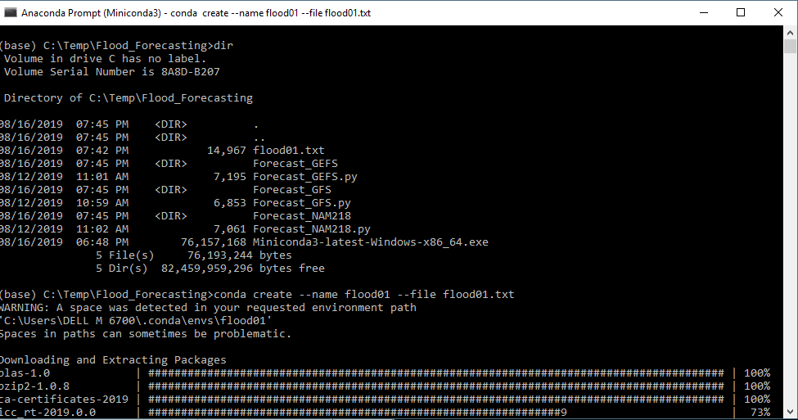
4. Create Python environment based on environment specification “flood01.txt” by executing :
conda create --name flood01 --file flood01.txt

Slide 11
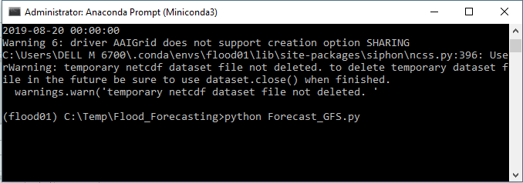
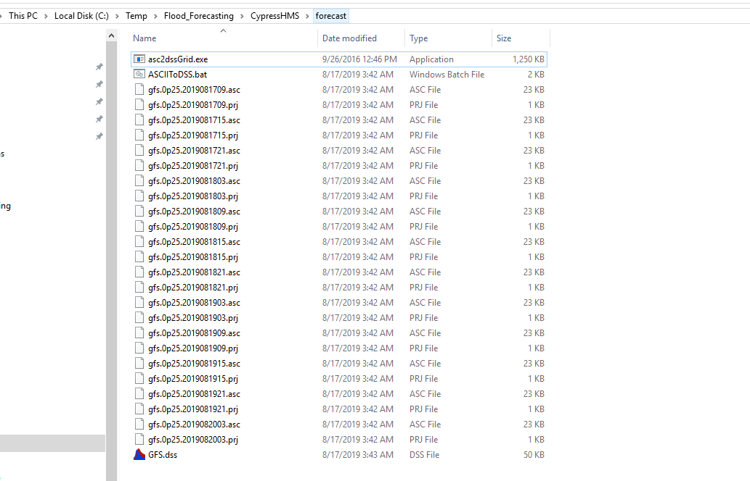
5. Execute Python script by executing below command. The GFS_Forecast.py will target HEC-HMS working folder (CypressHMS)
python GFS_Forecast.py

Slide 12
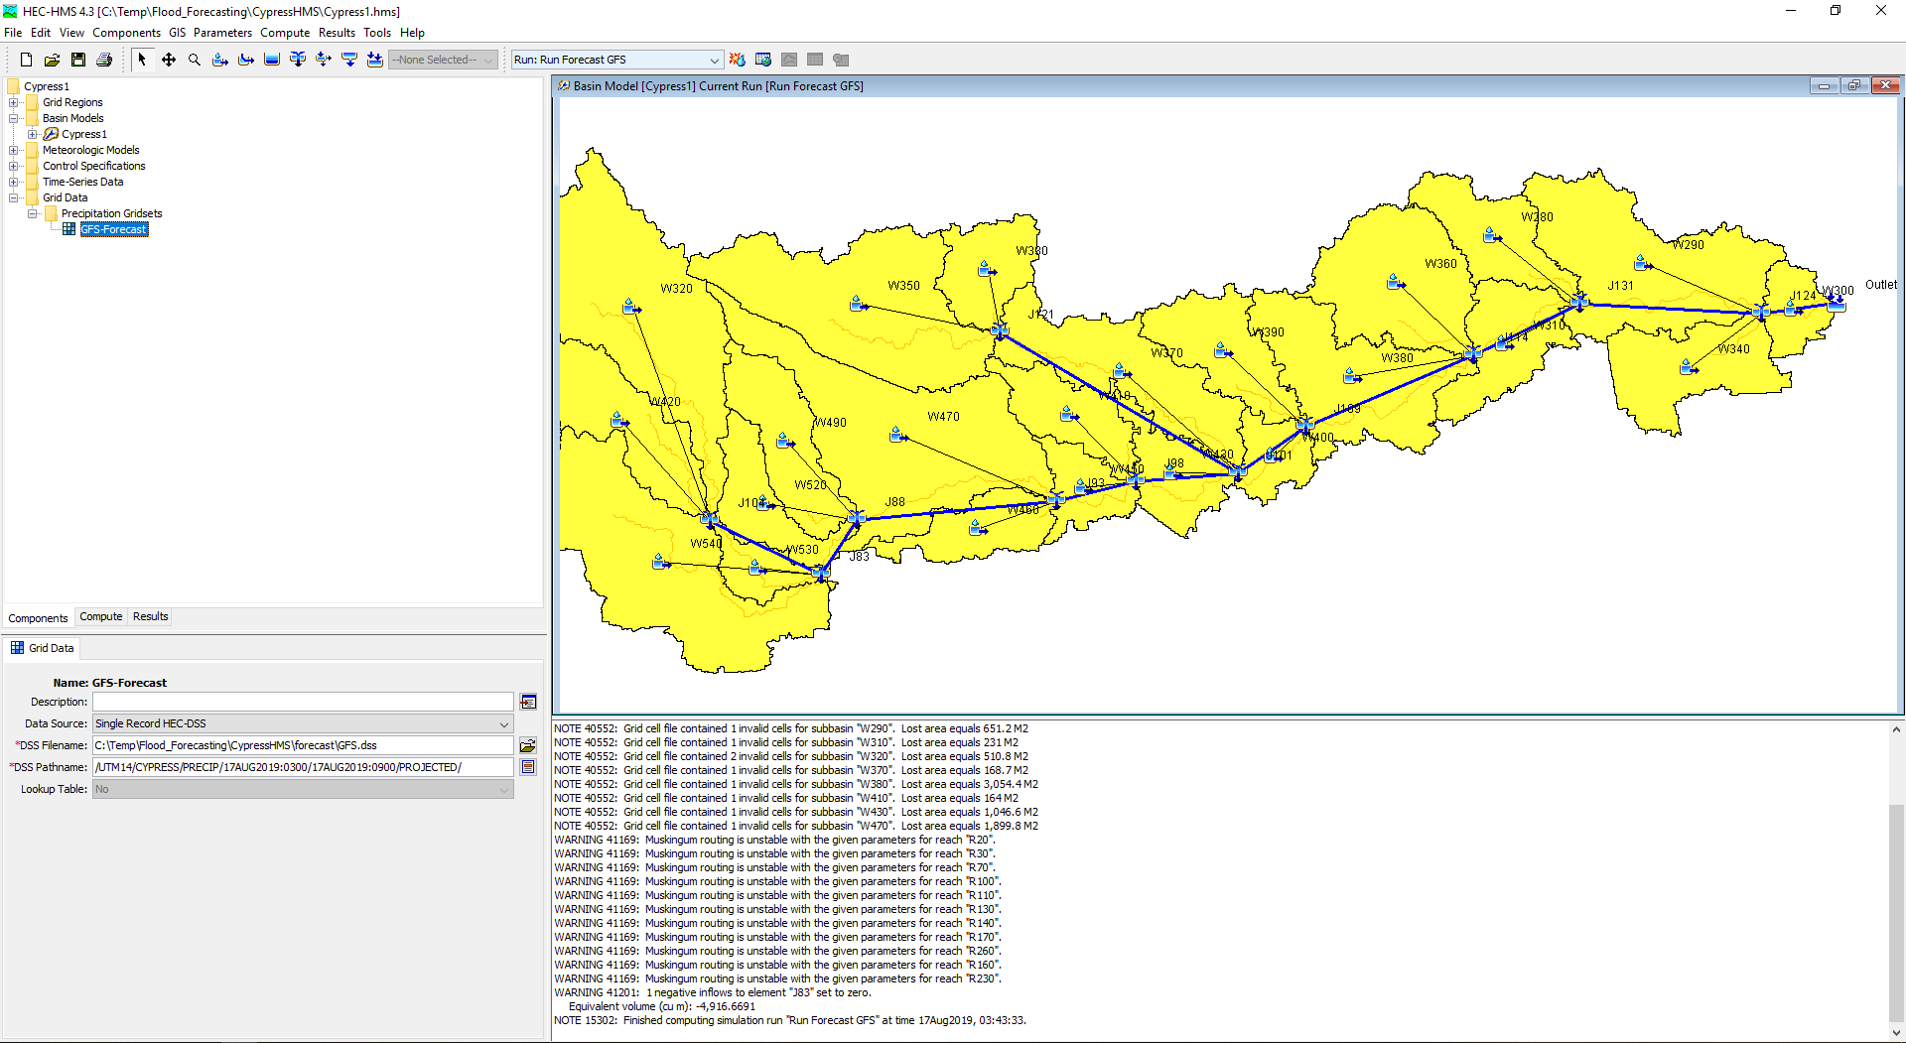
Use the .dss file in HEC-HMS 4.3

Slide 13
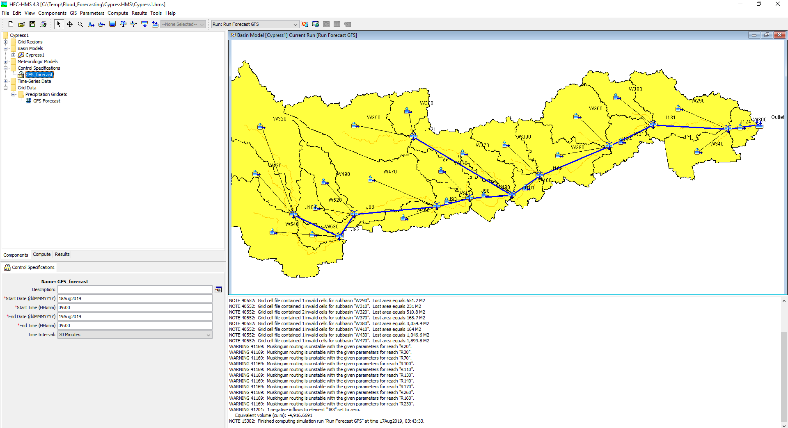
Make sure time simulation is within the GFS.dss time range in HEC-HMS 4.3

Slide 14
