Slide 1
Campus rides app
Artur cabral
Computer science major
Advisor: dr. dostert

Slide 2

What is the campus rides app?
Campus Rides is an application that has the goal to connect Riders and Drivers on and off campus
Drivers offer rides and share details
Departure and Destination, Date & Time, Preferences, and Price
Riders look for rides and choose the best fit
Based on destination, price, and preferences of the ride
Campus is more connected, Drivers save gas money, and Riders save on expensive tickets

Slide 3
inspiration
“The inspiration for Campus Rides App came from a conversation with some friends and staff members about how complicated is for international students or students in general who do not own a car to get from school to the airport and nearby cities during school breaks. Since mobile development is part of my major, as of my research class, I decided to do an independent study on mobile applications development, and create an app to solve this problem.”
Artur Cabral

Slide 4








The process

Slide 5
background
Hypertext Markup Language
Structure “What does it mean?”
HTML
Cascading Style Sheets Presentation “What does it look like?”
CSS
JavaScript Behavior “What does it do?”
JS

Slide 6

Developing platform
Intel XDK is a developing platform that has all the capabilities necessary for developing mobile HTML5 apps, including Apache Cordova for Android, iOS, and Windows 10
Allows cross-platform developing, creating an easy and compatible application environment for Android, iOS, and Windows
Includes simulation and testing environments

Slide 7
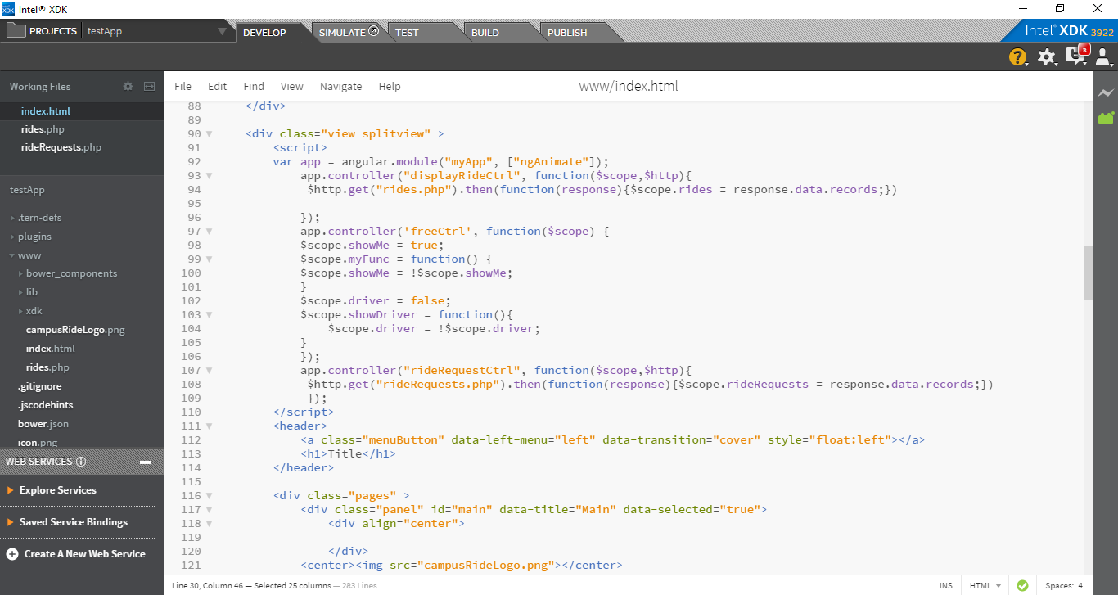
Developing Platform

Slide 8

One of the most modern JavaScript structural frameworks
Framework is a tool that provides specific functionalities to a programming language
Developed by Google
Allows the creation of single-page applications, using a modern, complex, responsive and scalable design
Mainly used in web and app development

Slide 9

Firebase is a mobile platform that helps you quickly develop high-quality apps, grow your user base, and earn more money. Firebase is made up of complementary features that you can mix-and-match to fit your needs.
Analytics – free unlimited analytics solution to see user behavior and measure attribution from a single dashboard
Develop – cloud messaging, authentication, real-time database, cloud storage, hosting, test lab, crash reporting
Grow – notifications, remote config, app indexing, dynamic links invites, AdWords

Slide 10
Functionalities
Create
Create an account with your school email
Find
Find Rides to take you places
Offer
Offer Rides to save gas money
Request
Request Rides that you need
Chat
Chat with the Driver to discuss details
Find
Find Rides “near me” for more convenience

Slide 11
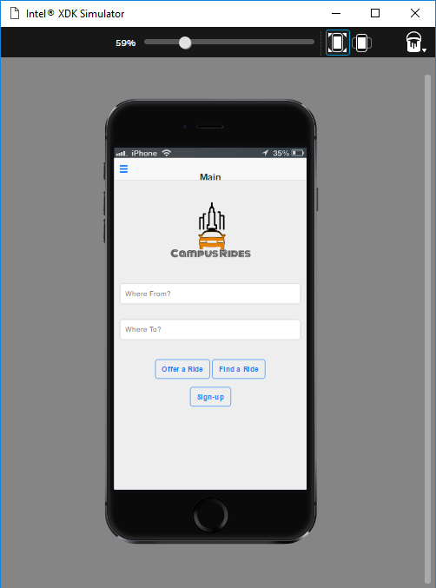
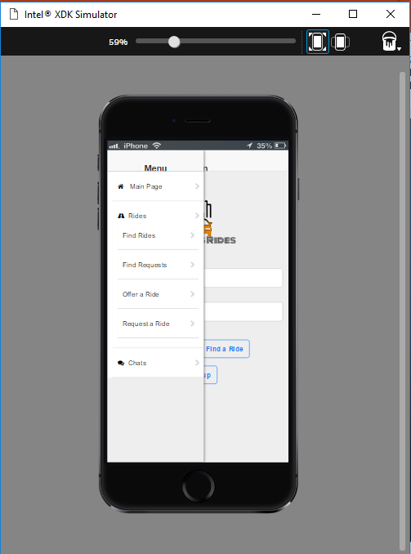
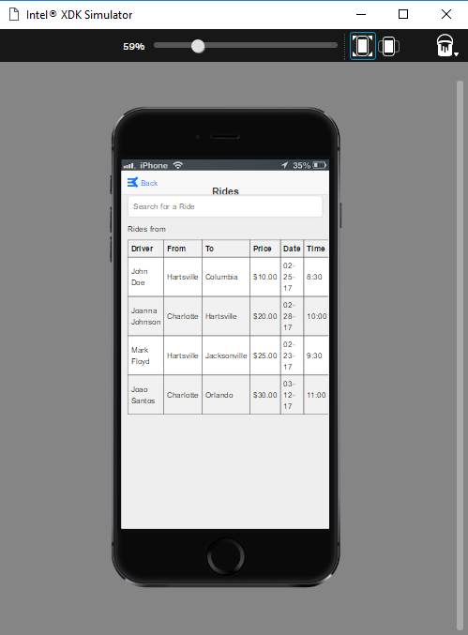
Simulation feature

Slide 12
Future work
Continue
Continue with Firebase implementation
Develop
Develop the chat and “near me” features
Improve
Improve the design and layout

Slide 13
Questions?

