Slide 1
ISTQB CERTIFIED TESTER FOUNDATION LEVEL V4.0

Slide 2
1. Fundamentals of Testing
1.1 What is testing
1.2 Why is testing Necessary
1.3 Testing Principles
1.4 Test Activities, Testware and Test Roles
1.5 Essential Skills and Good Practices in Testing

Slide 3
1.1 What is testing?
Software testing is a set of activities to discover defects and evaluate the quality of software artifacts. These artifacts, when being tested, are known as test objects. A common misconception about testing is that it only consists of executing tests (i.e., running the software and checking the test results). However, software testing also includes other activities and must be aligned with the software development lifecycle.

Slide 4
1.1.1 Test Objectives
• Evaluating work products such as requirements, user stories, designs, and code
• Causing failures and finding defects
• Ensuring required coverage of a test object
• Reducing the level of risk of inadequate software quality
• Verifying whether specified requirements have been fulfilled
• Verifying that a test object complies with contractual, legal, and regulatory requirements
• Providing information to stakeholders to allow them to make informed decisions
• Building confidence in the quality of the test object
• Validating whether the test object is complete and works as expected by the stakeholders

Slide 5
1.1.2 Testing and Debugging
Tests may show failures caused by defects in the software
Debugging is the development activity that finds, analyzes and
corrects defects

Slide 6
1.2 Why is Testing Necessary?
Testing, as a form of quality control, helps in achieving the agreed upon goals within the set scope, time, quality, and budget constraints.

Slide 7
1.2.1 Testing’s Contributions to Success
Testing provides a cost-effective means of detecting defects.
Testing provides a means of directly evaluating the quality of a test object at various stages in the SDLC.
Testing provides users with indirect representation on the development project. Testers ensure that their understanding of users’ needs are considered throughout the development lifecycle.

Slide 8
1.2.2 Testing and Quality Assurance (QA)
QC is a product-oriented, corrective approach that focuses on those activities supporting the achievement of appropriate levels of quality. Testing is a major form of quality control, while others include formal methods (model checking and proof of correctness), simulation and prototyping.
QA is a process-oriented, preventive approach that focuses on the implementation and improvement of processes. It works on the basis that if a good process is followed correctly, then it will generate a good product. QA applies to both the development and testing processes, and is the responsibility of everyone on a project.

Slide 9
1.2.3 Errors, Defects, Failures, and Root Causes
A person can make a mistake that can lead to the introduction of a defect in the software.
If a piece of code that contains a defect is executed, this can cause a crash.
A root cause is a fundamental reason for the occurrence of a problem.

Slide 10
1.3 Testing Principles
A number of testing principles offering general guidelines applicable to all testing have been suggested over the years. This syllabus describes seven such principles.
1. Testing shows the presence, not the absence of defects. Testing can show that defects are present in the test object, but cannot prove that there are no defects.
2. Exhaustive testing is impossible. Testing everything is not feasible except in trivial cases.
3. Early testing saves time and money. Defects that are removed early in the process will not cause subsequent defects in derived work products.
4. Defects cluster together. A small number of system components usually contain most of the defects.
5. Tests wear out. If the same tests are repeated many times, they become increasingly ineffective in detecting new defects.
6. Testing is context dependent. Testing is done differently in different contexts.
7. Absence-of-defects fallacy. It is a fallacy to expect that software verification will ensure the success of a system.

Slide 11
1.4 Test Activities, Testware and Test Roles
Testing is context dependent, but, at a high level, there are common sets of test activities without which testing is less likely to achieve test objectives.
1.4.1. Test Activities and Tasks
Test planning consists of defining the objectives of the test and then selecting the approach that best achieves the objectives.
Test analysis: Test monitoring involves the ongoing checking of all test activities and the comparison of actual progress against the plan.
Test design: It includes the elaboration of test conditions in test cases, the identification of coverage elements, test cases. Test design It also includes defining test data requirements, designing the test environment, and identifying any other necessary infrastructure and tools.
Test implementation: Includes creating or acquiring the testware necessary for test execution.
Test execution: Includes running the tests in accordance with the test execution schedule. Test execution may be manual or automated. Actual test results are compared with the expected results.
Test completion: Activities usually occur at project milestones.

Slide 12
1.4.2. Test Process in Context
The testing process will vary depending on the business context in which we find ourselves and the factors may be the following.
• Stakeholders
• Team members
• Business domain
• Technical factors
• Project constraints
• Organizational factors
• Software development lifecycle
• Tools

Slide 13
1.4.3. Testware
Test planning work products
Test plan, test schedule, risk register, and entry and exit criteria.
Test monitoring and control work products
Test progress reports, documentation of control directives and risk information.
Test analysis work products
Test conditions and acceptance criteria.
Test design work products
Test cases, test charters, coverage items, test data requirements and test environment requirements.
Test implementation work products
Test procedures, automated test scripts, test suites, test data, test execution schedule, and test environment elements.
Test execution work products
Test logs, and defect reports.
Test completion work products
Test completion report, action items for improvement of subsequent projects or iterations, documented lessons learned, and change requests.

Slide 14
1.4.4. Traceability between the Test Basis and Testware
In order to implement effective test monitoring and control, it is important to establish and maintain traceability throughout the test process between the test basis elements, testware associated with these elements, test results, and detected defects.
Examples
• Traceability of test cases to requirements can verify that the requirements are covered by test cases.
• Traceability of test results to risks can be used to evaluate the level of residual risk in a test object.

Slide 15
1.4.5. Roles in Testing
Test management role
The test management role oversees the test process, team, and activities, focusing on planning, monitoring, control, and completion. Its execution varies by context; in Agile, some tasks may be handled by the team, while others by external managers for broader scope.
Testing role
The testing role takes overall responsibility for the engineering (technical) aspect of testing. The testing role is mainly focused on the activities of test analysis, test design, test implementation and test execution.

Slide 16
1.5 Essential Skills and Good Practices in Testing
Skill is the ability to do something well that comes from one’s knowledge
1.5.1. Generic Skills Required for Testing
• Testing knowledge
• Thoroughness, carefulness, curiosity, attention to details, being methodical
• Good communication skills, active listening, being a team player
1.5.2. Whole Team Approach
One of the important skills for a tester is the ability to work effectively in a team context and to contribute positively to the team goals.
In the whole-team approach any team member with the necessary knowledge and skills can perform any task, and everyone is responsible for quality.
The whole team approach improves team dynamics, enhances communication and collaboration within the team, and creates synergy by allowing the various skill sets within the team to be leveraged for the benefit of the project.

Slide 17
1.5.3. Independence of Testing
Benefits
Different Perspectives
Independent testers offer varied backgrounds, technical viewpoints, and biases compared to developers. This aids in uncovering different types of failures and defects that developers might overlook.
Verification and Challenge
Independent testers can verify, challenge, or refute assumptions made by stakeholders during system specification and implementation. This ensures the system meets required standards and functionalities.
Drawbacks
Isolation
Independent testers may become isolated from the development team, leading to collaboration and communication issues. This could foster an adversarial relationship between testing and development teams.
Loss of Responsibility
Developers may lose a sense of responsibility for code quality if testing is completely independent. This could lower the overall product quality.
Perceived Bottlenecks
Independent testers may be viewed as hindrances in the development process, especially if product release is delayed. They may be unfairly blamed for these delays.

Slide 18
2. Testing Throughout the Software Development Lifecycle
2.1 Testing in the Context of a Software Development Lifecycle
A software development lifecycle (SDLC) model is an abstract, high-level representation of the software development process. A SDLC model defines how different development phases and types of activities performed within this process relate to each other, both logically and chronologically.
2.1.1. Impact of the Software Development Lifecycle on Testing
Testing must be adapted to the SDLC to succeed. The choice of the SDLC impacts on the:
• Scope and timing of test activities (e.g., test levels and test types).
• Level of detail of test documentation.
• Choice of test techniques and test approach.
• Extent of test automation.
• Role and responsibilities of a tester.

Slide 19
2.1.2. Software Development Lifecycle and Good Testing Practices
• For every software development activity, there is a corresponding test activity, so that all development activities are subject to quality control.
• Different test levels (see chapter 2.2.1) have specific and different test objectives, which allows for testing to be appropriately comprehensive while avoiding redundancy.
• Test analysis and design for a given test level begins during the corresponding development phase of the SDLC, so that testing can adhere to the principle of early testing (see section 1.3).
• Testers are involved in reviewing work products as soon as drafts of this documentation are available, so that this earlier testing and defect detection can support the shift-left strategy (see section 2.1.5).

Slide 20
2.1.3. Testing as a Driver for Software Development
Acceptance Test-Driven Development (ATDD).
Test-Driven Development (TDD).
Behavior-Driven Development (BDD).
2.1.4. DevOps and Testing
Promotes team autonomy, fast feedback, integrated toolchains, and technical practices like continuous integration (CI) and continuous delivery (CD).
• Fast feedback.
• Promotes automated processed.
• Reduces the need for repetitive manual testing.
2.1.5. Shift-Left Approach
Where testing is performed earlier in the SDLC.
• Reviewing the specification from the perspective of testing.
• Writing test cases before the code.
• Using CI and CD.
• Static analysis.
• Perform non-functional testing early.

Slide 21
2.1.6. Retrospectives and Process Improvement
It is usually celebrated as a project milestone, an iteration, or a set period of time.
• What was successful, and should be retained?
• What was not successful and could be improved?
• How to incorporate the improvements and retain the successes in the future?

Slide 22
2.2 Test Levels and Test Types
2.2.1 Test levels
Test levels are groups of test activities that are organized and managed together. Each test level is an instance of the test process, performed in relation to software at a given stage of development, from individual components to complete systems or, where applicable, systems of systems.
• Component testing.
Focuses on testing components in isolation.
• Component integration testing.
Focuses on testing the interfaces and interactions between components.
• System testing.
focuses on the overall behavior and capabilities of an entire system or product.
• System integration testing.
focuses on testing the interfaces of the system under test and other systems and external services.
• Acceptance testing.
Focuses on validation and on demonstrating readiness for deployment, which means that the system fulfills the user’s business needs.

Slide 23
2.2.2 Test types
Test types are groups of test activities related to specific quality characteristics and most of those test activities can be performed at every test level.
Functional testing.
Evaluates the functions that a component or system should perform. The functions are “what” the test object should do.
Non-functional testing.
Evaluates attributes other than functional characteristics of a component or system. Non-functional testing is the testing of “how well the system behaves”.
Black-box testing.
Is specification-based and derives tests from documentation external to the test object. The main objective of black-box testing is checking the system's behavior against its specifications.
White-box testing.
Structure-based and derives tests from the system's implementation or internal structure (e.g., code, architecture, workflows, and data flows).

Slide 24
2.2.3 Confirmation Testing and Regression Testing
They are tests associated with changes. Typically, changes are made to a component or system to improve it by adding a new feature or to solve it by eliminating a defect.
Confirmation testing.
Confirms that an original defect has been successfully fixed.
Regression testing.
Confirms that no adverse consequences have been caused by a change, including a fix that has already been confirmation tested. These adverse consequences could affect the same component where the change was made, other components in the same system, or even other connected systems.

Slide 25
2.3 Maintenance Testing
They are tests of changes to an operating system or the impact of a modified environment to an operating system.
The scope of maintenance testing typically depends on.
• The degree of risk of the change.
• The size of the existing system.
• The size of the change.
The triggers for maintenance and maintenance testing can be classified as follows.
• Modifications.
• Corrective changes.
• Upgrades.
• Migrations.
• Retirement.

Slide 26
3. Static Testing
3.1 Static Testing Basics
Not require running testable software.
3.1.1. Work Products Examinable by Static Testing
Almost any work product can be examined using static testing.
specification documents
source code
test plans
test cases
product backlog items
3.1.2. Value of Static Testing
Static testing can detect defects in the earliest phases of the SDLC.
identify defects which cannot be detected by dynamic testing.
Static testing provides the ability to evaluate the quality of, and to build confidence in work products.

Slide 27
3.1.3. Differences between Static Testing and Dynamic Testing
There are some defect types that can only be found by either static or dynamic testing.
Static testing finds defects directly, while dynamic testing causes failures.
Static testing may more easily detect defects that lay on paths through the code.
Static testing can be applied to non-executable work products, while dynamic testing can only be applied to executable work products

Slide 28
3.2 Feedback and Review Process
3.2.1. Benefits of Early and Frequent Stakeholder Feedback
Can prevent misunderstandings about requirements and ensure that changes to requirements are understood and implemented earlier.
Detect the parts of the system that represent the greatest value.
Review possible areas of risk and impact.

Slide 29
3.2.2. Review Process Activities
• Planning:
Scope, purpose, criteria, standards, efforts and deadlines.
• Review initiation:
Every participant has access to the work product under review, understands their role and responsibilities and receives everything needed to perform the review.
• Individual review:
Every reviewer performs an individual review to assess the quality of the work product under review, and to identify anomalies, recommendations, and questions.
• Communication and analysis:
For every anomaly, the decision should be made on its status, ownership and required actions.
• Fixing and reporting.
Corrective actions are applied. Once the exit criteria are reached, the work product can be accepted. The review results are reported.

Slide 30
3.2.3. Roles and Responsibilities in Reviews
• Author
Creates and fixes the work product under review.
• Manager
Decides what is to be reviewed and provides resources.
• Moderator
Ensures the effective running of review meetings.
• Scribe
Records review information.
• Reviewer
Performs reviews.
• Review leader
Takes overall responsibility for the review.

Slide 31
3.2.4. Review Types
• Informal review
Informal reviews do not follow a defined process and do not require a formal documented output.
• Walkthrough
Which is led by the author. Evaluate quality and improve trust. Educate reviewers, earn consensus, generating new ideas, motivating and training.
• Technical Review
A technical review is performed by technically qualified reviewers and led by a moderator.
• Inspection
It is the most formal type of review. Metrics are collected and used to improve the SDLC, including the inspection process.

Slide 32
3.2.5. Success Factors for Reviews
Clear objectives and measurable exit criteria.
Choose the appropriate type of review according to the needs and context of the project.
Providing feedback from reviews to stakeholders.
Support from management for the review process.
Providing adequate training for all participants.
Facilitating meetings.

Slide 33
4. Test Analysis and Design
4.1 Test Techniques Overview
Test techniques support the tester in test analysis (what to test) and in test design (how to test).
Test techniques also help the tester to define test conditions, identify coverage items, and identify test data during the test analysis and design.

Slide 34
4.2 Black-Box Test Techniques
Are based on an analysis of the specified behavior of the test object without reference to its internal structure.
4.2.1. Equivalence Partitioning
Equivalence partitioning divides software testing input data into two fields: valid and invalid inputs. The values within each partition should cause the software to display the same behavior.
If a test case, that tests one value from an equivalence partition, detects a defect, this defect should also be detected by test cases that test any other value fromthe same partition. Therefore, one test for each partition is sufficient.

Slide 35
4.2.2. Boundary Value Analysis
Is a technique based on exercising the boundaries of equivalence partitions. The minimum and maximum values of a partition are its boundary values.
Typical defects found by BVA are located where implemented boundaries are misplaced to positions above or below their intended positions or are omitted altogether.

Slide 36
4.2.3. Decision Table Testing
Decision tables are used for testing the implementation of system requirements that specify how different combinations of conditions result in different outcomes. Decision tables are an effective way of recording complex logic, such as business rules. When creating decision tables, the conditions and the resulting actions of the system are defined.
When creating decision tables, the conditions and the resulting actions of the system are defined.

Slide 37
4.2.4. State Transition Testing
A state transition diagram models the behavior of a system by showing its possible states and valid state transitions. A transition is initiated by an event, which may be additionally qualified by a guard condition.
A test case based on a state transition diagram or state table is usually represented as a sequence of events, which results in a sequence of state changes.

Slide 38
4.3 White-Box Test Techniques
Are based on an analysis of the test object’s internal structure and processing.
4.3.1. Statement Testing and Statement Coverage
The aim is to design test cases that exercise statements in the code until an acceptable level of coverage is achieved.
Coverage is measured as the number of statements exercised by the test cases divided by the total number of executable statements in the code, and is expressed as a percentage.

Slide 39
4.3.2. Branch Testing and Branch Coverage
A branch is a transfer of control between two nodes in the control flow graph, which shows the possible sequences in which source code statements are executed in the test object.
In branch testing the coverage items are branches and the aim is to design test cases to exercise branches in the code until an acceptable level of coverage is achieved.
Coverage is measured as the number of branches exercised by the test cases divided by the total number of branches, and is expressed as a percentage.
4.3.3. The Value of White-box Testing
Facilitates defect detection even when the software specification is vague, outdated or incomplete.

Slide 40
4.4 Experience-based Test Techniques
Effectively use the knowledge and experience of testers for the design and implementation of test cases. The effectiveness of these techniques depends heavily on the tester’s skills.
4.4.1. Error Guessing
Anticipate the occurrence of errors, defects, and failures.
• How the application has worked in the past.
• The types of errors the developers tend to make and the types of defects that result from these errors.
• The types of failures that have occurred in other, similar applications.

Slide 41
4.4.2. Exploratory Testing
Tests are simultaneously designed, executed, and evaluated while the tester learns about the test object.
Is conducted within a defined time-box.
Session-based testing.
Exploratory testing is useful when there are few or inadequate specifications or there is significant time pressure on the testing.
4.4.3. Checklist-Based Testing
In checklist-based testing, a tester designs, implements, and executes tests to cover test conditions from a checklist.
Checklists can be created to support various test types, including functional and non-functional testing.

Slide 42
4.5 Collaboration-based Test Approaches
Avoid defects through collaboration and communication.
4.5.1. Collaborative User Story Writing
The most common format for a user story is “As a [role], I want [goal to be accomplished], so that I can[resulting business value for the role]”, followed by the acceptance criteria. User stories have three critical aspects.
Card
The medium describing a user story.
Conversation
Explains how the software will be used.
Confirmation
The acceptance criteria.

Slide 43
4.5.2. Acceptance Criteria
Acceptance criteria for a user story are the conditions that an implementation of the user story must meet to be accepted by stakeholders.
• Define the scope of the user story.
• Reach consensus.
• Describe scenarios.
• Accurate planning and estimation.

Slide 44
4.5.3. Acceptance Test-driven Development (ATDD)
ATDD is a test-first approach. Test cases are created prior to implementing the user story. Criteria are analyzed, discussed, and written by the team members.
The test cases are based on the acceptance criteria and can be seen as examples of how the software works.

Slide 45
5. Managing the Test Activities
5.1.1. Purpose and Content of a Test Plan
Purpouse
• Documents the means and schedule for achieving test objectives.
• Helps to ensure that the performed test activities will meet the established criteria.
• Serves as a means of communication with team members and other stakeholders.
• Demonstrates that testing will adhere to the existing test policy and test strategy.
Content
• Context of testing (e.g., scope, test objectives, constraints, test basis).
• Assumptions and constraints of the test project.
• Stakeholders.
• Communication.
• Risk register.
• Test approach.
• Budget and schedule.

Slide 46
5.1.2. Tester's Contribution to Iteration and Release Planning
Iteration planning.
Iteration planning looks ahead to the end of a single iteration and is concerned with the iteration backlog.
Release planning.
Release planning looks ahead to the release of a product, defines and re-defines the product backlog, and may involve refining larger user stories into a set of smaller user stories.
It also serves as the basis for the test approach and test plan across all iterations.

Slide 47
5.1.3. Entry Criteria and Exit Criteria
Entry criteria define the preconditions for undertaking a given activity.
Exit criteria define what must be achieved in order to declare an activity completed.
Examples: people, tools, environments, test data, budget, time.
Exit criteria.
Examples: measures of thoroughness, achieved level of coverage, number of unresolved defects, defect density, number of failed test cases.

Slide 48
5.1.4. Estimation Techniques
Test effort estimation involves predicting the amount of test-related work needed to meet the objectives of a test project.
Estimation based on ratios.
In this metrics-based technique, figures are collected from previous projects within the organization, which makes it possible to derive “standard” ratios for similar projects.
In this metrics-based technique, figures are collected from previous projects within the organization, which makes it possible to derive “standard” ratios for similar projects. The ratios of an organization’s own projects (e.g., taken from historical data) are generally the best source to use in the estimation process. These standard ratios can then be used to estimate the test effort for the new project.

Slide 49
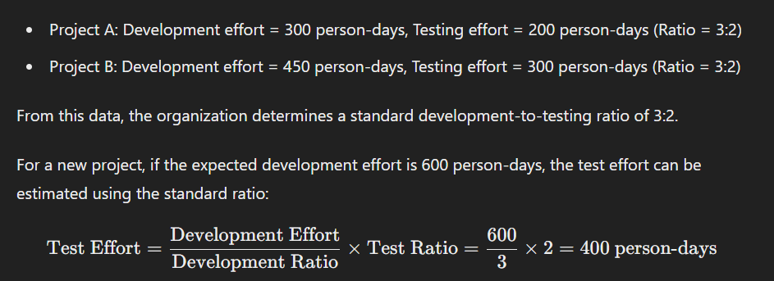
For example, if in the previous project the development-to-test effort ratio was 3:2, and in the current project the development effort is expected to be 600 person-days, the test effort can be estimated to be 400 person-days.

Slide 50

Extrapolation.
In this metrics-based technique, measurements are made as early as possible in the current project to gather the data.
In this metrics-based technique, measurements are made as early as possible in the current project to gather the data. Having enough observations, the effort required for the remaining work can be approximated by extrapolating this data (usually by applying a mathematical model). This method is very suitable in iterative SDLCs. For example, the team may extrapolate the test effort in the forthcoming iteration as the averaged effort from the last three iterations.
Iteration 1: 50 hours
Iteration 2: 55 hours
Iteration 3: 52 hours
To estimate the effort needed for the upcoming iteration, the team can calculate the average effort from the last three iterations:

Slide 51
Wideband Delphi.
Experts make experience-based estimations.
In this iterative, expert-based technique, experts make experience-based estimations. Each expert, in isolation, estimates the effort. The results are collected and if there are deviations that are out of range of the agreed upon boundaries, the experts discuss their current estimates. Each expert is then asked to make a new estimation based on that feedback, again in isolation. This process is repeated until a consensus is reached. Planning Poker is a variant of Wideband Delphi, commonly used in Agile software development. In Planning Poker, estimates are usually made using cards with numbers that represent the effort size.

Slide 52
Three-point estimation.
In this expert-based technique, three estimations are made by the experts: the most optimistic estimation (a), the most likely estimation (m) and the most pessimistic estimation (b).
In the most popular version of this technique, the estimate is calculated as E = (a + 4*m + b) / 6. The advantage of this technique is that it allows the experts to calculate the measurement error: SD = (b – a) / 6. For example, if the estimates (in personhours) are: a=6, m=9 and b=18, then the final estimation is 10±2 person-hours (i.e., between 8 and 12 person-hours), because E = (6 + 4*9 + 18) / 6 = 10 and SD = (18 – 6) / 6 = 2.

Slide 53
5.1.5. Test Case Prioritization
They can be organized into a test execution schedule that defines the order in which they will be executed.
• Risk-based prioritization
Test cases covering the most important risks are executed first.
• Coverage-based prioritization
the test case achieving the highest coverage is executed first.
• Requirements-based prioritization
Test cases related to the most important requirements are executed first.

Slide 54
5.1.6. Test Pyramid
The test pyramid is a model showing that different tests may have different granularity.
The pyramid layers represent groups of tests.
The higher the layer, the lower the test granularity, test isolation and test execution time.
The top layer represents complex, high-level, end-to-end tests.
Tests in the bottom layer are small, isolated, fast, and check a small piece offunctionality, so usually a lot of them are needed to achieve a reasonable coverage.

Slide 55
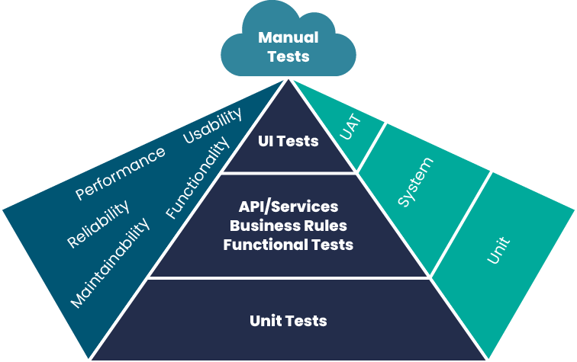

Slide 56
5.1.7. Testing Quadrants
Group the test levels with the appropriate test types, activities, test techniques and work products in the Agile software development.
In this model, tests can be business facing or technology facing. Tests can also support the team (i.e., guide the development) or critique the product (i.e., measure its behavior against the expectations). The combination of these two viewpoints determines the four quadrants:

Slide 57
Q1 (technology facing, support the team).
This quadrant contains component and component integration tests. These tests should be automated and included in the CI process.
Q2 (business facing, support the team)
This quadrant contains functional tests, examples, user story tests, user experience prototypes, API testing, and simulations. These tests check the acceptance criteria and can be manual or automated.
Q3 (business facing, critique the product)
This quadrant contains exploratory testing, usability testing, user acceptance testing. These tests are user-oriented and often manual.
Q4 (technology facing, critique the product)
This quadrant contains smoke tests and non-functional tests (except usability tests). These tests are often automated.

Slide 58
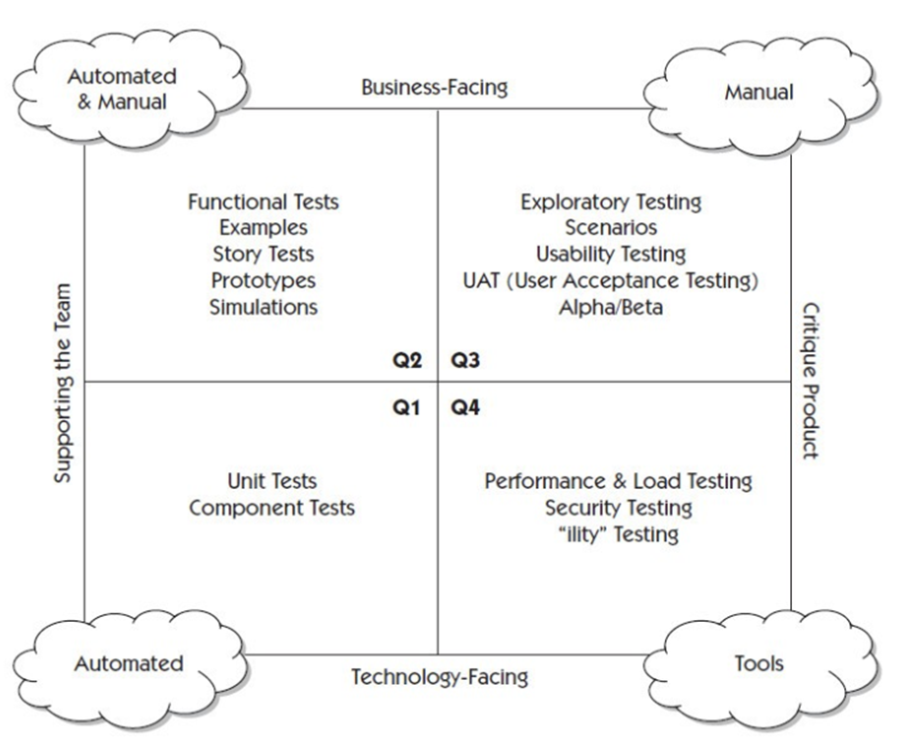

Slide 59
5.2 Risk Management
Risk management allows the organizations to increase the likelihood of achieving objectives, improve the quality of their products and increase the stakeholders confidence and trust.
• Risk analysis.
Consisting of risk identification and risk assessment.
• Risk control.
Consisting of risk mitigation and risk monitoring.
5.2.1. Risk Definition and Risk Attributes
Risk is a potential event, hazard, threat, or situation whose occurrence causes an adverse effect.
• Risk likelihood.
The probability of the risk occurrence.
• Risk impact.
The consequences of this occurrence.

Slide 60
5.2.2. Project Risks and Product Risks
• Project Risks.
• Organizational issues.
• People issues.
• Technical issues.
• Supplier issues.
• Product Risks.
• Missing or wrong functionality.
• Incorrect calculations.
• Runtime errors.
• Poor architecture.
• Inefficient algorithms.
• Poor user experience.
• Security vulnerabilities.

Slide 61
5.2.3. Product Risk Analysis
From a testing perspective, the goal of product risk analysis is to provide an awareness of product risk in order to focus the testing effort in a way that minimizes the residual level of product risk. Product risk analysis consists of risk identification and risk assessment.
These analyzes help us determine
• The scope of testing to be carried out.
• The particular test levels and propose test types to be performed.
• The test techniques to be employed and the coverage to be achieved.
• The test effort required for each task.
• Prioritize testing in an attempt to find the critical defects as early as possible.
• Whether any activities in addition to testing could be employed to reduce risk.

Slide 62
5.2.4. Product Risk Control
Risk mitigation involves implementing the actions proposed in risk assessment to reduce the risk level.
• Conduct reviews and perform static analysis.
• Apply the appropriate test techniques and coverage levels.
• Select the testers with the right level of experience and skills, suitable for a given risk type.
• Apply an appropriate level of independence of testing.
• Perform dynamic testing, including regression testing.
• Apply the appropriate test types addressing the affected quality characteristics.
The aim of risk monitoring is to ensure that the mitigation actions are effective.

Slide 63
5.3 Test Monitoring, Test Control and Test Completion
Test monitoring is concerned with gathering information about testing. This information is used to assess test progress and to measure whether the test exit criteria.
5.3.1. Metrics used in Testing
Test metrics are gathered to show progress against the planned schedule and budget, the current quality of the test object, and the effectiveness of the test activities with respect to the objectives or an iteration goal.
• Project progress metrics.
• Test progress metrics.
• Product quality metrics.
• Defect metrics.
• Risk metrics.
• Coverage metrics.
• Cost metrics.

Slide 64
5.3.2. Purpose, Content and Audience for Test Reports
Test reporting summarizes and communicates test information during and after testing. Test progress reports support the ongoing control of the testing and must provide enough information to make modifications to the test schedule, resources, or test plan, when such changes are needed.
Test progress reports
• Test period.
• Test progress.
• Impediments for testing, and their workarounds.
• Test metrics.
• New and changed risks within testing period.
• Testing planned for the next period.
Test completion report.
• Test summary.
• Testing and product quality evaluation based on the original test plan.
• Testing impediments and workarounds.
• Test metrics based on test progress reports.
• Unmitigated risks, defects not fixed.
• Lessons learned that are relevant to the testing.

Slide 65
5.3.3. Communicating the Status of Testing
• Verbal communication with team members and other stakeholders.
• Dashboards.
• Electronic communication channels.
• Online documentation.
• Formal test reports.

Slide 66
5.4 Configuration Management
In testing, configuration management (CM) provides a discipline for identifying, controlling, and tracking work products such as test plans, test strategies, test conditions, test cases, test scripts, test results, test logs, and test reports as configuration items. For a complex configuration item CM records the items it consists of, their relationships, and versions.
• All configuration items, including test items (individual parts of the test object), are uniquely identified, version controlled, tracked for changes, and related to other configuration items so that traceability can be maintained throughout the test process.
• All identified documentation and software items are referenced unambiguously in test documentation.

Slide 67
5.5 Defect Management
Since one of the major test objectives is to find defects, an established defect management process is essential.
Objetives.
• Provide those responsible for handling and resolving reported defects with sufficient information to resolve the issue.
• Provide a means of tracking the quality of the work product.
• Provide ideas for improvement of the development and test process.
Defect report structure.
• Unique identifier.
• Title with a short summary of the anomaly being reported.
• Date when the anomaly was observed, issuing organization, and author, including their role.
• Identification of the test object and test environment.
• Context of the defect.
Description of the failure to enable reproduction and resolution including the steps that detected the anomaly, and any relevant test logs, database dumps, screenshots, or recordings.
• Expected results and actual results.
• Severity of the defect on the interests of stakeholders or requirements.
• Priority to fix.
• Status of the defect.
• References.

Slide 68
6. Test Tools
6.1 Tool Support for Testing
• Management tools – increase the test process efficiency by facilitating management of the SDLC, requirements, tests, defects, configuration.
• Test design and implementation tools – facilitate generation of test cases, test data and test procedures.
• Test execution and coverage tools – facilitate automated test execution and coverage measurement.
• Non-functional testing tools – allow the tester to perform non-functional testing that is difficult or impossible to perform manually.
• DevOps tools – support the DevOps delivery pipeline, workflow tracking, automated build process(es), CI/CD.
• Collaboration tools – facilitate communication.
• Tools supporting scalability and deployment standardization (e.g., virtual machines, containerization tools).
• Any other tool that assists in testing (e.g., a spreadsheet is a test tool in the context of testing).

Slide 69
6.2 Benefits and Risks of Test Automation
Benefits.
• Time saved by reducing repetitive manual work (e.g., execute regression tests, re-enter the same test data, compare expected results vs actual results, and check against coding standards)
• Prevention of simple human errors through greater consistency and repeatability (e.g., tests are consistently derived from requirements, test data is created in a systematic manner, and tests are executed by a tool in the same order with the same frequency)
• More objective assessment (e.g., coverage) and providing measures that are too complicated for humans to derive
• Easier access to information about testing to support test management and test reporting (e.g., statistics, graphs, and aggregated data about test progress, defect rates, and test execution duration)
• Reduced test execution times to provide earlier defect detection, faster feedback and faster time to market
• More time for testers to design new, deeper and more effective tests

Slide 70
Risks.
• Unrealistic expectations about the benefits of a tool (including functionality and ease of use).
• Inaccurate estimations of time, costs, effort required to introduce a tool, maintain test scripts and change the existing manual test process.
• Using a test tool when manual testing is more appropriate.
• Relying on a tool too much, e.g., ignoring the need of human critical thinking.
• The dependency on the tool vendor which may go out of business, retire the tool, sell the tool to a different vendor or provide poor support (e.g., responses to queries, upgrades, and defect fixes).
• Using an open-source software which may be abandoned, meaning that no further updates are available, or its internal components may require quite frequent updates as a further development.
• The automation tool is not compatible with the development platform.
• Choosing an unsuitable tool that did not comply with the regulatory requirements and/or safety standards.

