Slide 1

Artur Castiel Renata Tavares
Intuitive Multilevel Preprocessor for Smart Simulation

Slide 2
Standard Direct Simulation
Fine-Scale Mesh
Custom Properties
Nodes
Examples
Nodes
Edges
Velocities
Edges
Faces
Faces
Volumes
Pressure
Volumes

Slide 3
Standard Direct Simulation
Fine-Scale Mesh
Nodes counted from 0 to n-1 :
M.nodes.all ; M.nodes.boundary, M.nodes.internal
M.nodes.flag ; M.nodes.all_flags ; M.nodes.all_flagged_elements
M.nodes.coords[:] - > M.nodes.coords[INPUT]
INPUT - > LIST , Numpy Array, Slice
M.nodes.bridge_adjacencies(index, interface, target)
Nodes
Edges
Faces
Volumes

Slide 4
Standard Direct Simulation
Fine-Scale Mesh
Edges counted from 0 to n-1 :
M.edges.all ; M.edges.boundary, M.edges.internal
M.edges.flag ; M.edges.all_flags ; M.edges.all_flagged_elements
M.edges.adjacencies[:] - > M.edges.adjacencies[INPUT]
INPUT - > LIST , Numpy Array, Slice
M.edges.connectivities[:] - > M.edges.adjacencies[INPUT]
INPUT - > LIST , Numpy Array, Slice
M.edges.bridge_adjacencies(index, interface, target)
Nodes
Edges
Faces
Volumes

Slide 5
Standard Direct Simulation
Fine-Scale Mesh
Edges counted from 0 to n-1 :
M.edges.all ; M.edges.boundary, M.edges.internal
M.edges.flag ; M.edges.all_flags ; M.edges.all_flagged_elements
M.edges.adjacencies[:] - > M.edges.adjacencies[INPUT]
INPUT - > LIST , Numpy Array, Slice
M.edges.connectivities[:] - > M.edges.adjacencies[INPUT]
INPUT - > LIST , Numpy Array, Slice
M.edges.center[:] - > M.edges.center[INPUT]
INPUT - > LIST , Numpy Array, Slice
M.edges.bridge_adjacencies(index, interface, target)
Nodes
Edges
Faces
Volumes

Slide 6
Standard Direct Simulation
Fine-Scale Mesh
Faces counted from 0 to n-1 :
M.faces.all ; M.faces.boundary, M.faces.internal
M.faces.flag ; M.faces.all_flags ; M.faces.all_flagged_elements
M.faces.adjacencies[:] - > M.faces.adjacencies[INPUT]
INPUT - > LIST , Numpy Array, Slice
M.faces.connectivities[:] - > M.faces.adjacencies[INPUT]
INPUT - > LIST , Numpy Array, Slice
M.faces.center[:] - > M.edges.center[INPUT]
INPUT - > LIST , Numpy Array, Slice
M.faces.bridge_adjacencies(index, interface, target)
Nodes
Edges
Faces
Volumes

Slide 7
Standard Direct Simulation
Fine-Scale Mesh
Faces counted from 0 to n-1 :
M.volumes.all ; M.volumes.boundary, M.volumes.internal
M.volumes.flag ; M.volumes.all_flags ; M.volumes.all_flagged_elements
M.volumes.adjacencies[:] - > M.volumes.adjacencies[INPUT]
INPUT - > LIST , Numpy Array, Slice
M.volumes.connectivities[:] - > M.volumes.adjacencies[INPUT]
INPUT - > LIST , Numpy Array, Slice
M.volumes.center[:] - > M.volumes.center[INPUT]
INPUT - > LIST , Numpy Array, Slice
M.volumes.bridge_adjacencies(index, interface, target)
Nodes
Edges
Faces
Volumes

Slide 8
Standard Direct Simulation
Fine-Scale Mesh
Custom Properties
Custom Properties
Nodes
self.flow = MoabVariableMS(self.core,data_size=3,var_type= "faces", data_format="float", name_tag="Flow")
self.pressure = MoabVariableMS(self.core,data_size=1,var_type= "volumes", data_format="float", name_tag="Pressure")
self.perm = MoabVariable(self.core,data_size= 3 ,var_type= "volumes", data_format="float", name_tag="Permeability")
Edges
Faces
Volumes

Slide 9
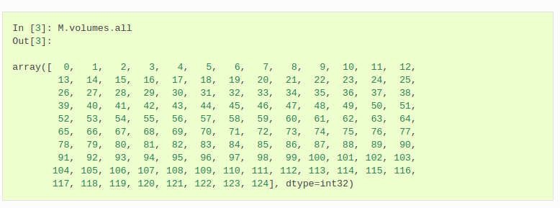
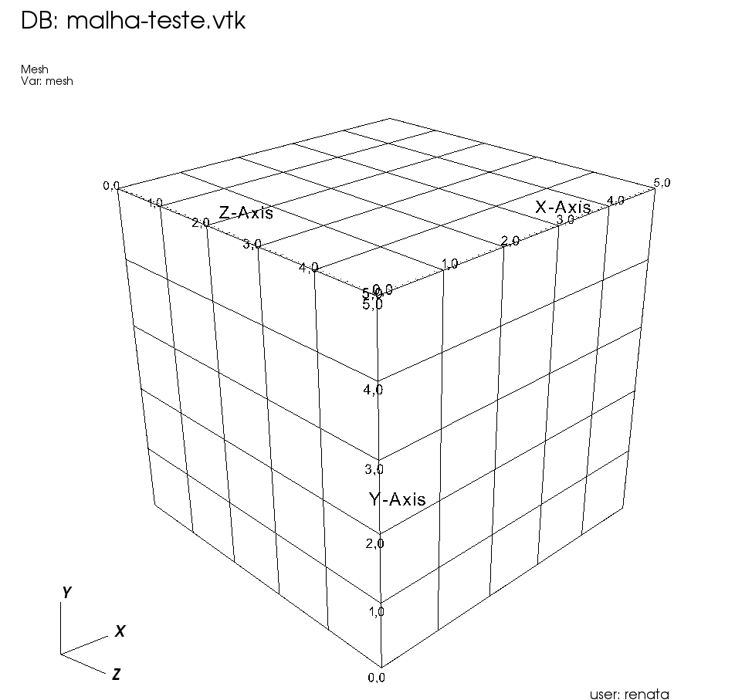
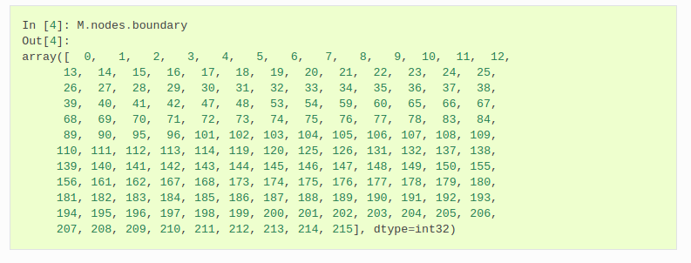
Standard Direct Simulation

Slide 10
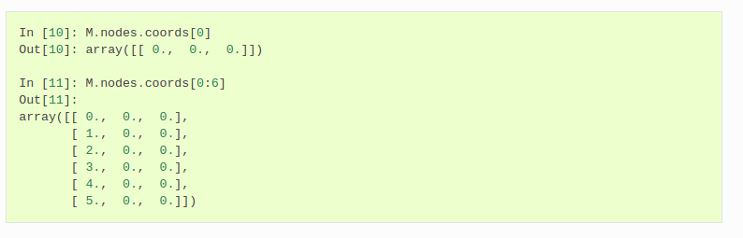
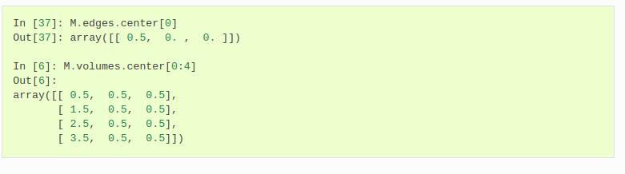
Standard Direct Simulation

Slide 11
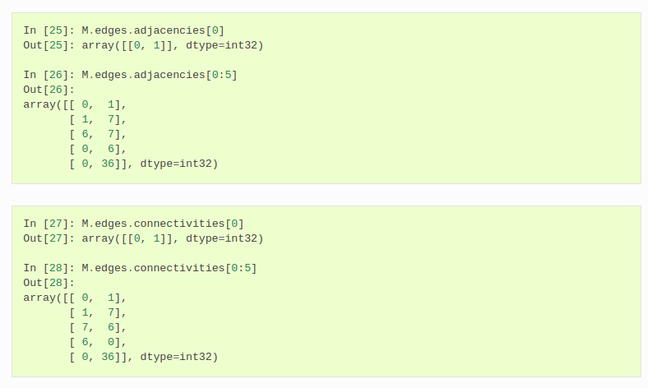
Standard Direct Simulation

Slide 12
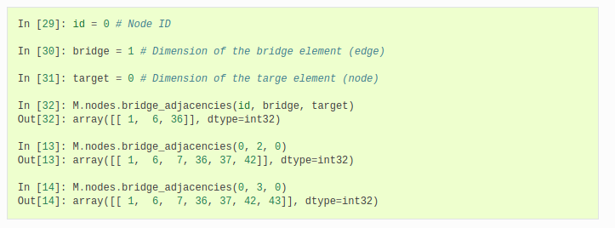

Standard Direct Simulation

Slide 13
Multilevel Simulation
Fine-Scale Mesh for Multiscale Simulation
Coarse Volumes
Nodes
Nodes
Coarse Volumes
Edges
Edges
Nodes
Faces
Edges
...
Faces
Faces
Volumes
Volumes
Volumes
Custom Properties
Custom Properties
Custom Properties

Slide 14
Multilevel Simulation
Fine-Scale Mesh for Multiscale Simulation

Slide 15
Multilevel Simulation
Fine-Scale Mesh for Multiscale Simulation
Coarse Volume 0
Coarse Volume 1
Coarse Volume 2
...

Slide 16
Multilevel Simulation
Fine-Scale Mesh for Multiscale Simulation
Coarse Volume 0
Coarse Volume 1
Coarse Volume 2
...
Coarse Volume 0
Coarse Volume 1
...
Coarse Volume 1
Coarse Volume 2

Slide 17
Multilevel Simulation
Fine-Scale Mesh for Multiscale Simulation
Coarse Volume 0
Coarse Volume 1
Coarse Volume 2
...
Coarse Volume 0
Coarse Volume 1
...
Coarse Volume 1
Coarse Volume 1
Coarse Volume 2
Coarse Volume 0
Coarse Volume 2
Coarse Volume 2
...

Slide 18
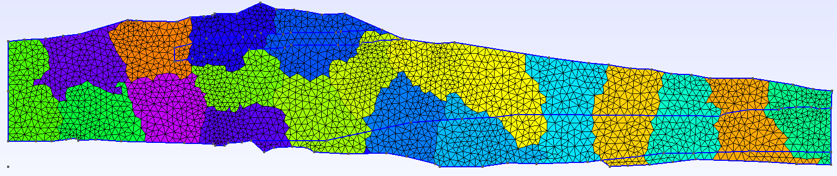
Multilevel Simulation
GMSH GEO FILE

Slide 19
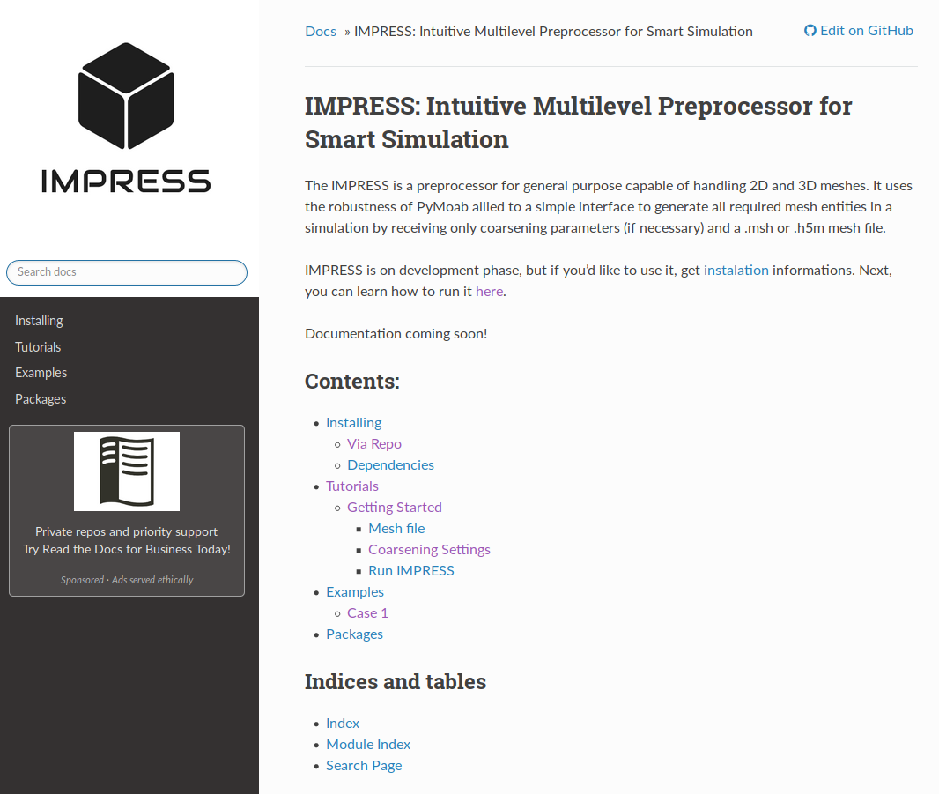
Let's get started!
Read the documentation!
https://impress-padmec.readthedocs.io/en/latest/

Slide 20
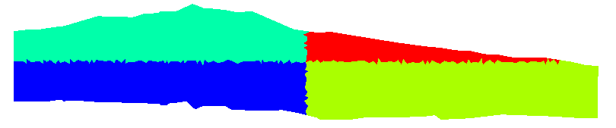

Multilevel Simulation
Geometric Paritition

Slide 21

Multilevel Simulation
Geometric Paritition

Slide 22
Artur Castiel Renata Tavares
Intuitive Multilevel Preprocessor for Smart Simulation

