Slide 1


Artur Castiel Reis de Souza This is an ADMIRE research group internal document and it is solely intended for evaluating the author's programming skills as part of the TNO recruitment process. TU Delft, Netherlands December 14, 2022
DARSim Beta Structure
29th February, 2024

Slide 2
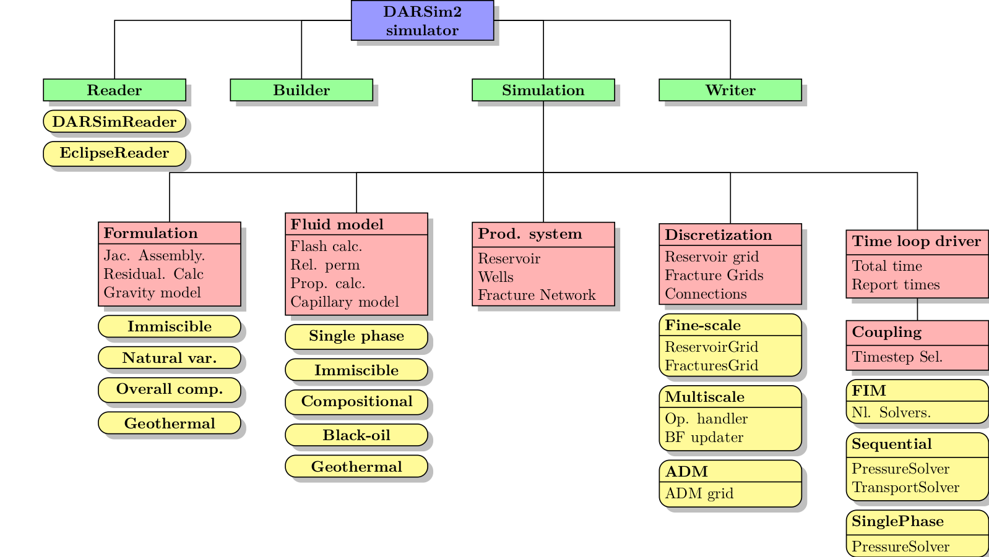


DARSim 2.0 (GITLAB) Structure
Up to DDARSim 2.0: Classes and objects are not clearly encapsulated.
Reader Class: Handles input file. Takes Builder as argument. Generate two main properties in the Builder – Simulation Input, Simulation Settings. There are a mixed of structs, strings, and built classes. Builder: Builder of the simulation . Uses the information Inputs. Takes Reader class as argument.
Simulation: Performs the simulation. Fairly organized but abstract. All the details need to come in a specific way from the builder.
Writer: Single class responsible for exporting VK files.
DARSim2 Simulator glues everything together . All objects are strongly coupled, and the way object communicate depend on the case.

Slide 3
DARSim 2.0 (GITLAB) Structure
DARSim’s Beta Outer Structure
How is a simulation object created?
What are the essential components?
How and where meshes, physics, and coupling are built?

Slide 4
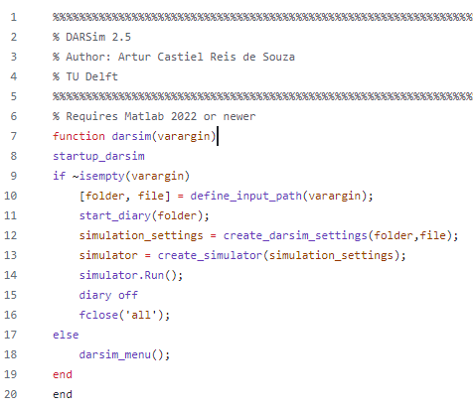
DARSim Beta Structure
Main DARSim Beta
startup_darsim : Starts up DARSim automatically. Avoid having to add the DARSim files manually like previous versions.
create_simulation_settings: Routines Structures that describe simulation settings. List of blueprints for the simulator factory.
create_simulator: Uses previous settings to create the simulation object.
(darsim_menu): Creates GUI that can be used to run simulation without having to write code.
Continuous Flow
1-Startup
2-Create Settings
3-Create Simulator
4-Run Simulation

Slide 5
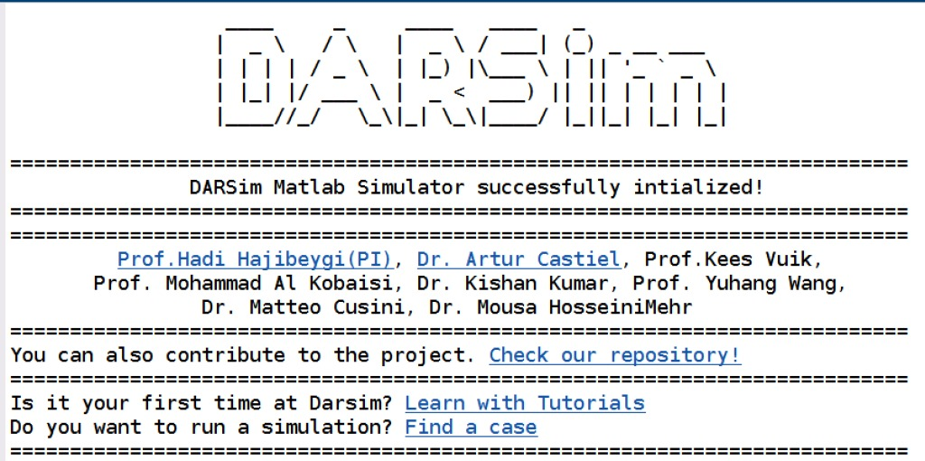
DARSim Beta Structure
How to run DARSim Beta?
Main DARSim Beta
Inside the SRC folder:
type darsim and use the text GUI.
Or type darsim(case_folder,case_input) to go to a specific case.
Main DARSim Beta
Startup
Read Settings
Create Simulation
Run Simulation
END

Slide 6
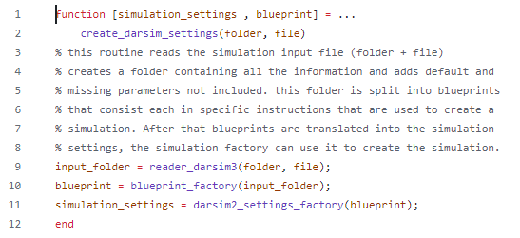
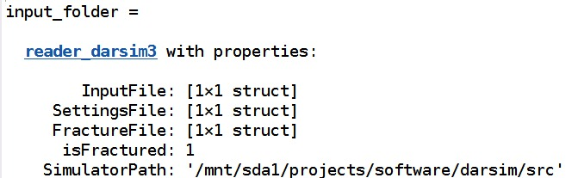
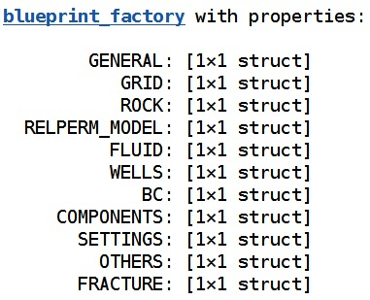
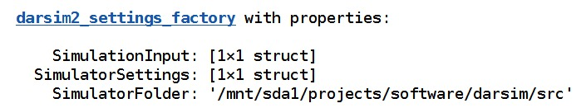
DARSim Beta Structure
reader_darsim3 : Reader of input files. Designed to be general. It uses a class called TXTReadplus designed to read all input files DARSim has been using. Adapts to the addition of new keywords. Students do not need to change it to update functionality. Generate input_folder:
blueprint factory: add default keywords that are placed when not declared. Splits components into several blueprints structures according to physics
darsim2_seetings_factory: Compatibility layer that converts blueprints into simulation settings acceptable by simulation factory.
Create Simulation Settings - Routine

Slide 7
DARSim Beta Structure
reader_darsim3 : Reader of input files. Designed to be general. It uses a class called TXTReadplus designed to read all input files DARSim has been using and it generates input_folder:
blueprint factory: adds default keywords that are placed when not declared. Splits components into several blueprints structures according to physics
darsim2_seetings_factory: Compatibility layer that converts blueprints into simulation settings acceptable by simulation factory.
Create Simulation Settings - Routine

Slide 8
DARSim Beta Structure
reader_darsim3 : Reader of input files. Designed to be general. It uses a class called TXTReadplus designed to read all input files DARSim has been using and it generates input_folder:
blueprint factory: adds default keywords that are placed when not declared. Splits components into several blueprints structures according to physics
darsim2_seetings_factory: Compatibility layer that converts blueprints into simulation settings acceptable by simulation factory.
Create Simulation Settings - Routine
Create Simulation Settings
Reader Darsim 3
Blueprint Factory
Translate DARSim 3 to DARSim 2
END

Slide 9
DARSim Beta Structure
Main DARSim Beta
startup_darsim : Starts up DARSim automatically. It avoids having to add the DARSim files manually like previous versions.
create_simulation_settings: Routines Structures that describe simulation settings. List of blueprints for the simulator factory.
create_simulator: Uses previous settings to create the simulation object.
darsim_menu: Creates GUI that can be used to run simulation without having to write code.
Continuous Flow
1-Startup
2-Create Settings
3-Create Simulator
4-Run Simulation

Slide 10
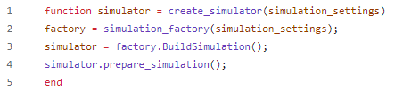
DARSim Beta Structure
Create Simulator
startup_darsim : Starts up DARSim automatically. Avoid having to add the DARSim files manually like previous versions.
create_simulation_settings: Routines Structures that describe simulation settings. List of blueprints for the simulator factory.
create_simulator: Uses previous settings to create the simulation object.
darsim_menu: Creates GUI that can be used to run simulation without having to write code.
Simulation Factory Class gets settings and produces a factory to create a simulator based on the input parameters. Simulation Builder refactored.
Method BuildSimulation is run after all parameters are set to create the Simulator object.
Simulator is initialized and prepared for simulation.
Create Simulator Function returns simulator.
Writer Class was added to simulator

Slide 11
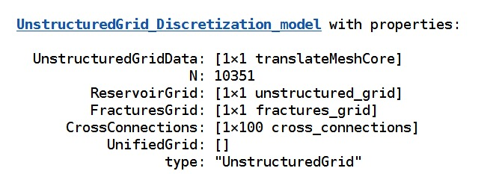
DARSim Beta Structure
DiscretizationModel
Simulation Factory: This is the most important routine. It creates the simulation object. It is a refactored version of the original simulation builder class, that had over 2 thousand lines of code. Now it has half of it. This is done by breaking the big factory and smaller specialized classed. The building of some of these routines have been modified and improved but not all of them.
Some of the components include:
DiscretizationModel
ProductionSystem
Formulation
TimeDriver
Summary
Writer
The main issue here is that these components need to behave exactly like DARSim 2, otherwise code breaks.
Contains
Rock Matrix mesh generation routines. Fracture Network generation routines.
Cross connections between rock matrix and fracture network meshes.

Slide 12
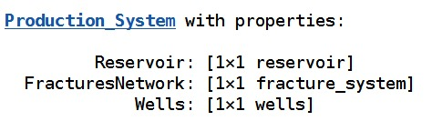
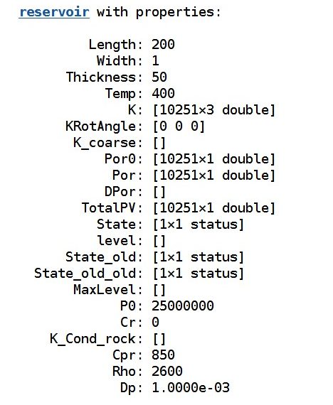
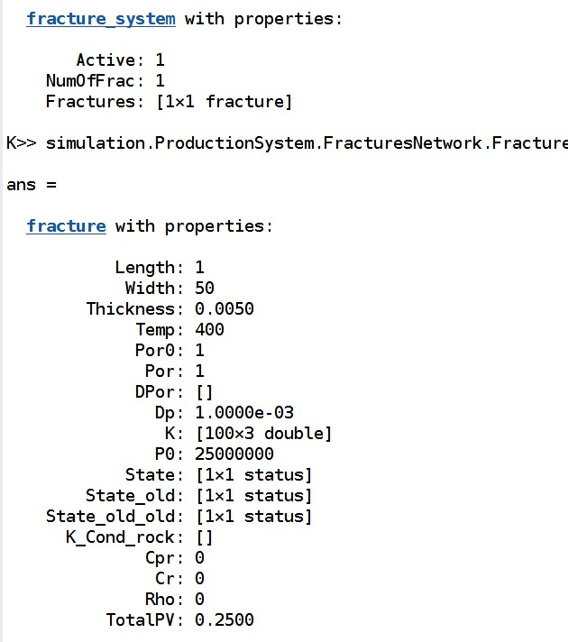
DARSim Beta Structure
ProductionSystem
Simulation Factory: This is the most important routine. It creates the simulation object. It is a refactored version of the original simulation builder class, that had over 2 thousand lines of code. Now it has half of it. This is done by breaking the big factory and smaller specialized classed. The building of some of these routines have been modified and improved but not all of them.
Some of the components include:
DiscretizationModel
ProductionSystem
Formulation
TimeDriver
Summary
Writer
The main issue here is that these components need to behave exactly like DARSim 2, otherwise code breaks.
Contains
Physical information of reservoir, fracture network and fractures. It also contains State, a class that is responsible for storing all variables that describes of the system as simulations progresses.

Slide 13
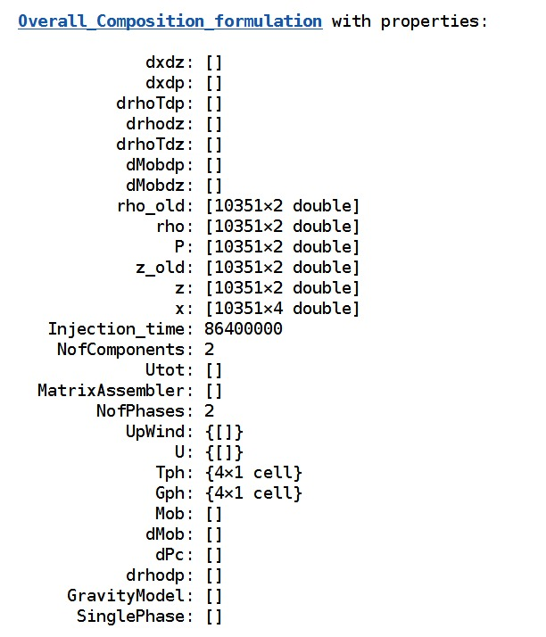
DARSim Beta Structure
Formulation
Simulation Factory: This is the most important routine. It creates the simulation object. It is a refactored version of the original simulation builder class, that had over 2 thousand lines of code. Now it has half of it. This is done by breaking the big factory and smaller specialized classed. The building of some of these routines have been modified and improved but not all of them.
Some of the components include:
DiscretizationModel
ProductionSystem
Formulation
TimeDriver
Summary
Writer
The main issue here is that these components need to behave exactly like DARSim 2, otherwise code breaks.
Contains
Physical formulation, i.e., Immiscible, Black Oil, so on. Overall compositional is a Blackoil model.
Each class contains methods for the computation of the Flux Approximation, Jacobian Building, Derivatives and so on. Routines depend on the mesh data structure, and they need to be adapted accordingly.

Slide 14
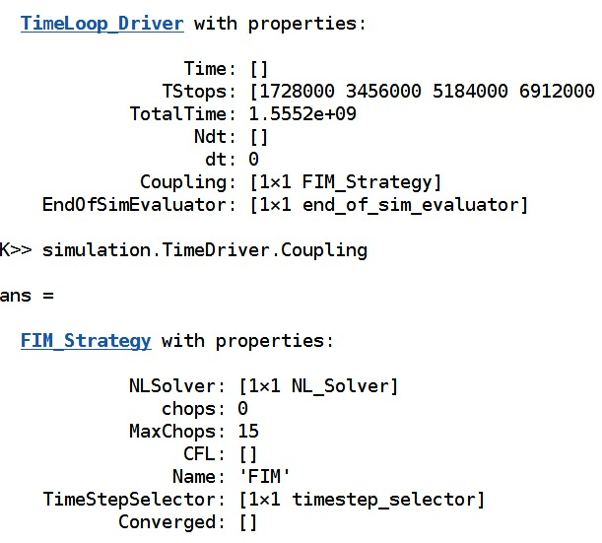
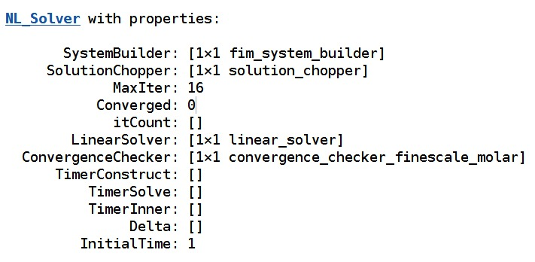
DARSim Beta Structure
TimeDriver
Simulation Factory: This is the most important routine. It creates the simulation object. It is a refactored version of the original simulation builder class, that had over 2 thousand lines of code. Now it has half of it. This is done by breaking the big factory and smaller specialized classed. The building of some of these routines have been modified and improved but not all of them.
Some of the components include:
DiscretizationModel
ProductionSystem
Formulation
TimeDriver
Summary
Writer
The main issue here is that these components need to behave exactly like DARSim 2, otherwise code breaks.
Contains
Time driver is a class that performs the simulation. It controls component objects. Components describe coupling between pressure and transport (components or saturation) as well as if any multiscale formulation is included.

Slide 15
DARSim Beta Structure
Simulation Factory: This is the most important routine. It creates the simulation object. It is a refactored version of the original simulation builder class, that had over 2 thousand lines of code. Now it has half of it. This is done by breaking the big factory and smaller specialized classed. The building of some of these routines have been modified and improved but not all of them.
Some of the components include:
DiscretizationModel
ProductionSystem
Formulation
TimeDriver
Summary
Writer
The main issue here is that these components need to behave exactly like DARSim 2, otherwise code breaks.
Simulation Factory
Build Discretization
Build Production
Build Formulation
Build Timedriver
Return Simulator

Slide 16
DARSim 2.0 (GITLAB) Structure
Unstructured Grid based routines
How is rock mesh read and created?
How do we mesh the fracture network?
EDFM and pEDFM routines?

Slide 17
DARSim 2.0 (GITLAB) Structure
Rock Matrix meshes and general Unstructured Grid Data Structure

Slide 18
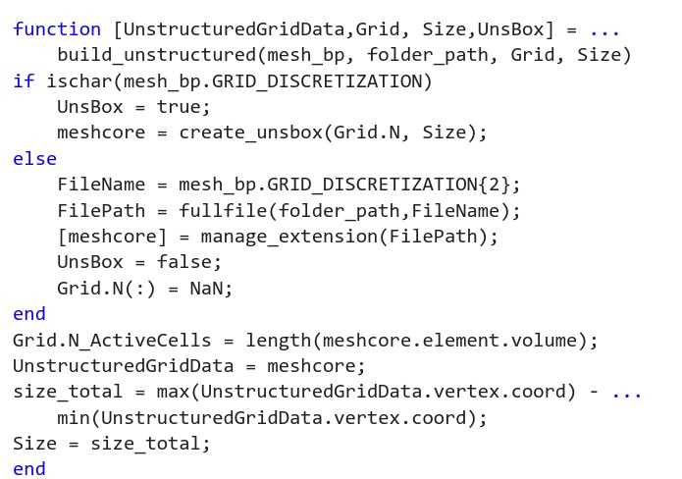
DARSim Beta Structure
Building Reservoir Grid
Create Unstructured Grid
Path to Mesh Give
Create Unstructured Box
Process Mesh
END

Slide 19
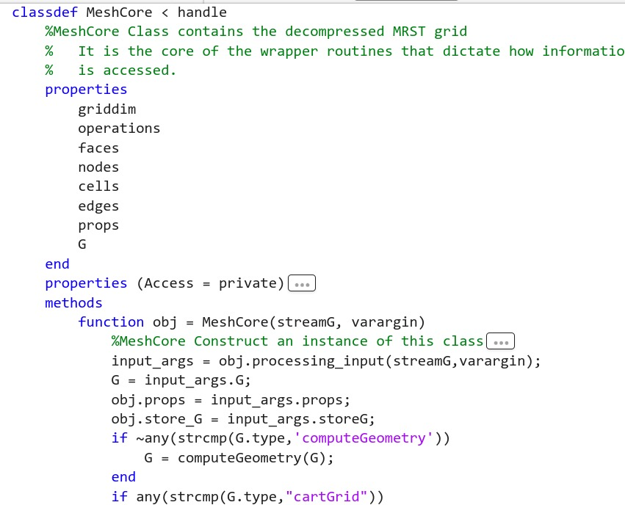
DARSim Beta Structure
MeshCore
Input: Path or MRST mesh
Building Reservoir Grid: MeshCore
Read and Process Mesh Using MRST Routines. Eclipse Files are read here.
Decompress Node, Faces, Cells and so on.
Add Centroid and Other entities
Return MeshCore

Slide 20
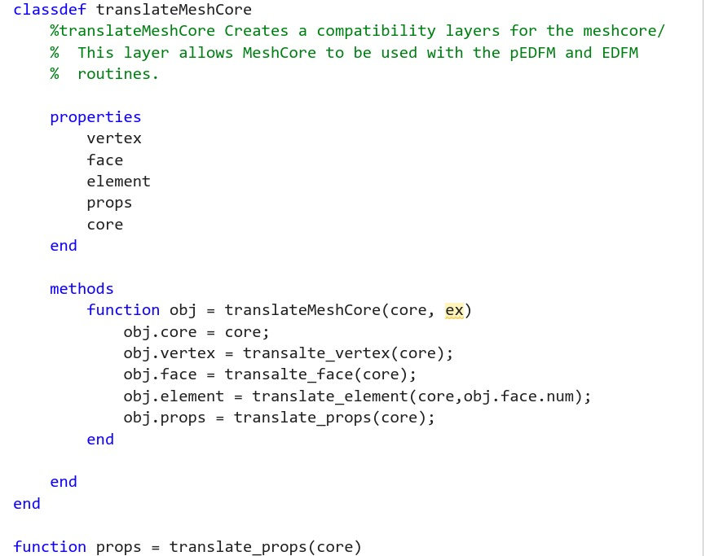
DARSim Beta Structure
translateMeshCore
Input: meshCore
Building Reservoir Grid: TranslateMesh
Organize hierarchically meshcore routines.
Return organized core

Slide 21
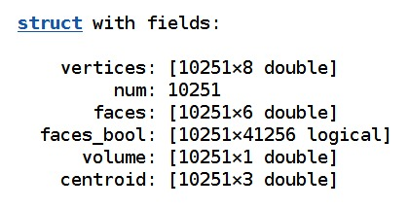
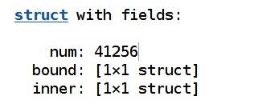
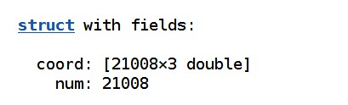
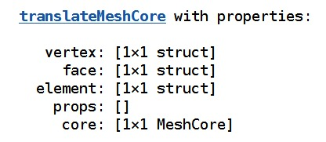
DARSim Beta Structure
Building Reservoir Grid: TranslateMesh
Cells
Faces
Vertex
True Structured Grid Description: Elements are described using Face Adjacencies.

Slide 22
DARSim 2.0 (GITLAB) Structure
Generating Rock Matrix meshes

Slide 23

DARSim Beta Structure
Building Reservoir Grid: scanfracture_data_uns
Fracture Blueprint
Definition of any structure needs to be generated with minimal modifications to the original Fracture Grid and Cross Connection Grid.
Original scanfracture_data was located inside reader and builder. It read the fracture_output.txt. Fracture generation and meshing was performed outside DARSim’s main code and it has a different set of routines.
Unstructured Version had already been built and it was later coupled to DARSim.
Unlike previous version, this code reads FractureInput.txt and generate fractures.
FractureFactory
FractureFactory Translation

Slide 24
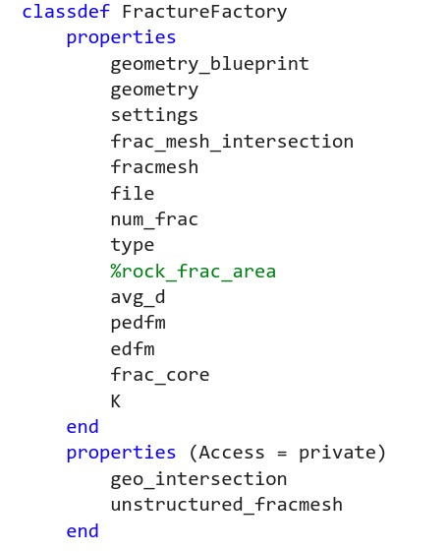
DARSim Beta Structure
Fracture Factory
RockGrid, Blueprint
Building Reservoir Grid: FractureFactory
Build Fracture Geometry
Build Fracture Geometry Intersection
Build Frac Meshes
Fracture Object is saved as fracture_process.mat. This removes the need to read and interpret an output file.
Find Frac Meshes Intersection
Find Frac Meshes RockMesh Intersection
Compute EDFM pEDFM properties
Return Fracture Obj

Slide 25
DARSim Beta Structure
Fracture Factory
RockGrid, Blueprint
Building Reservoir Grid: FractureFactory
Build Fracture Geometry
Build Fracture Geometry Intersection
Build Frac Meshes
Fracture Object is saved as fracture_process.mat. This removes the need to read and interpret an output file.
Find Frac Meshes Intersection
Find Frac Meshes RockMesh Intersection
Compute EDFM pEDFM properties
Return Fracture Obj

Slide 26
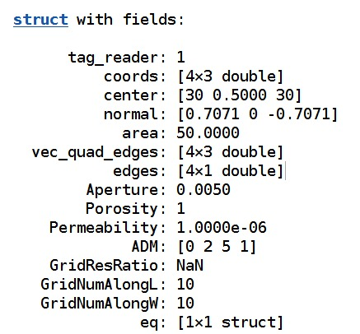
DARSim Beta Structure
FractureGeometry
Building Reservoir Grid: FractureFactory
Build Fracture Geometry
Fracture blueprint parameters are processed. Rotations, centres, normal, edges and other parameters are calculated.
Output an array of structures that encompass the basic information of the fracture geometry.

Slide 27
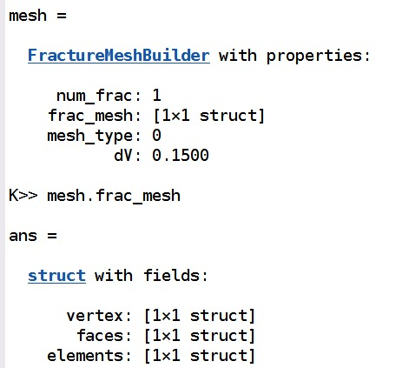
DARSim Beta Structure
FractureMeshBuilder
Building Reservoir Grid: FractureFactory
Build Fracture Mesh
Fracture blueprint parameters are used to mesh Fracture Geometry.
Cartesian and Unstructured Triangular meshes are generated.
Process of meshing is like rock matrix meshing.

Slide 28
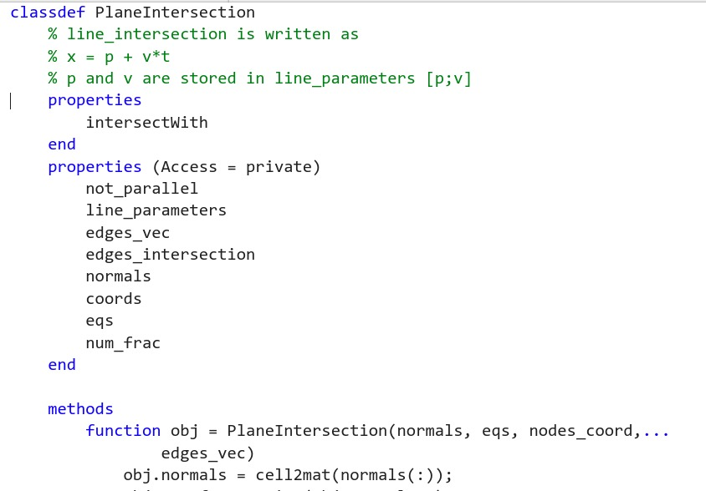
DARSim Beta Structure
GeometryIntersection
Building Reservoir Grid: FractureFactory
Build Geometry Intersection
Loops through fractures looking for intersections.
If an intersection is found, it is defined by the two points that comprised the intersection.
Only Geometry Intersection is computed.

Slide 29
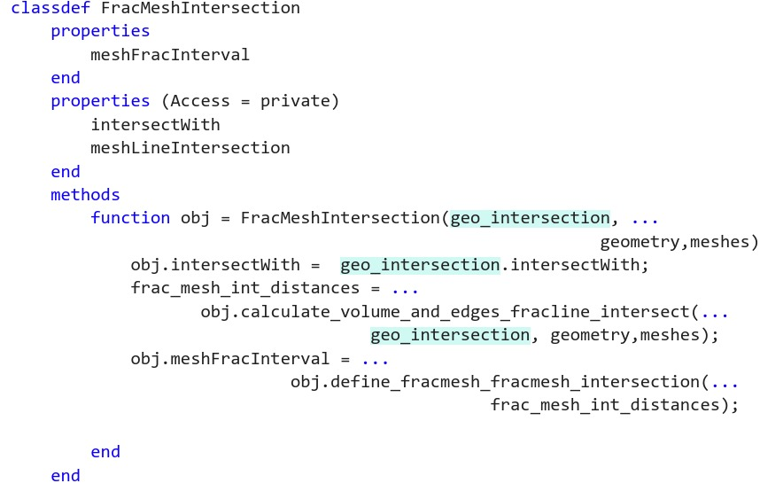
DARSim Beta Structure
Fracture Mesh Intersection
Building Reservoir Grid: FractureFactory
Build Fracture Mesh Intersection
Loops through fractures meshes looking for intersections with the fracture geometry intersection.
If fracture mesh I and J have a common geometrical intersection, we check each individual mesh I and J for intersection with the parametric line. Intersection between fracture mesh cells and this line are given in intervals.
This way, the intervals between I and J are compared to find IJ intersection.

Slide 30
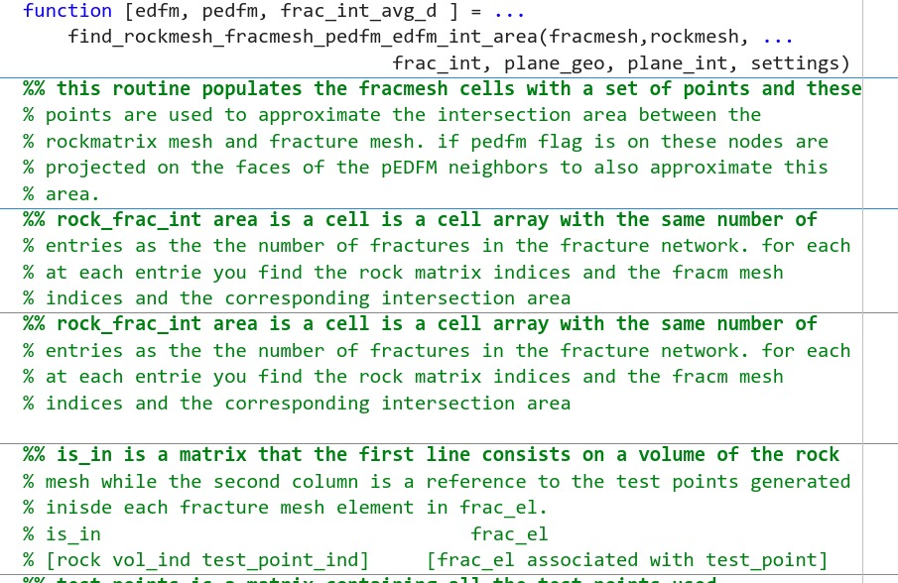
DARSim Beta Structure
Rock Fracture Meshes Intersection
Building Reservoir Grid: FractureFactory
Build Rock Mesh Fracture Intersection
Loops through fractures meshes looking for intersections with the rock matrix mesh.
Uses Monte Calor approach to approximate intersection area between fracture mesh cells and rock matrix cells.
The same strategy is also used to calculate the pEDFM projections.

Slide 31
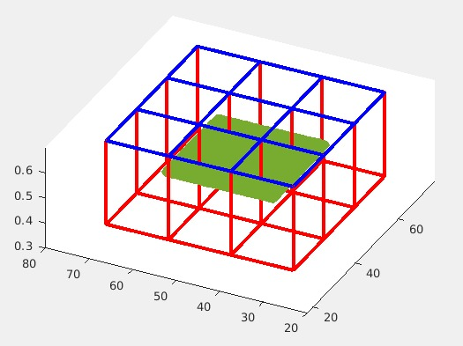
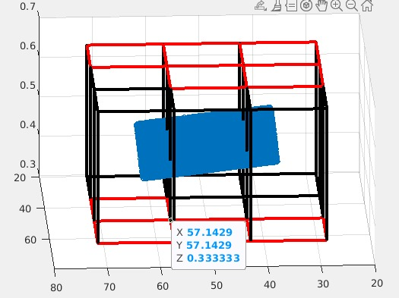
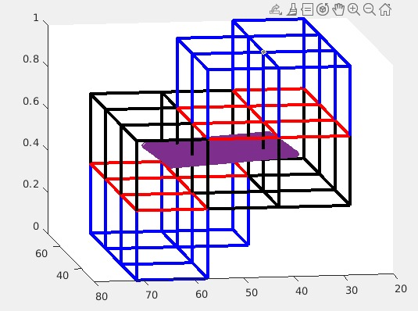
DARSim Beta Structure
Rock Fracture Meshes Intersection
Building Reservoir Grid: FractureFactory
Build Rock Mesh Fracture Intersection
Loops through fractures meshes looking for intersections with the rock matrix mesh.
Uses Monte Calor approach to approximate intersection area between fracture mesh cells and rock matrix cells.
The same strategy is also used to calculate the pEDFM projections.

Slide 32
DARSim Beta Structure
Rock Fracture Meshes Intersection
Building Reservoir Grid: FractureFactory
Build Rock Mesh Fracture Intersection - Algorithm
Generating Cloud of Points:
Because the meshes can be unstructured, the cloud of points needs to be generated randomly.
Cloud of points generates for each cell of fracture mesh N x N inside the cell bounding box.
If a point is outside the fracture cell element it is discarded. Points inside are counted.
The area of the fracture cell element is proportional to the number of points inside it.

Slide 33
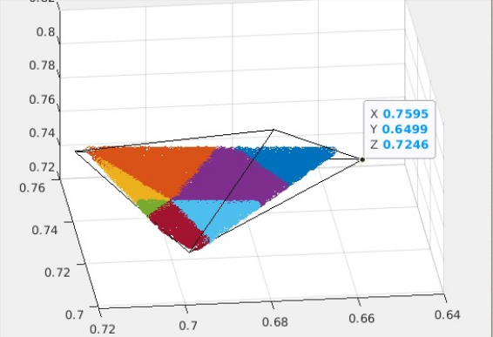
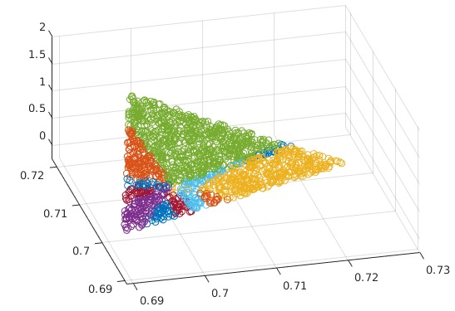
DARSim Beta Structure
Rock Fracture Meshes Intersection
Building Reservoir Grid: FractureFactory
EDFM Algorithm
Finding Intersection Area:
We create a vectorized algorithm that checks if a given point is inside or outside a general polyhedron.
We apply this algorithm to check which points in the fracture cells are inside rock matrix cell.
The intersection area is proportional to the number of points inside each fracture cell .
EDFM points are the points inside the intersection area.

Slide 34
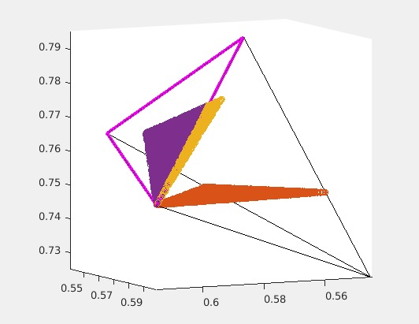
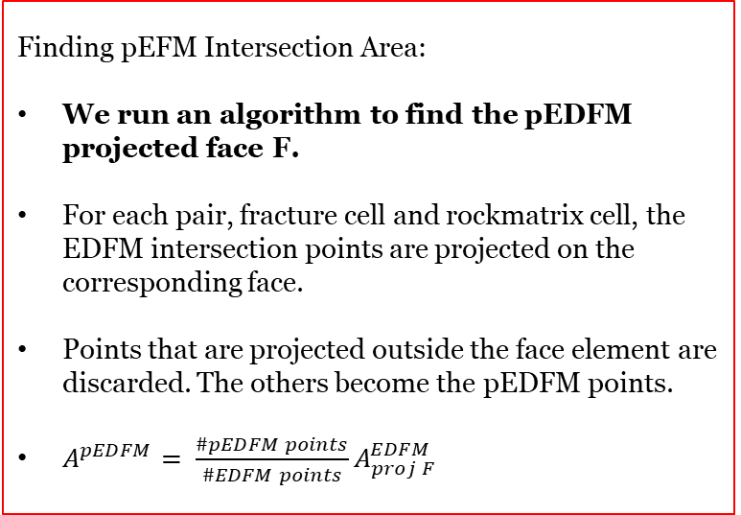
DARSim Beta Structure
Rock Fracture Meshes Intersection
Building Reservoir Grid: FractureFactory
pEDFM Algorithm
Finding pEFM Intersection Area:
We run an algorithm to find the pEDFM projected face F.
For each pair, fracture cell and rockmatrix cell, the EDFM intersection points are projected on the corresponding face.
Points that are projected outside the face element are discarded. The others become the pEDFM points.
$A^{pEDFM}= {\frac{\#pEDFM points}{\#EDFM points}A}_{proj F}^{EDFM}$

Slide 35
DARSim Beta Structure
Rock Fracture Meshes Intersection
Building Reservoir Grid: FractureFactory
pEDFM Algorithm for choosing Face Projection
The original algorithm for structured grids is not suitable for general unstructured grids.
Projection face is the face that minimize that distance average of all EDFM points inside a given cell.
Projection face is for each intersection pair Frac Cell I Rock cell J.

Slide 36
DARSim Beta Structure
Rock Fracture Meshes Intersection
Building Reservoir Grid: FractureFactory
<d> Average Distance Calculation
Generating Cloud of Points:
Because the meshes can be unstructured, the cloud of points needs to be generated randomly.
Cloud of points generates for each cell of Rock Mesh N x N x N inside the cell bounding box.
If a point is outside the rock matrix cell element it is discarded. Points inside are counted.
<d> of EDFM and pEDFM is the average distance between points inside the cell and the EDFM and pEDFM points.

Slide 37
Artur Castiel Reis de Souza This is an ADMIRE research group internal document and it is solely intended for evaluating the author's programming skills as part of the TNO recruitment process. TU Delft, Netherlands December 14, 2022
DARSim Beta Structure
29th February, 2024

