Slide 1
DEMO STORYBOARD |
From live client briefing
to AI-generated campaign video.
One AI Control Plane. Many agents. Human judgement only where it counts.
9
20+
4
100s
creative stages
specialist agents
human checkpoints
workflows, one supervisor
Prepared for: James MacGregor — Sr Dir Industry Advisory IBB

Slide 2
WHY THIS DEMO WORKS
The big idea
"From live client briefing to AI-generated campaign video —
with a control plane supervising the entire creative workflow."
01
02
03
Natural front door
High-value workflow
Clear control plane
Client + strategist + creative lead meet in Teams. AI joins the briefing as a facilitator.
Brief → audience → concepts → script/storyboard → video. Agents at every stage.
Policy, approvals, model choice, escalation, observability, HITL — all governed centrally.
AI Agency Demo | From live brief to campaign video under one control plane
02 / 16

Slide 3
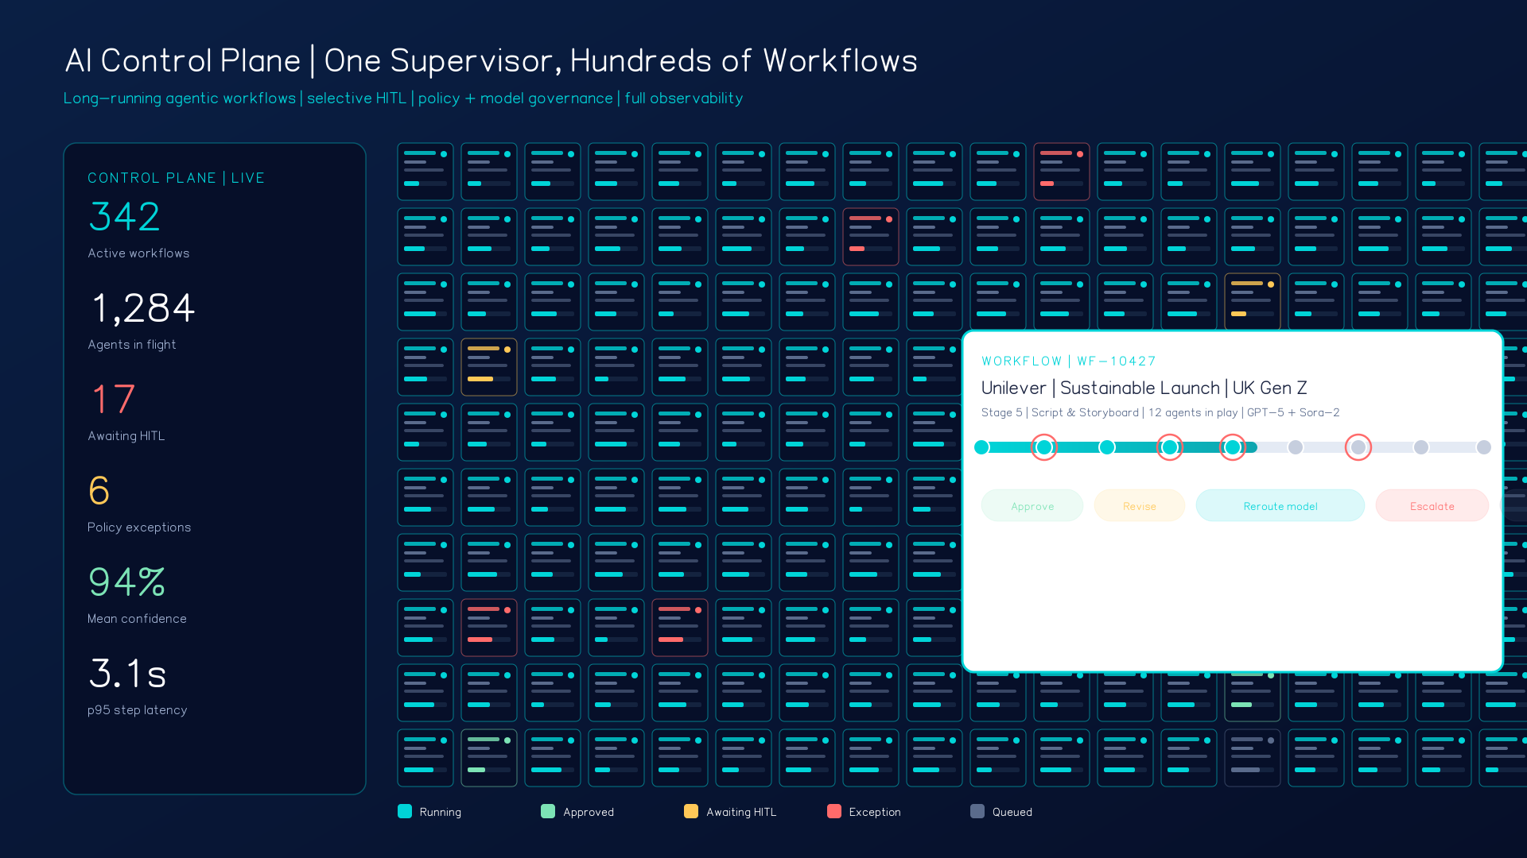
HERO MOMENT
The AI Control Plane — at massive scale.
What the audience sees
Hundreds of workflows running concurrently — one supervisor's view.
Live status, confidence, model mix, latency, HITL queue, exception count.
Drill into any single workflow for stage, agents, artefacts, lineage.
Route, approve, revise, reroute model, raise/lower autonomy — one click.
Talking point: "Not one agent. A governed creative operating system."

Slide 4
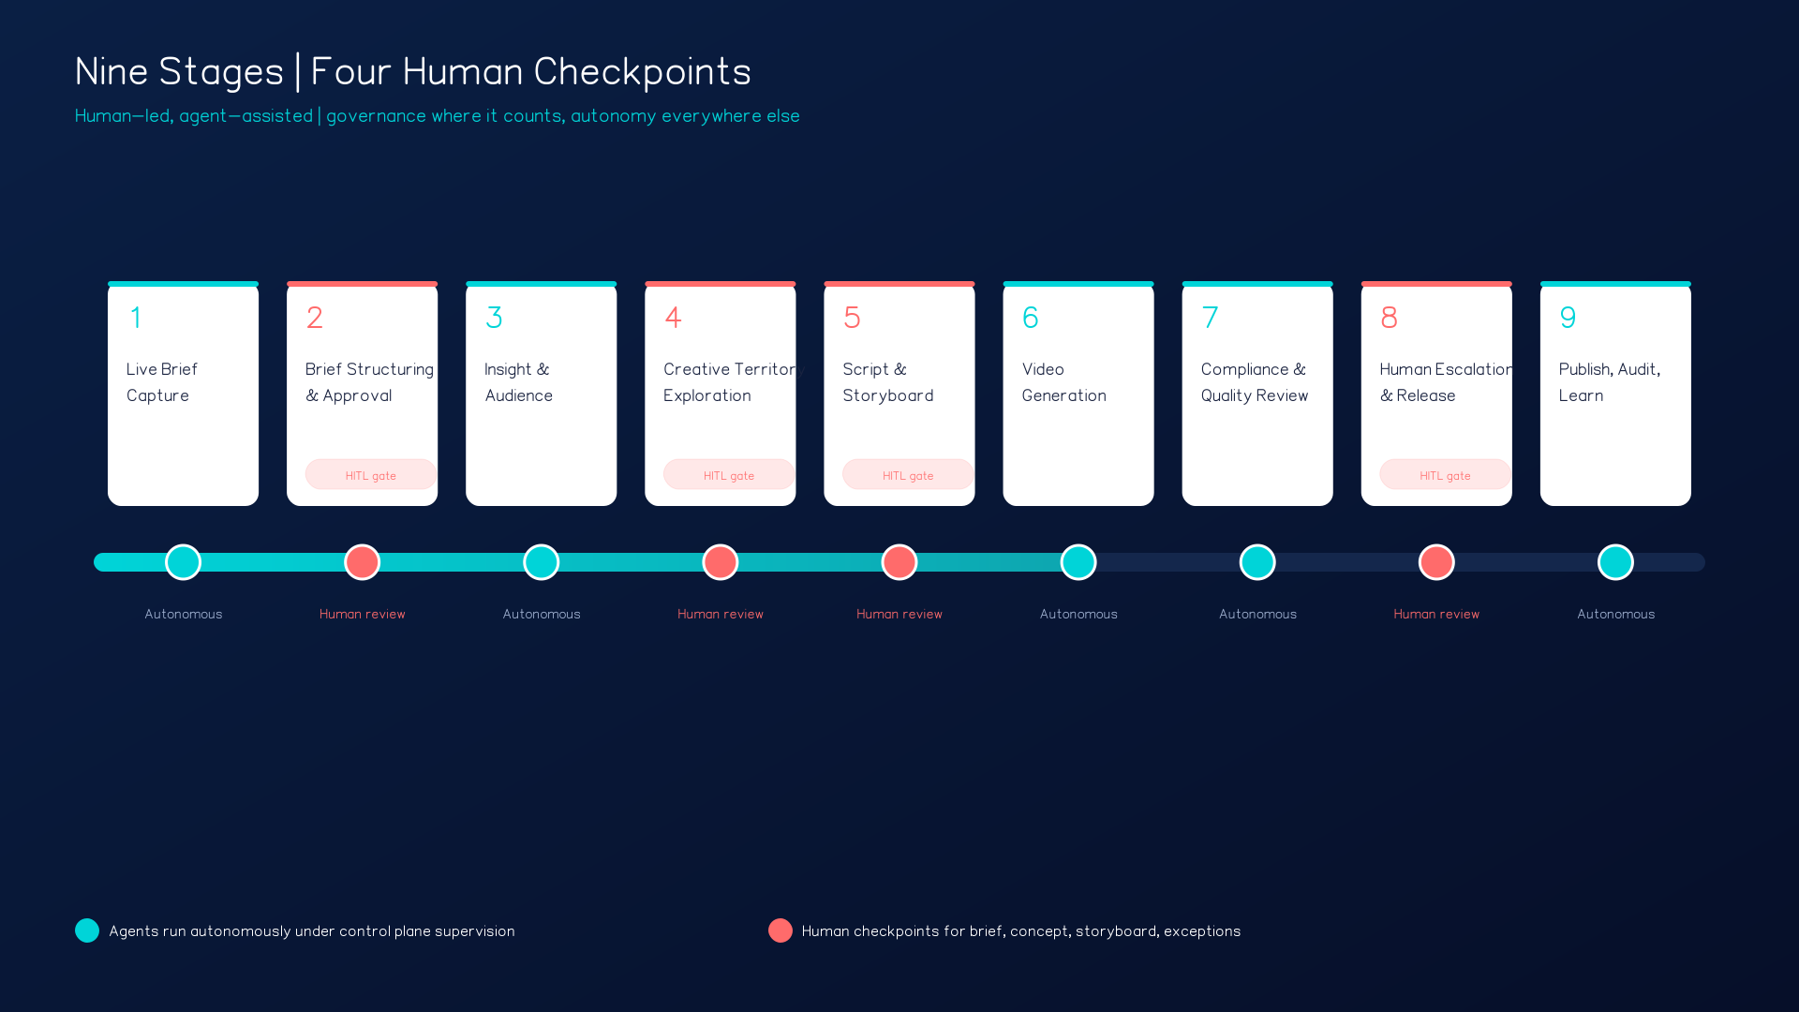
Nine stages. Four human checkpoints.
Human-led, agent-assisted — autonomy everywhere else.
Human checkpoints: Brief sign-off · Concept selection · Storyboard approval · Exception / release
AI Agency Demo | From live brief to campaign video under one control plane
04 / 16

Slide 5
CONTROL PLANE Workflow registered | autonomy = LOW | policy pack = Agency-standard | HITL gate armed
STAGE 01 LIVE BRIEF CAPTURE
The live creative briefing.
Teams meeting — client brand manager, agency strategist, creative lead. Briefing Agent joins as facilitator.
WHAT HAPPENS
DEMO MOMENT
Briefing Agent listens, prompts for missing details, structures the conversation into Agency's brief format.
Client: "We need a short video campaign for a new sustainable product launch targeted at Gen Z and young families in the UK."
Agent interjects: primary objective? awareness vs conversion? brand guidelines? markets, formats, approval constraints?
Agent grounded in agency's briefing standard — not a black-box autonomous system.
Watch the agent ask smart questions in the meeting — AI in the flow of work, not a side tool.
HITL STEP Strategist confirms objective, audience priority, and success metric before the brief is finalized.
CP Workflow ID minted, client policy pack attached, meeting transcript captured for lineage.
AI Agency Demo | From live brief to campaign video under one control plane
05 / 16

Slide 6
CONTROL PLANE Status: brief ready for validation | confidence 0.91 | missing fields flagged | reviewer assigned
STAGE 02 BRIEF STRUCTURING & APPROVAL
Brief synthesis and approval gate.
Post-meeting. Briefing Agent turns the conversation into a structured artefact in Word.
WHAT HAPPENS
DEMO MOMENT
Structured brief: objective, audience summary, mandatory messages, channel constraints, first-pass delivery plan.
Control plane shows workflow ID, client/brand, status "Brief ready for validation", confidence, missing fields, assigned reviewer.
First formal approval gate — human oversight is deliberate, not everywhere.
Clean audit trail: what the client said → what the agent produced → what the CD approved.
Show the Word brief next to the control plane card for this workflow — synced in real time.
HITL STEP Creative Director approves or edits the brief before downstream generation begins.
CP Checkpoint 1 of 4. Gate blocks Stage 3 until CD sign-off. All edits logged.
AI Agency Demo | From live brief to campaign video under one control plane
06 / 16

Slide 7
CONTROL PLANE 4 agents in flight | fan-out in parallel | model mix visible | no HITL gate on this stage
STAGE 03 INSIGHT & AUDIENCE ENRICHMENT
Insight and audience enrichment.
Once approved, a set of research and planning agents kick in — in parallel, under supervision.
WHAT HAPPENS
DEMO MOMENT
Audience Agent builds audience clusters and personas.
Trend / Research Agent pulls market, category, and cultural signals.
Brand Knowledge Agent retrieves past campaign learnings and brand guardrails.
Channel Planning Agent recommends initial video format assumptions.
Control plane comes alive — many agents running together, each with status, latency, model, and output readiness.
HITL STEP Planner / Strategist chooses one of three audience directions and confirms the strategic tension to resolve.
CP Supervisor sees where work is blocked, where confidence is low, and can rebalance models on the fly.
AI Agency Demo | From live brief to campaign video under one control plane
07 / 16

Slide 8
CONTROL PLANE Territories: 3 | brand safety check: PASS | distinctiveness check: PASS | HITL gate armed
STAGE 04 CREATIVE TERRITORY EXPLORATION
Creative territory generation.
The workflow fans out into exploration. Agents propose — humans decide.
WHAT HAPPENS
DEMO MOMENT
Concept Agent generates 3–5 campaign territories.
Copy Agent drafts taglines and key messages.
Moodboard Agent produces visual style directions.
Brand Safety and Competitive Distinctiveness agents screen early.
Show 3 distinct routes side by side: Emotional/cinematic · Social-first/creator · Product-led/high-energy.
HITL STEP Creative Director and client pick the winning route — AI amplifies taste, doesn't replace it.
CP Checkpoint 2 of 4. Non-chosen concepts preserved for reuse and learning loop.
AI Agency Demo | From live brief to campaign video under one control plane
08 / 16

Slide 9
CONTROL PLANE Policy pack enforced | model registry: script=GPT-5, viz=Sora-2 | rights agent active
STAGE 05 SCRIPT & STORYBOARD
Script, storyboard, and shot plan.
The chosen route becomes a production-ready package of script, scenes, shot prompts, and localisations.
WHAT HAPPENS
DEMO MOMENT
Script Agent writes a 30-second script.
Storyboard Agent converts it into scenes.
Shot Planner Agent creates prompts for video generation.
Localization Agent prepares regional variants. Rights & Compliance Agent checks policy constraints.
Control plane shows which model produced each asset and whether client-specific policy rules are satisfied.
HITL STEP Producer or creative lead approves the storyboard before "expensive" generation begins.
CP Checkpoint 3 of 4. Model choice is centrally governed — approved models only, by client and use case.
AI Agency Demo | From live brief to campaign video under one control plane
09 / 16

Slide 10
CONTROL PLANE Long-running job | cost budget: £X | content safety gate armed | autonomy = MEDIUM
STAGE 06 VIDEO GENERATION
AI video generation — the whizzy part.
A fleet of agents assembles the first cut under policy and safety guardrails.
WHAT HAPPENS
DEMO MOMENT
Video Generation Agent creates the first cut.
Voice / Audio Agent adds narration or soundtrack options.
Localization Agent adapts subtitle and copy variations.
Quality Agent checks pacing, framing, format fit. Content Safety Agent screens output before release.
Split screen: storyboard on the left, rendered draft video on the right, control plane behind — agents orchestrating.
HITL STEP No gate here by default — supervision handles it. Exceptions escalate to the next stage.
CP Token burn, render time, model lineage, and provenance metadata are captured for every frame.
AI Agency Demo | From live brief to campaign video under one control plane
10 / 16

Slide 11
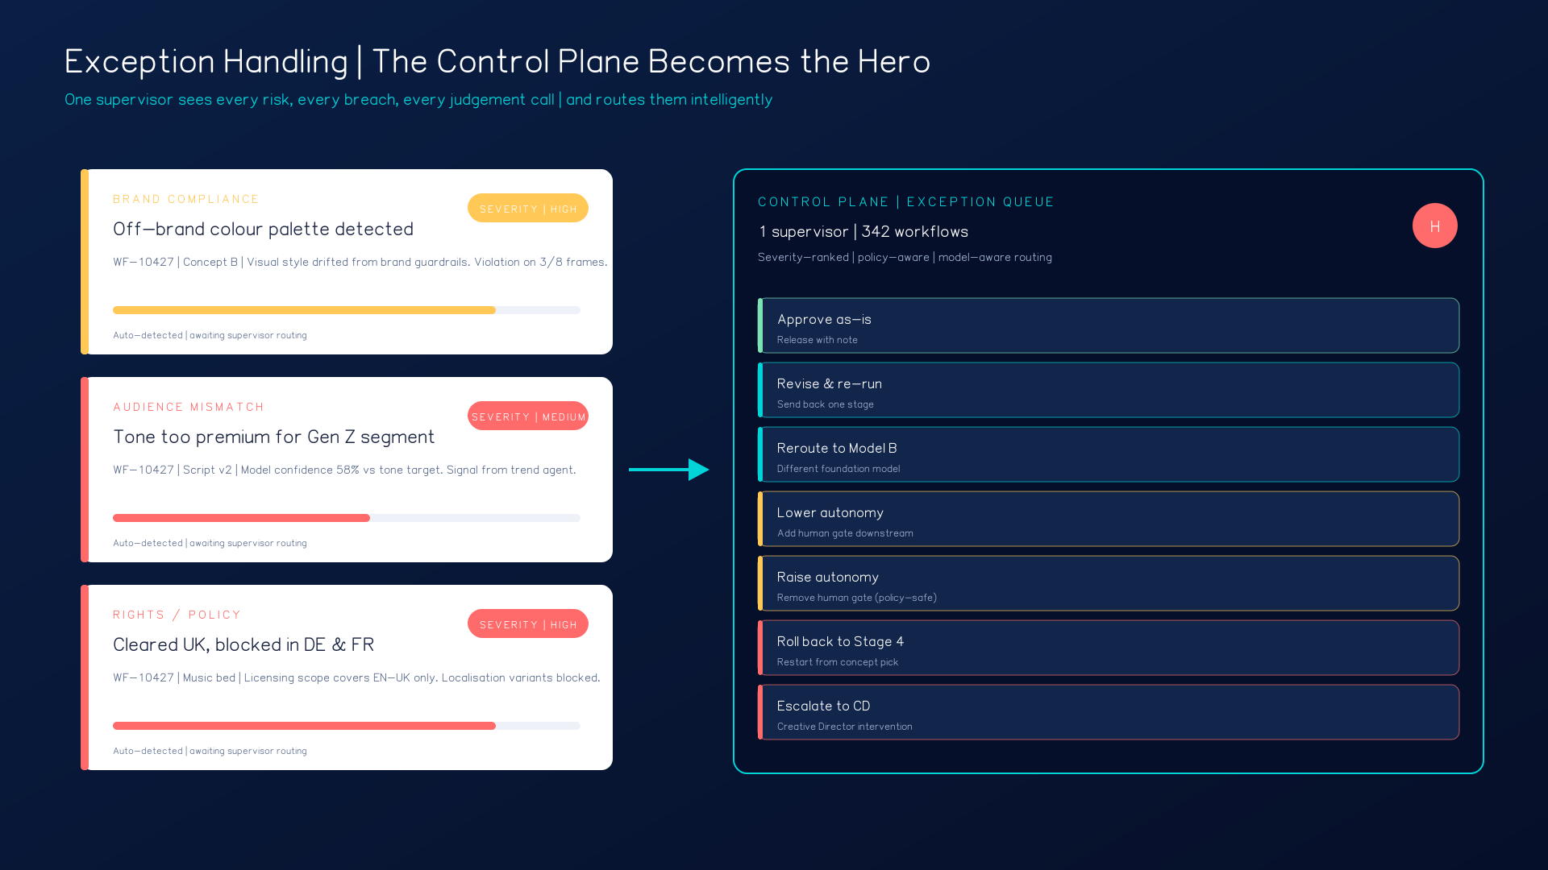
CONTROL PLANE 3 exceptions surfaced | routing queue engaged | 1 supervisor, 342 workflows live
STAGE 07 EXCEPTION HANDLING
Exception handling — the control plane becomes the hero.
Don't show a flawless path. Deliberately surface 2–3 exceptions and let the control plane resolve them.
HITL CHOICES
Approve as-is
Revise & re-run
Reroute to another model
Lower / raise autonomy
Roll back a stage
Escalate to Creative Director
Checkpoint 4 of 4. One person supervises many flows — HITL only where judgement, policy, or risk demands it.

Slide 12
CONTROL PLANE Workflow closed | artefacts packaged | audit trail signed | added to learning corpus
STAGE 08 PUBLISH, AUDIT, LEARN
Final output and the learning loop.
The approved video is packaged with full provenance — and the workflow becomes reusable.
WHAT HAPPENS
DEMO MOMENT
Package: campaign brief, final script, storyboard, output variants, provenance metadata, audit trail.
Performance assumptions captured; chosen creative path logged for reuse on next brief.
Closes the loop: next time, the system starts smarter.
Deliverable is not just an asset — it's a governed, observable, reusable production run.
Zoom out: "This is not one AI-generated asset. This is a governed creative production system."
HITL STEP Release approval already handled in Stage 7. This stage is autonomous.
CP Every artefact carries lineage back to the brief, the model, the human who approved it.
AI Agency Demo | From live brief to campaign video under one control plane
12 / 16

Slide 13
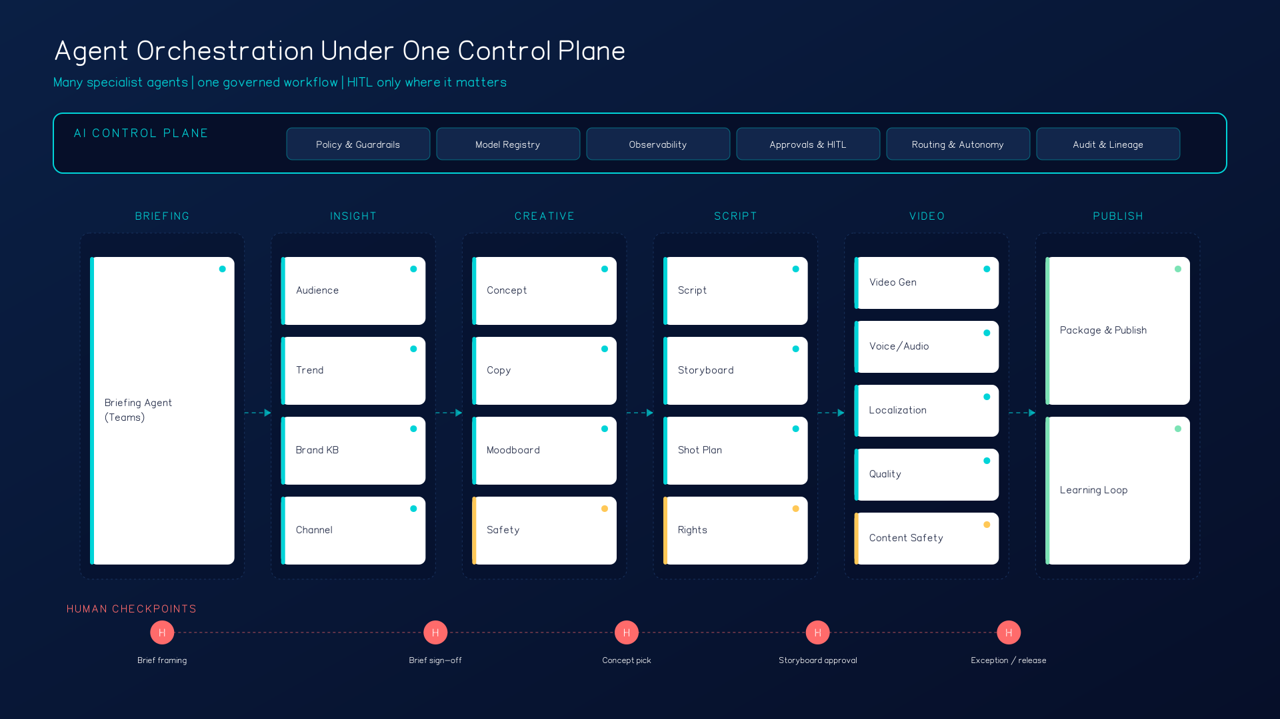
ARCHITECTURE VIEW
Many agents. One governed workflow.
Talking point: "The control plane is the layer across the top — policy, models, observability, approvals, routing, audit."

Slide 14
The four human checkpoints.
Human-led, agent-assisted. Discipline over gimmick.
1
2
3
4
Brief sign-off
Concept selection
Storyboard approval
Exception / release
Human validates objectives, audience, and constraints before any agent spends budget.
Human picks the winning creative route from 3 generated territories.
Human confirms narrative and production direction before expensive video generation.
Human resolves policy, compliance, or quality issues surfaced by the control plane.
AI Agency Demo | From live brief to campaign video under one control plane
14 / 16

Slide 15
Why this storyline is stronger than a back-office demo.
Agency relevance
Agency-native, not generic enterprise automation.
Control plane value
Many agents, long-running flows, selective HITL — the core differentiator.
Microsoft differentiation
Work starts where people already collaborate — Teams, Word, PowerPoint.
Visible outcome
Campaign video is an immediate, high-impact "wow" moment.
Governed scale
Zoom out: the same control plane supervises hundreds of briefs simultaneously.
AI Agency Demo | From live brief to campaign video under one control plane
15 / 16

Slide 16
THE TALK TRACK
A governed creative operating model — at scale.
"The demo starts where real agency work starts: in the briefing. A client and agency team meet in Teams, and an AI facilitator helps structure the brief in real time. Once approved, that brief triggers a fleet of specialised agents that enrich insight, generate concepts, build a script and storyboard, and produce a first-cut campaign video. The AI Control Plane supervises the entire workflow — monitoring status, enforcing policy, routing tasks, and escalating only when human judgement is needed. The result is not just faster content creation; it is a governed creative operating model at scale."
NEXT
Slide-by-slide script
Demo environment wire-up
Dry-run with Agency
RFP narrative brief

Slide 17
Work In Progress
Wireframes

Slide 18
AI AGENCY DEMO
Wireframes
From live client briefing to AI-generated campaign video — under one control plane.
9
20+
4
creative stages
specialist agents
human gates
v0.1 · Drop alongside the AI-Agency-Demo-Storyboard.pptx
Bastien Vitrolles · Microsoft France

Slide 19
HOW TO READ THESE WIREFRAMES
Two rails. One control plane through the whole demo.
LEGEND
LEFT RAIL — WORKING SURFACE (60%)
CONTROL PLANE
Word, Teams, Storyboard, asset preview, video player.
This is the human-facing canvas.
Agent step (auto)
Workflow state
Autonomy dial
Policy pack
HITL gate status
Active agents
Audit counter
Agent running / pending
Human gate (HITL)
System state / log
AUTONOMY RAMP
LOW (brief) → MEDIUM (concept) → HIGH (assets) → LOW (activation)
All 11 frames keep this two-rail structure. Only the right-rail state changes.

Slide 20
STORYBOARD MAP · YOU-ARE-HERE REFERENCE
9 stages · 20+ specialist agents · 4 human gates
G1
Brief
G2
Concept
G3
Assets
G4
Launch
01
02
03
04
05
06
07
08
09
Brief
capture
Strategy
Concept
Story-
board
Asset gen
Video
assembly
Media
plan
Brand QA
Activation
AUTONOMY
LOW
MEDIUM
HIGH
LOW
This map appears in the demo as a single "hero moment" slide before the live walkthrough.

Slide 21
AI AGENCY DEMO · WIREFRAMES v0.1
Frame 01 / 11
Title screen — set the stage
AI AGENCY DEMO
From live brief to campaign video
under one control plane.
9 creative stages
20+ specialist agents
4 human gates
▶ Start live demo
DEMO BEAT
Open on this. Don't narrate yet — let the chips do the work.

Slide 22
AI AGENCY DEMO · WIREFRAMES v0.1
Frame 02 / 11
Hero moment — the mental model
01 Brief
LEGEND
G1
02 Strategy
03 Concept
G2
• specialist agents
• specialist agents
• specialist agents
stage executed by AI
• guardrails apply
• guardrails apply
• guardrails apply
agent in flight
04 Storyboard
05 Assets
06 Video
G3
human gate
• specialist agents
• specialist agents
• specialist agents
• guardrails apply
• guardrails apply
• guardrails apply
log / state
07 Media
08 Brand QA
09 Launch
G4
• specialist agents
• specialist agents
• specialist agents
Reuse this single map throughout the demo as the "you-are-here" reference.
• guardrails apply
• guardrails apply
• guardrails apply
DEMO BEAT
Show before clicking Start. Reference back to it whenever the audience loses the thread.

Slide 23
AI AGENCY DEMO · WIREFRAMES v0.1
Frame 03 / 11
Stage 01 — Live brief capture
WORD · BRIEF.DOCX
CONTROL PLANE
Client Brief — JP2026 Spring Campaign
Workflow
STARTED
Stage
01 / 09
Audience
Gen-Z, FR + DE
Phase
Brief Capture
Tone
bold, optimistic
Autonomy
LOW
Channels
TikTok, OOH, CTV
Policy
Agency-std
KPI
+15% awareness, +8% intent
HITL
ARMED
Budget
€4.2M
ACTIVE AGENTS
Go-live
12 Jun
Brief Agent — listening
Compliance — pre-check
▮ live cursor: "...sustainable luxury, regenerative production..."
Brand voice — standby
AUDIT · ev. 12 logged
DEMO BEAT
Show Word brief and control plane updating token-by-token. All edits logged.

Slide 24
AI AGENCY DEMO · WIREFRAMES v0.1
Frame 04 / 11
Gate ◆1 — Brief approval (HITL)
GATE 1 · BRIEF APPROVAL
CONTROL PLANE
BRIEF READY FOR APPROVAL
Gate
1 / 4
Phase
Brief approval
DETECTED RISKS · Compliance Agent
REQUIRED
EU green-claims directive — wording "100% sustainable" needs caveat
Audience overlap with active Q1 campaign — re-target window suggested
Account Lead
Time-out
24 h
Override
CCO
Autonomy
→ MEDIUM
ON APPROVE
✎ Edit brief
✕ Reject
✓ Approve & dispatch
Strategy Agent dispatched
Insight Agent dispatched
AUDIT · ev. 47 logged
DEMO BEAT
Human clicks Approve. Autonomy dial moves LOW → MEDIUM. Audit ticks visibly.

Slide 25
AI AGENCY DEMO · WIREFRAMES v0.1
Frame 05 / 11
Stages 02–03 — Strategy & concept fan-out
STRATEGY ROOM
CONTROL PLANE
Insight Agent
▸ Gen-Z trust gap on luxury claims
Stage
03 / 09
Trend Agent
▸ TikTok + Pinterest signal: regenerative
Phase
Concept dev
Autonomy
MEDIUM
Audience Agent
▸ 3 personas drafted (FR / DE / hybrid)
ACTIVE AGENTS
Insight
CONCEPT ROUTES · 3 generated
Trend
Audience
Route A
Route B
Route C
Concept × 3
Brand voice
Roots
Pulse
Dare
AUDIT · ev. 142 logged
fit 0.91
fit 0.88
fit 0.74
heritage + craft
social-first energy
provocative, flagged
DEMO BEAT
Multi-agent fan-out, visible. Three concept cards land in parallel — fast, but legible.

Slide 26
AI AGENCY DEMO · WIREFRAMES v0.1
Frame 06 / 11
Gate ◆2 — Concept selection (HITL)
GATE 2 · CONCEPT SELECTION
CONTROL PLANE
CHOOSE A CREATIVE ROUTE
Gate
2 / 4
Phase
Concept select
Strategy Agent recommends Route B · highest audience resonance, brand-fit 0.88
REQUIRED
Route A — Roots
brand-fit 0.91 · heritage
Creative Director
Recommend
Route B
Route B — Pulse
brand-fit 0.88 · TOP audience resonance
Source
Strategy Agent
ON LOCK
Route C — Dare
brand-fit 0.74 · ⚠ compliance flag
Storyboard Agent → start
Asset agents → spin up
AUDIT · ev. 198 logged
✎ Refine
✓ Lock Route B
DEMO BEAT
Single click locks the route. Downstream agents start instantly.

Slide 27
AI AGENCY DEMO · WIREFRAMES v0.1
Frame 07 / 11
Stages 04–05 — Storyboard & asset generation
ROUTE B · PULSE
CONTROL PLANE
STORYBOARD · 6 shots
Stage
05 / 09
Phase
Asset gen
Autonomy
HIGH
01
02
03
04
05
06
TOOLING
Adobe Firefly
ASSETS · generating
Adobe Marketing Agt
Brand-kit RAG
Hero still
82%
Copy — FR
done
Brand-safety
PASS
Trademark
PASS
Copy — DE
60%
Tone-of-voice
PASS
Sound bed
queued
AUDIT · ev. 614 logged
DEMO BEAT
Adobe partner moment. Firefly + Marketing Agent visible inside the control plane.

Slide 28
AI AGENCY DEMO · WIREFRAMES v0.1
Frame 08 / 11
Stage 06 + Gate ◆3 — Video assembly & sign-off
VIDEO PREVIEW
CONTROL PLANE
Gate
3 / 4
Phase
Asset sign-off
▶
REVIEWERS
Creative Director
Brand Lead
Legal (auto)
0:12 / 0:30
Suggested
2 tweaks
Variants
6 ready
Variants: 6 · Aspect: 9:16, 16:9, 1:1 · Languages: FR, DE
AUDIT · ev. 871 logged
✎ Re-cut
↻ Re-render
✓ Approve
DEMO BEAT
Approve in one click. Re-cut sends a delta to the agents — not a restart.

Slide 29
AI AGENCY DEMO · WIREFRAMES v0.1
Frame 09 / 11
Stages 07–08 — Media plan & brand QA
MEDIA PLANNER AGENT
CONTROL PLANE
Channel
Spend
Reach
CPM
Stage
08 / 09
Phase
Brand QA
TikTok
€1.6M
12.4M
€4.20
Autonomy
HIGH
CTV
€1.4M
6.8M
€9.10
QA AGENTS
OOH
€0.9M
22M imp.
€0.30
Trademark
Programmatic
€0.3M
—
—
Tone-of-voice
Accessibility
Geo-compliance
OPTIMIZER · recommendation
Result
ALL PASS
Shift €120K TikTok → CTV ↗ +1.2% projected intent lift
AUDIT · ev. 1,021 logged
DEMO BEAT
Optimizer recommendation appears as soon as the table renders — never a separate screen.

Slide 30
AI AGENCY DEMO · WIREFRAMES v0.1
Frame 10 / 11
Gate ◆4 — Final sign-off & activation
GATE 4 · LAUNCH
CONTROL PLANE
READY TO LAUNCH
Gate
4 / 4
Phase
Launch
DELIVERABLES · 12 items
Autonomy
→ LOW
✓
6 video variants
✓
4 still sets
REQUIRED
✓
Media plan v1
✓
Compliance report
CCO
✓
Brand QA dossier
✓
Activation pack
Client lead
ON ACTIVATE
ACTIVATION
DSP push
✓
Push to DSP
Workfront push
✓
Push to Adobe Workfront
Teams notify
✓
Notify client (Teams)
AUDIT · 1,284 ev.
✓ APPROVE & ACTIVATE
DEMO BEAT
One click — three downstream systems light up. Audit logged end-to-end.

Slide 31
FRAME 11 / 11 · CLOSING
From brief to campaign — in one working session.
9 wks → days
fraction
20+ agents
4 gates
Time to first cut
Of traditional cost
Orchestrated
Where humans matter
BUILT ON
Microsoft 365 Copilot · Agent 365 control plane · Adobe Firefly + Marketing Agent · Azure AI Foundry
Same surface. Different brand. White-labellable.

Slide 32
DESIGN NOTES · CROSS-CUTTING
Seven decisions that hold the whole demo together.
01
Persistent control plane
02
Autonomy ramp
Same right-rail component on every frame; only state changes. The visual through-line.
LOW (brief) → MEDIUM (concept) → HIGH (assets) → LOW (activation). Show the dial moving.
03
Four HITL gates, one component
04
Audit counter ticks visibly
Same gate UI reused. Each shows: who's required, agent recommendation, override, time-out.
Reinforces "all edits logged". Governance message lands without a slide of its own.
05
Compliance silent until it flags
06
Adobe shown, not told
Keeps the screen calm. Surfaces value at gates. Avoids alert fatigue in the demo flow.
Firefly + Marketing Agent surface naturally in stages 5–6. Partner story is staged, not pitched.
07
Dual-track narration
Left rail = creative/business. Right rail = governance/IT. Same demo, two audiences.
DEMO BEAT
Companion to AI-Agency-Demo-Storyboard.pptx. Pair these wireframes with the script next.

