Slide 1
OS Presentation
Explaining process switching with file allocation as an example.

Slide 2
Framework
Efforts
Overview
Detailed Introduction
Motivation
Data Analysis
Process
process.c
File reading
Scheduling
Breakpoints and codes
Extra
Before process.c
After process.c

Slide 3
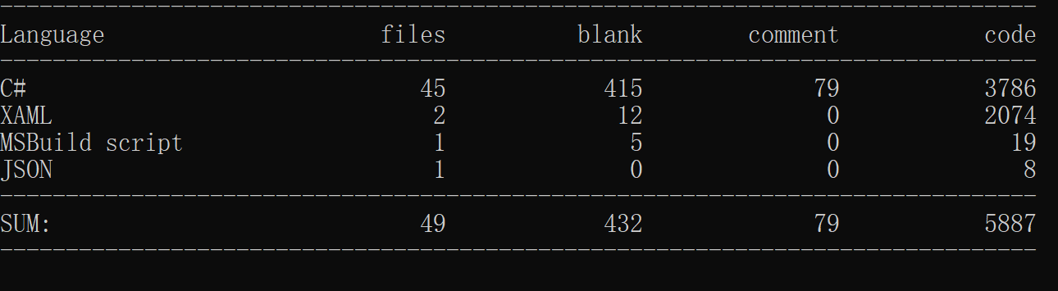
Efforts
Code
Breakpoints
Output_sample.txt
Gdb scripts
53 breakpoints, from 14 files
40 used

Slide 4
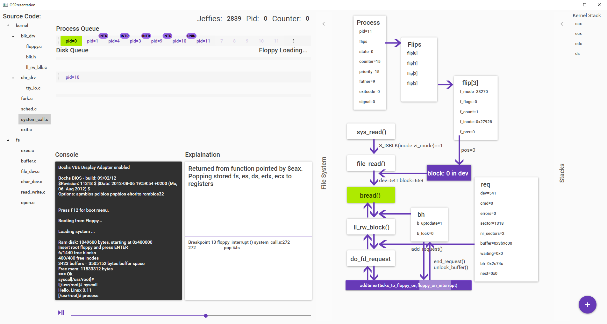
Overview(1)

Slide 5
Detailed Introduction
Motivation
How processes switch and why
Data Visualization
Fully data-driven, procedure independent
For visualized data analyzing
Process switching
Change in stack
Procedure flow
Procedure dependent, breakpoints driven
Better explanation
Highly related to process switching

Slide 6
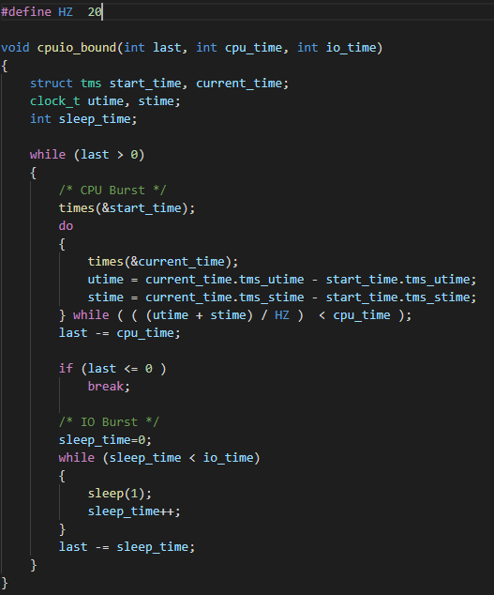
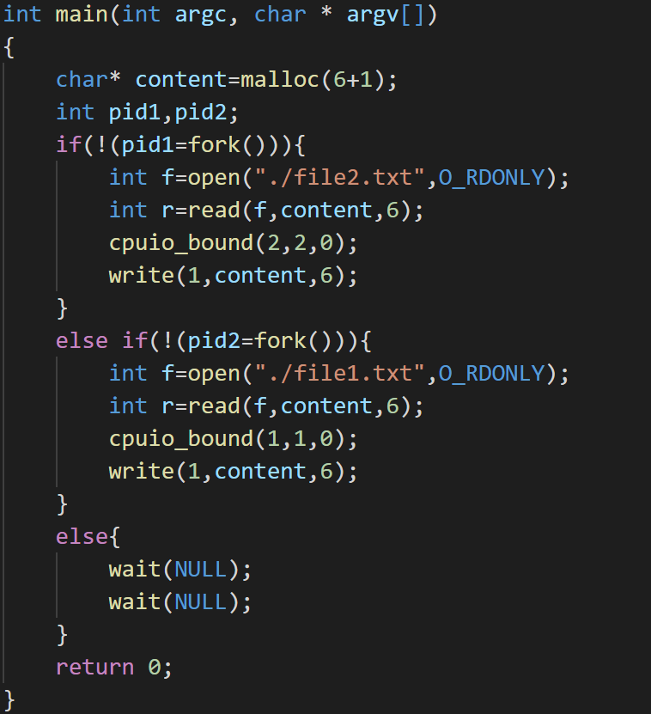
Process.c

Slide 7
Data Analysis
last_pid increases automatically
Empty task after releasing will be used for new process
Which child process runs first after forking?
Where does scheduling often happen? Do_timer(from traceback)
The scheduling sequence of process after calling add_timer
Does the next process(10) call before finished
Or after finishing and the previous (11) process is running?

Slide 8
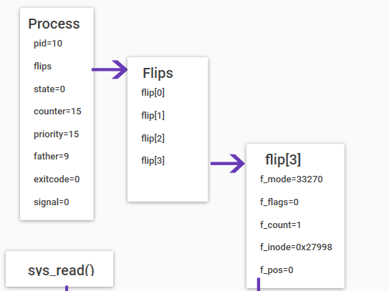
File Reading
Open()

Slide 9
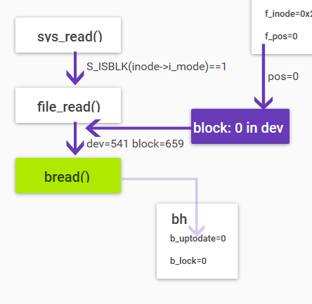
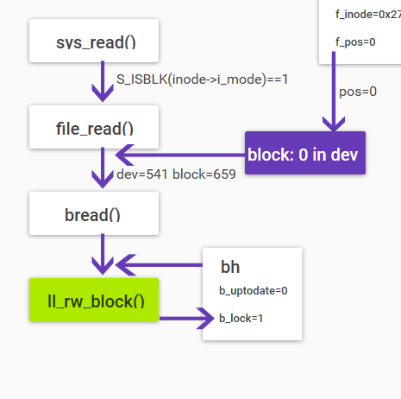
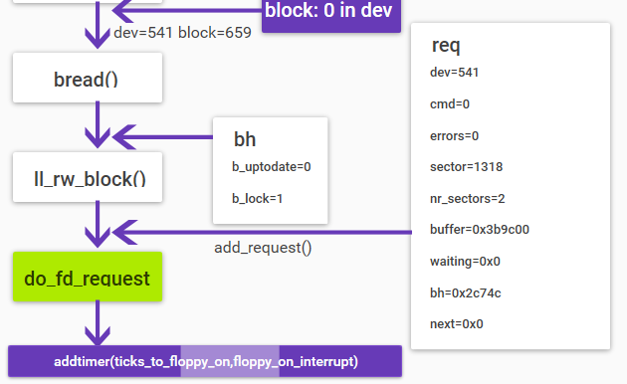
File Reading (cont.)

Slide 10
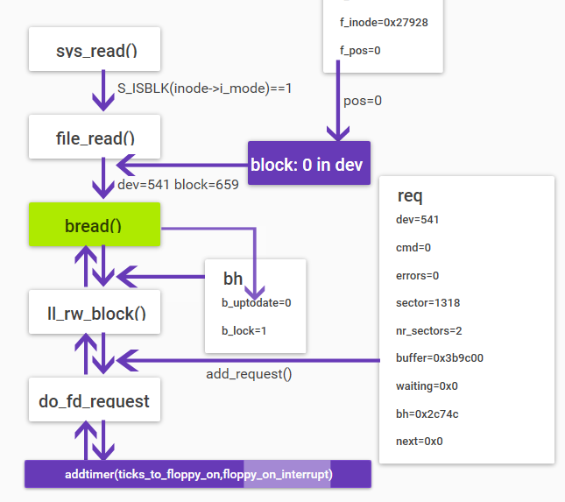
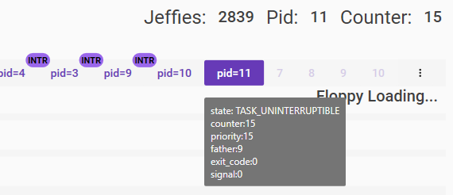
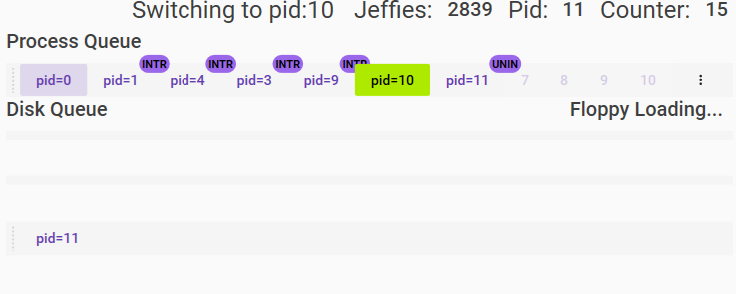
File Reading (cont.)
Sleep() and set uninterruptable

Slide 11
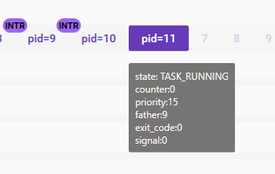

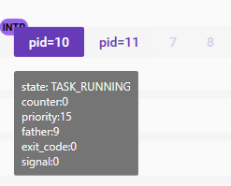
Scheduling
Counter of pid=10 and pid=11 is 15.
Whole running time is 40 and 20.
So, the running sequence is 11-10-11-10-11-9-4

Slide 12
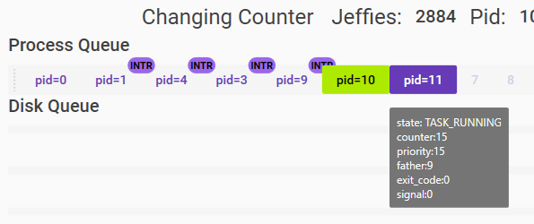
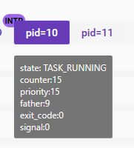
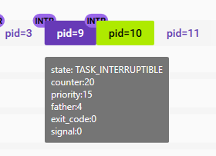
Scheduling (cont.)
When scheduling, since all RUNNING processes’ counters are 0, change the counter and reschedule.

Slide 13
Displaying(2)

Slide 14
Breakpoints and codes
Breakpoints
Print stacks directly
Conditional breakpoint
Global variables for specifying parent function
Codes
Handling by type of breakpoints
Read the raw breakpoint file(delete some breakpoints for simplicity)

Slide 15

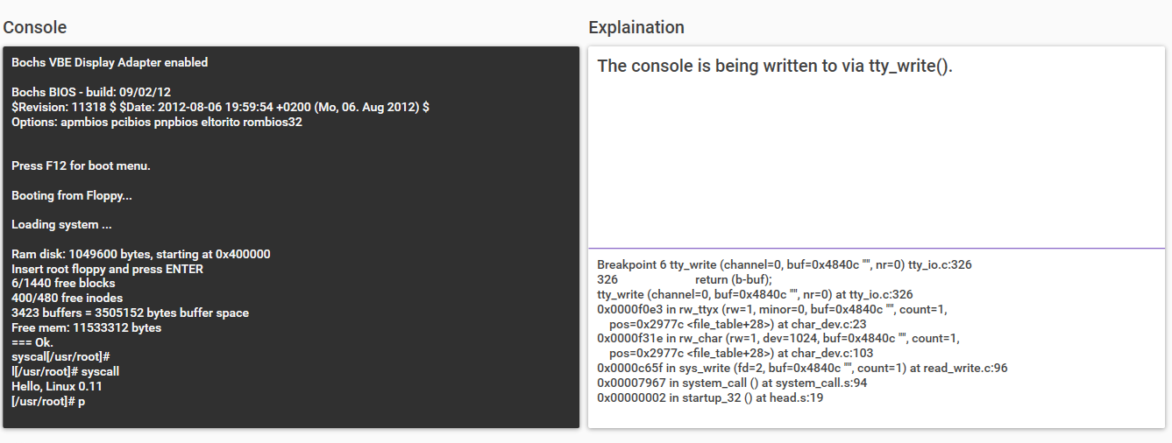
Before process.c(3)
Keyboard input and wake up pid=4, call sys_write, then tty_write
Pid=4 sleep until waken up by next keyboard input

Slide 16
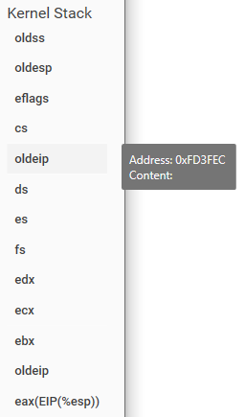
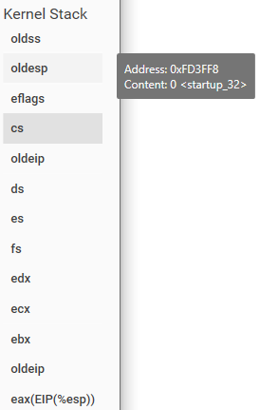
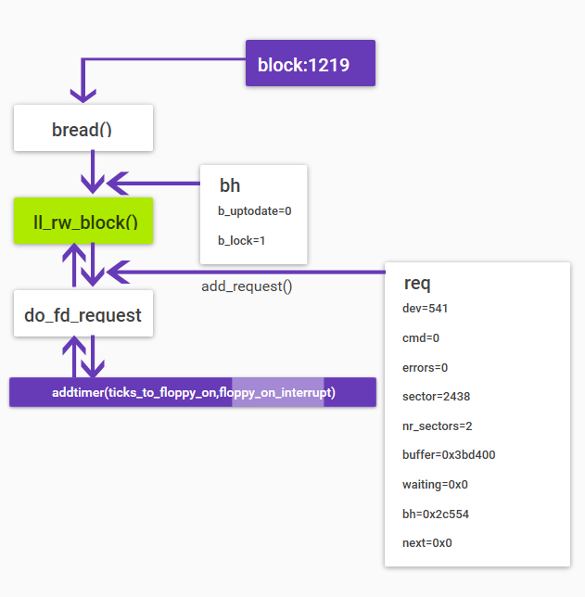
Before process.c (cont.)(4)
Execute pid=9
File loading
Stack manipulation

Slide 17
After process.c(5)
Exit pid=9
Tell_father
Pid=4 handles pipe for pid=9
Pid=4 automatically creates child process pid=12
Exit pid=12
Write new line
Pid=4 Interruptable
Switch to pid=0

Slide 18
Thank you.

