Slide 1
Customer Name and Logo
Common Financials Initiative
Case for Change

Slide 2
Agenda
Executive Summary
  Current Situation
  Goals
  Scope
  Approach
  Potential Benefit Summary
  Conclusions and Recommendations
  Next Steps
Appendix
  Financials Results
  Projects Results
  Procurement Results
  Participants

Slide 3
Executive Summary

Slide 4
Today, (client name) derives world-wide financial, projects, and procurement information with great difficulty because of complex (and often manual) business processes and disparate systems
Divisional financial operations struggle to provide timely and accurate management information
Few standard financial processes and best practices exist across (client name).
Few standard data models exist to facilitate sharing and retrieval of information across/between systems and divisions
Many current systems are out of date, inflexible, lack critical functionality and the ability to support business rules for processes such as project and commitment tracking
Some divisions are in critical need of strategic system solutions
Corporate MIS will face increasing difficulty and costs in supporting (client name) systems unless standardization occurs
(Client Name)’s current size and expected growth will not be cost effectively sustained by using redundant systems and functions

Slide 5

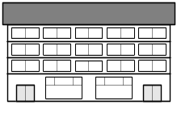


To address these issues, (client name) has launched the Common Financials Initiative (CFI) to assess the use of a single enterprise application
In the current environment, (client name) has disparate, one-off solutions for each division:
(Client Name)’s goal is to have common yet flexible solutions to support its lines of business throughout the divisions:
System 1
System 2
System 3
Costing Report
Revenue Report
Desktop
Spreadsheet
Revenue Estimates
Project Costs
Purchase Orders
Invoices
Division A
Division A
Corporate
Division B
System 4
System 5
System 6
Division B
Costing Report
Revenue Report
Desktop
Spreadsheet

Slide 6
The primary goals of the Common Financials Initiative are to address current issues and support business growth
Implement common world-wide financial processes and systems to address current business issues
Build the foundation for(client name) future growth with integrated financial systems across divisions
Provide access to consistent and timely information for comprehensive analysis and reporting
Enable(client name) to proactively manage vs “maintain” by establishing best practices and standards
Leverage enterprise applications to enable the business to analyze and react quickly...improving performance, profit and growth
Provide quality, cost effective MIS support through standardization of common application architecture and environments

Slide 7
The project scope is world-wide and focuses on three primary business areas: Financials, Projects, and Procurement
  Financials
GL
AR
Billing
Budgets
AP
Assets
Cash Mgt.
  Projects
  Procurement
Product Costing
Purchasing
Profitability Analysis
Inventory
Tracking

Slide 8




A Common Financials Initiative team has been formed to identify the potential benefits and to launch a business justification for the world-wide enterprise solution
Business Strategy Workshops
  Key Issues, Opportunities
  Business Process Vision
  Process Area Principles for the Project
  Specific Strategies
Best Practice Based Visioning Workshops
  Definition of (client name) Business Process Hierarchy
  Business Benefits by Sub-process
  Best Practices and Metrics
Validation Workshops
  Cross Process Benefit Validation
  Divisional Benefit Validation
  Confirm Responsible Process Owners
  Determine Business Case Assumptions
Case for Change

Slide 9
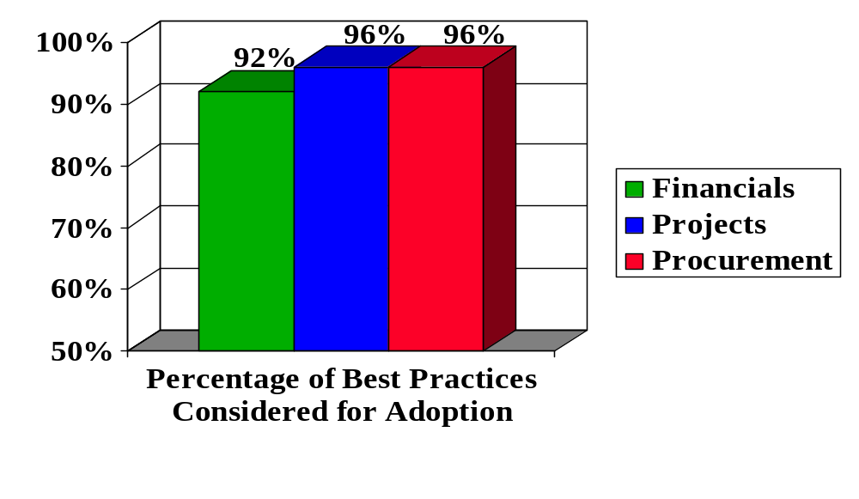
Best practices considered for adoption helped to complete the identification of potential tangible benefits
Based on best practices considered a total of 280 potential benefits have been identified from the Financials, Projects and Procurement business processes
41 Selected
37 Selected
42 Selected
95 Identified
85 Identified
100 Identified
41 Selected
37 Selected
42 Selected

Slide 10
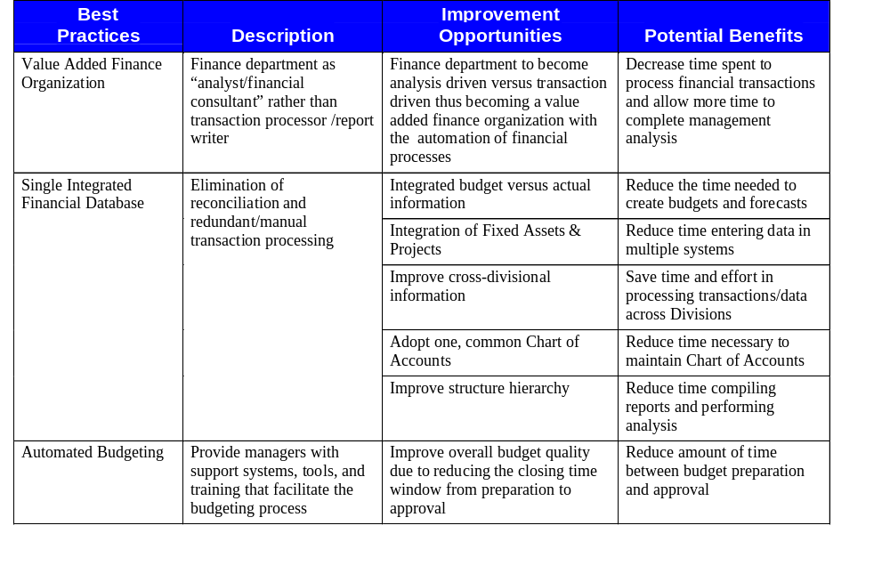
The CFI Financials team identified best practices for (client name) to drive benefits

Slide 11
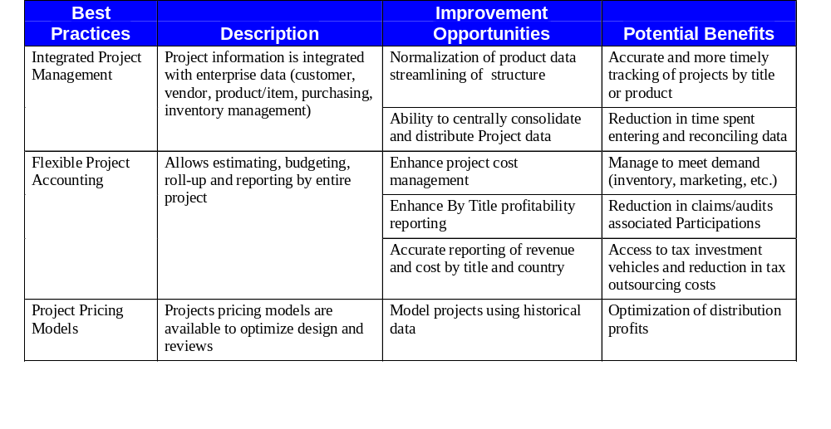
The CFI Projects team identified best practices for(client name) to drive benefits

Slide 12
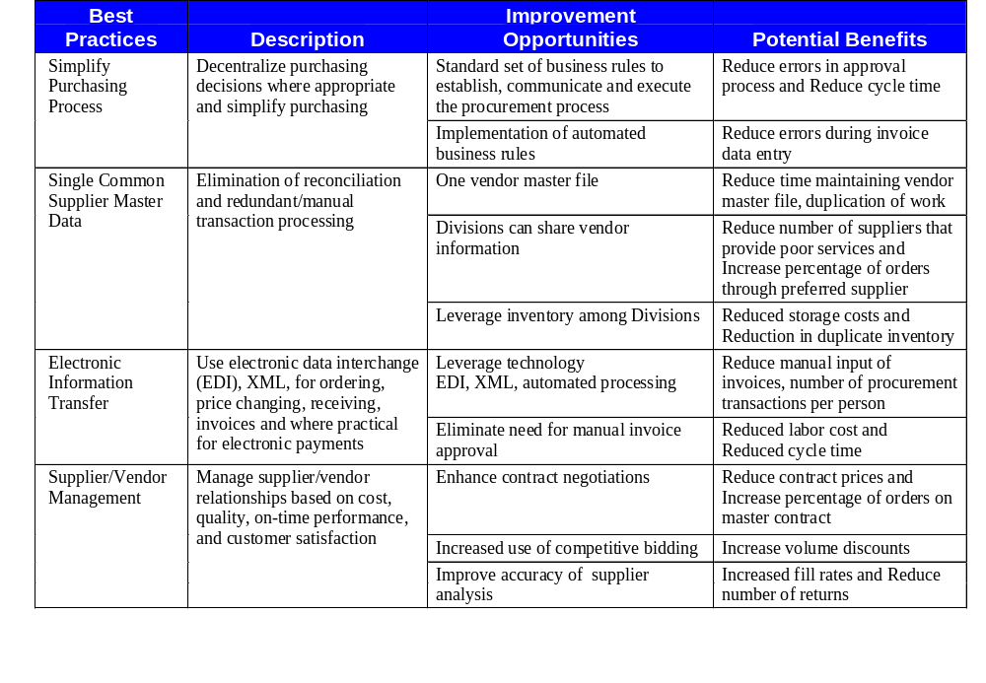
The CFI Procurement team identified best practices for (client name) to drive benefits

Slide 13
The project team expects that quantifiable benefits will be realized from cost savings using many of the same best practices that like companies have adopted in their enterprise application implementations
Best Practice
Area of Cost Savings
Integrated Financials and Controls
Reduction in the Total Number of Days to perform monthly closing and audit activities
Automated Budgeting and Forecasting
Reduction in the Number of Work Hours needed to investigate budget variances
Integration between Finance and Procurement Systems
Reduction in the Number of System Hours required to reconcile purchasing, receiving and payables
Empowered Procurement Function
Increase in Supplier On-time Delivery and Conformity to Specifications as a percentage of number of orders
Global Contract Negotiations
Increase in the Ratio of Negotiation Offers accepted to those rejected
Enhanced Management and Decision Support Capabilities
Increased ROI as measured by the Present Value of Benefits from Process Improvement divided by the Present Value of Investment Cost
Source: IBM Intellectual Capital, ERP Services 2000

Slide 14
Enterprise application research shows that companies, on average, achieve break even within five years from start of implementation and continue to realize improved performance after break even occurs
Implementation
Return on Investment
Once
implemented,
enterprise applications
can generate
annual returns of
2.5 times
annual cost
Annual gains
from enterprise applications
average
33% of TCO
Total Cost of
Ownership
Cumulative $
Break Even
Year 1
Year 2
Year 3
Year 4
Year 5
Source: Meta Group 1999

Slide 15
The project team has uncovered intangible benefits which may be realized in addition to quantified operational improvement or return on investment (ROI)
“Heard Around the Lot”
I’ve been through
this process before
with no results..will it be
different this time?
I have to enter this data
into many different systems!
Employee morale
Workforce efficiencies
Alignment to corporate
strategy
Ownership of information
Framework for future business process improvement and emerging technologies
The information we produce
today is good but getting there
is painful…we don’t have the right tools.
It’s a “no-brainer”
that we
need to do this!

Slide 16
Inaction means surviving with the current environment and conducting “business as usual”
(Client name) management will continue to struggle to obtain necessary information in a timely manner
“One-off” systems and solutions will continue to grow with no focus on the integrated needs of (client name) world-wide
A serious competitive disadvantage will exist without the infrastructure in place to move into emerging technologies such as e-business, web applications
Procurement strategic initiatives will not be adequately supported
Management and maintenance of disparate systems (languages, platforms, applications) will become more and more difficult
System support maintenance costs will continue to grow
“Traditional thinking claims there is no real value in the infrastructure, that there is only a delta between one which is poorly implemented and one which is well-managed (cost vs.more cost). It is important for IT to evolve from this to a value create, i.e. How does IT contribute to revenue enhancement, expense control, market share, time to market, etc.”
- 1999 Gartner Group Total Cost of Ownership (TCO) Conference

Slide 17
The Common Financials Initiative could help (client name) avoid costs of one-off disparate systems by providing desired functionality across divisions
In the past year, several projects were approved that would likely have been included in the Common Financials Initiative, had the project begun sooner
  ABC Order-to-Cash
  Consumer Products World-wide Accounts Receivable
  XYZ Facilities Purchasing System
Projects that have been proposed and are waiting for a CFI decision:
  International ABC Accounting System
  HP3000/HPFB Replacement
  International Accounts Receivable
  Balance of Consumer Products Financials
Enterprises should evaluate centralization and look for opportunities to automate high-cost functions and reduce labor expenses whenever possible. A heavy focus on capital costs may only undermine TCO reduction efforts - 1999 Gartner Group TCO Conference

Slide 18

Several constraints were identified which will require our focus in order to mitigate risk to the Common Financials Initiative project
Common Data Definition
Requires project decision policies, concurrence, cooperation
Project Resources Backfill
Requires management buy-in, efficient project management, backfill planning
Unique Requirements
Requires flexible application, separate “need” to have from “nice” to have
Need to assess/evaluate replacement and conversion strategy, and supported interfaces
System Migration
Skills
Focus early on skills training
Standard Policies & Procedures
Executive support, buy-in

Slide 19
Based on our analysis, the team has concluded that sufficient evidence exists to support the development of a Business Case
Tangible benefits from operational improvements have been identified and can be quantified
The opportunity cost of not adopting process improvements and best practices is significant to an enterprise application implementation
Adoption of best practices may reduce the total cost of ownership for an enterprise application and produce additional long-term benefits
Many intangible benefits can be realized from implementation of an enterprise application
“Many companies still aren’t sure whether they’re getting a positive return on their enterprise applications. They didn’t build a business case, and they’re now saying to themselves, ‘What the heck was I thinking?’”
…Analyst Holincheck as quoted in Infoweek 5/99

Slide 20
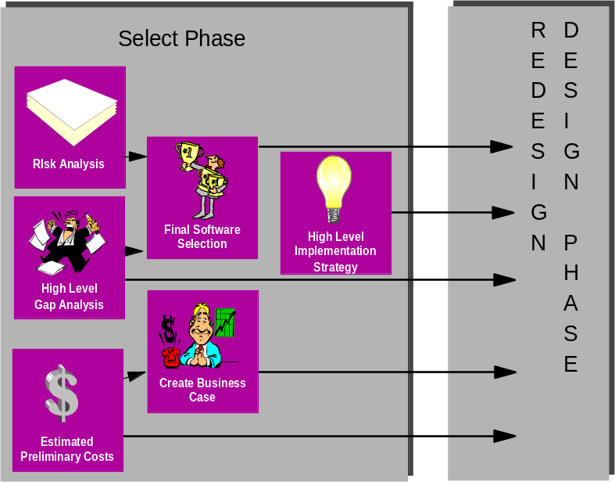
In summary, the project team recommends developing a detailed business case, high level future process design, and selecting the enabling enterprise application
Common Financials Initiative
Prepare Phase
Focus Phase
Provide Vision & Strategy
Manage Improvement & Change
Manage
production &
Understand
Market
Sell & handle
material
Manage
Provide
Market &
products &
orders
distribution &
customer
New entrants
Service
services
Manage
logistics
service
Remove available qualified resources
Outsourcing companies
Bundle solutions and supply total solutions
Services
IT platform companies
Manage Research & Technology
Strategic acquisitions
cycle support
Outsourced IT departments
Procure Goods & Services
Strategic
Rivals
Manage Maintenance
conflict
“Big Six” Consultants
Do it your yourself
Manage environmental. health, safety and medical services
IT service companies
Competent buyers
Manage projects
strategy
Small local companies
Solution - commodities
Own integration
Provide financial support
Supplier
General business climate
Customer
Manage External Relationships
Keep a high level of R&D to be in
Manage human resources
New and efficient ways of
front of technology
Base the consulting & services on a broad portfolio of packages
developments
implementing
Manage information resources
New SW technologies
Threats
Target To Be Design
Current Environment
Recommendation A
PROCESS
ATTRIBUTE:
Recommendation B
Process
Cycle
Rework/
Decision
HR
Info
Process
PERF
Recommendation C
Output
Time
Defects
Making
Utilization
Cost
Effectiveness
Mgmt
RATING *
Recommendation D
Recommendation E
Recommendation F
Recommendation G
Recommendation H
H = 1
L = 5
M = 3
Performance Rating
Develop Case for
*
= Sum of all attribute ratings for each individual process
L+ = 4
M+ = 2
High-Level
Change
H- = 2
L- = 6
M- = 4
Identify Key Issues
Business Case
Development of
Identify
Business Strategy
Opportunities
Decision
Model
2/22/00
6/30/00
Assumptions:
(Client name) resources will be available for all scheduled activities
This estimate does not include IT and Organizational Change activities

Slide 21
Appendix

Slide 22
Financials Results

Slide 23
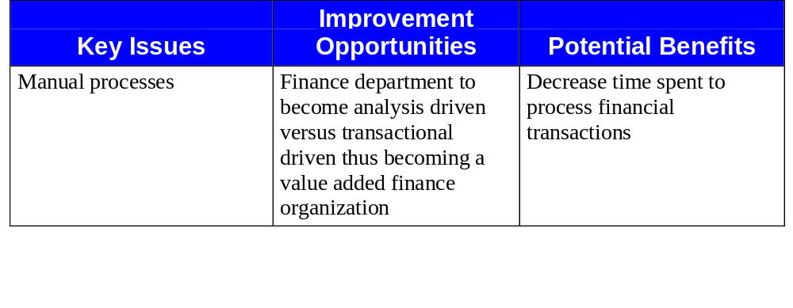
Financials - Provide Financial Services
Issues, Opportunities, Benefits and Costs:
Potential Costs/Constraints:
Transformation of employee skill-set to more analytical through
additional education and new hires

Slide 24
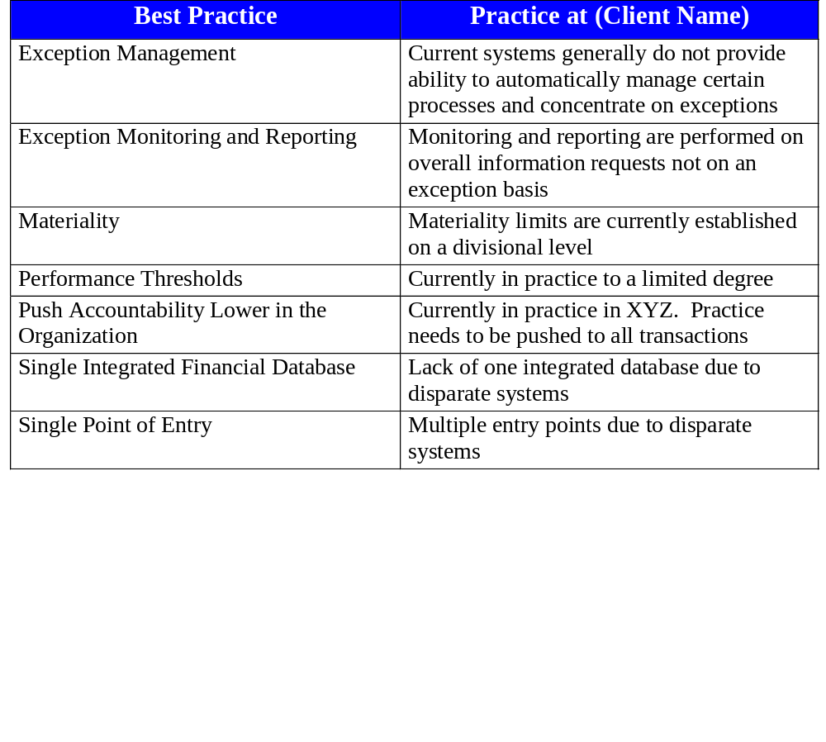
Financials - Provide Financial Services
Best Practices Necessary for Improvement:

Slide 25
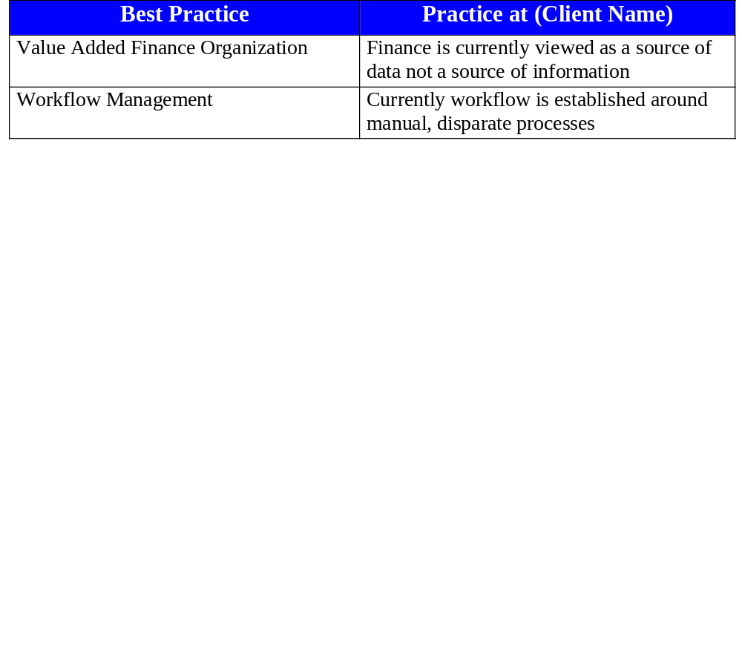
Financials - Provide Financial Services
Best Practices Necessary for Improvement (cont.):

Slide 26
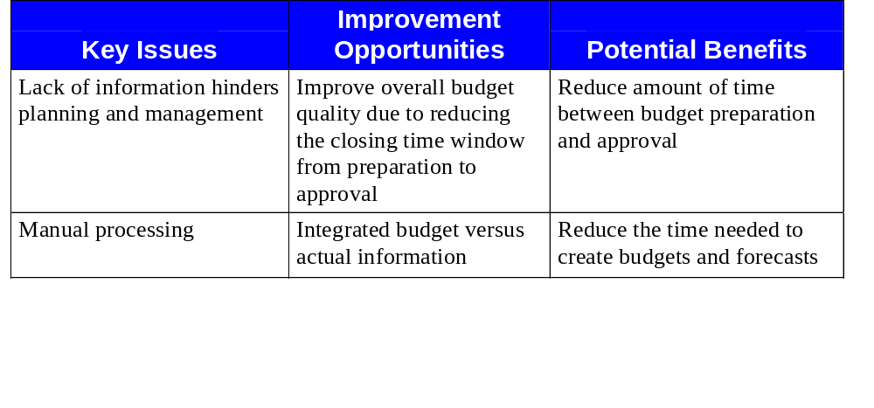
Financials - Manage Financial Budgeting
Issues, Opportunities, Benefits and Costs:
Potential Costs/Constraints:
All appropriate people may not have access to the system
Sharing information between Divisions
Skill set, past experience and local experience of employees due to
turnover

Slide 27
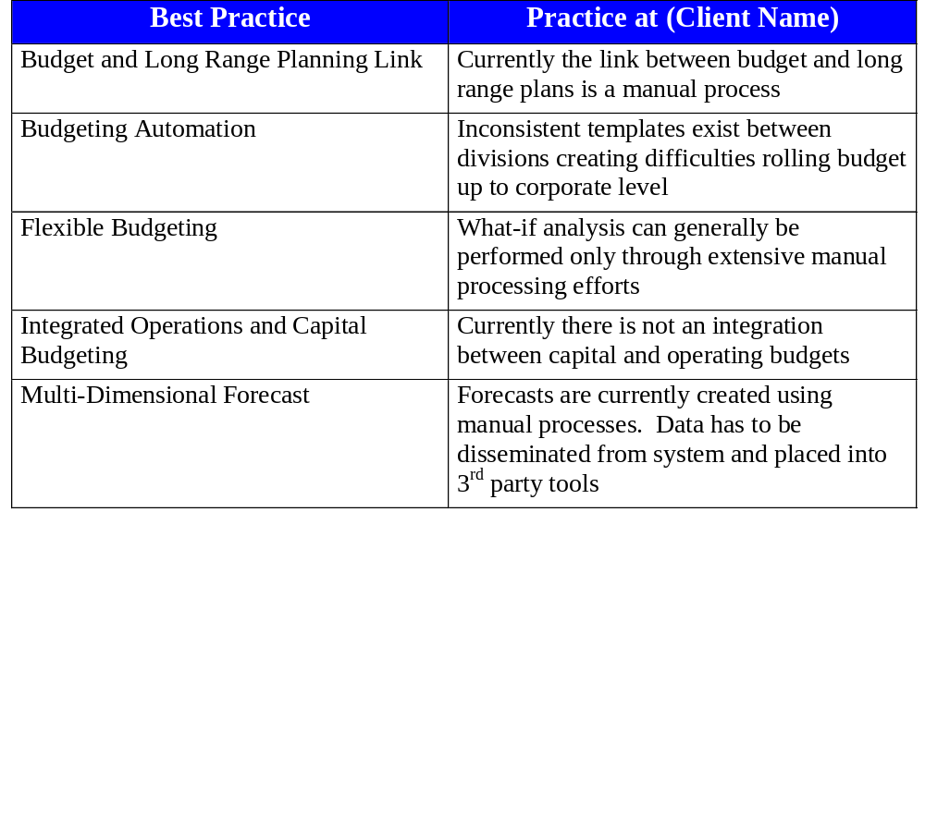
Financials - Manage Financial Budgeting
Best Practices Necessary for Improvement:

Slide 28
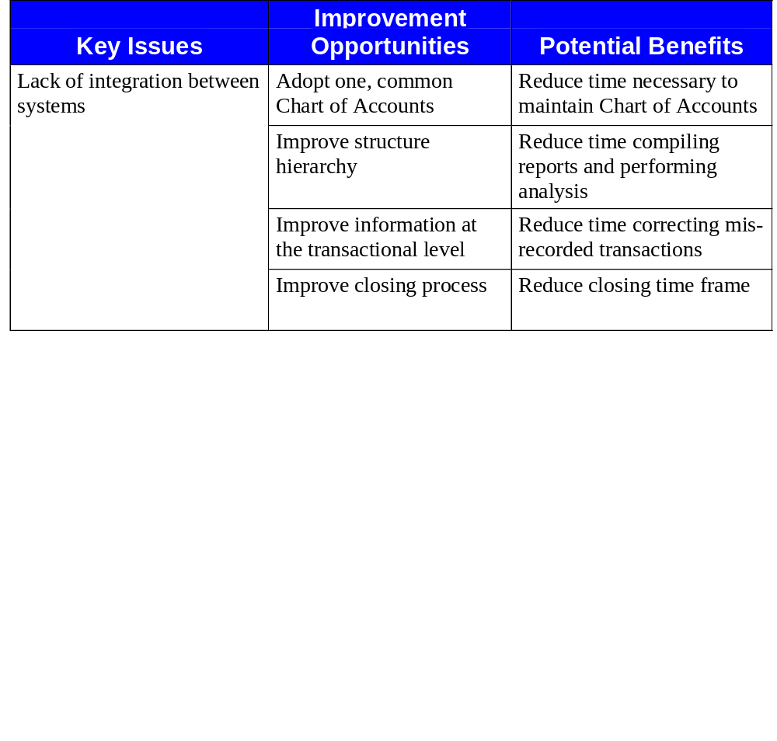
Financials - Manage General Ledger
Issues, Opportunities, Benefits and Costs:

Slide 29
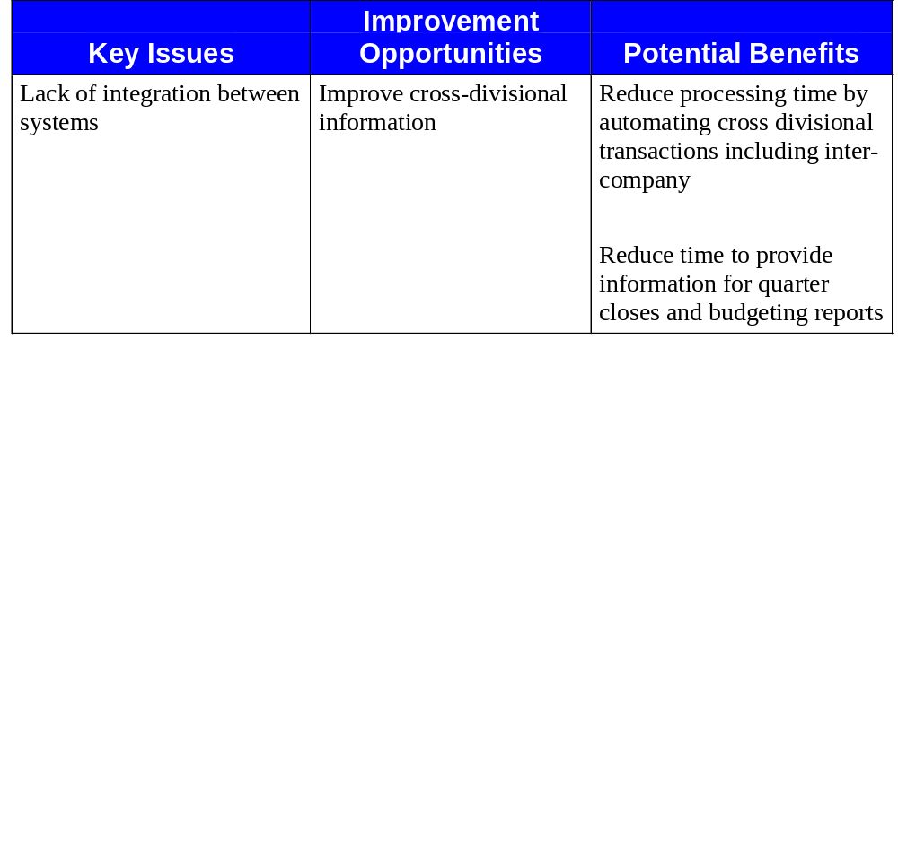
Financials - Manage General Ledger
Issues, Opportunities, Benefits and Costs (cont.):

Slide 30
Financials - Manage General Ledger
Issues, Opportunities, Benefits and Costs (cont.):
Potential Costs/Constraints:
Potential increase in resources to maintain common Chart of Accounts
Divisional account structure differs
Unique territorial needs may inhibit a common Chart of Accounts
Handling of intercompany transactions due to different financial cycles
and cut-off dates
Timelines between Divisions

Slide 31
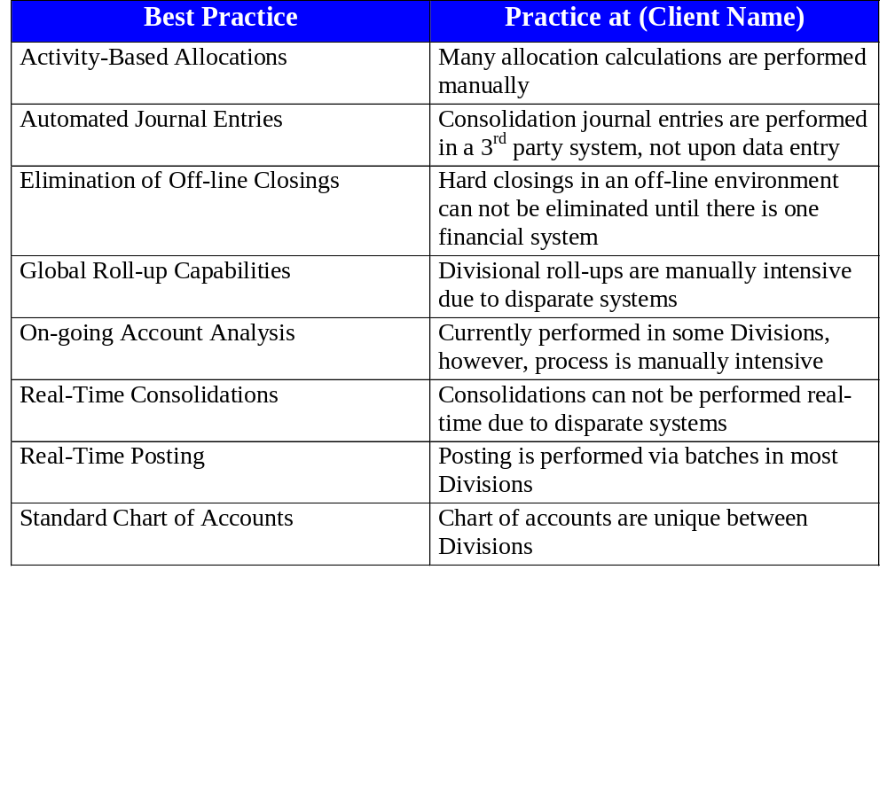
Financials - Manage General Ledger
Best Practices Necessary for Improvement:

Slide 32
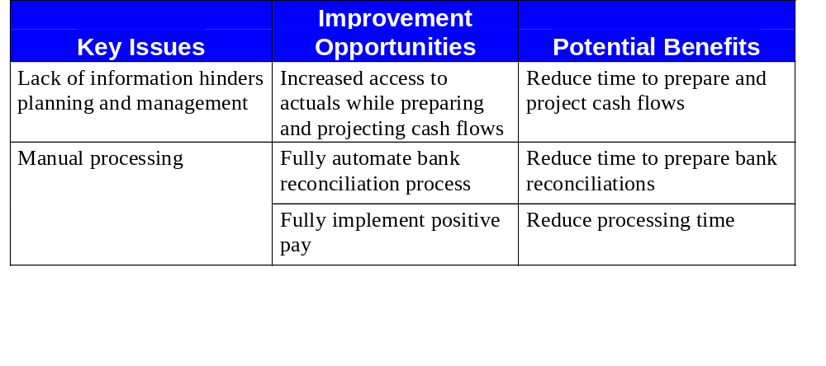
Financials - Perform Cash Management
Issues, Opportunities, Benefits and Costs:
Potential Costs/Constraints:
Inter-company royalties owed to US Company by International
Divisions
Divisions may be resistant to push cash down to a minimum level
Bank fees associated with positive pay
Delivery of accurate and timely information to banks
Time window associated with positive pay

Slide 33
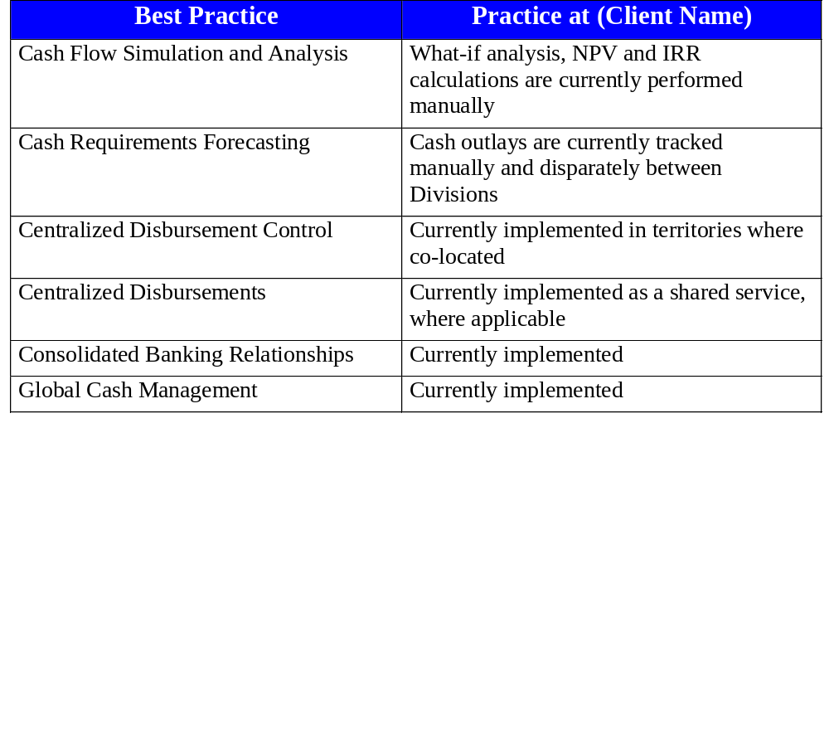
Financials -Perform Cash Management
Best Practices Necessary for Improvement:

Slide 34
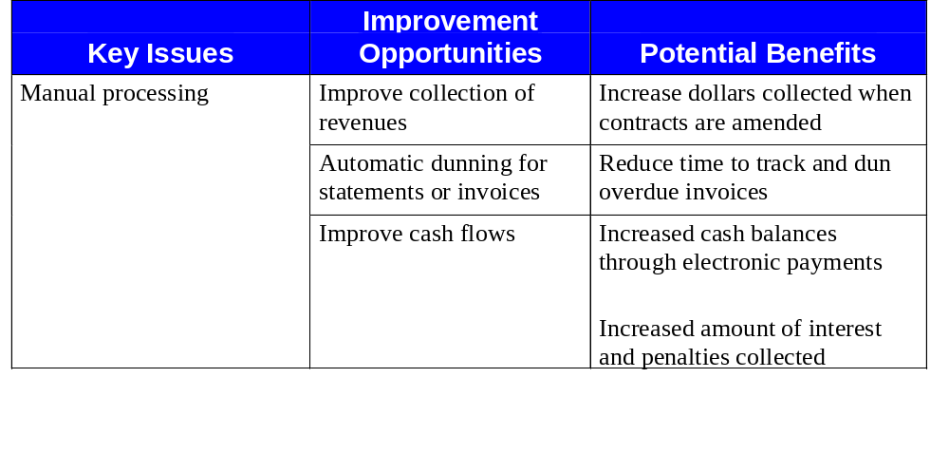
Financials - Manage Accounts Receivable
Issues, Opportunities, Benefits and Costs:
Potential Costs/Constraints:
Unique customer base by Division
Divisions may be adverse to sharing resources
Need remittance information upon receipt of cash
Integration of feeder systems

Slide 35
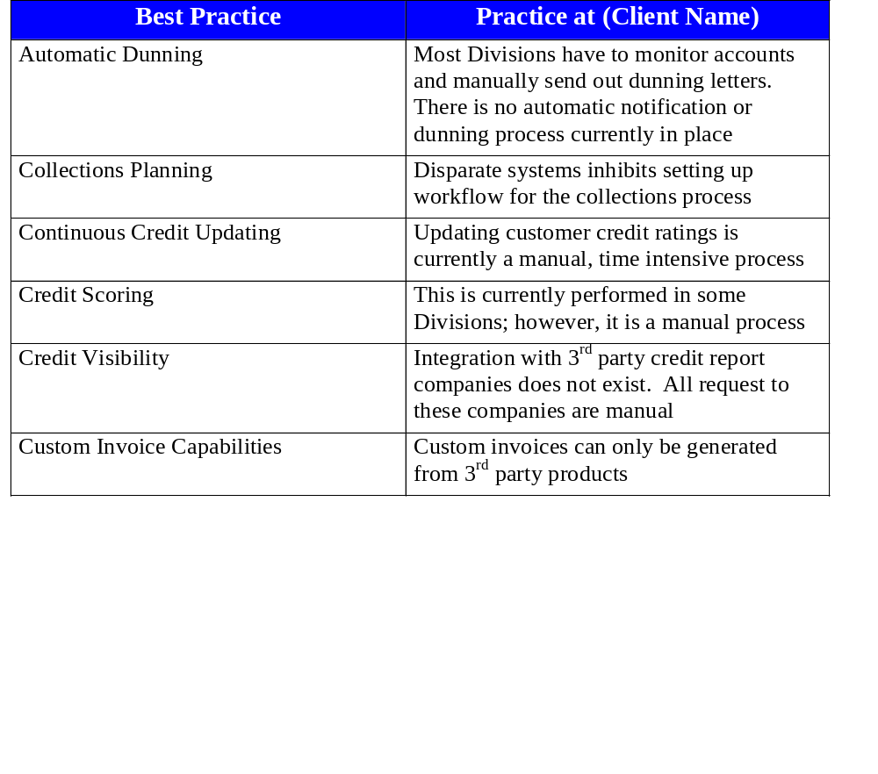
Financials - Manage Accounts Receivable
Best Practices Necessary for Improvement:

Slide 36
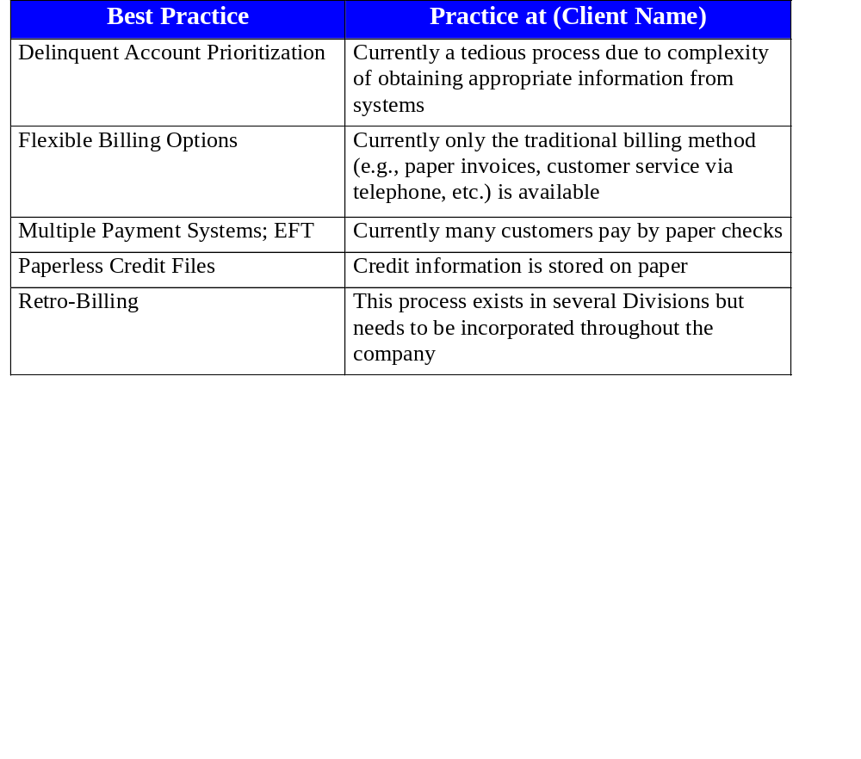
Financials - Manage Accounts Receivable
Best Practices Necessary for Improvement (cont.):

Slide 37
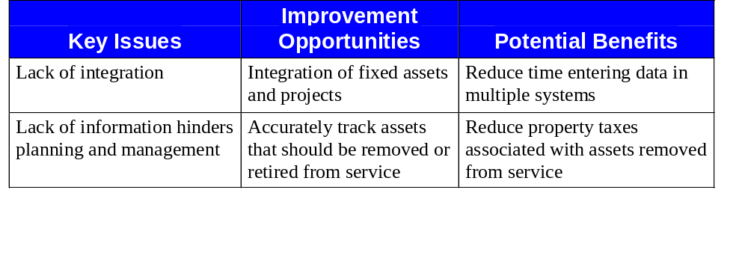
Financials - Perform Asset Management
Issues, Opportunities, Benefits and Costs:
Potential Costs/Constraints:
Effort to maintain asset records
Numerous methods of depreciation

Slide 38
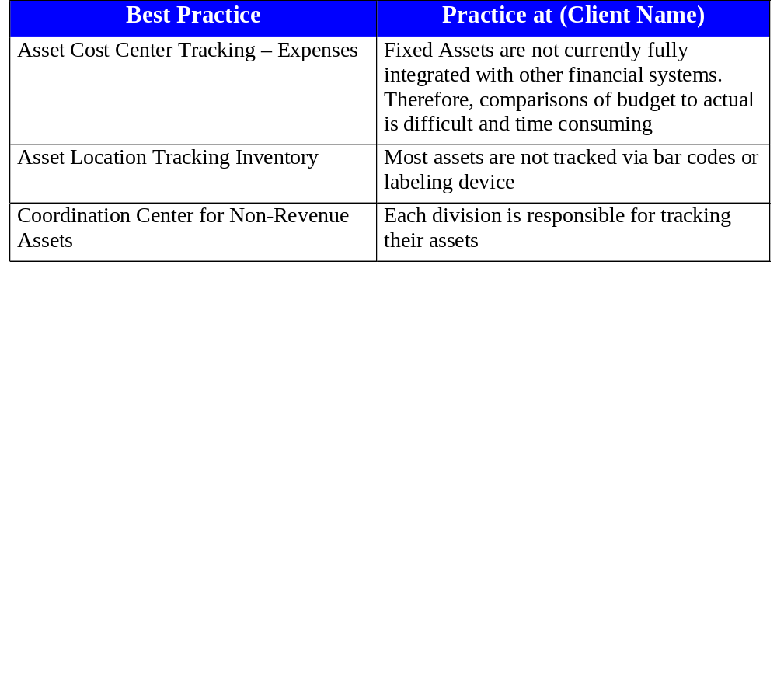
Financials - Perform Asset Management
Best Practices Necessary for Improvement:

Slide 39
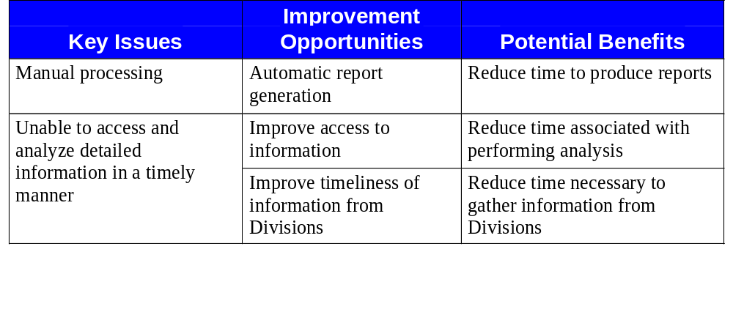
Financials - Perform Financial Analysis
Issues, Opportunities, Benefits and Costs:
Potential Costs/Constraints:
Skill set of employees

Slide 40
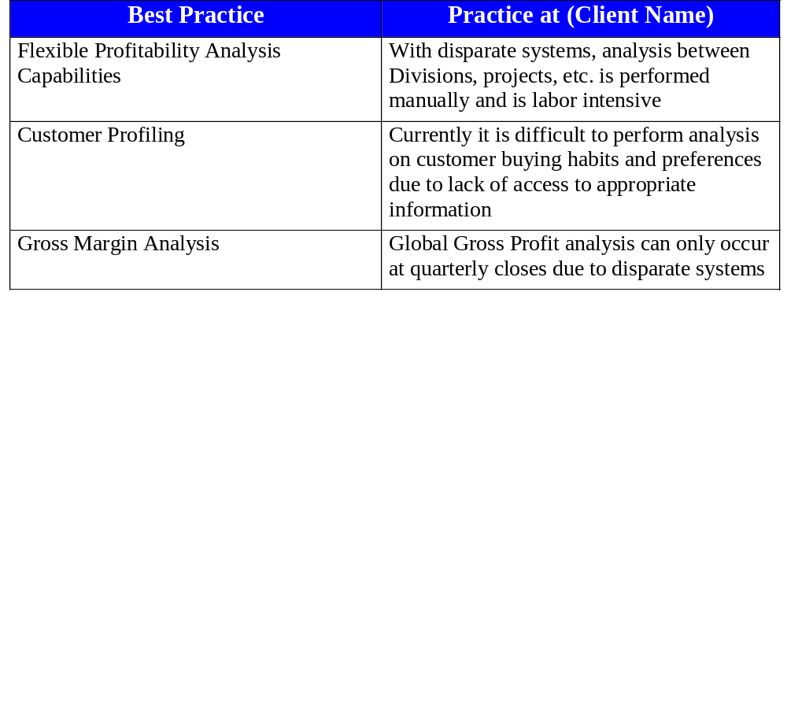
Financials - Perform Financial Analysis
Best Practices Necessary for Improvement:

Slide 41
Financials Intangible Benefits
Ensure adherence to company policies
Reduce stress level of staff
Improve employee efficiency
Improve analysis
Enhanced reporting capabilities
Improve query capabilities
Proactive versus reactive management
Improve response to management information
requests
Eliminate separation of duties issues
Improve transaction visibility
Improve data integrity

Slide 42
Projects Results

Slide 43
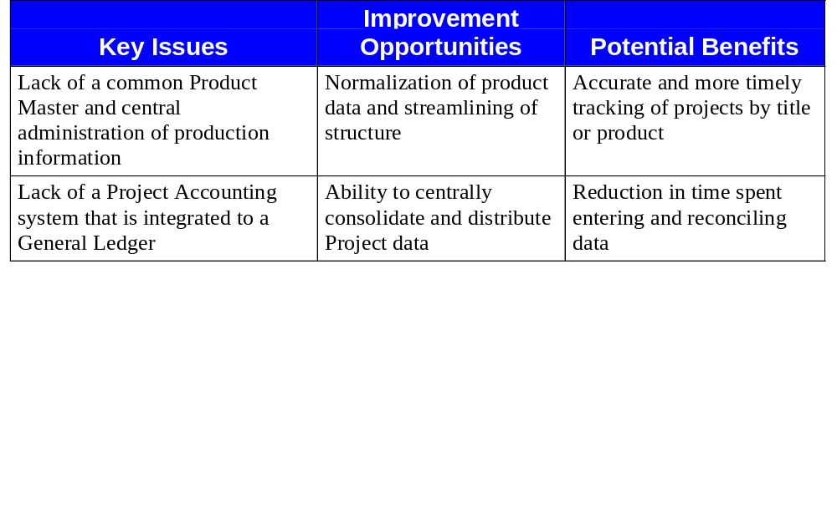
Projects - Define Projects
Issues, Opportunities, Benefits and Costs:
Potential Costs/Constraints:
No central administration of product or release information
Current de-central collection and administration of project data

Slide 44
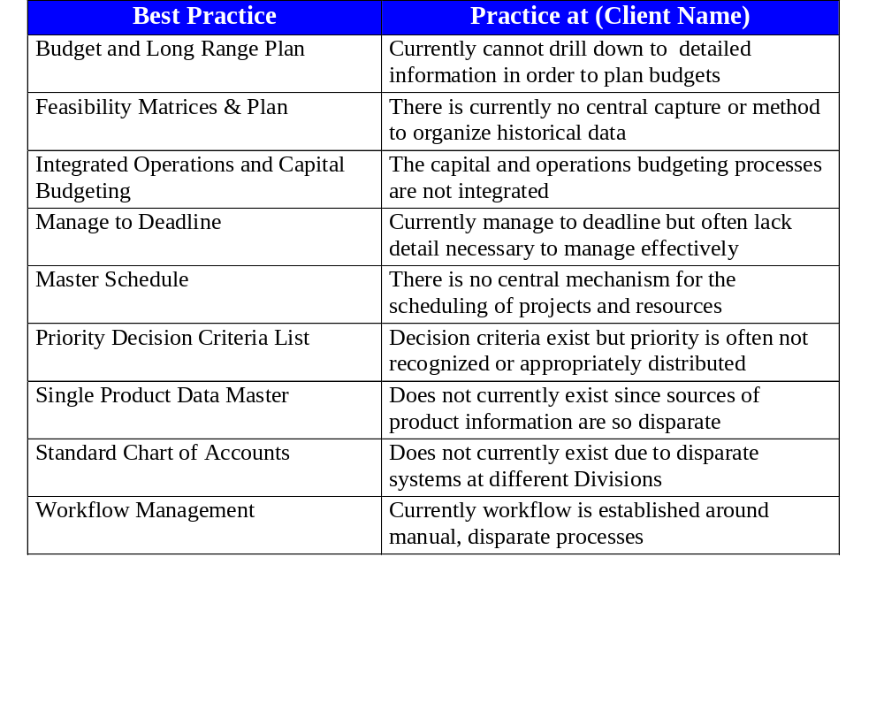
Projects -Define Projects
Best Practices Necessary for Improvement:

Slide 45
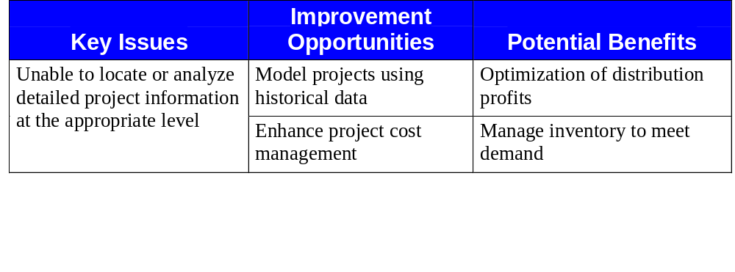
Projects - Plan Projects
Issues, Opportunities, Benefits and Costs:
Potential Costs/Constraints:
Inability to access historical data
Production demands and availability of resources

Slide 46
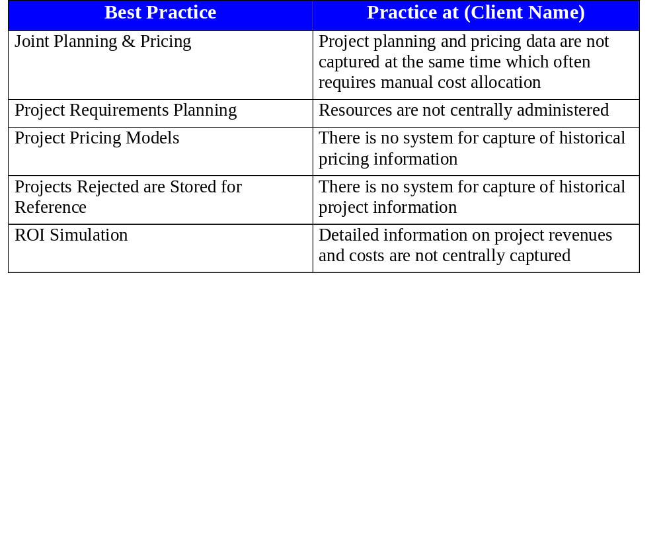
Projects - Plan Projects
Best Practices Necessary for Improvement:

Slide 47
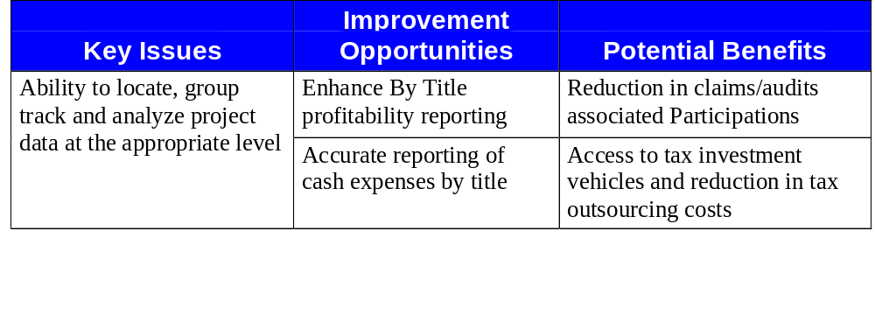
Projects - Project Management
Issues, Opportunities, Benefits and Costs:
Potential Costs/Constraints:
Disparate locations for titles and balances
No existing ledger which tracks cash spending

Slide 48
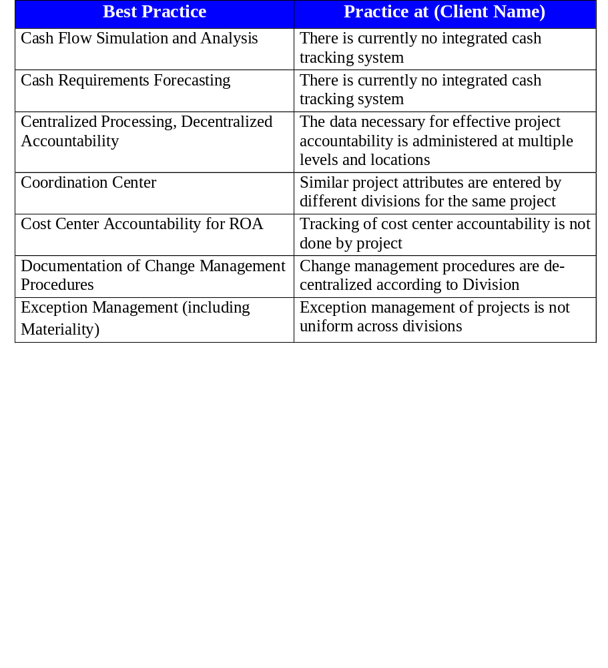
Projects - Project Management
Best Practices Necessary for Improvement:

Slide 49
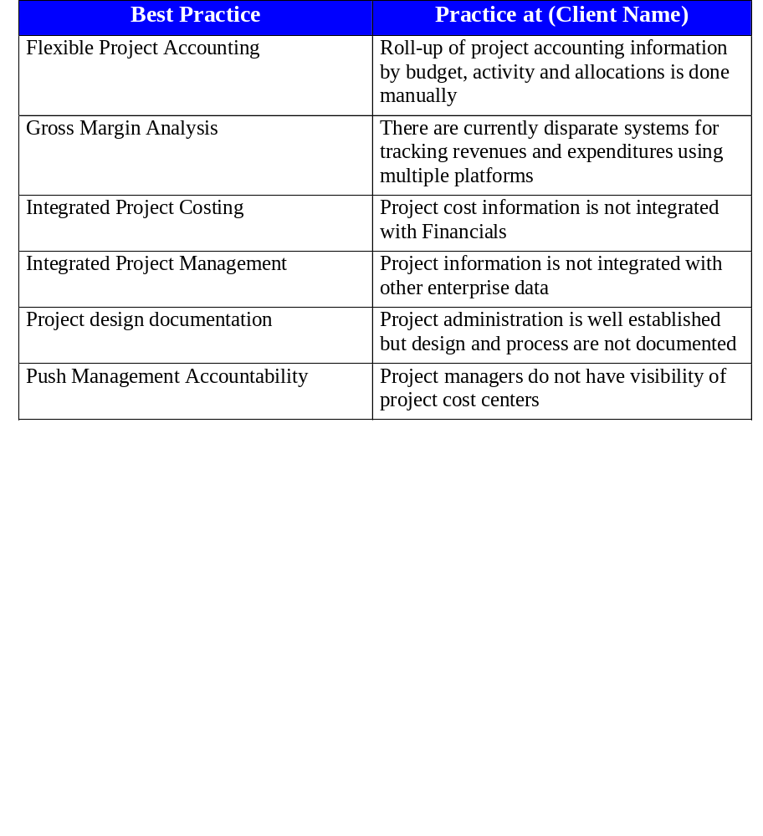
Projects - Project Management
Best Practices Necessary for Improvement (cont.):

Slide 50
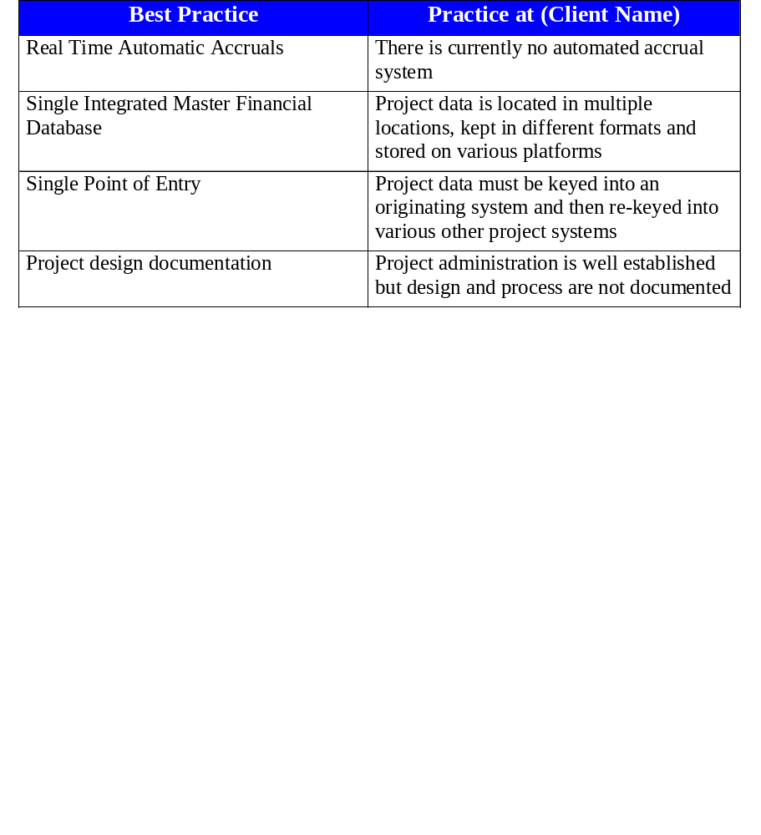
Projects - Project Management
Best Practices Necessary for Improvement (cont.):

Slide 51
Projects Intangible Benefits
Increased management administrative time
Reduction of frustration level
Ability to analyze multiple budget scenarios
Better management of resources
Increased accountability and ownership of information
Common world-wide financial information on a common platform

Slide 52
Procurement Results

Slide 53
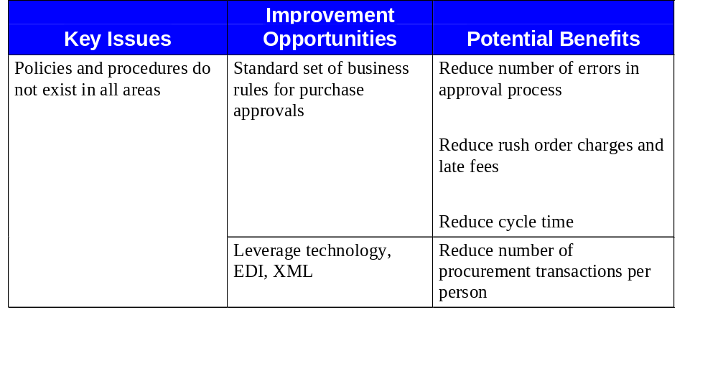
Procurement - Define Procurement Strategy
Issues, Opportunities, Benefits and Costs:

Slide 54
Procurement - Define Procurement Strategy
Issues, Opportunities, Benefits and Costs:
Potential Costs/Constraints:
Resource constraints to implement the system and changes
Expertise and specialists need to be hired and/or trained
Leadership from single significant influencer
ERP system must be implemented
Division support and buy-in
Lack of strict adherence

Slide 55
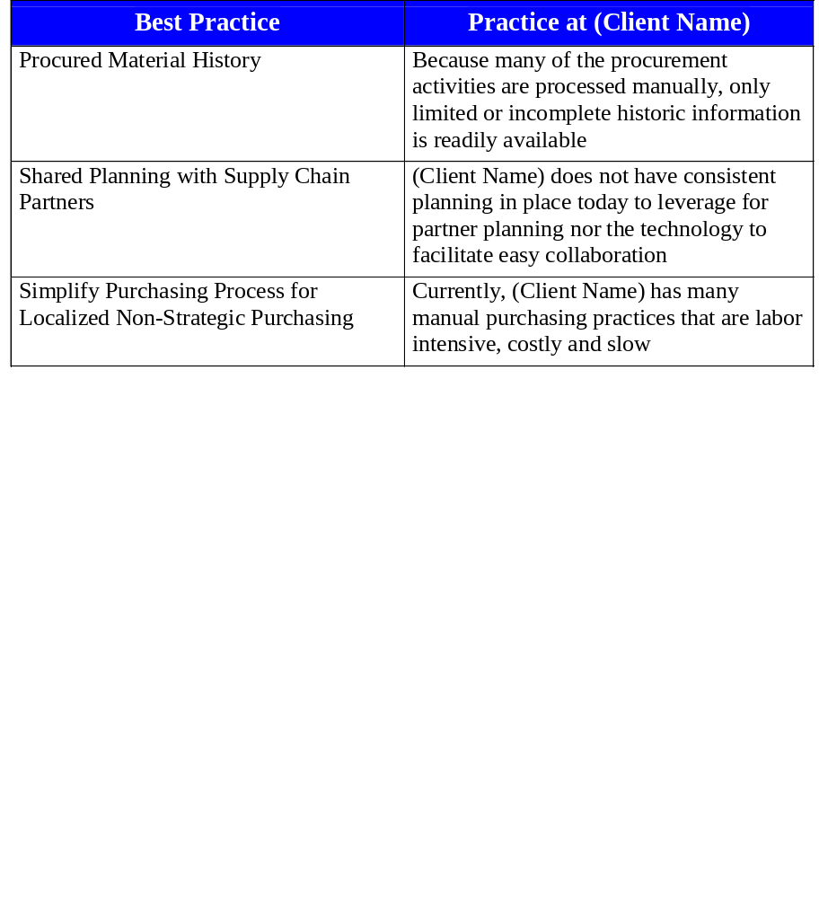
Procurement - Define Procurement Strategy
Best Practices Necessary for Improvement:

Slide 56
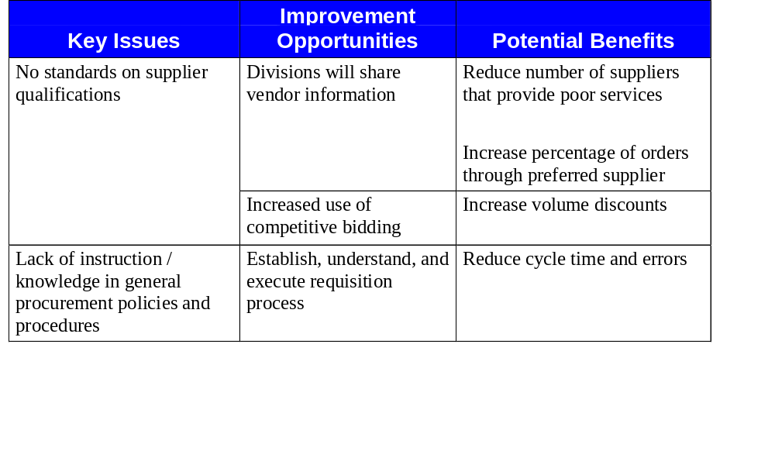
Procurement - Procure Goods and Services
Issues, Opportunities, Benefits and Costs:

Slide 57
Procurement - Procure Goods and Services
Issues, Opportunities, Benefits and Costs (cont.):
Potential Costs/Constraints:
Automated ordering may be more time consuming/cumbersome
Vendor may not have the capability of electronic transmissions
Infrastructure; access to the system and system response time
Obtaining consensus across divisions for interdependency
Skilled labor is more expensive; procurement skills
Pre-existing agreement with many suppliers/vendors
Market rates - benchmarks must be monitored
Training the entire company on procurement
Organizational changes - centralized focus
Specialty suppliers/vendors
Cost of changing technology
Resources required
Talent restrictions

Slide 58
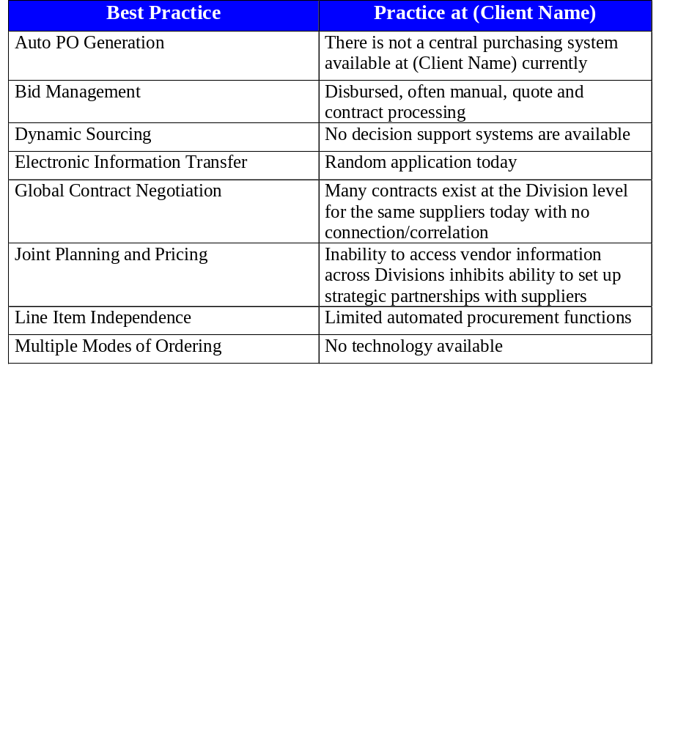
Procurement - Procure Goods and Services
Best Practices Necessary for Improvement:

Slide 59
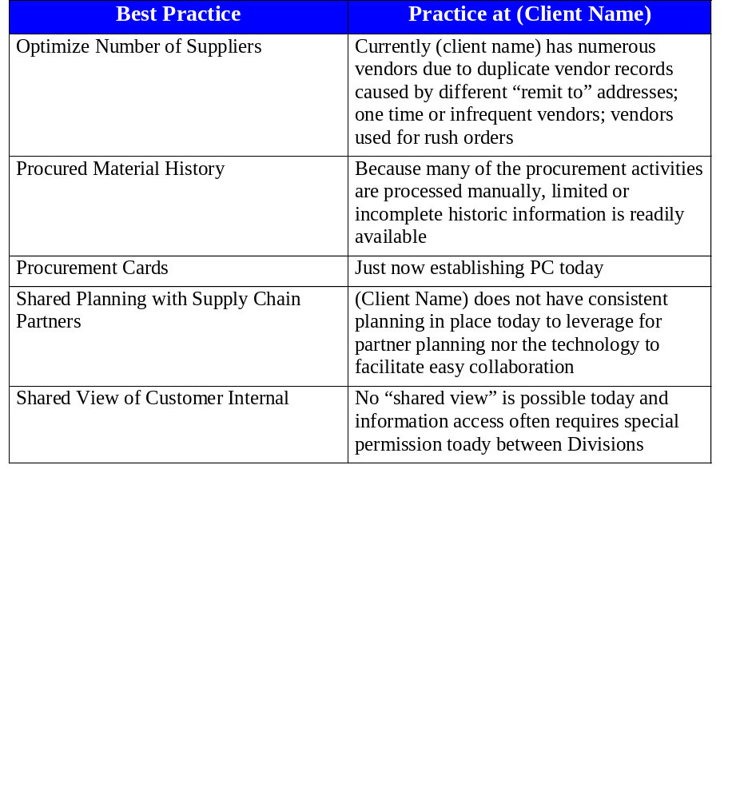
Procurement - Procure Goods and Services
Best Practices Necessary for Improvement:

Slide 60
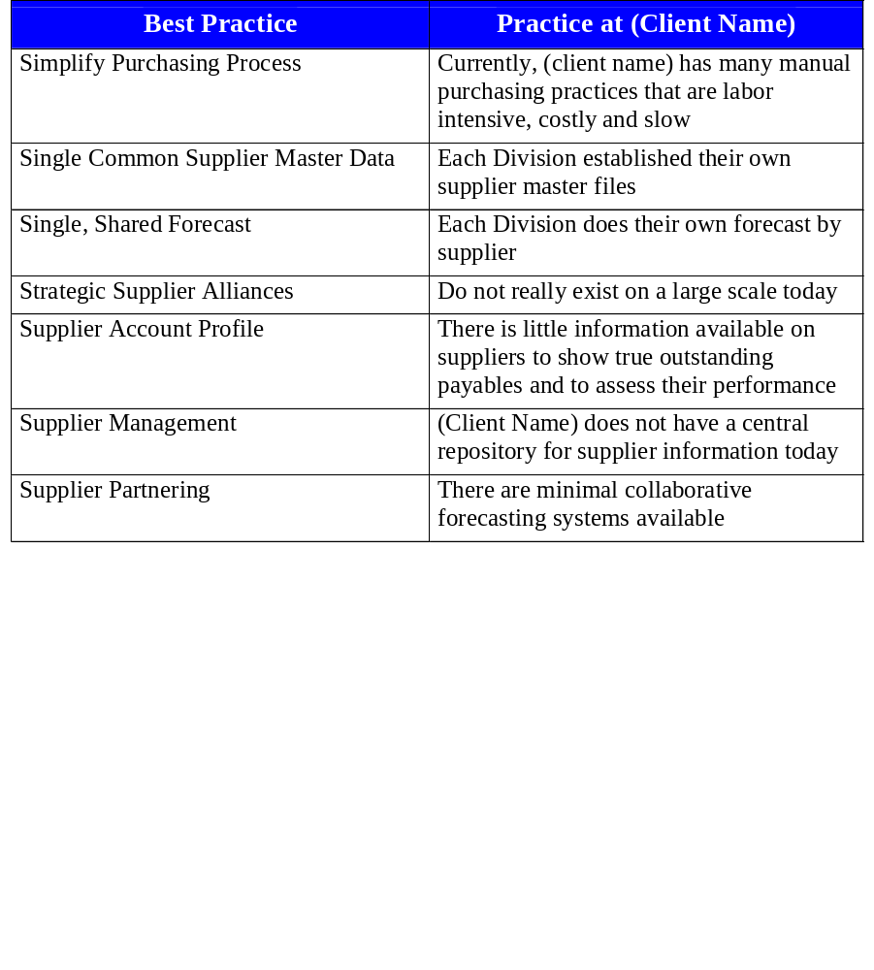
Procurement - Procure Goods and Services
Best Practices Necessary for Improvement (cont.):

Slide 61
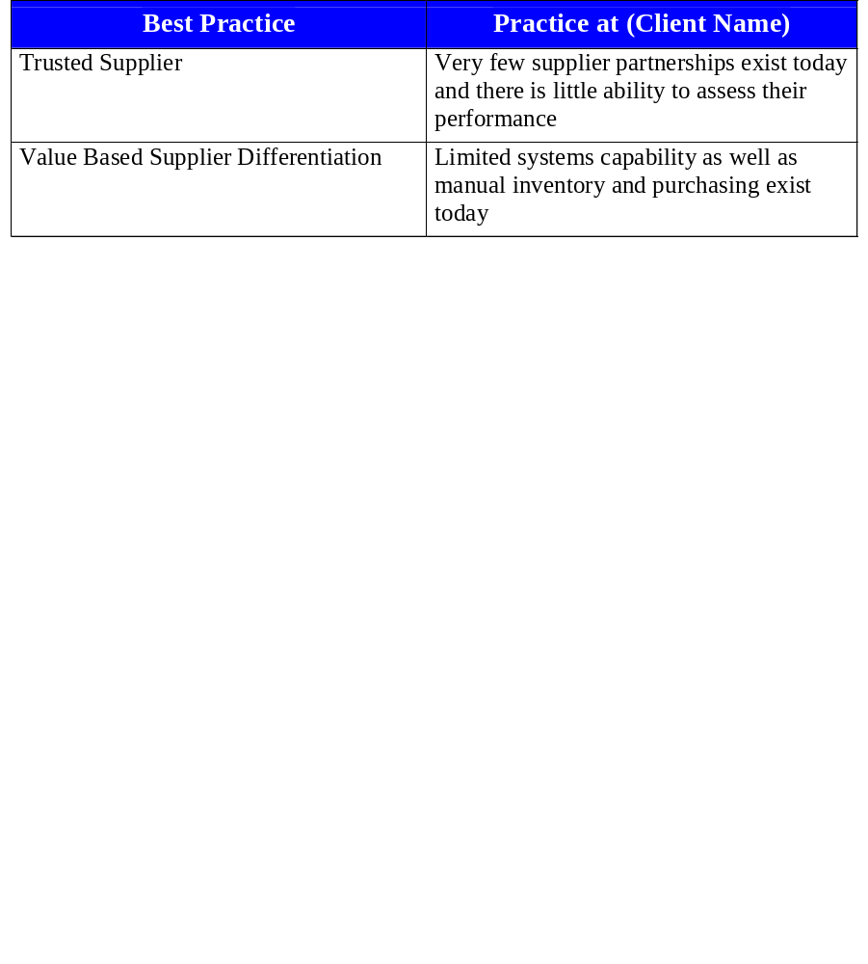
Procurement - Procure Goods and Services
Best Practices Necessary for Improvement (cont.):

Slide 62
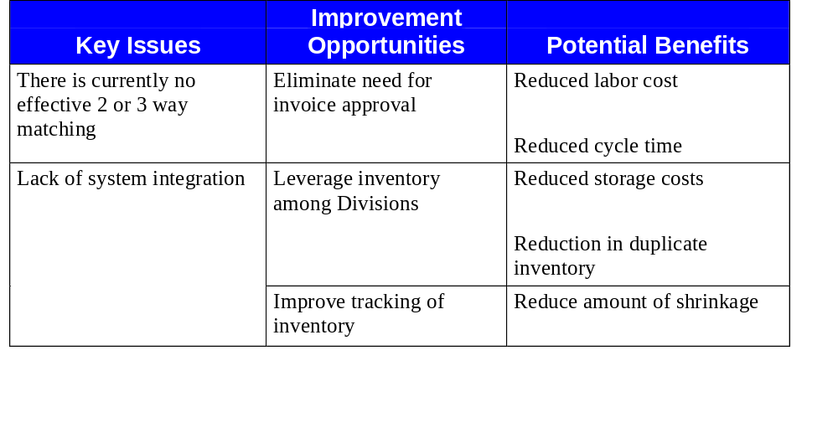
Procurement - Expedite Goods and Services
Issues, Opportunities, Benefits and Costs:

Slide 63
Procurement - Expedite Goods and Services
Issues, Opportunities, Benefits and Costs (cont.):
Potential Costs/Constraints:
Existing storage facilities may no longer be necessary
Technology cost associated with bar coding and RF
Increased headcount to support processes
Disbursement of cash earlier
Training for end user

Slide 64
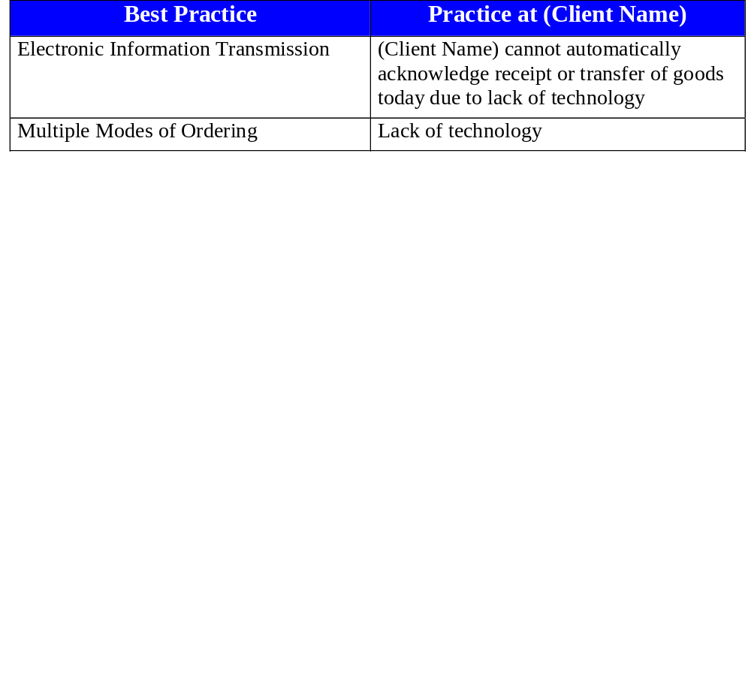
Procurement - Expedite Goods and Services
Best Practices Necessary for Improvement:

Slide 65
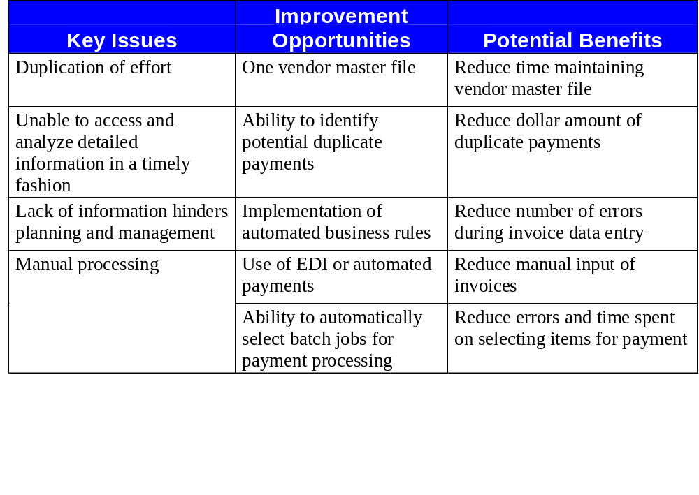
Procurement - Manage Accounts Payable
Issues, Opportunities, Benefits and Costs:

Slide 66
Procurement - Manage Accounts Payable
Issues, Opportunities, Benefits and Costs (cont.):
Potential Costs/Constraints:
Establishing and maintaining appropriate bank account information
Cultural change from enforcement to customer service
Divisional buy-in for standardized processes
Partnership with purchasing departments
Change the way (Client Name) deals with vendors
Complex divisional approval process
Electronic integration with vendors
Support for training end users
Inconsistent entry of invoices
Required hardware for all users
Vendor categorization difficulties

Slide 67
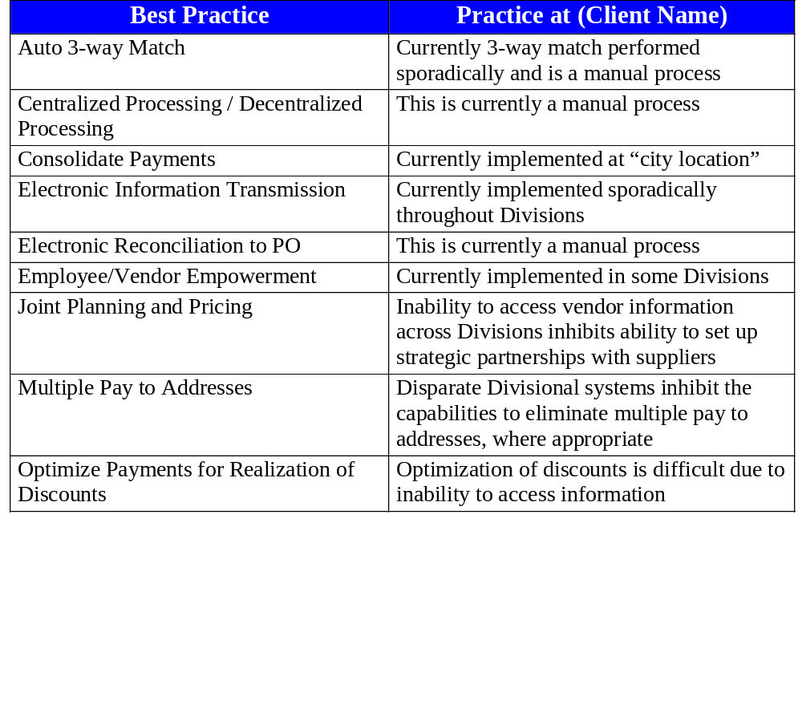
Procurement - Manage Accounts Payable
Best Practices Necessary for Improvement:

Slide 68
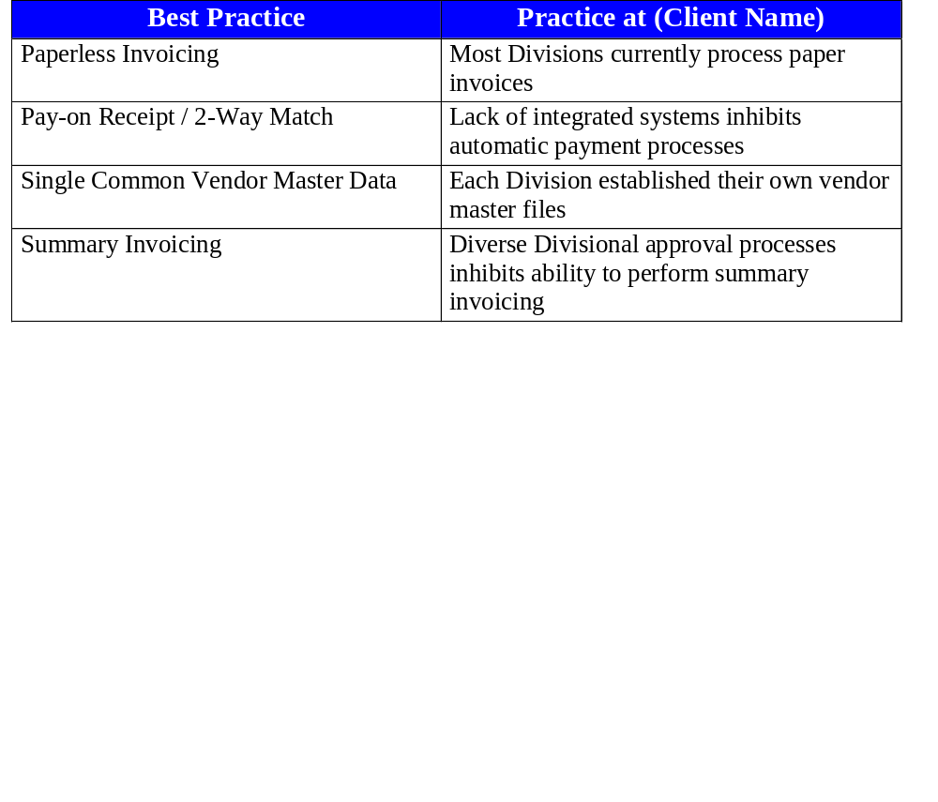
Procurement - Manage Accounts Payable
Best Practices Necessary for Improvement (cont.):

Slide 69
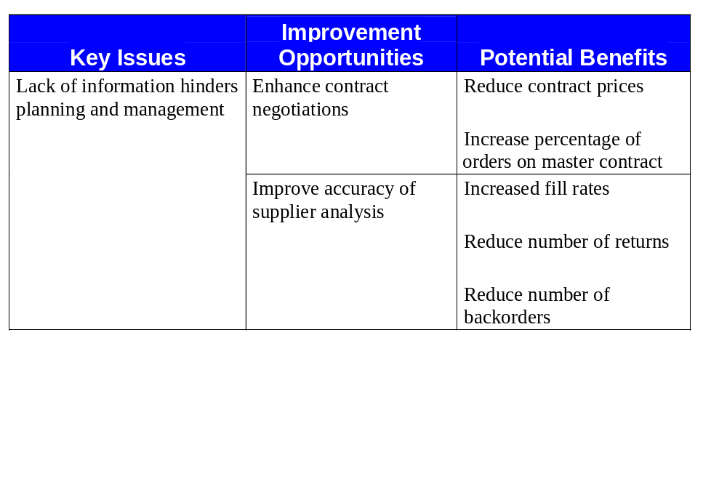
Procurement - Monitor Performance
Issues, Opportunities, Benefits and Costs:
Potential Costs/Constraints:
Change in the way we do business

Slide 70
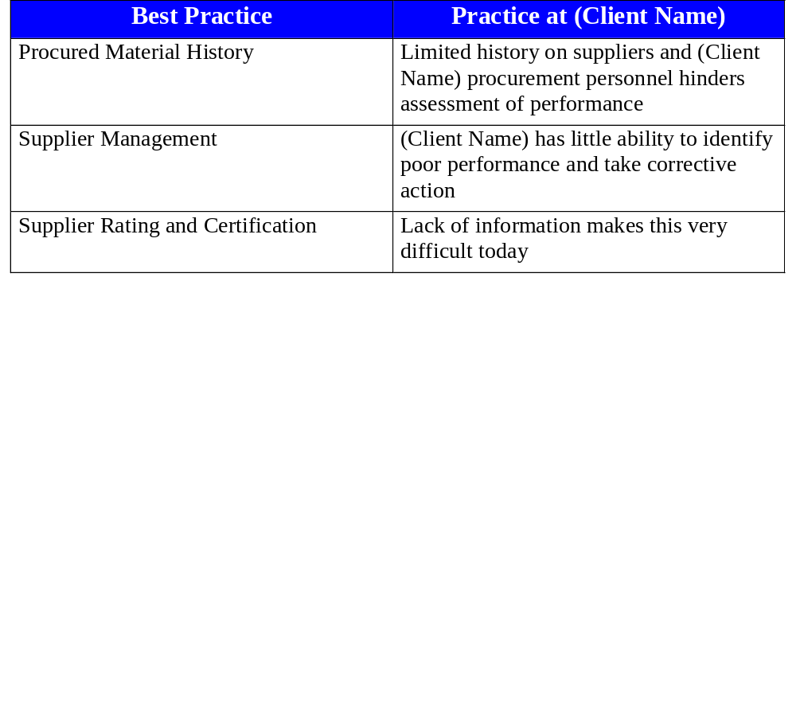
Procurement - Monitor Performance
Best Practices Necessary for Improvement:

Slide 71
Procurement Intangible Benefits
Consistent supplier/vendor qualification
Better visibility to overall cost of product/service
Ability to track at a line item level
More timely and accurate spend information
Ensures internal customer satisfaction
Enhance supplier/vendor contract negotiations
Better analysis of supplier/vendor performance
Enhanced reporting and query capabilities
Improved data integrity

Slide 72
Participants

Slide 73
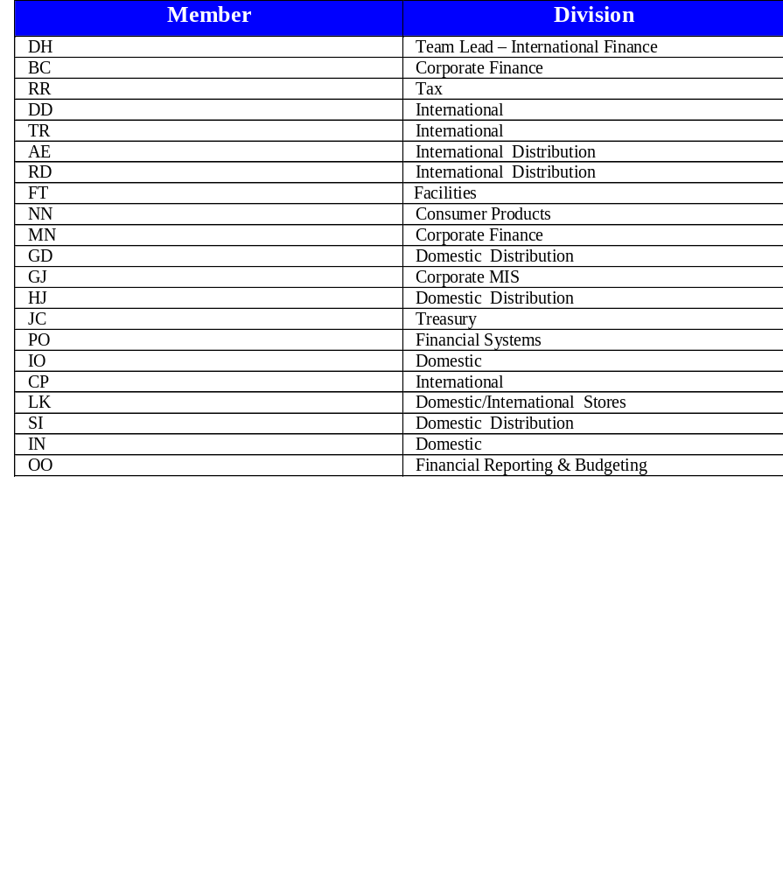
Financials - Participants

Slide 74
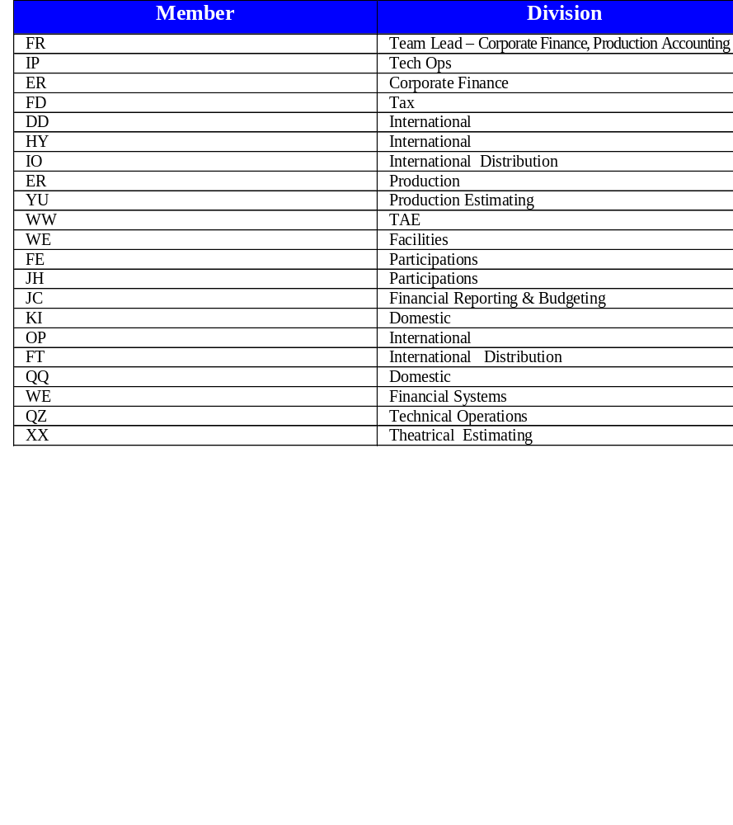
Projects - Participants

Slide 75
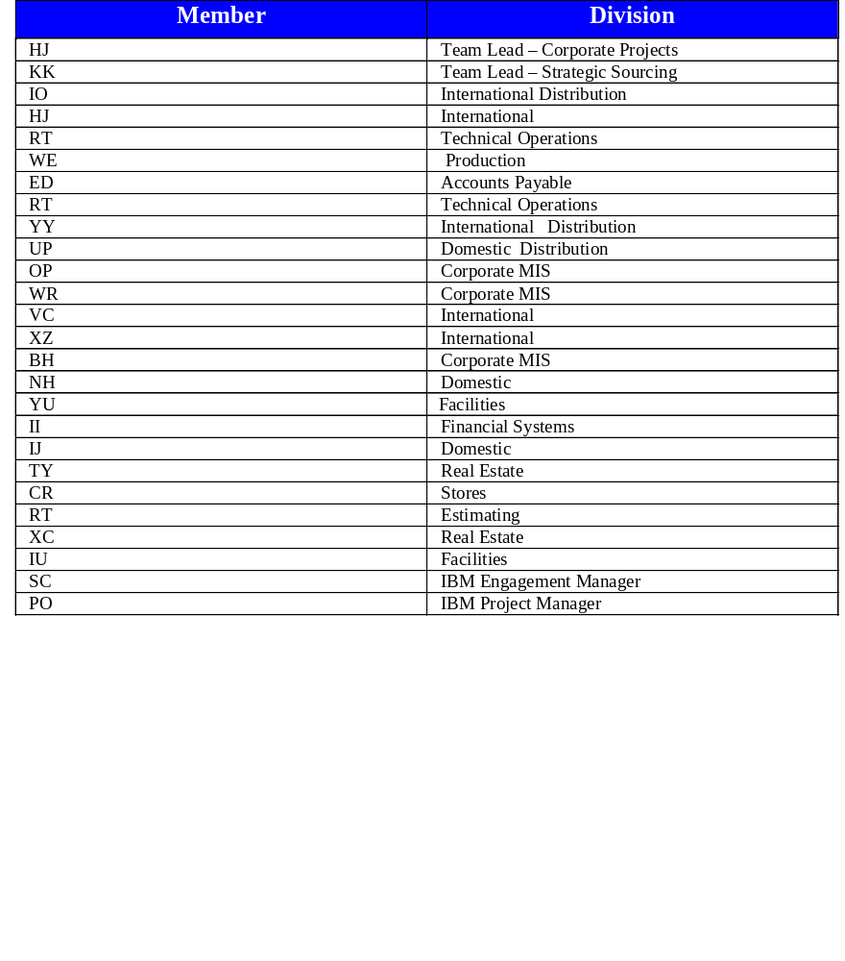
Procurement - Participants

