Slide 1

Strategic Portfolio assessment and recommendations
Notes:
I was at a presentation earlier this week where the consultant stood up and said that the golden rules for giving presentations are ABC and XYZ....... Always Be Cheerful and Examine Your Zip
Want to talk about planning and building our systems and technology ......
Saying to CJB, its been about five years since I last came to talk to you about this subject which was presented in the form of a paper so I am hoping for a slightly better result this time!!

Slide 2
The IT Principles and IT Architecture Models which have been previously defined, provide a basis for assessing both current systems and future projects and for identifying recommendations for the implementation of the Enterprise Architecture, in support of business goals.
Assessment of existing IS/IT systems
  used to determine alignment with the architecture
  provide a basis for identifying future project directions (to achieve better alignment)
Functional mapping of strategic projects - used to determine potential areas of overlap and scope for sharing common processes
Assessment of strategic projects - used to identify possible changes which will influence and improve future alignment with the architecture
The key advantage of alignment, is the potential achievement of identified business directions and associated business benefits

Slide 3
We assessed a number of key projects from the current project portfolio, as the basis for the future project portfolio
The current top six investment projects over the next 2 - 3 years were assessed
The assessment identified the areas where alignment could be improved
The architectures will be developed and implemented via these strategic projects which will be used to pick components that all future systems will use.

Slide 4
Using the application function model it is possible to start seeing the potential for sharing enterprise-wide processes and functions, between future strategic projects. The implementation of shared processes will be dependent on the timelines involved and is subject to more detailed planning and analysis.
Risk
Product Management
Party
Sales
Product
Customer
Third Party
Opportunity
Marketing
Project 2
Planning
Information
Management
Management
Product
Definition
Customer
Product
Relationship
Performance
Application
Agreement Management
Management
Risk Analysis
Market
Arrears
Agreement
Recovery
Risk & Exposure
Research
Risk
Product Management
Party
Sales
Management
Maintenance
Management
Management
Product
Marketing
Planning
Customer
Third Party
Opportunity
Payment
Account
Channel
Information
Management
Management
Account
Features
Management
Product
Assessment
Instruction
Payment
Maintenance
Management
Definition
Customer
Risk
Admin
Authorisation
Product
Relationship
Payment
Payment
Financial
Card
Performance
Scheduling
Transmission
Transactions
Management
Campaign
Application
Management
Disposal
Calculations &
Sales Planning
Management
Management
Exposure
Accruals
& Performance
Risk Analysis
Agreement Management
Market
Arrears
Agreement
Recovery
Risk & Exposure
Research
Management
Maintenance
Management
Management
Funding (Treasury)
Payment
Account
Channel
Pricing
Rate
Liquidity &
Deal
Settlement
Quotations
Account
Features
Management
Management
Performance
Management
Management
Assessment
Instruction
Payment
Maintenance
Management
Financial Management
Risk
Admin
Authorisation
General
Management
Tax
Payment
Payment
Financial
Card
Accounting
Accounting
Accounting
Scheduling
Transmission
Transactions
Management
Campaign
Management
Disposal
Calculations &
Sales Planning
Management
Exposure
Accruals
& Performance
Project 1
Funding (Treasury)
Rate
Liquidity &
Deal
Settlement
Pricing
Management
Performance
Management
Management
Quotations
Financial Management
General
Management
Tax
Accounting
Accounting
Accounting

Slide 5
Project 3 – like the previous two development projects, there are considerable areas of overlap which could be rationalised and developed as common components.
Risk
Product Management
Party
Sales
Product
Marketing
Planning
Customer
Third Party
Opportunity
Information
Management
Management
Product
Definition
Customer
Product
Relationship
Performance
Application
Management
Risk Analysis
Agreement Management
Market
Research
Arrears
Agreement
Recovery
Risk & Exposure
Management
Maintenance
Management
Management
Payment
Account
Channel
Management
Assessment
Instruction
Payment
Account
Features
Risk
Admin
Authorisation
Maintenance
Management
Payment
Payment
Financial
Card
Scheduling
Transmission
Transactions
Management
Campaign
Disposal
Calculations &
Management
Management
Sales Planning
Exposure
Accruals
& Performance
Funding (Treasury)
Pricing
Rate
Liquidity &
Deal
Settlement
Quotations
Management
Performance
Management
Management
Financial Management
General
Management
Tax
Accounting
Accounting
Accounting

Slide 6
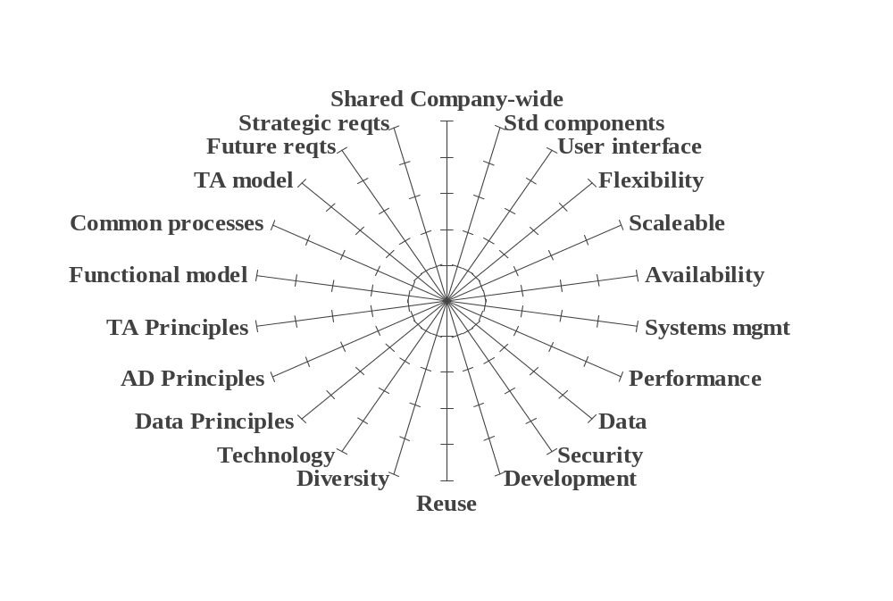
The assessment of these strategic projects was based on conformance to the architecture principles and the data, application and technical models, plus support for the desired capabilities and future requirements.

Slide 7
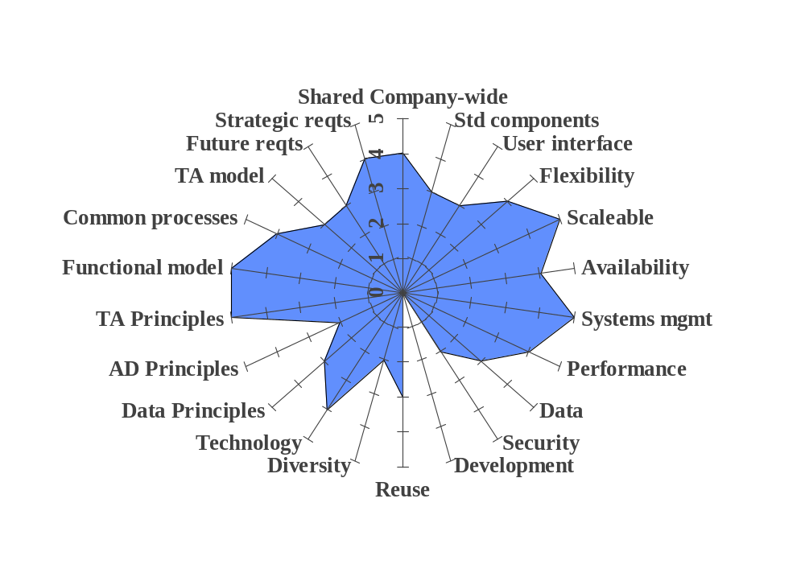
These assessments provide a focus for future activities to improve alignment. The following shows the assessment for Project 1, which is based on a package solution.

Slide 8
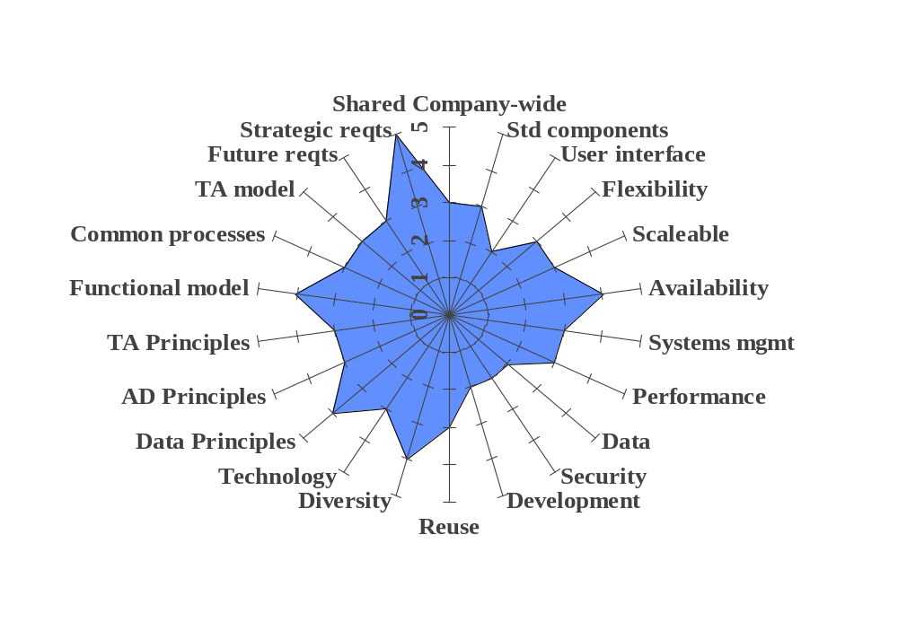
Project 2 is another package solution. It has no areas of non-conformance, but does not effectively meet requirements in many key areas like data sharing, security and user interface.

Slide 9
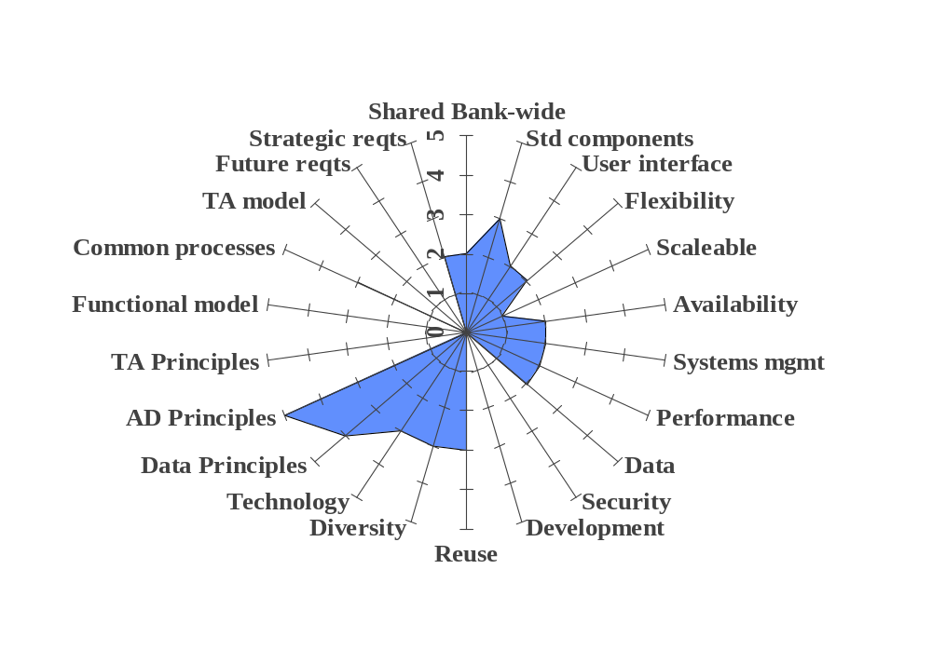
Project 3, is a large, in-house development project which, as currently planned, will replicate the infrastructure and application deficiencies of the current systems it is planned to replace, into the future.

Slide 10
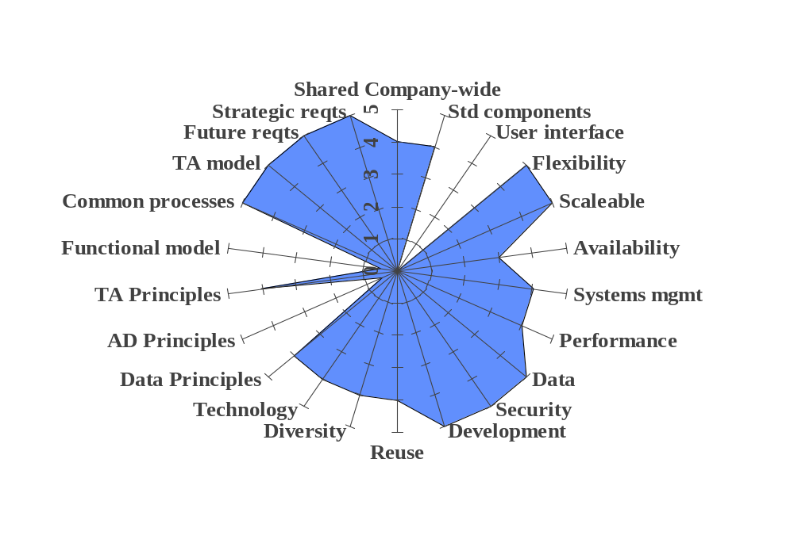
Project 4 is a package which has the highest potential. It is very much liked by all business executives. The package supplier has agreed to fix the existing deficiencies, so with careful planning, this will become the environment of choice and replace planned project # 3.

Slide 11
Based on these assessments, the Enterprise Architecture project has identified ten new activities which should be incorporated into the project portfolio. Where these activities impact planned projects, revised business cases will be taken forward for approval.
These activities include:
  The selection of the xyz package (project#4) as the basis for all future application delivery
  the rationalisation of common processes within the strategic projects
  defining and building common interface requirements and standards for the implementation of common processes
  the ongoing development of the IT Architecture models (driven by specific project activity)
  defining a strategy and plan for achieving a single, common, enterprise - wide base of customer and product data

