Slide 1
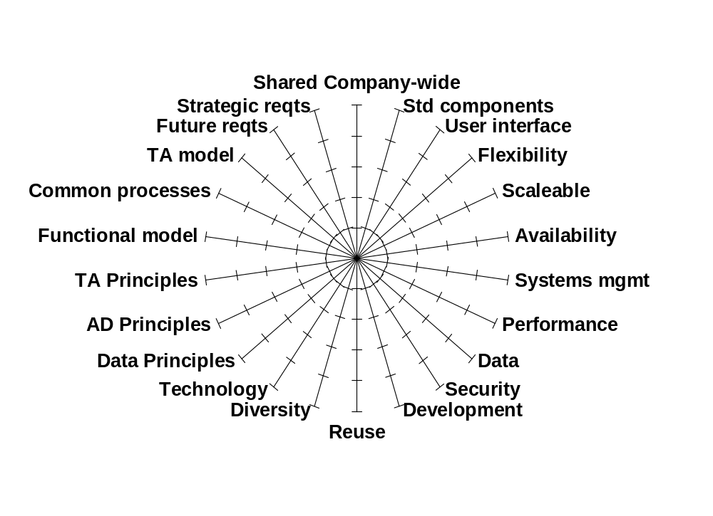
Strategic Project Analysis Criteria

Slide 2
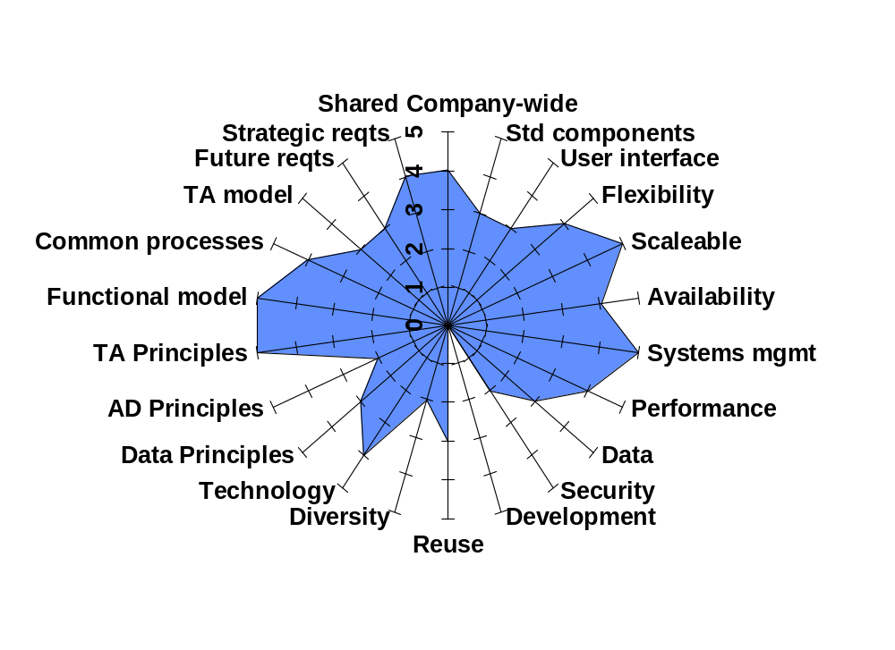
Conformance to Enterprise Architecture
Project 1

Slide 3
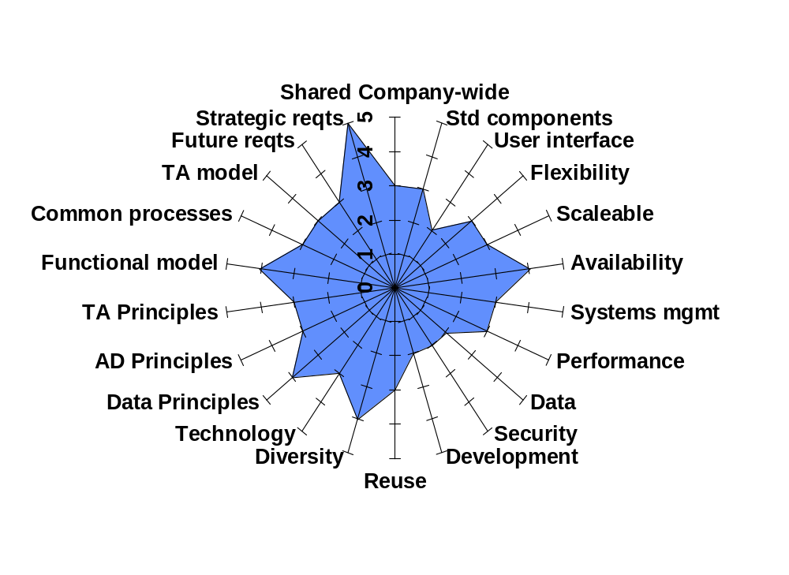
Conformance to Enterprise Architecture
Project 2

Slide 4
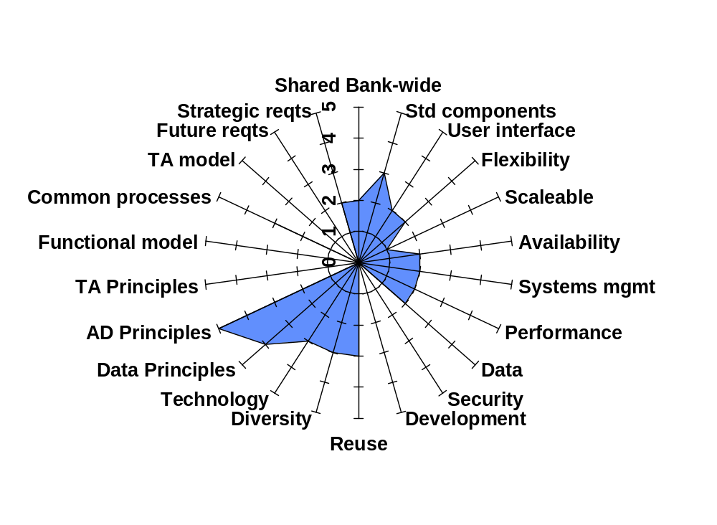
Conformance to Enterprise Architecture
Project 3

Slide 5
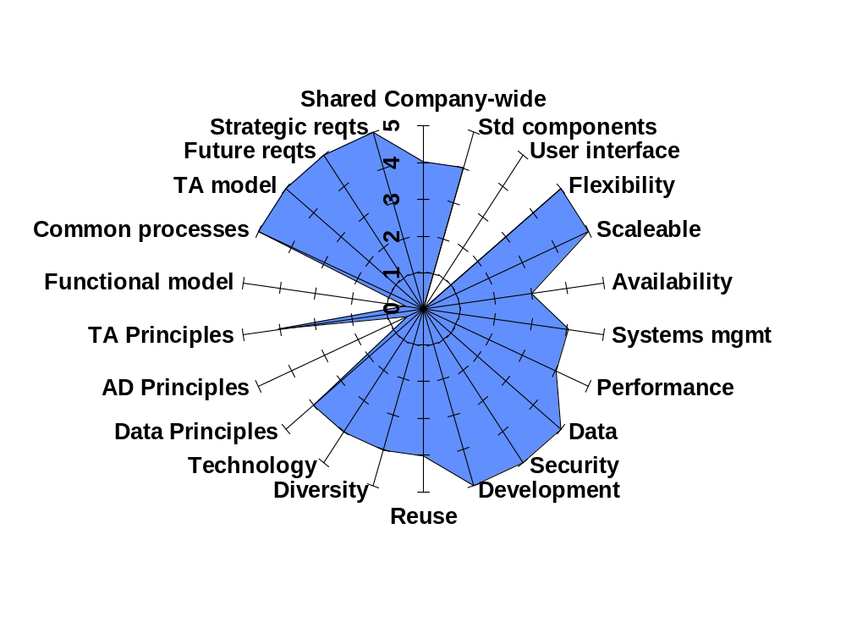
Conformance to Enterprise Architecture
Project 4

