Slide 1

Market Based Product Innovation
Concept Phase: IPMT Orientation
Simulating Integrated Product Development (IPD) for Multimedia
May 24, 2001

Slide 2
Agenda
Set the “Stage”
  Where are we in the MBPI Concept Simulation?
  What is IPD?
    Market Planning Link
    Pipeline Management
    Decision Checkpoints (DCPs)
    PDT
    IPD Phases
IPMT IPD-Concept DCP Exercise
  Background
  Multimedia Concept DCP
  IPMT Decision
Exercise Learnings
  Market Planning
  IPD

Slide 3
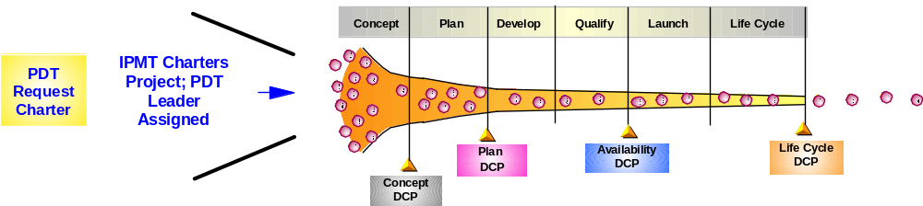
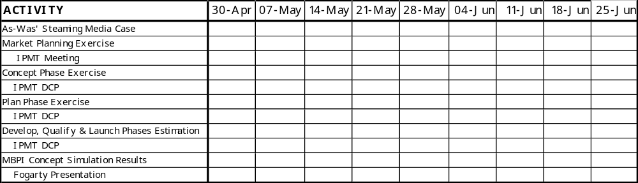
You commissioned a PDT, lead by xxx, to perform a Concept Phase analysis for xxx. The team will present their initial offering business plan and their recommendations at today’s DCP.
Where are we in the MBPI Concept Simulation?
You are here!

Slide 4
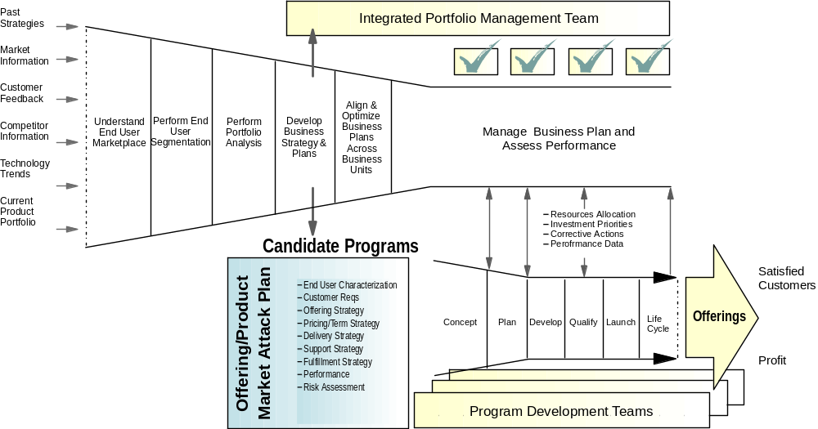
Market Planning decisions drive the Product Development pipeline.
What is IPD?
Market Planning Link
Market Planning provides valuable input to the Product Development (PD) process. It is the decisions made during the Market Planning phase which will ultimately drive PD
Market Planning Phase

Slide 5
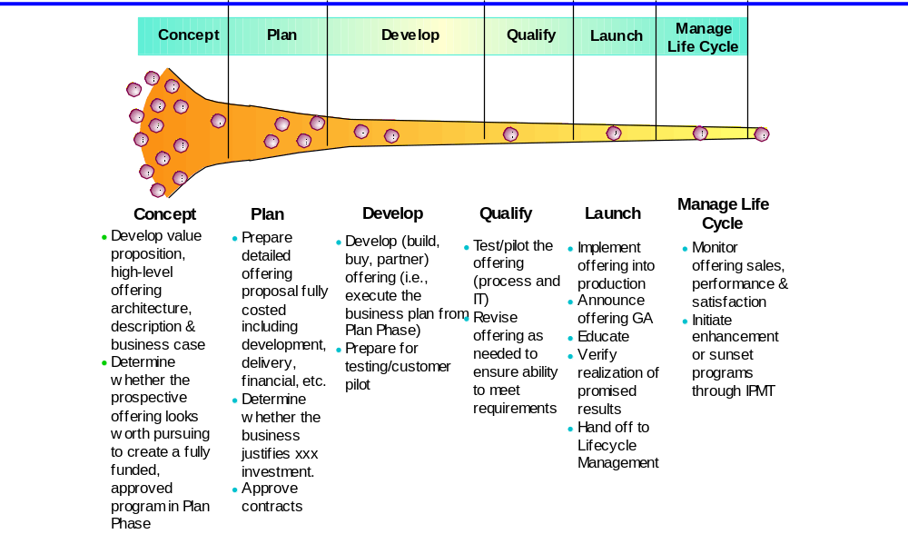
Candidate programs are executed according to the phased approach in IPD, with each stage having a clear purpose and defined exit criteria.
What is IPD?
Pipeline Management

Slide 6
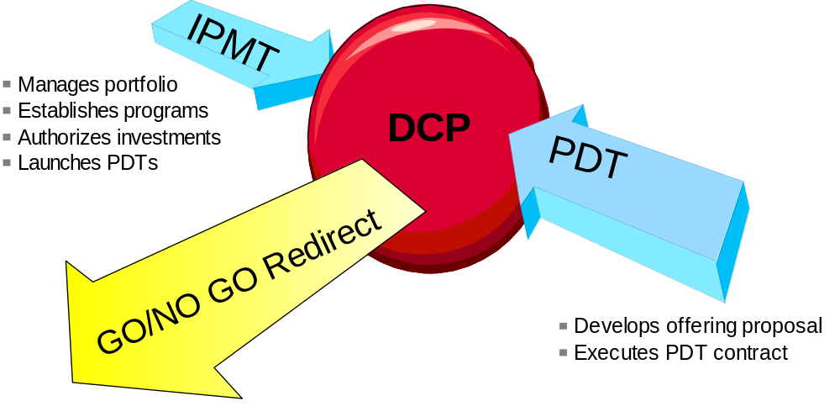
IPMTs decide to allocate resources based on the merit of PDT deliverables
What is IPD?
Decision Checkpoints

Slide 7
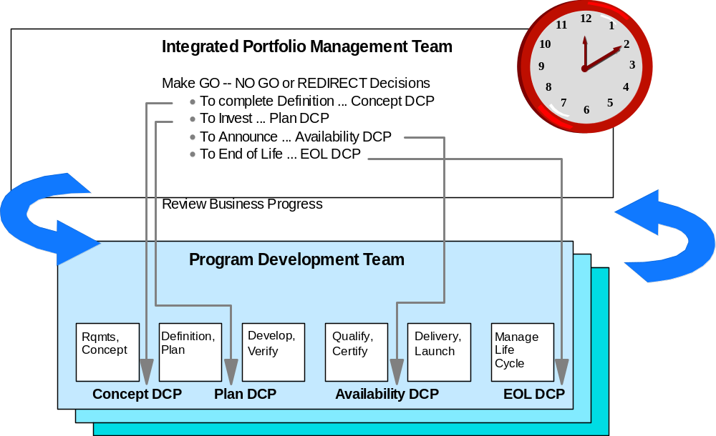
IPMTs make timely, fact-based decisions at the Decision Checkpoints (DCP).
What is IPD?
Decision Checkpoints

Slide 8
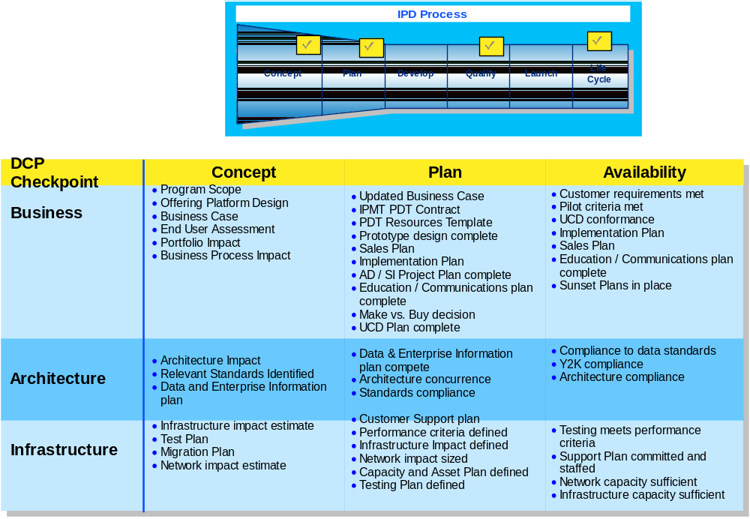
DCPs are structured program reviews addressing specific business, architecture & infrastructure issues where key decisions are made
What is IPD?
Decision Checkpoints

Slide 9
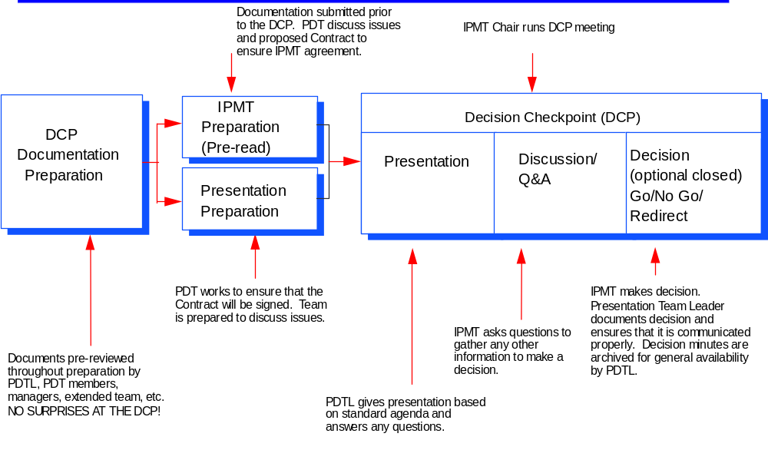
What happens at a DCP Review Meeting?
What is IPD?
Decision Checkpoints

Slide 10
IPMT Options at DCPs
What is IPD?
Decision Checkpoints
GO!
  If program is approved, IPMT authorizes funds and resources for the next phase at Concept DCP and for entire program at Plan DCP.
NO GO
  The program is terminated in an orderly manner, including appropriate program documentation and close-out, then resources are reassigned
Redirect
  IPMT instructs the PDT to refocus project or plans in a specific direction or to gather additional information and return. Since strategic alignment has been emphasized from program start, redirects are rare

Slide 11

Outcome of "Go" decision at Plan DCP is a Contract and a Final Offering/Program Plan.
What is IPD?
Decision Checkpoints
Signing the Plan DCP Contract indicates:
PDT Commitment:
  execute program according to contract and report back to the IPMT via an Interim DCP if the contract parameters exceed variances
IPMT Commitment:
  support program as described in proposal, make resources available, and allow PDT to proceed to Availability DCP

Slide 12
The PDT Leader has some specific responsibilities that span the duration of the program
What is IPD?
PDT
Communications
  Ensures communication and interaction with the IPMT, Functions, other PDTs and with other IPMTs/programs
  Provides concise and timely communications to all persons involved in the program
Interaction with the IPMT
  Acts as a program champion in representing the project to the IPMT
  Manages all aspects of the DCPs
Team Management
  Manages team composition and ensures roles are assigned and executed
  Leads the team in completing the activities and deliverables for all phases
  Drives PDT decision making
Teaming
  Leads the team in establishing team guidelines and enforces agreed upon rules
  Cultivates positive group dynamics and resolves conflicts
Resource Management
  Obtains resources for the PDT and monitors workload

Slide 13
PDT Members have individual & team responsibilities that span the duration of the program
What is IPD?
PDT
Key Responsibility of PDT Members
  Meet or beat the provisions of their contract
  Work continually to anticipate potential problems and enlist the support of the Functions and IPMT when and as needed
General PDT Member Responsibilities
  Decisions
    Act as a liaison between their functional area and the Team; representing and providing functional expertise in team decision-making
    Keep Functional IPMT Member Updated
  Program Execution
    Follow IPD, execute program plans and assist the PDT Leader through monitoring their functional plans for the project
  Communication
    Regularly and openly communicates with the team, the PDT Leader and their functional areas

Slide 14
If it is felt that contract variances will be exceeded, the team must call an Interim DCP meeting with the IPMT ASAP!
What is IPD?
PDT
Some conditions which would trigger an Interim DCP include:
  Increased resource requirements or, additional resources required above what the functional management can allocate
  Change in scope
  Cost increases beyond commitment on remainder of project
  Cost exceeds target commitments
  Capital required exceeds commitments
  Market forecast reductions beyond agreed to commitments
  Unsolvable technology roadblock that requires an innovation or executive intervention

Slide 15
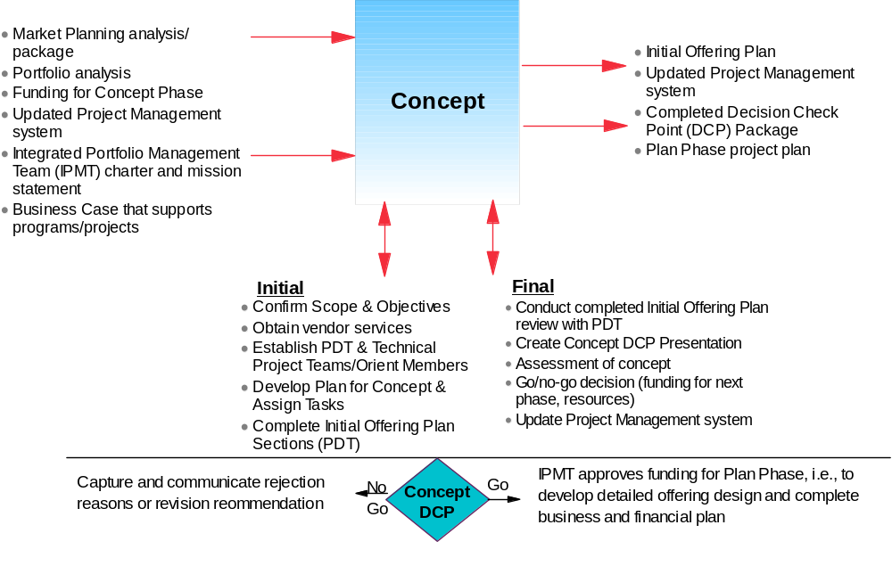
Concept Phase: To qualify the business need and justify the business case
What is IPD?
IPD Phases

Slide 16
Concept DCP Considerations: Questions the IPMT may ask the PDTL to Assess Completeness of the Concept DCP
What is IPD?
IPD Phases
Does the proposal have enough business potential relative to other programs to be viable:
Is the market requirement significant enough to proceed with this project?
Can the project deliver sufficient value to the targeted end users?
Do the assumptions (financial, technical, market, schedule, risks) appear reasonable?
Does Architecture & Standards, eProcessing, and Professional Services agree on the offering?
Do you have the required resources committed for plan phase if concept phase is approved?
Are there any fulfillment issues within the geographies?
Does the recommendation support the portfolio?
Is the offering feasible?
Did you follow the buy vs build rule?
Does the project appropriately leverage intellectual capital and assets?
Are there other vendors/subcontractors involved?
Are there any Sunset Plans associated with this project?
How do the project dependencies affect scope and time/resources?
Are there NLS requirements?
Are target dates in place for DCPs?
Does the project fit within the Enterprise Architecture?
Are all members of PDT with necessary skills identified and available?

Slide 17
IPMT Concept DCP Questions (cont)
What is IPD?
IPD Phases
Does the proposal have enough business potential relative to other programs to be viable (cont):
Are there other programs that address these end user segments and how does this program relate to them?
Do the assumptions (financial, technical, market, schedule, risks) appear reasonable?
How have these assumptions been validated?
What is the payback period?
What are the risks and their impact associated with the program? What are the corrective actions to minimize risk?
Would any existing projects be sunset when this project is completed?
Does the Initial Offering Proposal include a preliminary schedule and target date for the Plan phase?
Has there been an Architecture Board Review conducted on this project? If so, what were the results?
Has the Project Management system been updated?
Are performance criteria set and agreed to?
Were there key areas where functional PDT members differed in their recommendations? How were the differences resolved? Was consensus achieved?
Is the scope and general function of the offering sufficiently clear to begin the plan phase and to warrant funding for the plan phase?
End of Life Questions to be included in Concept DCP
What is the life expectancy of the application being developed?
What current applications are impacted by this new application?
Are the current applications able to be sunset by this new application or do they need additional investment to extend their life?

Slide 18
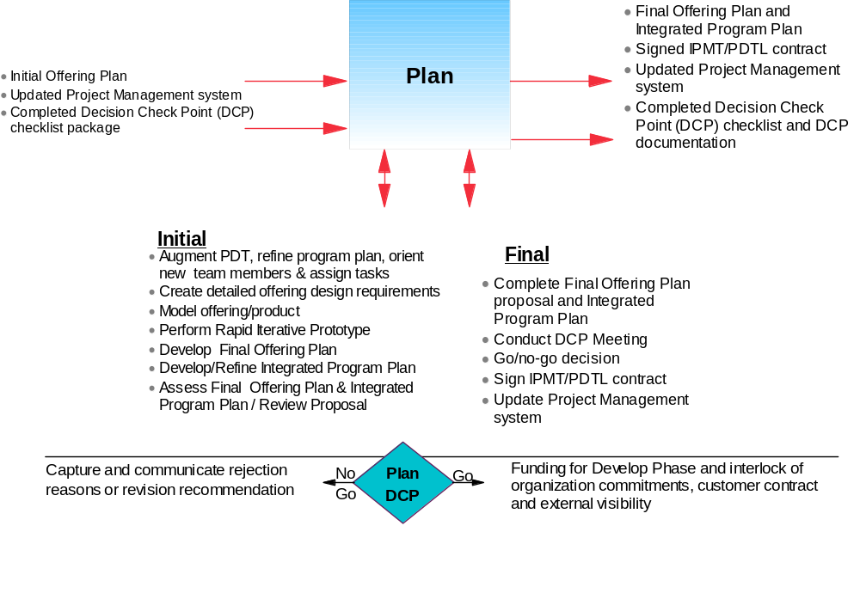
Plan Phase: To develop a final program plan proposal to gain approval for a committed contract
What is IPD?
IPD Phases

Slide 19
Plan DCP Considerations: Questions the IPMT may ask the PDTL to Assess Completeness of the Plan DCP
What is IPD?
IPD Phases
Does the proposed program support business objectives in a timely manner?
What has changed from the Concept Phase?
How does this program link to our business vision, mission, goals and corporate strategy?
How does this program optimize the return on our Business Plan commitments? Describe how the design supports achievement of benefits noted in the business plan?
How does this program optimize the Initiative portfolio?
Do commitments satisfy specific worldwide geography/customer requirements?
What business problem are we trying to resolve and for which end users? How important is an offering to this problem? (value or exposure to end users)
Have any fulfillment issues identified by the Geographies been resolved?
What are the corrective actions to minimize program risk?
Is the offering design stable and achievable?
Has the buy vs build decision been approved by Architecture & Standards?
What vendors are being utilized for this program?
How were end user requirements validated?
To what extent has the offering design been validated with SMEs outside the PDT?
Do you have the required resources committed for the remainder of the program?

Slide 20
IPMT Plan DCP Questions (cont)
What is IPD?
IPD Phases
Does the proposed program support business objectives in a timely manner? (cont)
Does the PDT include all appropriate business, functional and technical areas?
In the Integrated Project Plan feasible and is the availability DCP date attainable?
Are fulfillment & support plans in place?
Have all Sunset Plans been associated with this program?
Have all dependent project plans been identified in the Project Management system?
How do the identified dependencies affected scope and time/resources?
Has there been an Architecture Board Review conducted on this project? If so, what were the results?
Were there any architecture or infrastructure deviations requested?
Were there key areas where functional PDT members differed in their recommendations? How were the differences resolved? Was consensus achieved?
Who reviews the program quality?
Has a communication plan been completed and agreed to by the PDT?
How is the budget (plan and actuals) being tracked for the project?
How is project success determined/measured?
Have all requests for IPMT action been clearly defined and assigned to the appropriate IPMT or PDT member for resolution?

Slide 21
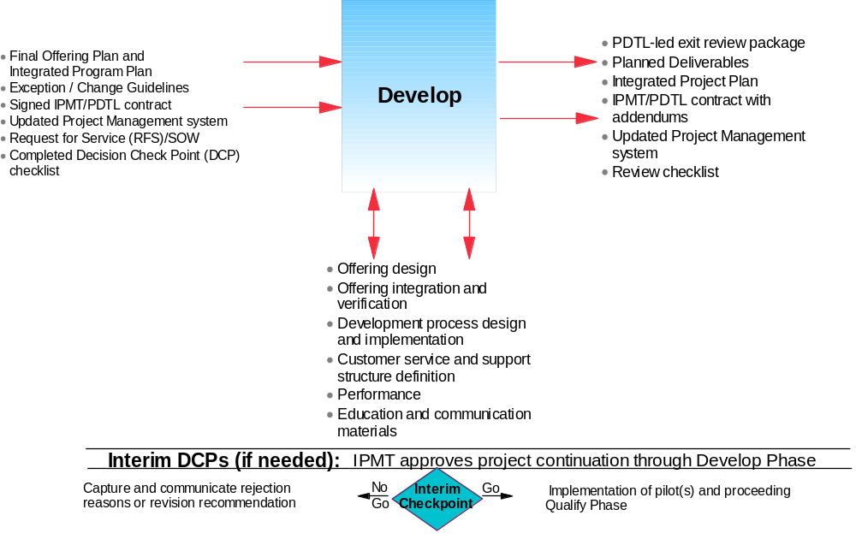
Develop Phase: To develop and verify the offering to defined specifications
What is IPD?
IPD Phases

Slide 22
Develop DCP Considerations: Questions the PDTL may use to to assess completeness of the Develop phase
What is IPD?
IPD Phases
What risks still exist and what are the contingency plans?
What has changed from the Plan phase?
What is the status of the Risk Assessment?
What are the risks if the project is delayed or does not meet end user expectations/requirements?
What financial exposures exist for the project?
What are the key areas of expense which are above or behind the plan?
Are vendors/subcontractors delivering accurately according to their agreed upon output?
What contingencies are in place to cover vendor/subcontractor delays, errors or cost overruns?
What are the critical success factors for the Develop Phase?
How have the xxx requirements been met in the Develop Phase?
Describe how standards were enforced and consistency applied in the Develop process.

Slide 23
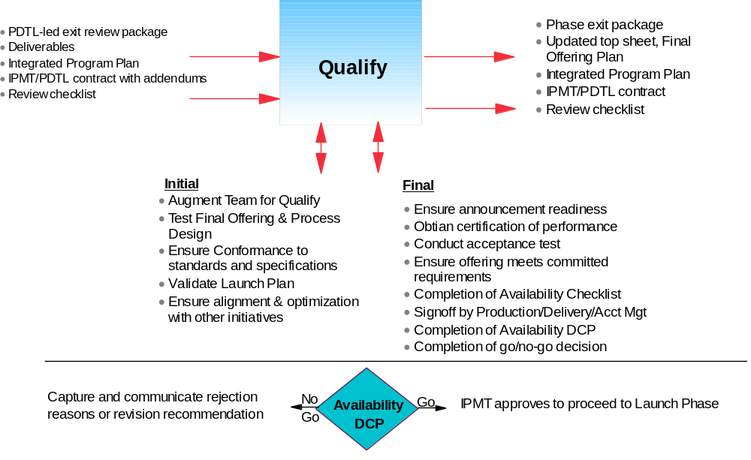
Qualify Phase: To perform final testing, conduct pilots, ensure infrastructure readiness & certify “launch-ability”
What is IPD?
IPD Phases

Slide 24
Availability DCP Considerations: Questions the IPMT may ask the PDTL to Assess Launch Readiness
What is IPD?
IPD Phases
Is the program ready for general availability?
Does the project continue to make business sense?
What controls were in place to ensure tests were executed completely and consistently?
Has the stability of the design been validated?
Are there any areas that have not been tested and why?
How are the sponsors showing continued, visible commitment?
Have the objectives, changes and plans been communicated to all stakeholders and constituencies (Internal, external, touch points, customers, entire organization)?
Are there any outstanding risks and have any new risk factors come to light since the planning phase (Timing, Personnel changes, marketplace changes, stress level of project team)? How are these being handled?
Has the Euro readiness been confirmed or Exception granted?
Have all the necessary resources for roll out been made available?
What specific decision or action do you need from the IPMT to help you to enter the roll out phase?
End of Life Questions to be included in Qualify DCP
Is it still appropriate to sunset the currently identified applications?
Are there changes to the timing?
Has the funding for sunsetting the applications been approved?

Slide 25
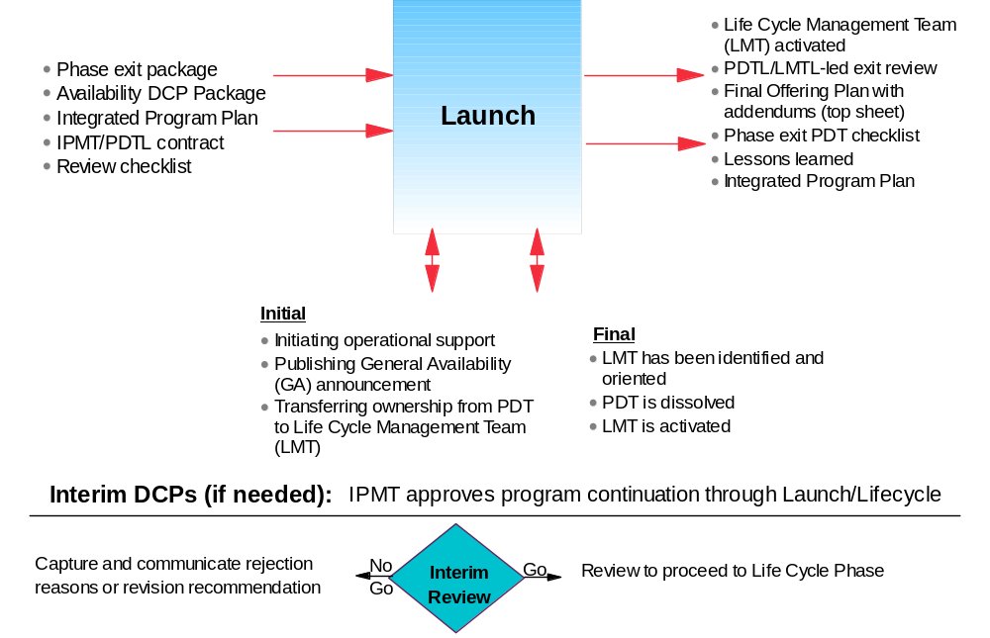
Launch Phase: To make offering generally available
What is IPD?
IPD Phases

Slide 26
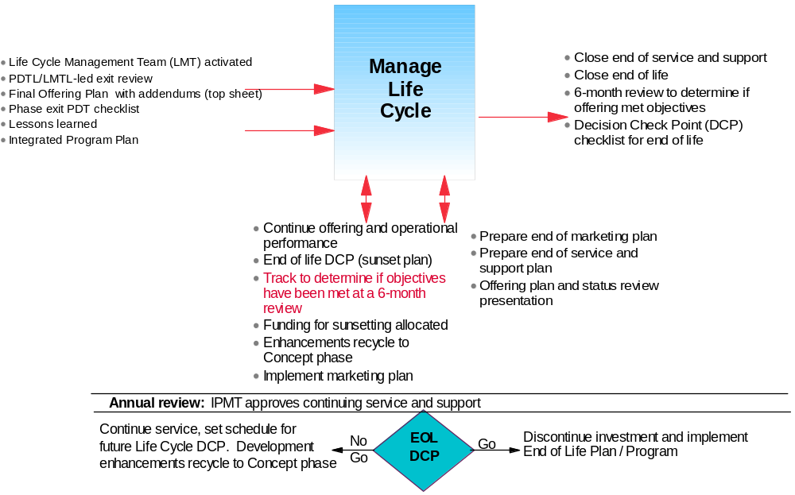
Life Cycle Management Phase: To manage offering's performance, provide support & verify met commitments
What is IPD?
IPD Phases

Slide 27
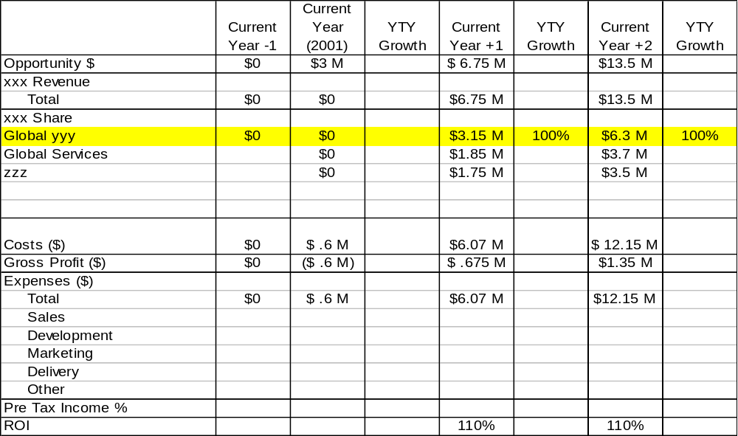
You tasked the PDT with defining the offering design and constructing the offering business plan that achieves the $6.3M Y+2 revenue target for xxx.
IPD Concept DCP Exercise

Slide 28

Simulating the IPD Concept DCP
IPD Concept DCP Exercise
Let’s Begin the IPMT IPD-Concept DCP Exercise!

Slide 29

Market Planning Key Learning “Nuggets”
Exercise Learnings
Formalized use of a common market segmentation schema to define an offering’s potential revenue opportunity is critical to business case construction
Automated market planning tools enforce a more rigorous approach to market planning analysis
The SPT is a critical role – candidates will need to be carefully considered
Marketing and financial analysis are key core competencies of an effective SPT
Product Managers will need to go through “SPT Boot Camp” as well!
Current financial systems do not effectively support market planning
Customer buying behavior & preference data is lacking
Competitor product & competency data is weak
The transformational effort will need to expand the xxx mindset of “open market”

Slide 30
IPD Key Learning “Nuggets”
Exercise Learnings
Earlier, more consistent & frequent cross functional communication
Facilitates end-to-end offering ownership & accountability
Ensures complete & comprehensive end-to-end offering design and planning
“Non-believers” became “believers” that this process would make a difference in xxx because its formal, systematic structure does not leave any elements to chance
The process inherently draws team into true business management – i.e. time-to-profit becomes a key consideration
Business justification forces PDT to “design-in” modularity & reuse for earlier revenue generation
“The right relationship” works well for few in number, one-to-one commitments between functional areas – but breaks down for offering management, where large numbers of multi-functional commitments are required
Emphasis on customer demand validation ensures offering designs are truly customer-focused

Slide 31
The End

