Slide 1
The Role of Change Agent as a Strategist for Change
Cleint Project Name
Date
Notes:
1

Slide 2
Agenda
Overview of the Strategist
Review of the Change Agent’s role as a Strategist

Slide 3
What is Organization Change?
.
Organization change is the development, delivery, execution and proactive leadership of a change strategy and plan to drive visible and constant change
within an organization, enabling it to achieve its desired state.

Slide 4
An important key to Organization Change success is the development and execution of a strategy to manage the magnitude of change.
CHANGE STRATEGY
AND PLAN
AMC
Organization
&
People
Process
Current State
Desired State
Proactive
Organization Change
Leadership
Information
Technology
Visible and
Constant Change

Slide 5
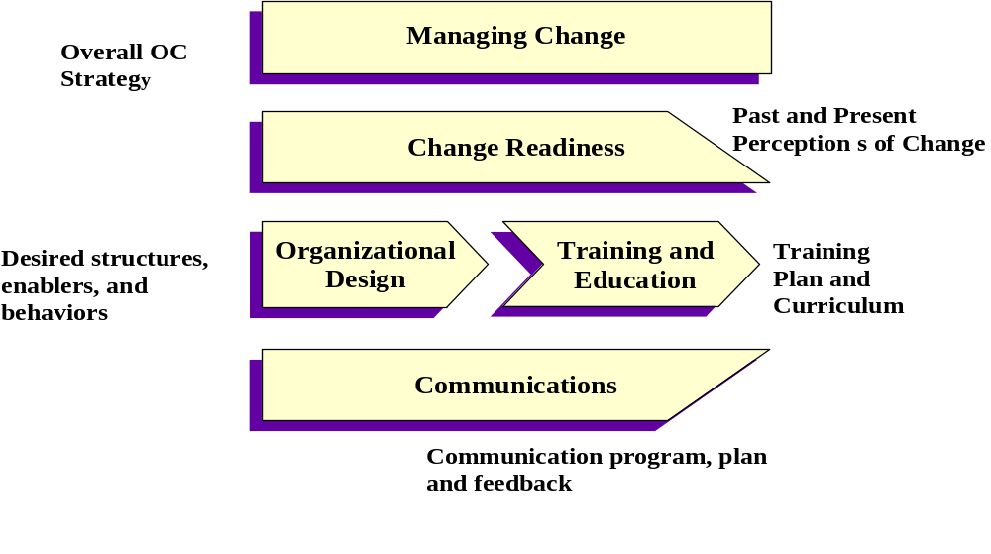
To develop and execute these strategies, the Change Agent uses a great deal of information
Notes:
1. Let's examine the difference between these two ideas further.
I am quoting my friend John Kotter here on the difference between managers and leaders.
John Kotter, as Jeff Aibel knows, has been a personal friend for over 20 years. When Jeff learned about the difference in our daily rates
--Kotter gets US$40,000 a day.
-- I got invited to give this talk instead of Kotter.
Vision 2003 requires leaders and managers. We need both. Your priority should be leadership.
We trust that as an IBM executive we have taught you well the lessons of management.
Vision 2003, however, needs leadership and leaders.
GE is our best example and has been transforming itself under Jack Welch's leadership for 14 years. If you looked at GE you would be going through an annual exercise where the goal is to double in three years. If you think the pressure is intense here for doing better, it is much higher there. And they have been through at least three cycles of what we are about to do.
2 When it comes to goals, managers plan, budget, and
-- establish detailed steps and timetables
-- allocate resources to make it happen
Leaders establish direction
-- develop a vision of the future
-- develop strategies or a logic for how the vision can be achieved
Allied Signal turned from a cyclical company, dependent on the automotive and aerospace industries, into a vibrant growth company. Take a lesson from Larry Bossidy, the CEO, who since he took over infused the organization with one simple message: "Deliver our numbers by keeping commitment."
-- use one problem-solving method
-- ignore organizational boundaries -- focus on core values
-- immerse all 86,000 persons in problem-solving training, starting with Larry and his team
-- In the first year Bossidy spoke to 15,000 people personally to deliver the message.
The leadership lesson here is clear: develop the vision and execute key strategies.
Immerse yourself personally into the effort..
3. In terms of the organization's people,
-- managers
-- establish a structure
-- delegate
-- provide policies
-- create methods
-- leaders
-- communicate by word and deed to ALL whose cooperation may be needed. They don't worry about organization charts and the matrix
-- influence the creation of teams and coalitions by stating the vision and strategies that will help the organization be successful.
If you were to examine the success of a GLAXO, before it became GLAXO-Wellcome or AMGEN, both world-class performers when it comes to new drugs, you would see "leadership behavior that organizes at a molecular level. If a researcher isolates a molecule that has the possibility of being turned into a drug that will treat one of the targeted diseases, that molecule will become a business unit with a project leader. R&D, marketing exist to serve these business units.
Again, the leadership lesson is clear: align the key people, ignore the matrix.
Our version of the molecule is the customer.
4. In solving problems,
-- managers
-- monitor results of the paln
-- identify deviations, plan and organize to solve the deviation
-- leaders
-- ENERGIZE people to overcome major political, bureaucratic, and revenue barriers
-- seek to satisfy basic, but unfulfilled, human needs
As we have seen, management produces a degree of predictability and stability for short-term results. Leadership has the ability to produce dramatic change for long-term effect.
You probably feel tension and discomfort between these two roles. I am not surprised. I suggest if you do not feel comfortable with the message of leadership you have several alternatives to follow: when you get the urge to write a memo or tell people what to do -- give a speech, tell a story, or in some way influence the behavior of those reporting to you -- energize them to solve the problem.

Slide 6
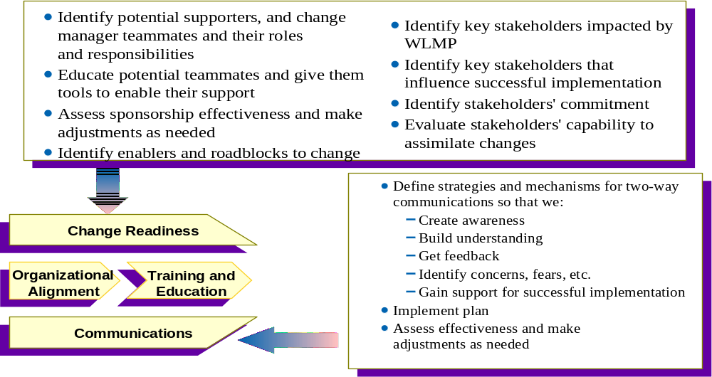
The Change Agent uses the objectives and output of each component of change to develop action plans to address the needs of the organization

Slide 7
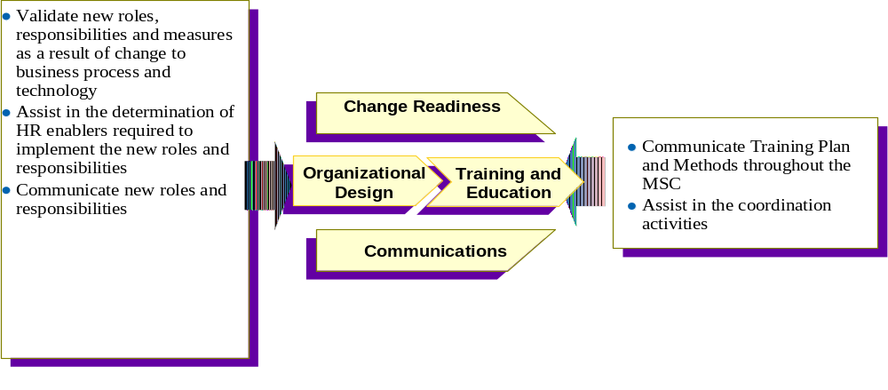
The Change Agent uses the objectives and output of each component of change to develop action plans to address the needs of the organization

Slide 8
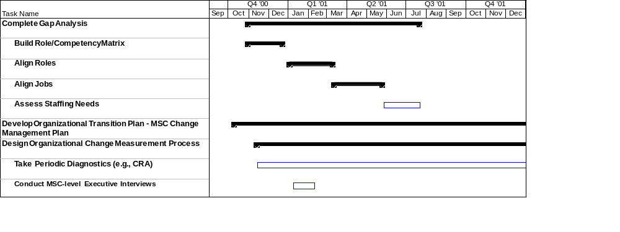
And the driving force behind these components is the OC action plan. This information is also used to develop and execute plans at the MSC level.
Review CRA with key managers
Obtain their support and help in developing a communication campaign for the CRA
Select participants
Ensure participation
Obtain results
Develop action plan from results

Slide 9
SPECIFIC ACTIVITIES OF THE CHANGE AGENT AS STRATEGIST

Slide 10
Advise “Client Leaders”
Keep “Client Leaders” abreast of the Organization Change related issues.
Help the “Client Leaders” prepare for change within the organization.

Slide 11
The Change Agent Role in Advising “Client Leaders”
Serve as a member of the team
Ensure that change related issues are included in discussions
    Keep “client leader” abreast of organization change related issues
    Provide feedback to the Organization Change team regarding specific organization related issues that must be addressed.
    Serve as liaison between the all parties

Slide 12
Develop and Execute Implementation Plans
Develop and execute change related activities articulated in the Organization Change Action Plan.
Apply Organization Change strategy to meet the specific needs of the organization.

Slide 13
Role of Change Agent in Developing and Executing Implementation Plans
Use Organization Change Action plan to determine execution strategies within the organization
    Execute scheduled activities according to plan
    Prepare in advance for issues which my delay activities to deter delay in plan development
    Develop plan to manage change that addresses specific needs of the organization
    Maintain ownership of organization change plan

Slide 14
Manage Change Agent Team
Use knowledge of the organization to select key individuals to support the Change Agent efforts
Use the team to execute specific OC actions as defined by the OC Action Plan

Slide 15
Change Agents Role in Managing Change Agent Team
Select key individuals
  possessing MSC knowledge
  understands the importance of change
  success in implementing change-related activities in the organization
Effectively build team
  successfully manage the stages of teambuilding (norming, storming, forming performing)
  define roles, responsibilities and rules
Ensure team effective executes OC plans
  set effective measures of team performance

Slide 16
Factors to Consider when developing plans for change
Purpose for the change
The vision, values, and beliefs about change
Overriding imperative for change (the "burning platform");
The Characteristics of the change
    who will be affected
    why they will be affected
    where the change will happen
    what the change will look like
    when the change will take place;
    identification of implementation stakeholders, support, and target communities
    approach for identifying and managing resistance to implementation.

Slide 17
Example: Using OC Strategy to develop a MSC Plan
OC Strategy/Plan: Take quarterly CRA diagnostic to evaluate and change readiness and assess organizational risks.
Use this information to summarize needed activity and define overall approach for the CRA in the Organization:
  Review overview of CRA and methodology
  Identify key individuals affected
  Identify key stakeholders and participants
  Develop/execute communication campaign for CRA
  Obtain support and participation from managers
  Follow methodology for distributing CRA
  Establish feedback channels for employees
  Obtain results
  Develop plan to attack risks

Slide 18
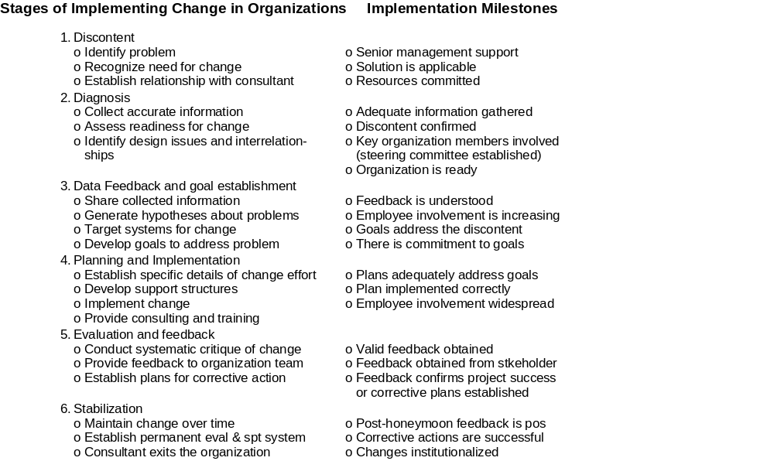
Facts about Implementing Change to Remember

Slide 19
Tools for Developing Teams

Slide 20
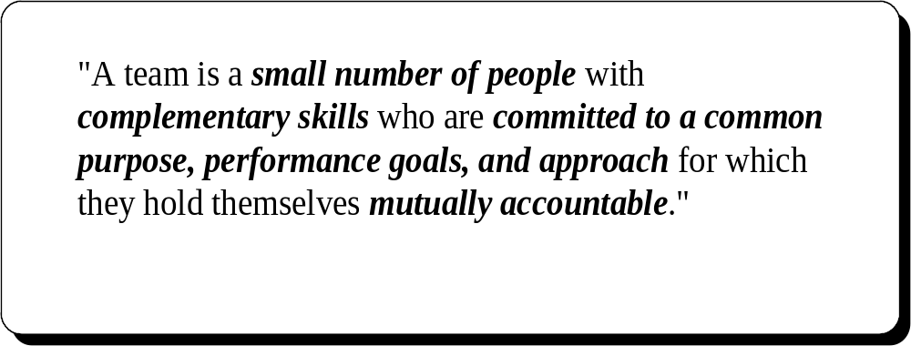
A clear definition of a team helps to distinguish this new organizational arrangement from more traditional work groups

Slide 21
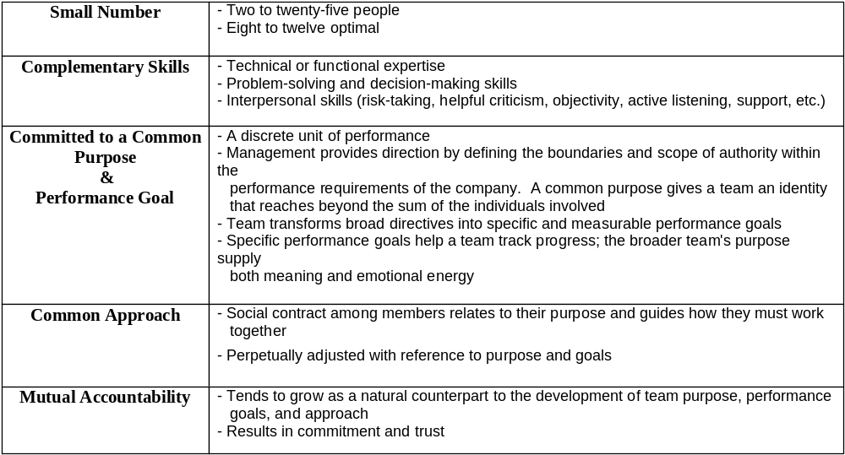
When building a team, there are a number of factors that should be considered:

Slide 22
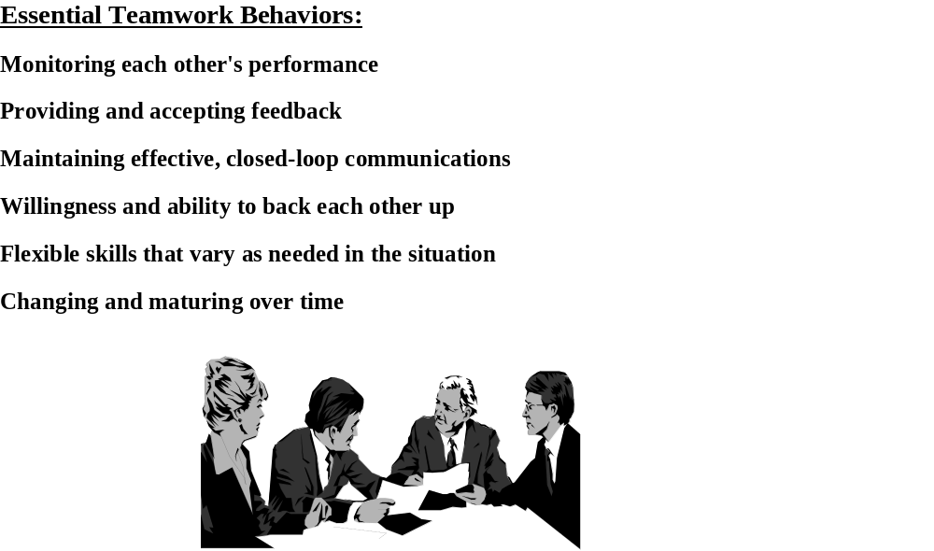
Appropriate teamwork behavior

Slide 23
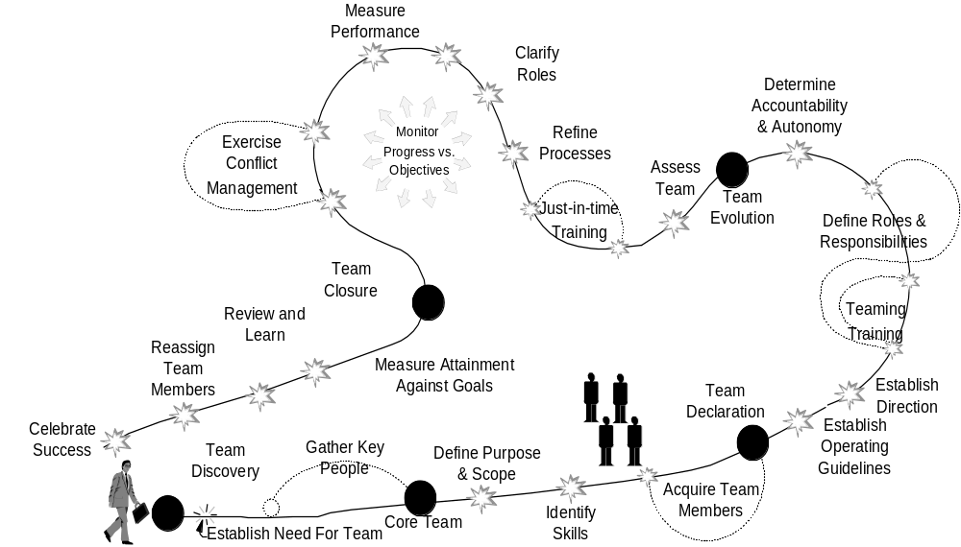
Establishing a strong team is a challenging, but a worthwhile journey

Slide 24
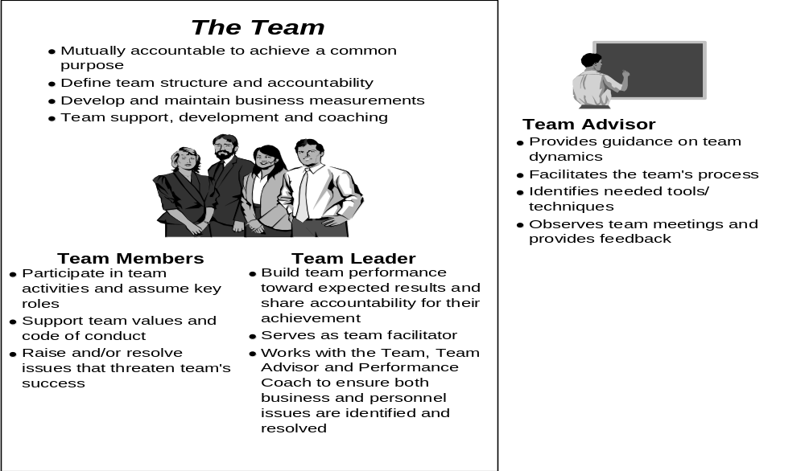
And understanding the various roles of each member is a key first step

Slide 25
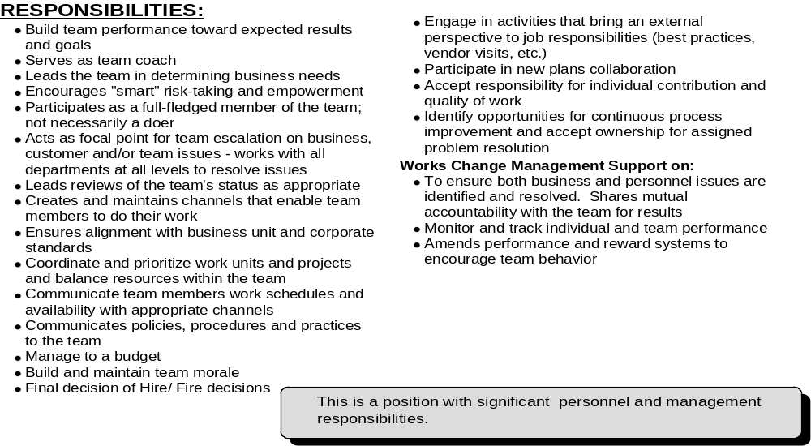
Change Agent Lead Responsibilities

Slide 26
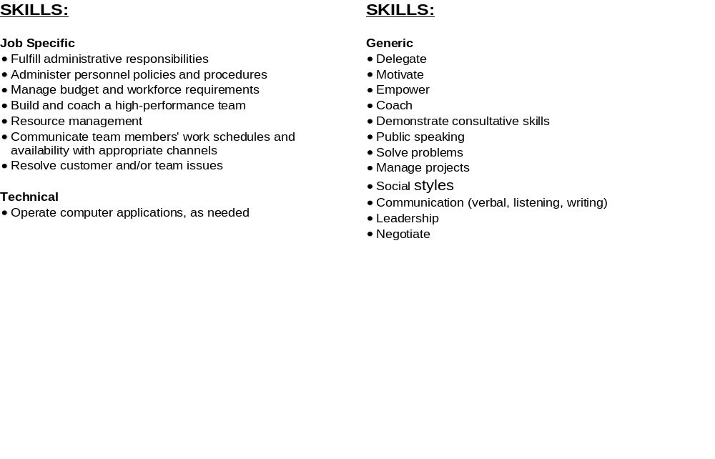
Change Agent Team Lead Responsibility (cont.)

Slide 27
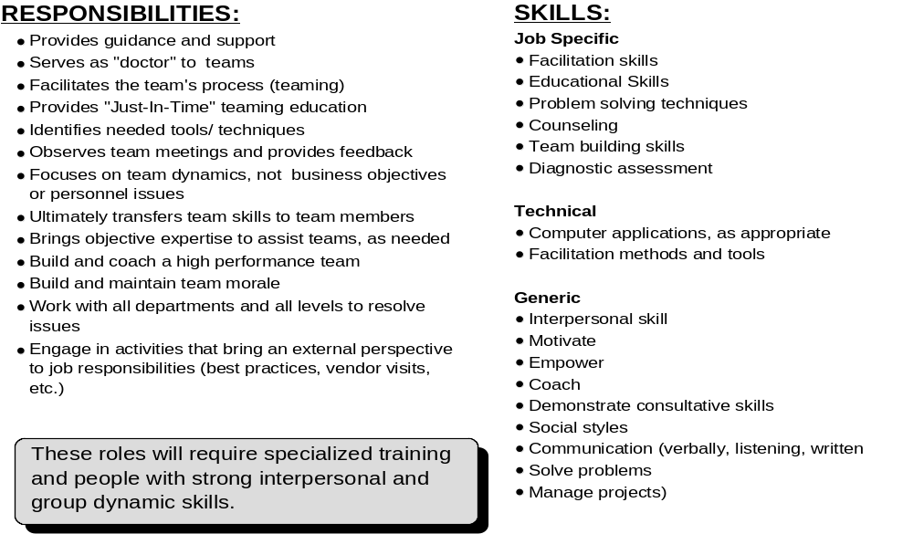
Change Agent Support Responsibility

Slide 28
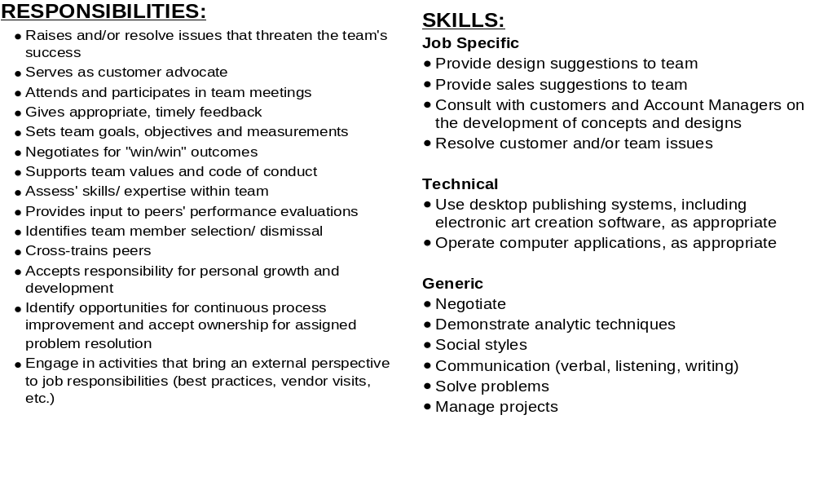
Change Management Team Member Responsibility

Slide 29
Factors to consider when building a team:
Clarify Goals
  ensure the team is unified around a clear purpose
  establish goals early
  set intermediate goals as well as long-term objectives

Slide 30
Factors to consider when building a team:
Define Roles
  Make sure your role is clear to the team
  Make sure team members understand what you expect from them and they can expect from you
  Make sure everyone is well aware of the talents and experience within the group

Slide 31
Factors to consider when building a team:
Nurture Healthy Relationships
  Establish and maintain trust within the team
  Establish acceptable, respectable behavior for all members
  Clarify processes, procedures, and relationships

Slide 32
Factors to consider when building a team:
Promote Open Communication
  Make it clear that all team members should contribute to discussions
  Communicate with team members effectively. Determine how frequently feedback should occur
  Be a good listener

Slide 33
Factors to consider when building a team:
Keep the Team Motivated
  Make sure team members know that their work is important
  Don’t neglect your role as head cheerleader. Demonstrate enthusiasm for the team and pride in its achievements
  Keep morale high when the going gets tough.

Slide 34
Factors to consider when building a team:
Don’t be afraid of conflict
  Allow members to confront one another in a health, productive manner. Disagreements can trigger discussions that can ultimately bring the team together
  Embrace varied ideas

