Slide 1





Telecomm Client
15 August, 2000
e-Processes Portfolio
Strategy Formulation
&
Prioritization

Slide 2


The objectives of today’s session are to understand the change in tenor of strategic planning from rationing to venturing, and to weight the e-Processes investment prioritization model.
Contents
Strategic Planning Imperatives
  New rules for the digital enterprise
  From rationing to venturing
  An essential competency for Domains and Business Units
Domain/BU e-Processes Strategy Formulation
  Understanding the “implied” strategy
  Formulating the “desired” strategy
    standardized terminology & disciplines
  e-Processes Portfolio Map
“Hardwiring” Portfolio Prioritization
  e-Processes Program Prioritization Model

Slide 3
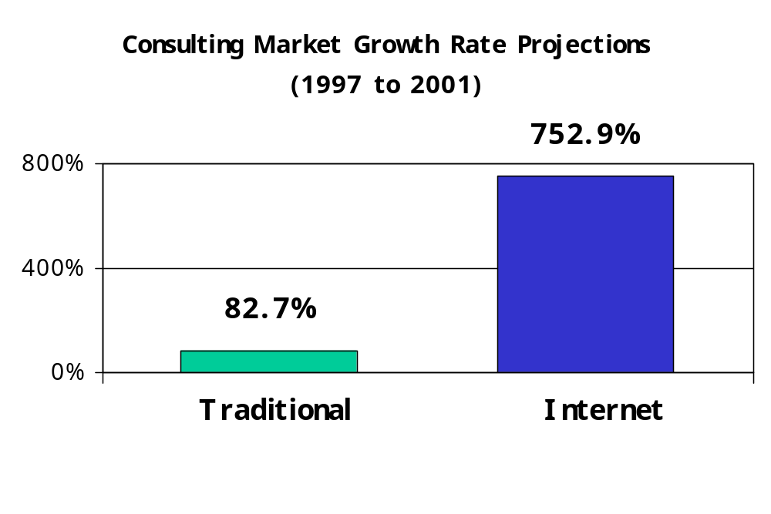
Industries dramatically impacted by digitization are finding traditional planning processes unsuited to competition in the cyberspace.
Strategic Planning Imperatives
Growth in Internet planning is expected to outstrip traditional systems by tenfold in the next years.
Source: IDC
The challenge is to improve speed & scope of planning efforts, and to superimpose an external perspective above current inwardly focused resource allocation process.

Slide 4
Politicized planning process leaves companies susceptible to democratic investment allocation, spreading scarce funds evenly across BUs to preserve harmony rather than investing proportional to strategic objectives.
Strategic Planning Imperatives
“Strategic Drift” common in e-business portfolios
Customer Service
Administration
Size of cell proportional to priority
Size of bubble proportional to project spending
Sales/Fulfillment
Quality
Companies relying on obsolescent planning models will be consigned to reactive, incremental strategies especially ill-suited for rapid-cycle Internet projects.

Slide 5
There are four visible signs of strategic planning proficiency: “diversified” portfolio, “proportionality” to strategic objectives, “strategic relevance” of programs, and “broad dissemination” of strategy.
Strategic Planning Imperatives
“Diversified”
  “asset” allocation mix appropriate “risk appetite” of business strategy
“Proportionality”
  allocation of funds and resources directed by transparent, objective measures of strategic priorities
“Strategic Relevance”
  all programs and projects map to “live” business opportunities
“Broad Dissemination”
  All senior & line management, and high percentage of employees can articulate strategic priorities & name strategic programs

Slide 6
Six week forward plan for Domains and Business Units
Strategic Planning Imperatives
Strategy
Program Plan
Funded/
resourced
e-process
programs
underway
E-processes
Opportunity
Workshop
E-processes
Positioning
Analysis
Workshop
E-processes
Strategy
Construction
E-processes
Program Plan
Construction
1 week
1 week
2 weeks
Decision Point
2 weeks
Decision Point
Participants:
BU Management and staff at various levels
Involvement:
GMDs - 0
MDs - 2 days
Method:
Search Conference
Outcome:
identify e-processes opportunities
Produce high-level designs of future e-processes
Participants:
GMD and MDs
Involvement:
GMDs - 4hrs
MDs - 2days
Snr staff - 1 week
Method:
Strategy Formulation
Outcome:
Position e-processes on value matrix
Select top initiatives
Participants:
MD lead and senior staff
Involvement:
GMDs - 2 hrs
MDs - 4 days
Snr staff - 2 weeks
Method:
Strategy Formulation
Outcome:
e-processes Initiative Concept Package
Participants:
e-processes Director, GMDs and MDs
Participants:
MD lead and senior staff
Involvement:
GMDs - 2hrs
MDs - 4 days
Snr staff - 2 weeks
Method:
Rapid Delivery
Outcome:
e-processes Program Plan Package
Participants:
e-processes Director, GMDs and MDs

Slide 7
The front-end of the six week forward plan formalizes collection of strategy planning inputs and knowledge of “status quo” strategy.
E-Processes Strategy Formulation
Expanded Strategy Planning Inputs
  Search Conferences
    through scenario planning, develops insight into how external economic conditions, demographic & regulatory change, and emerging technologies will change industry/value chain structure
Baseline Strategy
  Domain Portfolio Map
    current initiatives and projects are organized by Domain and mapped based on business criticality & capability innovation

Slide 8
Business criticality and capability innovation are the two drivers of e-business success that best discriminate with respect to strategic advantage.
E-Processes Strategy Formulation
Core Transformation
“Ground Breaking” Business/Industry Rules
HIGH
Business Criticality
New Fundamentals
Rational Experimentation
LOW
LOW
HIGH
Capability Innovation
Source: Boston Consulting Group, McKinsey, Net Ready, Hartman, Sifonis, & Kador, McGraw-Hill 2000.

Slide 9
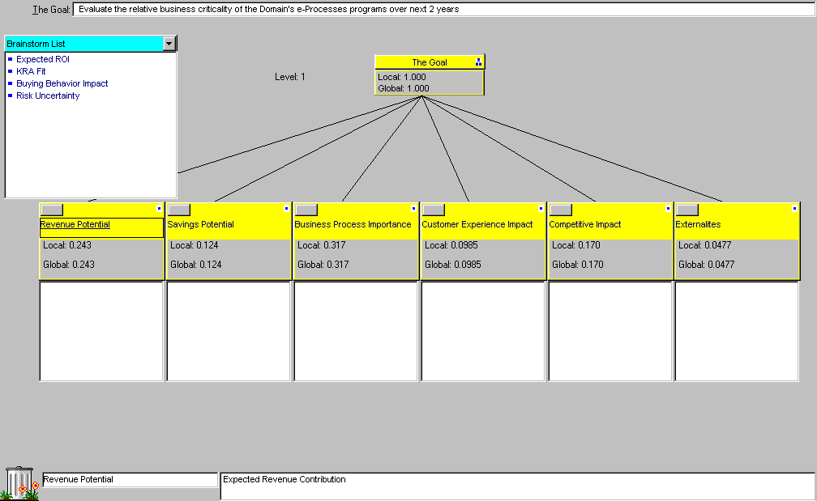
Business criticality gauges how critical to the business’s mission is this capability.
E-Processes Strategy Formulation

Slide 10
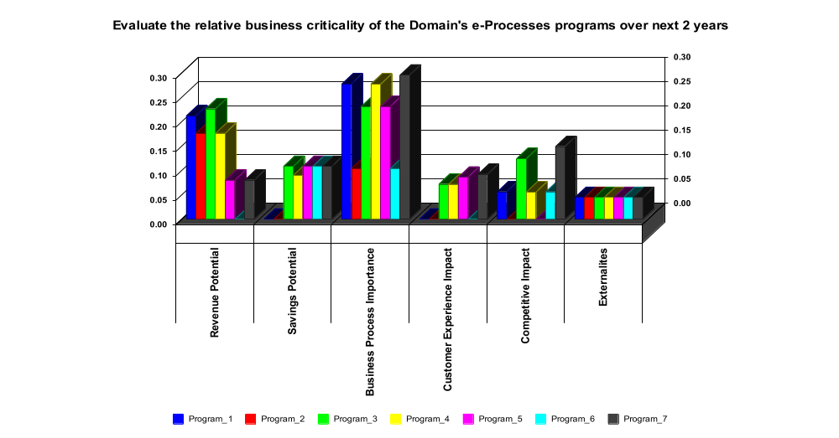
E-Processes Strategy Formulation

Slide 11
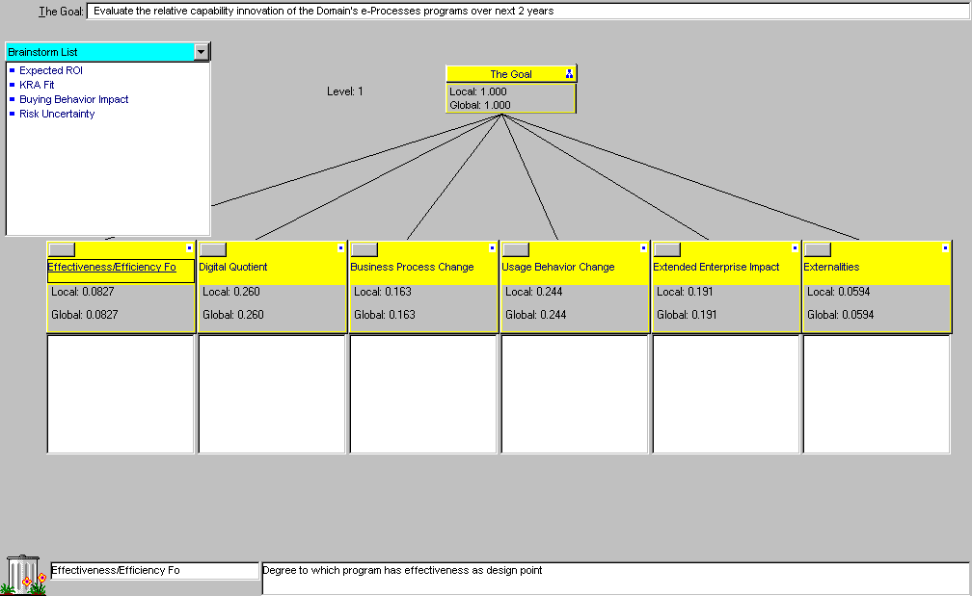
Capability Innovation gauges how new is this capability in your industry -- Is this new or does it already exist? Is this an incremental step or does it represent a fundamental leap?
E-Processes Strategy Formulation

Slide 12
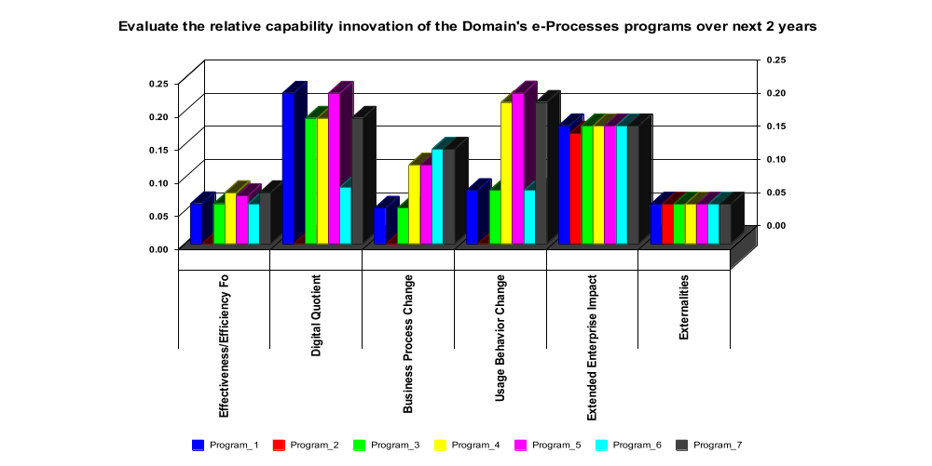
E-Processes Strategy Formulation

Slide 13
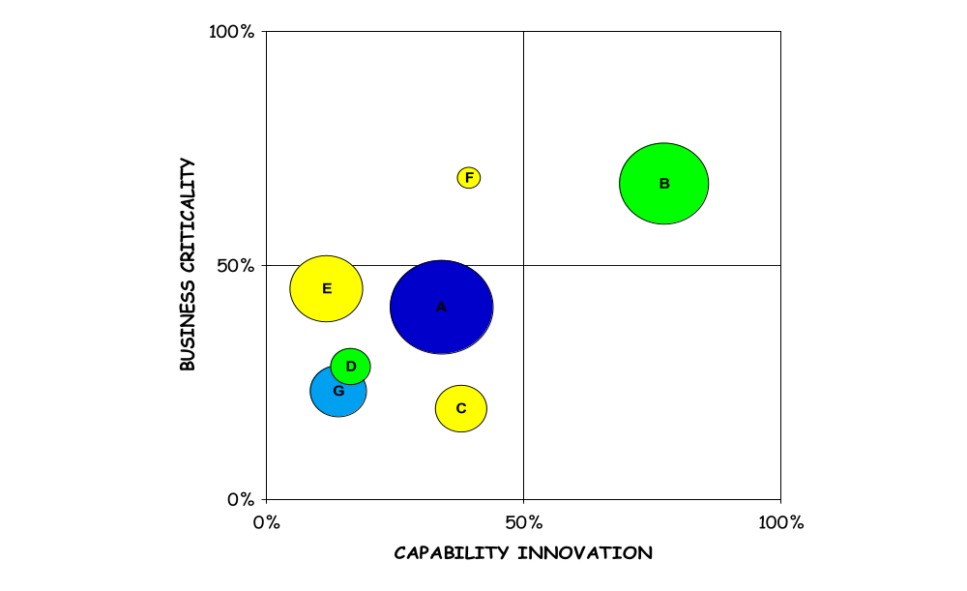
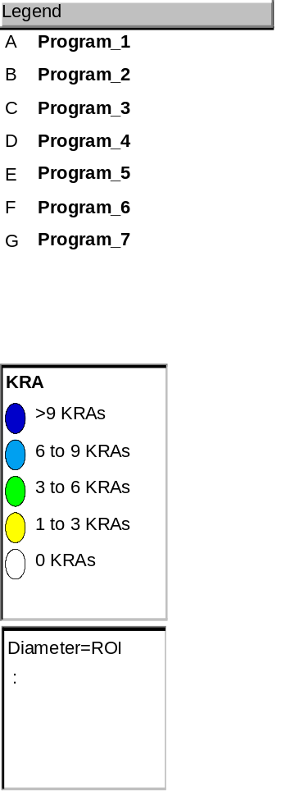
The e-Process Strategic Positioning Analysis Tool assists teams in understanding the “implied” strategy of current initiatives & projects.
E-Processes Strategy Formulation

Slide 14
The discipline of time-boxing is ensured by tight coupling with standardized units of portfolio analysis for comparative exercises.
E-Processes Strategy Formulation
Initiative
  multi-year effort that develops a business capability
Program
  time-boxed to one year, the initiative's programs evolve the business capability through versioning
Project
  time-boxed to 3-4 months, a program’s projects evolves user functionality through versioning

Slide 15
An agreed and understood governance structure is essential for rapid prioritisation and resource allocation.
E-Processes Strategy Formulation
Governance Model
Work Breakdown Structure
CEO Leadership Board
Domain Investment Envelope
Authority
Visibility
Domain Teams
Initiatives
> 1 year
Program Teams
Programs
< = 12 months
3 -6 people
Project Teams
Projects
< = 3 months

Slide 16
Scenario planning insights are investigated against the backdrop of the “implied” strategy to identify potential gaps with strategic priorities.
E-Processes Strategy Formulation
More investments
in experimentation
desired
Less investments
in fundamentals
mediocre returns

Slide 17
Six week forward plan for Domains and Business Units
“Hardwiring” Program Prioritization
Strategy
Program Plan
Funded/
resourced
e-process
programs
underway
E-processes
Opportunity
Workshop
E-processes
Positioning
Analysis
Workshop
E-processes
Strategy
Construction
E-processes
Program Plan
Construction
1 week
1 week
2 weeks
Decision Point
2 weeks
Decision Point
Participants:
BU Management and staff at various levels
Involvement:
GMDs - 0
MDs - 2 days
Method:
Search Conference
Outcome:
identify e-processes opportunities
Produce high-level designs of future e-processes
Participants:
GMD and MDs
Involvement:
GMDs - 4hrs
MDs - 2days
Snr staff - 1 week
Method:
Strategy Formulation
Outcome:
Position e-processes on value matrix
Select top initiatives
Participants:
MD lead and senior staff
Involvement:
GMDs - 2 hrs
MDs - 4 days
Snr staff - 2 weeks
Method:
Strategy Formulation
Outcome:
e-processes Initiative Concept Package
Participants:
e-processes Director, GMDs and MDs
Participants:
MD lead and senior staff
Involvement:
GMDs - 2hrs
MDs - 4 days
Snr staff - 2 weeks
Method:
Rapid Delivery
Outcome:
e-processes Program Plan Package
Participants:
e-processes Director, GMDs and MDs

Slide 18
Creating transparent, objective measures of program “strategic relevance” and embedding “excess” staff and fund reserves ensure the portfolio remains responsive to unforeseeable changes in strategic priorities.
“Hardwiring” Program Prioritization
“Strategic Relevance”
  defined strategic evaluation criteria used to assign quantitative scores to programs
  defined strategic importance weightings that are multipliers to the criterion score
  results are summed to yield a total strategic “score” for each program
Embedding Flexibility
  Targeted programs receive annual budget approval
  Program managers perform resource (funds & staff) allocation at project
  Domains reserve resources for uncertainty

Slide 19
Quarterly recalibration of program valuations by strategic criteria automates real-time reprioritization of portfolio.
“Hardwiring” Program Prioritization
Defining and Weighting
  Senior management validates criteria against which programs will be prioritized and determines the relative weighting of each
    weightings are informed by strategic priorities
Scoring Program Criteria
  Program leads determine the scores for each criteria to calculate the overall strategic score
  Domain leads review & adjust portfolio allocations
    ensures overall portfolio allocations foot with strategic priorities
Changing Strategic Weights
  Senior management change strategic weightings in response to externally and internally driven changes in business priorities
Redistribution of Resources
  Domain & Program leads reassign funds & staff to reflect recalibrating portfolio scoring
    ensuring resources are allocated proportionately with most current strategic priorities

Slide 20
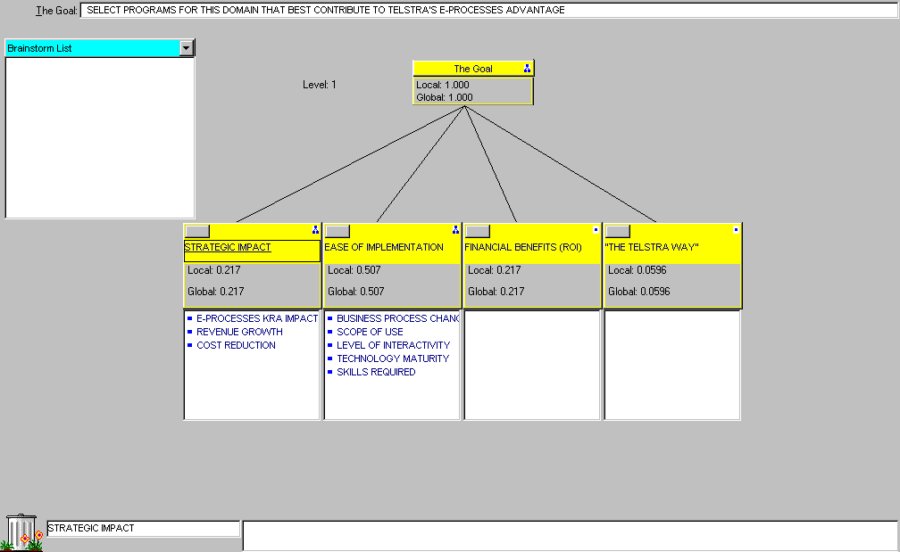
The e-Processes Prioritization tool documents the strategic evaluation criteria and priorities (weightings).
“Hardwiring” Program Prioritization

Slide 21
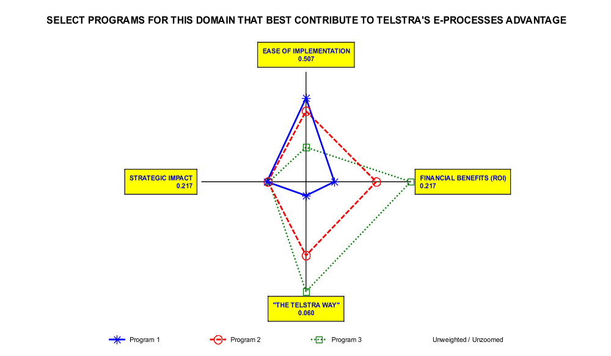
“Hardwiring” Program Prioritization

