Slide 1
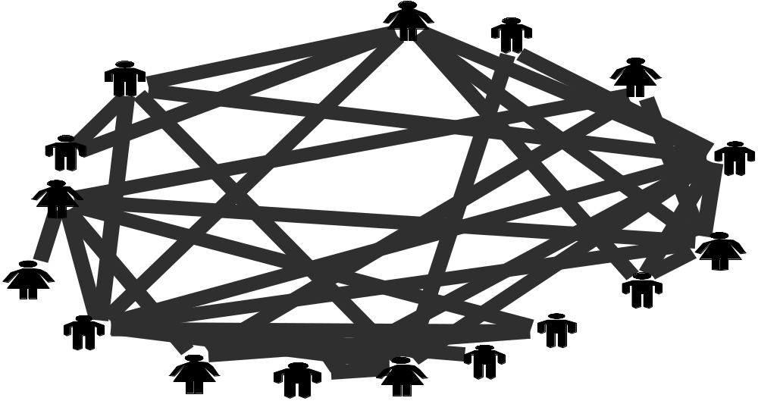
From Knowledge Management to ‘Knowing Networks’
Social Network Analysis

Slide 2
From Knowledge Management to Knowing Networks...
Social Network Analysis
  Principles and Network Diagram Interpretation
  Applications of Social Network Analysis
Knowledge Dimensions Underlying
Knowledge Flow In Networks

Slide 3
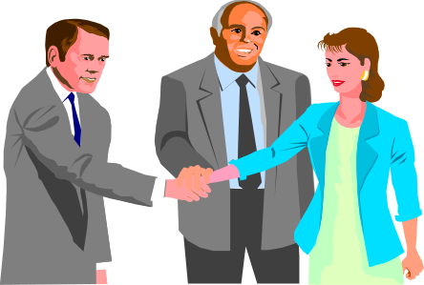
Social Network Analysis
Relationships -- Are multi-dimensional and ‘discovered’ through the questions we ask.
Network structure can facilitate or impede effectiveness:
  Are certain people overly central?
  Are some people loosely connected and so under-utilized?
  Are there divisive subgroups?
  Is the network’s level of connection sufficient?
Tim
Bob
Sue
Sal
Work Together
Advice
Friendship
Trust
Support
Eat with
Pam
Ed

Slide 4
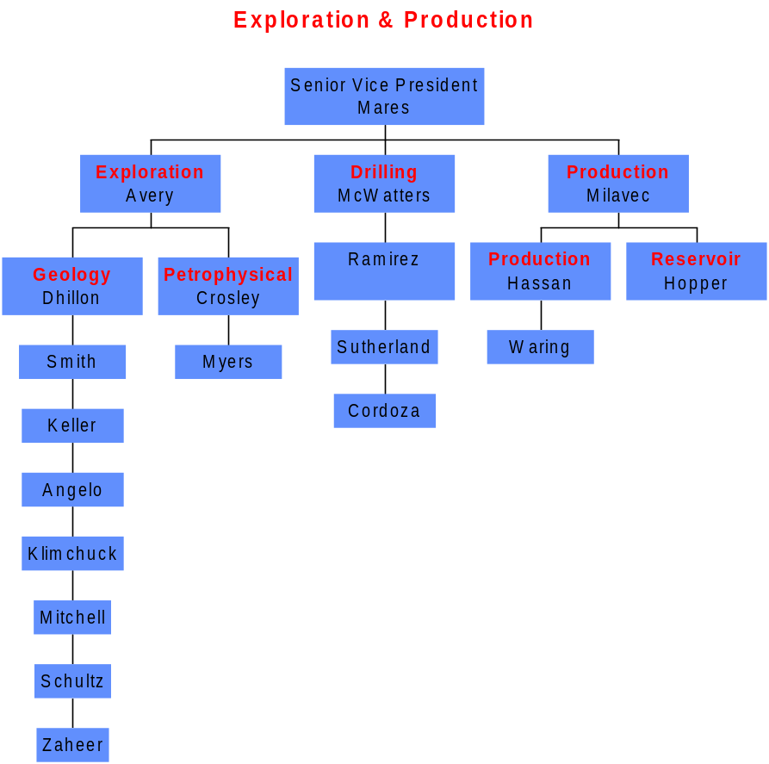
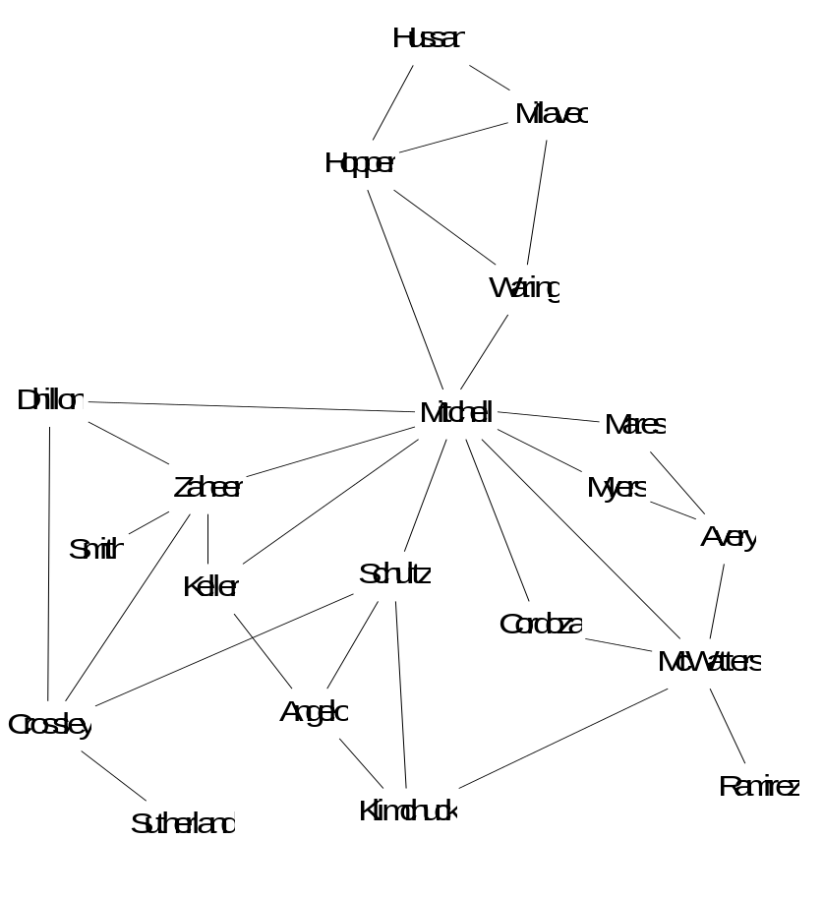
Who do you turn to for information to get your work done?
Getting things done often depends less on formal structure than an informal network of friends and colleagues...
Formal Structure
Informal Structure

Slide 5
Social Network Analysis can be a powerful tool to assess the health of a community or team...
A partner leading a consulting team specializing in knowledge management was concerned with his group’s interactions.
  Had little history with this group.
  Team was globally dispersed and had unique skill sets.
We were interested in understanding the extent to which the group collaborated and leveraged its collective knowledge.
Conducting a network analysis told us who people turn to for information or advice to get their work done.

Slide 6
A Virtual ‘Group’ of Experts
The network is split into two subgroups which minimizes the overall flow of knowledge.
C is acting as the main connection between the two subgroups

Slide 7
Nine Months Later The Group Reported Winning Joint-Project Work and Network Analysis Revealed a More Cohesive Network...
Interventions to increase the flow of knowledge and information included:
  Mixed revenue targets. Joint staffing on internal projects (e.g. white papers or process redesign).
  Established new communication forums (e.g. lead & project status calls, update e-mails).
24 hour commitment to accessibility made visible.
C was actually a bottleneck not a broker and left the group.

Slide 8
From Knowledge Management to Knowing Networks...
Social Network Analysis
  Principles and Network Diagram Interpretation
  Applications of Social Network Analysis
Knowledge Dimensions Underlying
Knowledge Flow In Networks

Slide 9

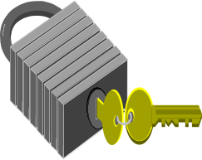
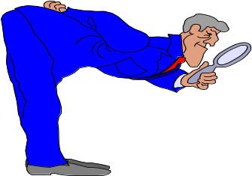
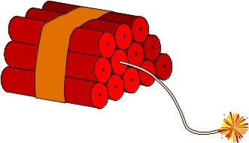
How do we view a network of people to make it more effective in terms of knowledge creation and sharing? Research with 40 managers on 120 important relationships indicates four key dimensions...
Knowledge -- Knowing what someone else knows dictates whether and for what problems you are likely to turn to them for help.
  How well do you feel you understand this person’s knowledge, skills and abilities?
Access -- People are busy and can’t make time for everyone. Access (both social and technical) is also important.
  When I need information or advice, this person is generally accessible to me within a sufficient amount of time to help me solve my problem.
Engagement -- Yet access alone may not result in actionable knowledge. People who actively engage in problem solving are more helpful.
  If I ask this person for help, I can feel confident that they will take time to understand my problem and shape what they know to the problem.
Safety -- To promote true learning and creativity, people must feel safe to ask questions that expose their lack of knowledge.
  Please indicate the extent to which you feel personally safe asking this person for information or advice on work related topics.

Slide 10
Social Network Analysis can be a powerful tool to detect the Potential for Knowledge Flow...
We administrated a social network analysis on a telecommunications practice of a large consulting company.
  The group contained four hierarchical levels
We were interested in understanding the extent to which the group collaborated and leveraged its collective knowledge.
By combining the four dimensions that create the potential for knowledge flow we are able to isolate at what point the network breaks down. This allows for more targeted interventions.

Slide 11
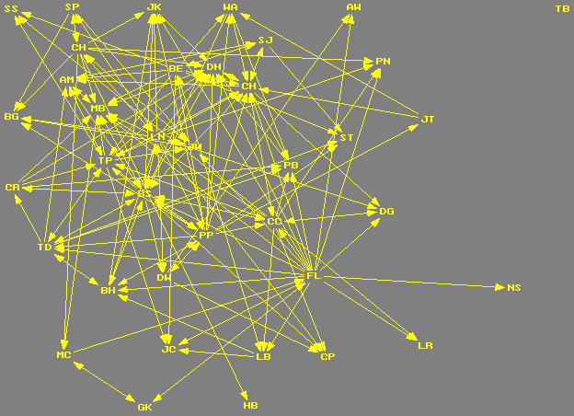
Visual Analysis: Know
The Know network is cohesive with only 1 unconnected person.
A number of well connected central actors.

Slide 12
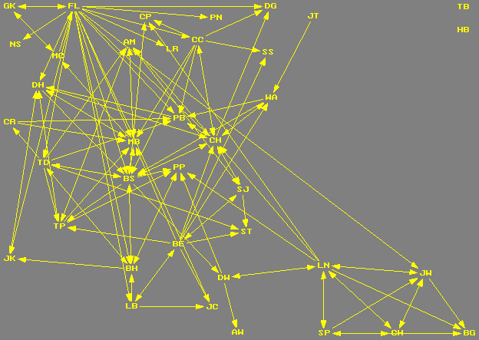
Visual Analysis: Know x Access
When Know and Access are combined there is a less dense network with 5 central actors.
Clique on the bottom right with LN & JW acting as bridges to the main network.

Slide 13
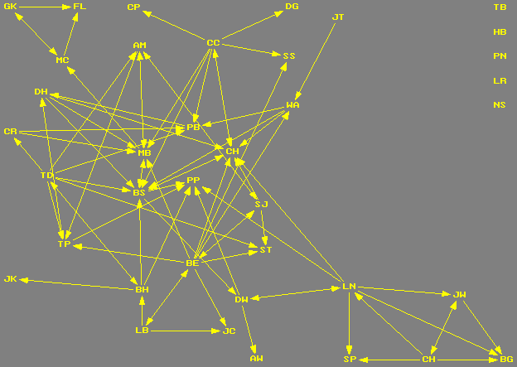
Visual Analysis: Know x Access x Engage
When the Engage dimension is added the network becomes less dense network with the same
central actors remaining prominent.
Several actors isolated from the network.
Only LN acting as a bridge between the clique and the main network, a second clique in the top right.

Slide 14
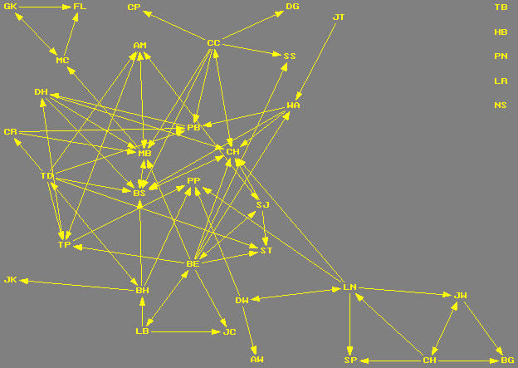
Visual Analysis: Know x Access x Engage x Safe
When the safety dimension is included there is minimal change due to high density of Safety network --- A good cultural indicator.

Slide 15
From Knowledge Management to Knowing Networks...
Social Network Analysis
  Principles and Network Diagram Interpretation
  Applications of Social Network Analysis
Knowledge Dimensions Underlying
Knowledge Flow In Networks

Slide 16
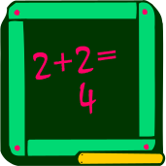

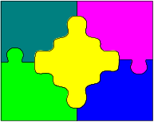


What flows between people that might be different than between a computer and a person?
Answer -- Sometimes when we turn to people for information we get lucky and obtain answers.
Meta-Knowledge -- Often people point us to other people with expertise or information in data bases. Meta-knowledge helps us locate information in a timely manner and so increases efficiency.
Problem Reformulation -- Some people help us think about our problem differently by considering important dimensions of a problem or by pointing out consequences of certain actions. These people help us solve the right problem.
Affirmation -- Sometimes no information may be obtained, but simple confirmation of our thinking is critical to confidently introducing our ideas.
Symbol -- On occasion when we seek information from someone we benefit by being able to associate a person’s name with the proposed solution. The ability to “name drop” can significantly increase efficiency.

Slide 17
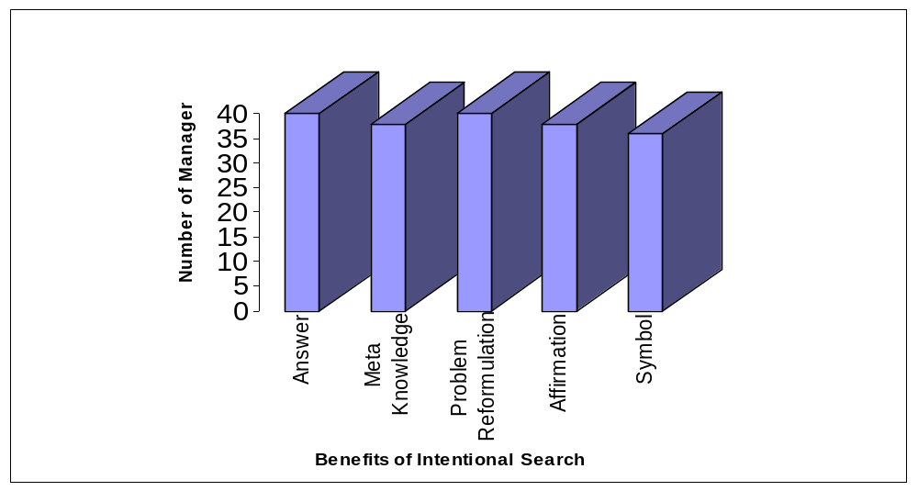
Individual Manager’s Networks...
Benefits Received in Intentional Search
Managers created a balanced network using a variety of different people for the five dimensions
of knowledge flow

Slide 18
Social Network Analysis can be a powerful tool to analyze what flows between people…
We used Social Network Analysis to analyze the flow of knowledge between people in the Human Resources department of a large healthcare organization.
  The organization had grown rapidly in the last five years through mergers and acquisitions.
  Theoretically the department should act as one unit.
We were interested in understanding the extent to which the group collaborated and leveraged its collective knowledge.
Conducting a network analysis helped us to understand if people turned to the same people for different types of help.

Slide 19
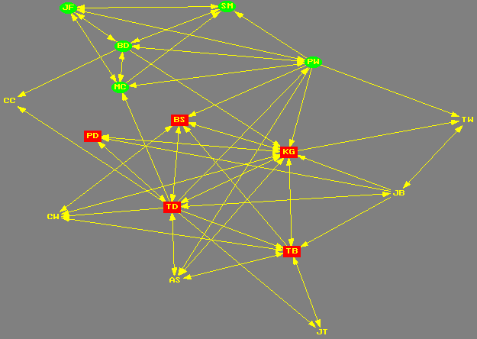
Knowledge Flow: Answer Network
= Original Organization
= Large Acquisition
Clear = Other Acquisitions
The Answer network is cohesive with no isolated people.
There are several people including KG, BS & BD who are quite central.

Slide 20
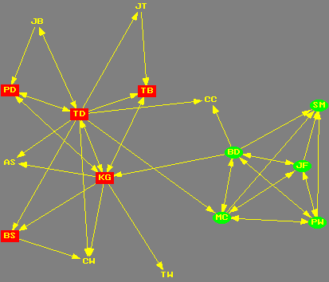
Knowledge Flow: Meta-Knowledge Network
= Original Organization
= Large Acquisition
Clear = Other Acquisitions
The Meta-knowledge network is less dense with the beginnings of a split between the original
organization and the large acquisition.

Slide 21
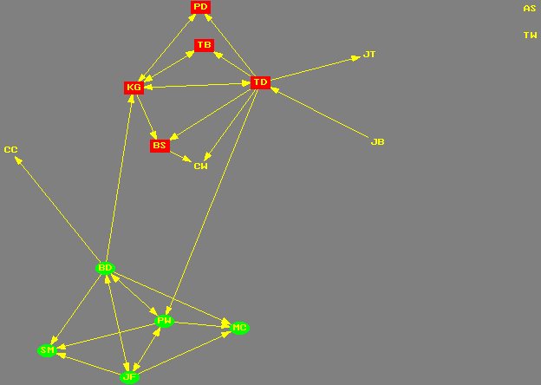
Knowledge Flow: Problem Reformulation Network
= Original Organization
= Large Acquisition
Clear = Other Acquisitions
The Problem Reformulation network is even less dense with only two ties between the original organization and the large acquisition.
Two people have become isolated from the network.
Problem reformulation requires trust which is more likely to occur with people who you have built up a relationship with over time.

Slide 22
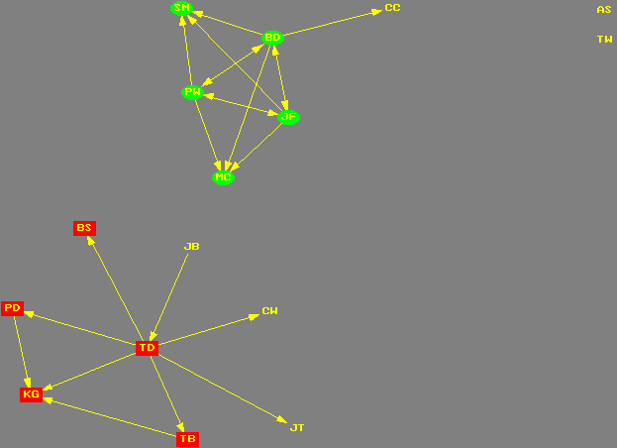
Knowledge Flow: Affirmation Network
= Original Organization
= Large Acquisition
Clear = Other Acquisitions
The Affirmation network is even less dense with no ties between the original organization and the large acquisition.
It is probable that for affirmation people will only go to the people who they have strong trusting relationships with built up over time.

Slide 23
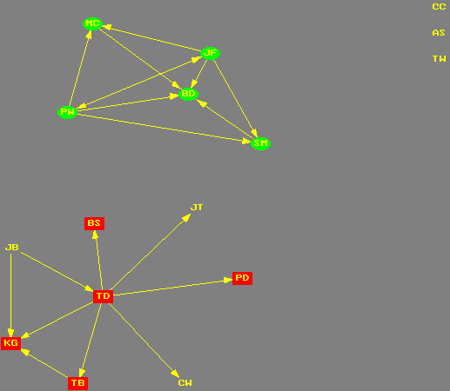
Knowledge Flow: Symbol Network
= Original Organization
= Large Acquisition
Clear = Other Acquisitions
The Symbol network is slightly less dense than that of affirmation. There are only two ties between the two subgroups.
Three people have become isolated from the network.
The large acquisition network is more cohesive than that of the original acquisition.

