Slide 1
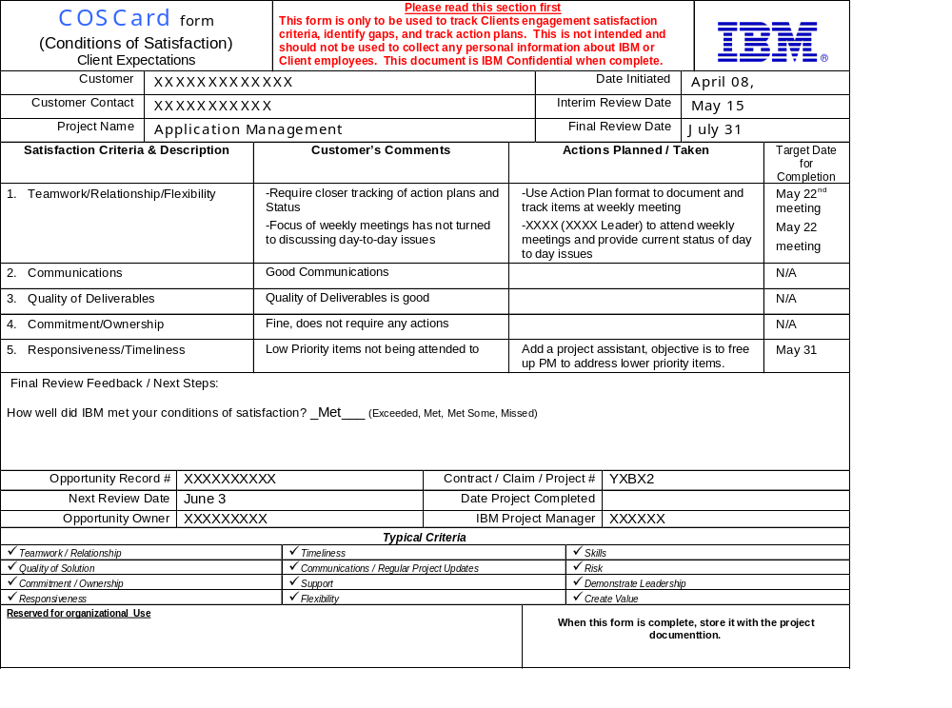
IBM Confidential when complete

