Slide 1

XYZ company
High Level Implementation
Strategy
XYZ project
IBM Global Services
Practice name
Date

Slide 2
Contents:
Review of the XYZ project Objectives
Assumptions
Implementation Approach
Rapid Implementation Considerations
Overall Considerations
Proposed Release Timeline
Implementation Activities Overview
Planning the Next Steps

Slide 3
Review of The XYZ project Objectives

Slide 4
The primary objective of the XYZ project is to select then implement new software to support improved business processes and shorter cycle times for core financial functions.
Review of Project Objectives
Select the best integrated software solutions to manage the key business areas and replace existing systems (core functions):
  GL
  AP
  AR
  Consolidations
  Fixed Assets
  Management Reporting
  Materials Management
  Total Cost of Ownership Accounting

Slide 5
Secondarily, the project should implement the chosen software to improve processes and shorten cycle time for a set of extended business functions.
Review of Project Objectives
Select the best integrated software solutions to integrate or replace existing systems in these business areas (extended functions):
  Asset Management
  Budgeting & Forecasting
  Contract Services
  HR
  Payroll
  Purchasing
  Data Warehouse

Slide 6
Finally, the project should implement the software solution to improve integration and smooth processing with existing systems.
Review of Project Objectives
Select the best integrated software solutions to integrate existing systems in these business areas:
  Purchasing / procurement
  Tax & Compliance
  Treasury & Cash Management

Slide 7
Assumptions

Slide 8
Since package selection is scheduled to be finalized in July 1999, several business related assumptions were made in order to develop this high level implementation approach.
Assumptions
The selected package will support the business functions of the systems to be replaced and allow for the desired systems to be integrated.
A key goal is to utilize the functionality of the selected package wherever possible to fully reap the benefits of an integrated solution.
A “Big Bang” approach is not feasible for XYZ company.
Risk minimization is a major requirement for the implementation approach
XYZ company wants to do a rapid implementation approach with implementation cycles of not more than 6 months.
The system design can be done in a manner that achieves 60% common business processes and 90% common data while satisfying the unique regional needs.

Slide 9
In addition, several assumptions related to technical feasibility were made in order to develop this approach.
Assumptions
The implementation can be done in two phases for each targeted instance:
  Phase One Core Functionality
  Phase Two Extended Functionality and enablers (web-connectivity, workflow etc.)
The system rollout can follow the pattern of the existing Millennium instances. (Europe/Africa, Americas, Asia Pacific.)
Applications will be developed based on desired standards wherever possible to allow for a rollout strategy and re-use of functionality rather than a re-design for every region.
Bolt on solutions will be standardized throughout the regions as long as local requirements do not force different solutions (I.e tax packages)
The IT infrastructure does not require radical changes to support the selected package

Slide 10
Implementation Approach

Slide 11
The XYZ project team has expressed a desire for using a rapid implementation approach. The environment can affect the ease of using this approach.
Implementation Approach
Rapid
Implementation
Comprehensive
Implementation
Typical Framework of Approach
Few Interfaces
Simple GL structure
Standard predefined Chart of Accounts
Heavy use of templates
Typical Framework of Approach
Many Interfaces
Complex GL structure
International group
Few templates

Slide 12
Considerations for a Rapid Implementation

Slide 13

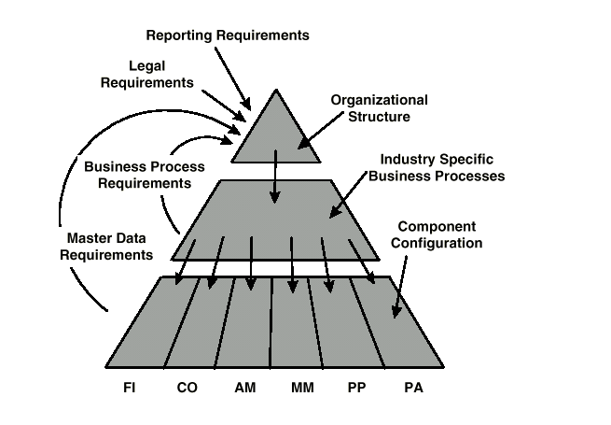
Rapid Implementation Considerations
The XYZ project has some factors that should be addressed prior to beginning a rapid implementation. First, XYZ company is a diversified, global organization so developing an Enterprise Model is recommended.
XYZ company is a diversified global organization
To lay the cornerstone for a successful global implementation, and reap the benefits from an integrated financial system, the Enterprise Model should be developed.
The existing number of GL is rather large with 73 entities world wide (GL corporations: either legal entities or reporting entities)
Enterprise Model

Slide 14
The Enterprise Modeling step should immediately follow the package selection and allow for the specifics of the selected package.
Rapid Implementation Considerations
Develop the Enterprise Model within the constraints of the selected package
Refine Reporting needs and verify against the Enterprise Model
Create a system topology to reflect the Enterprise Model of choice and verify against
      reporting needs
      performance needs
      required availability
      maintenance, release upgrade
Prepare operational IT infrastructure model
    Create a detailed project plan for implementing the enterprise model with phase exit criteria and deliverables

Slide 15


The number and complexity of the interfaces should also be addressed to support a rapid implementation approach.
Rapid Implementation Considerations
Interfaces
The existing financial system for GL, AP and AR have 35 different interfaces.
Additional 392 users world wide use PC-Link to retrieve information from the financial systems. The Background and further processing of this information is unknown at this point. Possibly several major interfaces connected through PC-Link need to be identified.
To allow for the successful execution of a rapid implementation the work to realize the interfaces has to be started now.
Interfaces design activity

Slide 16
Rapid Implementation Considerations
The number of interfaces may require the team to start design work as soon as the package is selected to allow for rapid implementation cycles.
Review of Application portfolio for
  Applications to integrate
  Applications to replace with XYZ project
Review of Interface portfolio for
  Interface that will exist with XYZ project
  Interfaces that will be replaced by the integrated aspects of XYZ project
Review of project portfolio
  Applications that are planned and need to be replaced by XYZ project
  Applications that are planned and need to be integrated by XYZ project
Create a detailed project plan for interface design and development with phase exit criteria and deliverables

Slide 17



Rapid Implementation Considerations
The chart of accounts for all XYZ company organizations should be reviewed and redesigned, if needed, early in the project.
Complex Chart of Accounts
Due to insufficient functionality in controlling the GL Accounts are heavily used to carry attributes for reporting purposes. Which will require an extensive review of GL account structures.
By leveraging the controlling functionality of integrated software systems, the Chart of Accounts can be simplified and standardized.
Global Charts of Accounts

Slide 18
Rapid Implementation Considerations
To allow for fast financial reporting and consolidation a global standard chart of accounts (commonly shared accounts) should be defined.
Collect as is Charts of Accounts
Isolate commonly shared accounts
Formally define the new global standard for a chart of accounts
Create a detailed project plan for the creation of a global chart of accounts with phase exit criteria and deliverables

Slide 19

Rapid Implementation Considerations
Some early design work on the controlling functions of the new software should be considered as these capabilities may be new to the XYZ company environment.
Management Reporting and Controlling
Today’s integrates solution packages have comprehensive functionality for Controlling which were not available in the legacy systems. To reap the full benefits of these functionality XYZ company’s controlling systems need to be reviewed.
The existing capabilities for management reporting are very limited due to the lack of support through the existing financial systems. Costs for projects, products and services across all regions are almost impossible to obtain.
Controlling Design

Slide 20
Rapid Implementation Considerations
To take advantage of the integrated software package’s global controlling capabilities a global design for a XYZ company controlling system should be completed early in the project.
Document the Current State
  Budgeting
  Project accounting
  Cost accounting for services and products
Develop and design a Controlling concept for XYZ company leveraging the capabilities of the chosen package.
Get agreement from management in the regions and International for this concept to be the XYZ company Controlling standard.
Create a detailed project plan for the inception of the new XYZ company controlling standard with phase exit criteria and deliverables.

Slide 21
Overall Considerations

Slide 22
The project team should develop an awareness of other key considerations that may have an effect when planning the overall project.
Overall Considerations
The management team may need to integrate the XYZ project project plan with other implementation initiatives in order to manage inter-dependencies.
Full time participation may be required from “power users” at several stages of the implementation.
Sufficient resources, personnel and other, must be made available to support the rapid implementation approach.
Decisions must be made in a timely manner. A “48 hour rule” may be required in order to keep to the accelerated schedule. (i.e. where an issue or problem requiring a decision must be resolved within 48 hours)

Slide 23
Proposed Release Timeline

Slide 24
A phased implementation approach with specific functional components can create a manageable flow of incremental package releases.
Proposed Release Timeline
1999
2000
2001
2002
EU/CEMEA
US/Canada
International/LA
Asia/Pacific
Refinements
Core Functionality
Extended Functionality

Slide 25
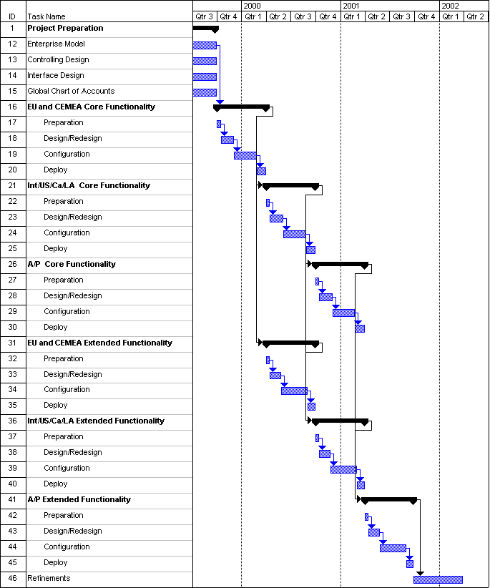
Development of a macro level project timeline helps coordinate the implementation activities.
Proposed Release Timeline

Slide 26
Implementation Activities Overview

Slide 27
A number of activities are needed to successfully implement any integrated software package. Project initiation and planning are always first.
Implementation Activities Overview
Project Startup
  Verify and document Scope and Objectives
  Project Team Orientation on methodology
  Establish Project Workspace
  Establish project management systems and tools.
Project Planning
  Review and Refine Project Implementation Strategy
  Develop Detail Implementation Plan
  Perform Technical Review

Slide 28
Business process redesign and identification of areas of process improvement, through automation for example, occur in the design preparation activity.
Implementation Activities Overview
Design Preparation
  Review Initial Process Gap Analysis
  Perform Detailed Gap Analysis
  Review Initial Business Requirements
  Perform Report and View Definitions
  Define Technical Infrastructure Requirements
  Assess Data Conversion Effort
  Define Application Interface Specifications
  Define Training and Documentation Requirements

Slide 29
Turning a software package into a usable business system is an iterative process that requires the full commitment of the team’s resources.
Implementation Activities Overview
Iterative Design and Development
  Conduct Function Design Workshops
  Configure Application
  Perform Unit Testing
  Identify New Procedures
  Define Skill Requirements and Roles
  Identify Security Requirements
Design and Development Completion
  Perform Conversion and Interface Development
  Conduct Integration Testing
  Perform and Confirm Application Configuration
  Refine Procedures and Documentation
  Implement Application Security
  Finalize End-User Training

Slide 30
Testing, managing organizational change, and quality assurance activities are key to ensuring the successful migration to a new software enabled business system.
Implementation Activities Overview
Testing and Quality Assurance
  Conduct Full Integration Test
  Perform User Acceptance Testing
  Perform Quality Assurance Review
Organizational Change
  Assess Readiness for Change
  Develop Stakeholder and Change Leadership Program
  Develop Communication Plan
  Finalize End-User Documentation
  Schedule and Execute Technical and End-User Training
Production Migration
  Develop Readiness Assessment
  Design Contingency Plan
  Perform Final Data Conversion
  Perform Post Implementation Audit

Slide 31
The technical infrastructure work packages will provide the IT system basis for XYZ project.
Implementation Activities Overview
Technical Architecture
  Define Technical Infrastructure
  Validate Development Environment
  Define Test Environment
  Conduct Application Interface Review
  Conduct Enterprise Integration Review
  Perform System Management Review
  Manage Technical Issues

Slide 32
Planning the Next Steps

Slide 33
Planning the Next Steps
Planning the Next Steps
Finalize implementation vendor selections
Identify resources and start sub projects
  Interfaces
  Enterprise model
  Global Charts of Accounts
  XYZ company Controlling standards

Slide 34
Planning the Next Steps
Planning the Next Steps
Start Preparation phase with these key targets:
  Prepare detailed project plan for the preparation phase and the implementation phases for the first functional release.
  Prepare Project Charter
  Develop Communication strategy
  Develop user documentation and training strategy
  Prepare Enterprise Area Scope document
  Perform training of XYZ company project team members on methodology
  Perform database, software, hardware and implementation agreement negotiations
  Finalize technical infrastructure operational model and have development system in place by September, 1st 1999
  Perform logistics preparation (rooms, PC’s, etc., project management systems and repository) for project teams

