Slide 1
Client Name
Internal Project Kickoff Meeting
Date

Slide 2
Agenda
    Agenda
    · Introduce the Project
    · Review the Client Business Strategy
    · Confirm the Scope and Objectives of the Project
        IBM Responsibilities
        Client Responsibilities
        Out of Scope
    · Identify Key Issues and Risks
    · Review Project Approach
    · Review Roles and Responsibilities
    · Review Project Timeline

Slide 3
Agenda - Cont’d
    Review of Work Products to be produced in the Current Phase
    Review of Contracted Deliverables
    Review of Technical Environment
    ·Review of Project Processes and Procedures

Slide 4
Client Business Strategy
Strategy from the Prepare and Focus Phases….

Slide 5
Project Scope (example)
Financial Application Software Selection:
  G/L
  A/P
  A/R
  Fixed Assets
  This should map to the Statement of Work
HR/Payroll
Asset
Management
Financials
& Accounting
Executive
Information
Systems
Banking
Operations

Slide 6
Tasks In-Scope
IBM Responsibilities - derived from contract

Slide 7
Tasks Out-of-Scope
    Client responsibilities
    Other Activities Not Covered in SOW
      Tools creation/modification
      Others

Slide 8
Project Objectives (example)
Streamline Business Processes
Achieve Greater Volume Processing
Reduce Operating Costs
Establish Electronic Commerce in Purchasing and Sales
etc.

Slide 9
Key Issues and Risks (example)
Year 2000 Failure of Current General Ledger and Accounts Payable Applications
Slow volume processing for General Ledger transactions
Lack of Business Resources
etc.

Slide 10




Project Approach (example)
Project Startup
Confirm
Corporate
Strategy
Develop
Vendor
Demo Scripts
Conduct Vendor
Demonstrations
Determine
Vendor
Shortlist
Develop Software Selection Requirements
Produce
RFP
Use a visual or bullet list of the approach

Slide 11
Project Roles & Responsibilities
Examples...
Facilitators
  Responsible for establishing workshop goals, process and assisting participants in the development of future business requirements
  Subject Matter Experts
  Responsible for providing expert knowledge of the specific functional area they represent during the workshop
  Should consider the cross-functional aspects of business requirements definition

Slide 12
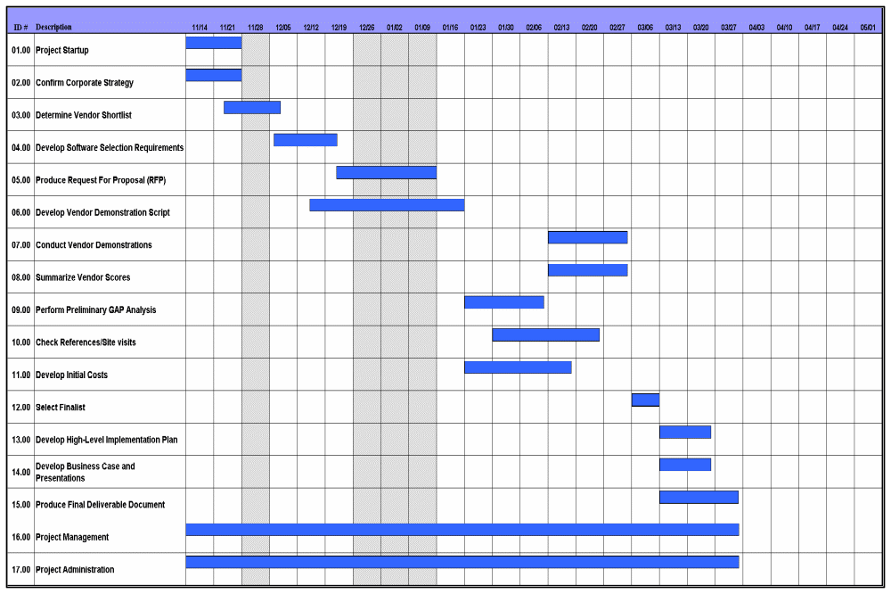
Project Timeline/Plan (example)

Slide 13
Phase 1 Work Products
List Work Products….this should now include all the work products that lead up to deliverables.

Slide 14
Review of Contracted Deliverables
    Review of Contracted Deliverables such as…
      Design Documents
      Standards
      etc

Slide 15
Technical Environment
A Description of the As-Is Environment
A Description of the To-Be Environment (if known)
Environment usage and considerations for the various stages of the project

Slide 16
Project Processes and Procedures
    Change Control
    Communications Plan
    Issue Management
    Escalation Procedures
    Review of Project Tracking Procedures
    Issues Logging and Tracking
    Actions Logging and Tracking
    etc.

