Slide 1
Total Cost of Ownership (TCO) Analysis & Short IT Assessment
Initiative Description – Proposal
Version 1.0
February 2001
IBM Deutschland GmbH

Slide 2
Total Cost of Ownership (TCO) Short Analysis – Motivation
Motivation for the Initiative
  e.g.:
  The IT shop of client xxx has to charge back the IT costs for ist products and services to its customers.
  There is no transparency about IT costs, i.e. the IT shop does not know what causes how many costs.
  Cost pressure on IT shops increases – potential cost savings areas have to be identified and savings have to be realized.

Slide 3
Total Cost of Ownership (TCO) Short Analysis - Objectives
Objectives of the Initiative
  Assessment and analysis of all IT related costs for client/server as well as backend components
  Assessment of IT Services including their scope and quality
  Assessment of system and application architecture (capacity, complexity, etc.)
  Comparison and positioning of IT costs in relation to industry average
  Identification of „high cost“ areas by analyzing costs with regard to current IT environment
  Identification of potential for cost savings
  Evaluation of different client architecture scenarios with regard to costs
  Creating cost transparency
additionally:
  Achieving a basis for a chargeback system and further IT benchmarks
Remark: To make sure that these objectives are achieved it is necessary that client staff collaborates
and that client management sponsors this project.

Slide 4
Total Cost of Ownership (TCO) Short Analysis – Tasks
Tasks of the Initiative
  Consulting and support of IT Controlling
    Definition of departments and cost areas to be considered
    Assessment of IT costs (e.g. interviews)
    IT Assessment (processes, organization, tools) in order to
      Determine and assess service quality
      Identification of relevant departments and process owners
    Definition of assumptions to compensate lacking cost information (e.g. according to Gartner Group findings)
    Structuring of assessed costs
    Comparison to industry average TCO
    Analysis / Evaluations
      Presenting overall TCO
      Identification of high cost areas based on IT Assessment
      Evaluation of client architecture scenarios
    Identification and high level planning of initiatives in order to realize cost savings

Slide 5
Total Cost of Ownership (TCO) Short Analysis – Scope and Risks
Input Information
  Cost areas, cost departments from IT Controlling
  Actual cost data
Scope
  Costs: IT relevant costs
  Services/Processes: Customer Management
  IT: Infrastructure Project Management, System Architecture
  Interfaces: CRM, infrastructure management, system architecture
Risks
  If client execs don‘t sponsor the project approach
  If client staff don‘t collaborate
  If „hidden“ costs are not revealed, e.g. costs not residing in IT organization but customer organization
Impact of not doing this project
  CRM, infrastructure management, system architecture don‘t have enough information to complete their projects and make decisions
  No cost transparency, lacking information for charge back
Priority (high – middle - low):
  high
Interested Parties:
  CIOs
  Cost department responsible managers
  Controlling
  Procurement
  CRM
  Infrastructure Management
  System Architecture

Slide 6
Total Cost of Ownership (TCO) Short Analysis – Project Organization
Client:
  Contract Owner: ??
  Review Board: ??
  Sponsor: ??
IBM and Client Project Team:
  Project leader:
    At client
    At IBM
  1 Senior Consultant IBM
  2 Consultants IBM
  1 Controlling person at client
  1 Customer management person at client
Additional at client:
  Cost department responsible managers
  IT department responsible managers

Slide 7
Total Cost of Ownership (TCO) Short Analysis – Resources
Resources
  Client:
    1 Project leader, ca. 15 person days
    Experts, ca. 15 person days
    Cost and IT department responsible managers 1 person day each
  IBM:
  ca. 80-90 person days

Slide 8
Total Cost of Ownership (TCO) Short Analysis – Collaboration
Client
IBM
Nominates a project leader and coordinates dates
Provides project team with IT controlling person for cost assessment
Provides with relevant information in a timely manner
Makes sure the necessary staff members are available for interviews and workshops
collaborates
Takes full responsibility for consulting and support
Provides skilled consultants (method skill and practical experiences)
Leades interviews and workshops with client management and staff
Presents at review meetings
Responsible for time and budget
Leads the project team

Slide 9
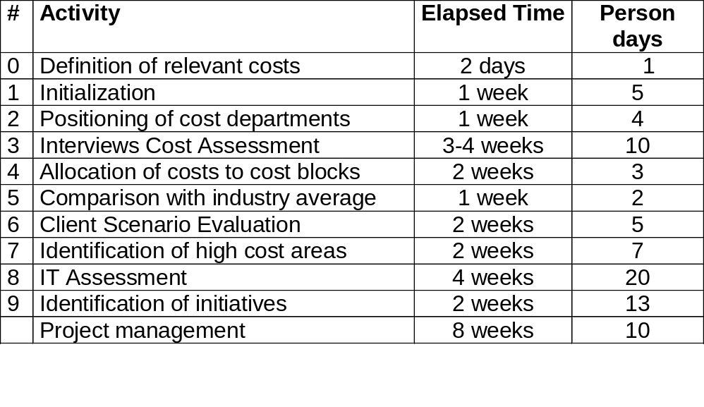
Total Cost of Ownership (TCO) Short Analysis – Resource and Time Planning
Price:
ca. xxx DM
Planning:
0
1
2
3
4
5
6
7
8
9
1Q01
2Q01
3Q01

Slide 10
Additional Information

Slide 11

The advantage of a Total Cost of Ownership Analysis is that it comprises all costs of an IT environment.
Total Cost of Ownership as well as the purchasing costs includes the costs to do with the administration and use of IT components – even as far as their final disposal.
In this way the complete life cycle of the IT components will be closely looked at.
With the assistance of the TCO Method, all relevant costs will be assessed, validated and analysed.
Acquisition
+
+
Disposal
Management & Support
+

Slide 12
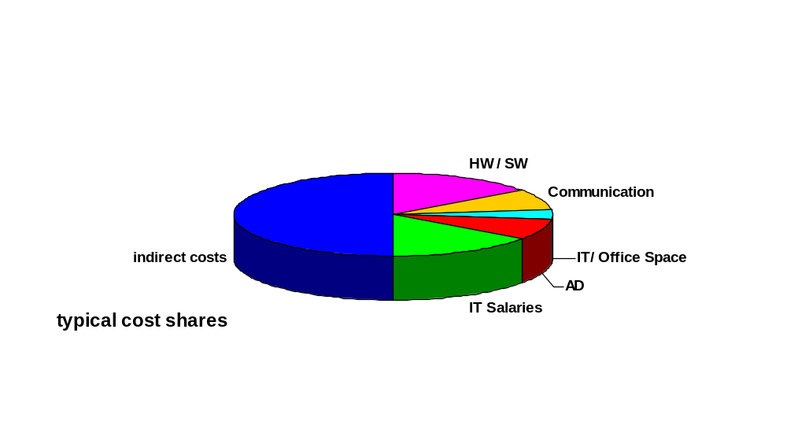
In a TCO short analysis you only look at the direct costs, which are about 50% of all costs (source: Gartner Group).
Direct Costs – included in the IT budget plan
  Hardware / Software
  Communication
  IT and Office Space
  Application Development
  IT Salaries and Personnel Costs
Indirect Costs – not included in the IT budget plan; enduser costs caused by the use of IT
  Productivity Losses through IT Problems
  Fallout Times
  Education Time

Slide 13
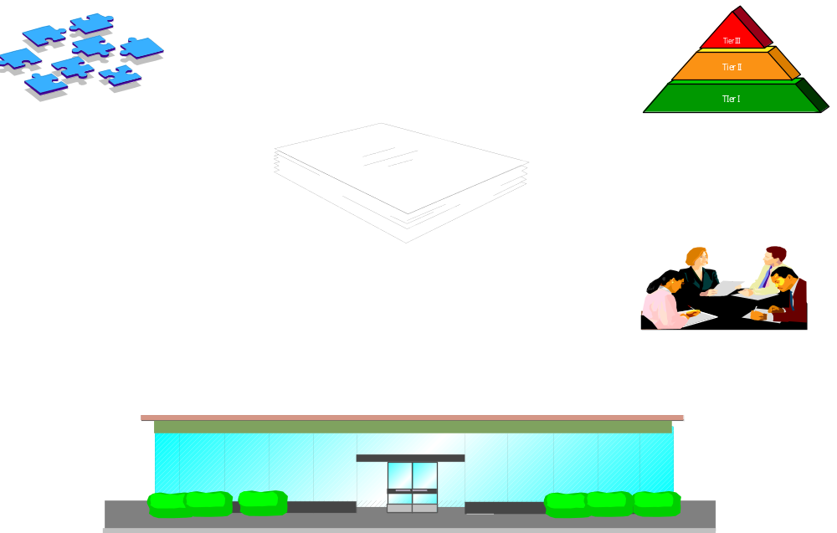


In order to be able to interpret the costs you have to consider several factors which influence the TCO.
System Architecture
  diversity
  complexity
  capacity
TCO Analysis
Dir. Costs
Indir. Costs
Application Architecture
  Number of applications
  Complexity of applications
Process
Tools
IT Services
(scope, quality, service level)
Customer requirements
IT Organization
  Job analysis
  Structure
People
Systems Management
Customer

Slide 14
Therefore you assess not only costs, but also the IT environment to be able to identify high cost areas in detail.
The approach used in a TCO study:
Project
Initialisation
Assessment
Validation
Analysis
Final
Report
Analysis of the
cost data using one
or more of the analysis
models
Consideration of the
Incidental cost factors
Identification of cost
savings potential with
regard to IT Assessment
Assessment of the
relevant costs
Assessment of the
incidental cost factors
Assessment of client
profile
Assessment of processes
and services
Assessment of job
profiles
Assessment of system and
application architecture
Definition of the
project scope
Definition of the
project team
Planning the
scope of the cost
assessment
Definition of analysis
models
Preparation of a
comprehensive report
including the assessment
and analysis results according
to the requirements
Validation of the
assessed data with
regard to complete-
ness and significance

Slide 15
The assessment framework for a TCO short analysis covers several cost blocks which should sum up to the total IT costs.
Overall
TCO
Hardware /
Software
IT Personnel Costs
Communi-
cation
IT/Office
Premises
Application
Development
Platforms
Clients
Servers
Peripheral Devices Network Components
Different Cost Types
Leasing/Licences
Depreciation
Annual costs
Maintenance
Salaries and incidental staff costs
Iinternal IT Personnel
External IT Personnel
Education costs
Outsourcing / Outtasking
WAN costs
Remote access costs
Rents
Office material / furniture
Hardware / Software
IT Salaries /incidental staff costs
Communicaiton
IT/Office Premises
Indirect
Costs

Slide 16
The analysis results may be presented in a tree diagram. Statements about high cost areas have to be added.
TCO results in a tree diagram
TCO
per Client
10.000
: number of clients
Overall
TCO
500.000.000
Hardware /
Software
210.000.000
Communi-
cation
40.000.000
IT/Office
Premises
50.000.000
IT Personnel
costs
200.000.000
...to be detailed in the cost blocks...

Slide 17
Process assessments in the IT and systems management environment can be presented as radar charts and show the process maturity.
Processes are evaluated with regard to effectiveness, efficiency, documentation, automation etc. in order to come to an index for process maturity.
Low process maturity may give a hint for high cost areas (but this is not always correct).
Change Mgmt.
5
...
4
Config Mgmt.
3
2
1
Client/Server
IT Strategy Mgmt.
0
Problem Mgmt.
Host
Asset Mgmt.
Event Mgmt.
...

Slide 18
For IT services you consider scope, quality and service levels.
Typical questions you ask are:
  What services are provided?
  Who gets the services?
  How many instances of the services are delivered?
  Are the services aligned with customer requirements, what is the customer satisfaction?
  What service levels are agreed (e.g. service times, response times, availability, mean time to repair etc.)?
  Etc.
These criteria help to determine the degree of service delivery.
High service quality (high service levels) can mean high costs. You have to determine if there is potential for cost savings or if the high costs are a result of the customer requirements and the resulting services.

Slide 19
For system and application architecture you consider system models, capacity, complexity, tools, type and number of applications etc.
Capacity
Enterprise Storage
Installed versus used
Installed versus used
Examples:
1200
1200
1500
1000
1000
-2
800
800
Installed
1000
-1
600
Utilized (P)
0
400
600
Utilized (A)
500
+1
0
+2
GBytes
200
400
BU1
BU2
0
BU1
BU2
BU3
Ext1
Ext2
200
BU3
Ext1
Ext2
Business Unit
Network Bandwidth
Installed applications
Installed versus used
1200
1200
1000
1000
15
800
800
Installed
10
-2
600
Utilized (P)
-1
600
0
400
Utilized (A)
5
+1
200
400
+2
Bandwidth
0
200
0
BU1
BU2
BU3
Ext1
Ext2
BU1
BU2
BU3
Ext1
Business Unit
Ext2
System model architecture
Host.
Platte
Kass.
ESCON
Dir.
Druck-
strasse
Kuvret.
anlage
Kommu-
nik.R.
Sysplex
Timer
Coupl.
Facil.
From this information you can come to conclusions concerning high cost areas.
OS/390
4/2
CMOS
n/a
13/3
ESCON
n/a
2/1
n/a
12/1
n/a
1
n/a
1
n/a
3/1
n/a
2/1
n/a
3/1
SAP
Serv.
EXC
Serv.
I*NET
Serv.
Appl.
(sonst.)
DB
Serv.
SMS
Serv.
F/ P
Serv.
Schu-
lung
Infra.
Serv.
Mgmt
Serv.
AS/400
Communi-
cation
NT
7/3
x86
NT
11/3
x86
NT
8/3
x86
NT
4/3
x86
NT
7/3
x86
NT
11/2
x86
NT
17/2
x86
NT
2/1
x86
NT
ca. 25
x86
HPUX
4/2
RISC
OS/400
1/1
RISC
EXC
Serv.
SMS
Serv.
F/P
serv.
Infra
Serv.
Schu-
lung
Agentur
Serv.
NT
1/1
x86
NT
1/1
x86
NT
1/1
x86
NT
1/1
x86
NT
1/1
x86
NT
1/1
x86
Clients
SB, BF, RB, EW, SEK
SB
3270
Terminal
PC
PC
Tele
Local
NT
2600/6
x86
NT
50-350/1
x86
10-30/1
NT
2-30/1
x86
NT
1/1
x86
WIN 3.11
1/1
x86
NT
1/1
x86
NT
1/1
x86

Slide 20
Additional high cost areas can be found when assessing the IT organization and combining the results with the results of the other assessments.
An assessment of the IT organization comprises e.g.:
  How many people fulfill a certain role?
  What it the skill management process?
  How many locations have to be served? How many IT locations are there?
  Is the IT shop process, platform or location driven?
  Etc.
80
60
40
20
0
...
Operating
1st Level Support
3rd Level Support
2nd Level Support
Systems Management
Network administration
Number of people

Slide 21


The results from the cost analysis and from the IT assessment lead to the identification of high cost areas and potential cost savings areas.
Facts
Conslusions
Recommendations
Cost data
KW xx
KW..
KW..
KW..
KW..
IT
Assessment
System and Application Architecture
Systems Management
IT Organisation
Customer Requirements
Identification of high cost areas and cost savings potential
High level planning of initiatives in order to realize cost savings

