Slide 1
Total Cost of Ownership (TCO)
Short Analysis
Initiative Description – Proposal
Version 1.0
February 2001
IBM Deutschland GmbH

Slide 2
Total Cost of Ownership (TCO) Short Analysis – Motivation
Motivation for the Initiative
  e.g.:
  The IT shop of client xxx has to charge back the IT costs for ist products and services to its customers.
  There is no transparency about IT costs, i.e. the IT shop does not know what causes how many costs.

Slide 3
Total Cost of Ownership (TCO) Short Analysis – Objectives
Objectives of the Initiative
  Assessment and analysis of all IT related costs for client/server as well as backend components
  Comparison and positioning of IT costs in relation to industry average
  Identification of „high cost“ areas
  Evaluation of different client architecture scenarios with regard to costs
  Creating cost transparency
Remark: To make sure that these objectives are achieved it is necessary that client staff collaborates
and that client management sponsors this project.

Slide 4
Total Cost of Ownership (TCO) Short Analysis – Tasks
Tasks of the Initiative
  Consulting and support of IT Controlling
    Definition of departments and cost areas to be considered
    Assessment of IT costs (e.g. interviews)
    Definition of assumptions to compensate lacking cost information (e.g. according to Gartner Group findings)
    Structuring of assessed costs
    Comparison to industry average TCO
    Analysis / Evaluations
      Presenting overall TCO
      Identification of high cost areas
      Evaluation of client architecture scenarios

Slide 5
Total Cost of Ownership (TCO) Short Analysis – Scope and Risks
Input Information
  Cost areas, cost departments from IT Controlling
  Actual cost data
Scope
  Costs: IT relevant costs
  Interfaces: CRM, infrastructure management, system architecture
Risks
  If client execs don‘t sponsor the project approach
  If client staff don‘t collaborate
Impact of not doing this project
  CRM, infrastructure management, system architecture don‘t have enough information to complete their projects and make decisions
  No cost transparency, lacking information for charge back
Priority (high – middle - low):
  high
Interested Parties:
  CIOs
  Cost department responsible managers
  Controlling
  Procurement
  CRM
  Infrastructure Management
  System Architecture

Slide 6
Total Cost of Ownership (TCO) Short Analysis – Project Organization
Client:
  Contract Owner: ??
  Review Board: ??
  Sponsor: ??
IBM and Client Project Team:
  Project leader:
    At client
    At IBM
  1 Senior Consultant IBM
  2 Consultants IBM
  1 Controlling person at client
Additional:
  Cost department responsible managers

Slide 7
Total Cost of Ownership (TCO) Short Analysis – Resources
Resources
  Client:
    1 Project leader, ca. 7 person days
    Experts, ca. 10 person days
    Cost department responsible managers 1 person day each
  IBM:
  ca. 40 – 45 person days

Slide 8
Total Cost of Ownership (TCO) Short Analysis – Collaboration
Client
IBM
Nominates a project leader and coordinates dates
Provides project team with IT controlling person for cost assessment
Provides with relevant information in a timely manner
Makes sure the necessary staff members are available for interviews and workshops
collaborates
Takes full responsibility for consulting and support
Provides skilled consultants (method skill and practical experiences)
Leades interviews and workshops with client management and staff
Presents at review meetings
Responsible for time and budget
Leads the project team

Slide 9
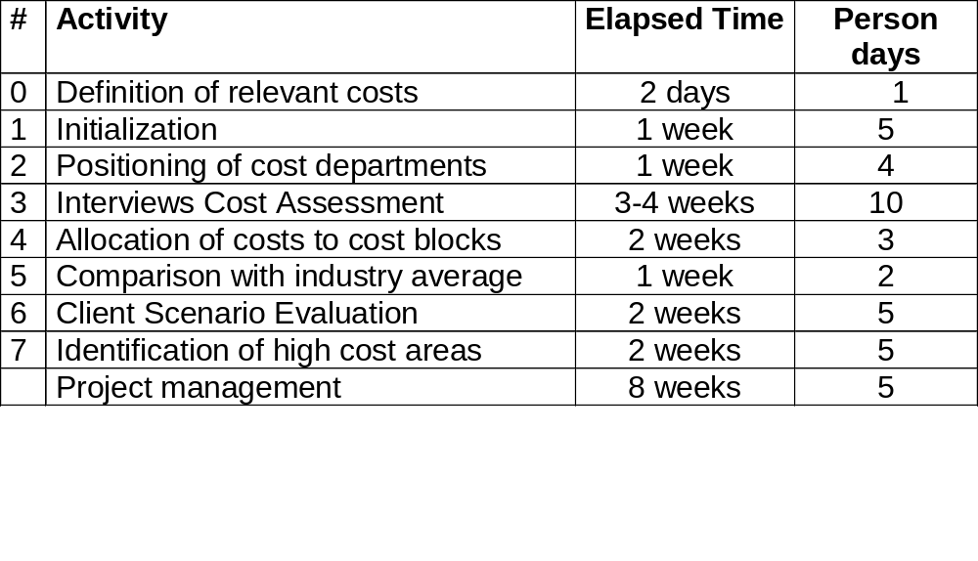
Total Cost of Ownership (TCO) Short Analysis – Resource and Time Planning
Price:
ca. xxx DM
Planning:
0
1
2
3
4
5
6
7
1Q01
2Q01
3Q01

Slide 10
Additional Information

Slide 11

The advantage of a Total Cost of Ownership Analysis is that it comprises all costs of an IT environment.
Total Cost of Ownership as well as the purchasing costs includes the costs to do with the administration and use of IT components – even as far as their final disposal.
In this way the complete life cycle of the IT components will be closely looked at.
With the assistance of the TCO Method, all relevant costs will be assessed, validated and analysed.
Acquisition
+
+
Disposal
Management & Support
+

Slide 12
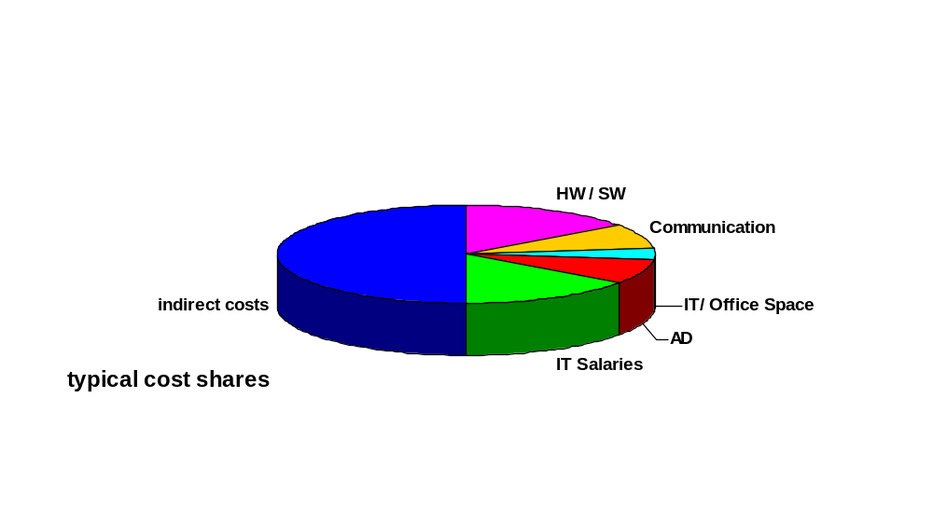
In a TCO short analysis you only look at the direct costs, which are about 50% of all costs (source: Gartner Group).
Direct Costs – included in the IT budget plan
  Hardware / Software
  Communication
  IT and Office Space
  Application Development
  IT Salaries and Personnel Costs
Indirect Costs – not included in the IT budget plan; enduser costs caused by the use of IT
  Productivity Losses through IT Problems
  Fallout Times
  Education Time

Slide 13
In a TCO short analysis you achieve cost transparency and identify who or what creates these costs.
The approach used in a TCO study:
Project
Initialisation
Assessment
Validation
Analysis
Final
Report
Analysis of the
cost data using one
or more of the analysis
models
Consideration of the
Incidental cost factors
Assessment of the
relevant costs
Assessment of the
incidental cost factors
Definition of the
project scope
Definition of the
project team
Planning the
scope of the cost
assessment
Preparation of a
comprehensive report
including the assessment
and analysis results according
to the requirements
Validation of the
assessed data with
regard to complete-
ness and significance

Slide 14
The assessment framework for a TCO short analysis covers several cost blocks which should sum up to the total IT costs.
Overall
TCO
Hardware /
Software
IT Personnel Costs
Communi-
cation
IT/Office
Premises
Application
Development
Platforms
Clients
Servers
Peripheral Devices Network Components
Different Cost Types
Leasing/Licences
Depreciation
Annual costs
Maintenance
Salaries and incidental staff costs
Iinternal IT Personnel
External IT Personnel
Education costs
Outsourcing / Outtasking
WAN costs
Remote access costs
Rents
Office material / furniture
Hardware / Software
IT Salaries /incidental staff costs
Communicaiton
IT/Office Premises
Indirect
Costs

Slide 15
The analysis results may be presented in a tree diagram. Statements about high cost areas have to be added.
TCO results in a tree diagram
TCO
per Client
10.000
: number of clients
Overall
TCO
500.000.000
Hardware /
Software
210.000.000
Communi-
cation
40.000.000
IT/Office
Premises
50.000.000
IT Personnel
costs
200.000.000
...to be detailed in the cost blocks...

