Slide 1
Method Adoption Workshop (MAW) Overview
J. Todd Fredrickson - June 16, 2009

Slide 2
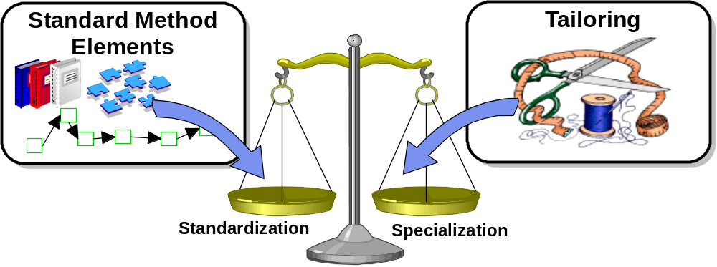
The Unified Method Framework supports both standardization and specialization
In order to support an asset-based approach the method must support both
  Standardization - encourage and promote common approaches to various types of projects to facilitate the sharing of resources and promote reuse of intellectual capital
  Specialization – enables each project to meet their unique requirements through specialized approaches
The Unified Method Framework achieves this balance by providing a common set of method elements that can be assembled into a wide range of custom solutions
  Practices
  Work Products
The tailoring process allows for these standardized "building blocks" to be customized as needed to fit a particular project by selecting different sets or rearranges existing content

Slide 3
A Method Adoption Workshop (MAW) is used to tailor the UMF to a specific project
Inputs
Unified Method Framework
Tools (e.g. RMC, RPM)
Outputs
Work Breakdown Structure
Risk Definition
Work Product List
Briefed Team
Candidate Asset List
Estimation Report
Published Method
Project Participants
Project Manager
Consultant
IT Architect
Business Analyst
Designer
Tester
Other selected participants
MAW
Method Champion
Notes:
IBM Global Business Services
© Copyright IBM Corporation 2007

Slide 4
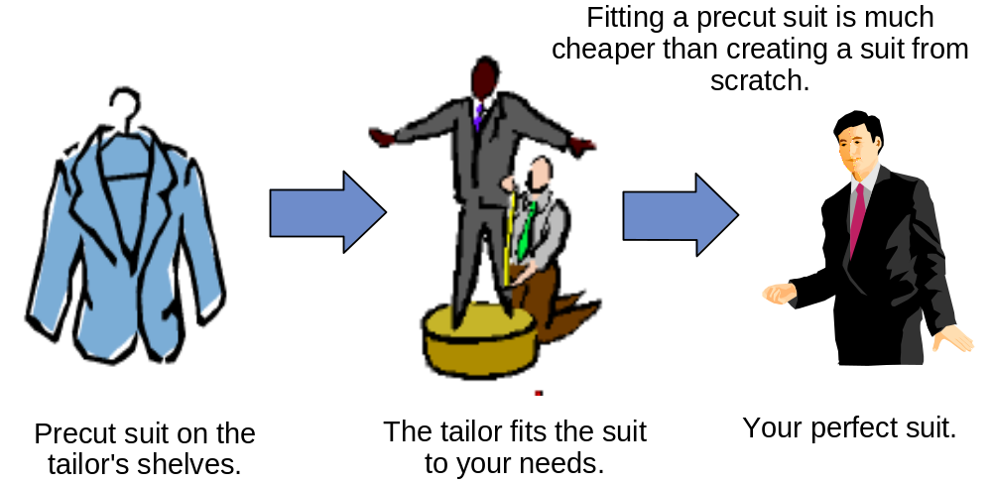
During the Method Adoption Workshop, the method is fitted to the needs of an individual project
Each project is different; therefore, we need to tailor the method to meet the specific project situation
A specific, ready-to-use method can only be applied to very specific uses
We do not typically perform all of the activities or develop all of the work products on a project
  Not all of the method components apply to every project
  There is a constant push to reduce costs
  Doing everything would result in an unrealistically long project
  Some of the work may have already been covered outside the scope of the current project
Content to be excluded needs to be balanced against project risks

Slide 5

Method Champions
MAWs are facilitated by Method Champions who:
  Provide expertise on using Unified Method Framework and Rational Method Composer
  Facilitate proposal and project teams in tailoring the UMF to the specific project
  Coach proposal and project teams in the MAW process
Method Champions use Rational Method Composer tool for method tailoring
Notes:
IBM Global Business Services
© Copyright IBM Corporation 2007

