Slide 1
Basic Method Tailoring in UMF
J. Todd Fredrickson – June 16, 2009

Slide 2
Agenda
Approaches to tailoring
Work product base tailoring

Slide 3

There are three basic approaches to tailoring the method to suit a specific project
The most straightforward approach is when a delivery process already exists that has either been authored specifically for the project on hand or someone else has previously tailored a delivery process for a similar project
The second approach assumes that one or more delivery processes exist that are close to what is needed for the current project
The last approach and most time consuming is when there are not any predefined delivery processes that already exist for this type of project

Slide 4
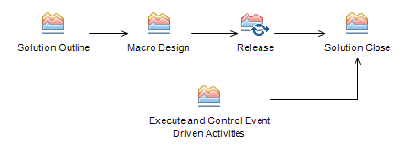


Using an existing delivery process that matches the current project
Tailored Delivery Process
Existing Delivery Process
Once a matching delivery process has been found make sure to check the following:
  Make sure the overall work breakdown structure will meet the needs of the current project
  Make sure that all required deliverables are called out in the existing delivery process
  Make sure that no work products are missing and that no extra work product are identified in the work breakdown structure

Slide 5


Modifying one or more delivery processes to suit the needs of the current project
+
+
Delivery Process, with Practices and Work Products
Tailored Delivery Process
First, establish a context for tailoring by identifying the delivery process that most closely resembles the current project
Add, remove or swap out practices as required
Next, select the deliverables that need to be produced
  If necessary pull in deliverables from other delivery processes or practices
  If the required deliverables are not defined, define them and list the work products that comprise those deliverables
Once the complete set of deliverables has been identified, adopt the work products that need be produced
  Start with the work products that make up the actual deliverables
  From there walk through the dependency diagrams to determine what other work products are required
Next, modify the work breakdown structure to take into account the work products selected or omitted
Last, develop the work breakdown structure into a project schedule

Slide 6
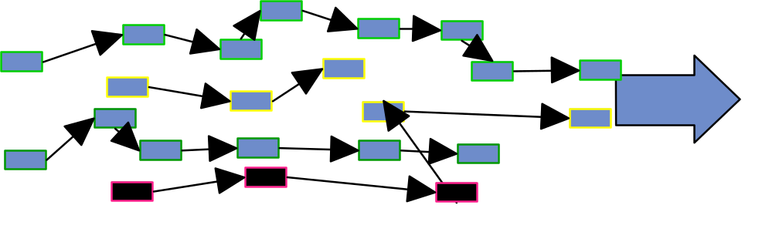
Developing a new delivery process for a "First of a kind" project
New Delivery Process
Practices
If a delivery process does not already exist it's still possible to assemble an delivery process using predefined practices
Start by working out the phase structure required for the project
Next select the set of practices that produce the deliverables required for the project
  it is also possible to extract pieces from existing delivery processes if the required practice does not exist
Once the set of practices has been identified, either add the required process slots or copy the relevant activities and tasks from those practices to the phases that have been defined for the project
From this point on tailoring is done exactly the same as customizing any other delivery process

Slide 7
Agenda
Approaches to tailoring
Work product base tailoring

Slide 8
Dependency diagrams give an overview of work products and their relationships, they are very useful for tailoring
Use dependency diagrams on foils to review and select work products
For each work product identify the work products on which it principally depends
New work products are either deliverables or have some impact on deliverables
Most are produced from (are impacted by) some other work products as input
Remove omitted work products from the diagram
For each omitted work product check that the impacts/depends on chains of relationships can be satisfactorily redefined in its absence
Dependency diagrams give a good overview of the project
Graphically show affect on omitting work products in the relationships indicated on the dependency diagrams

Slide 9
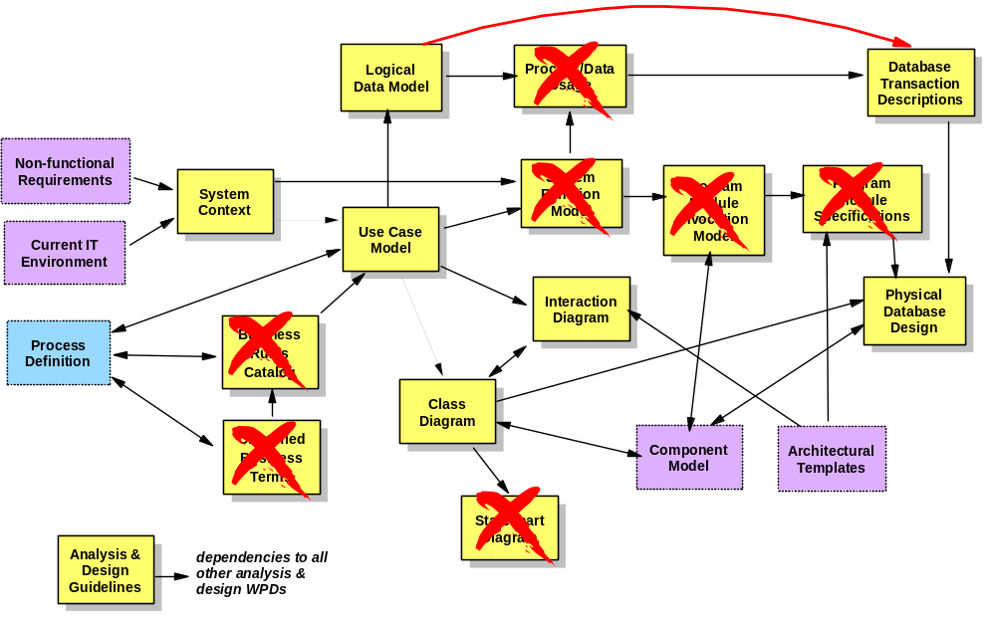
Example of modifying a dependency diagram to show the results of tailoring

Slide 10
Things to consider when selecting work products for a project...
Which Work Products are needed to produce the deliverables?
What areas of the solution are out of scope for this part of the project?
Do any of the work products already exist?
Which work products can we eliminate without additional risk?
Which work products are good candidates for reusing existing assets?
What tools are we going to use?
To what extent are we responsible for producing the work products?
What are the project scope, schedule, and budget constraints?

Slide 11
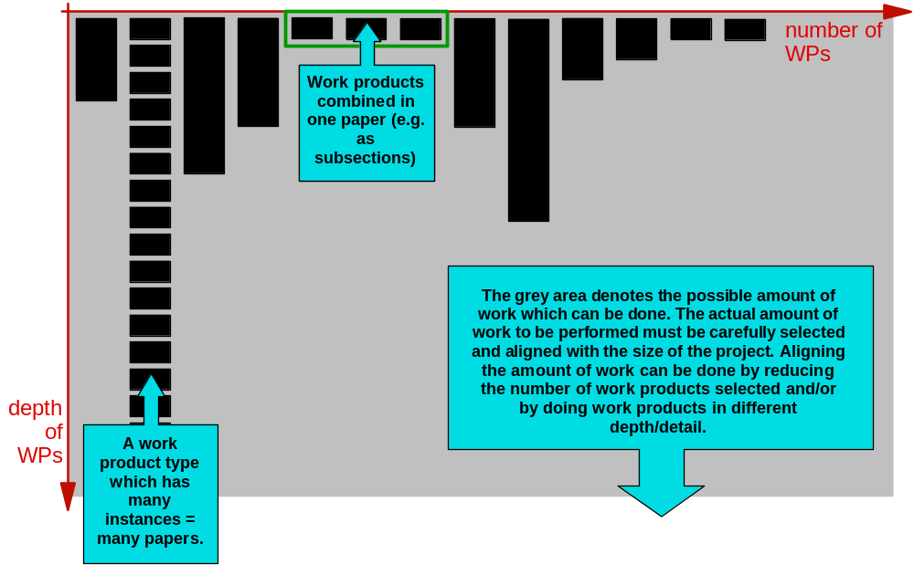
Selection of work products has two dimensions: number of work products and depth of work products

Slide 12
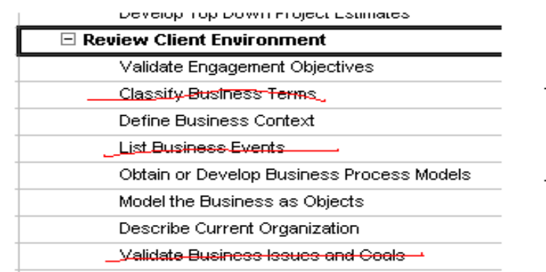
After we select work products, we develop our initial work break down structure
Amend the work breakdown structure of a matching delivery process so that it matches the needs of the project
  Remove the tasks that produce the omitted work products
  Amend the tasks that have omitted work products as inputs or outputs
  Add tasks to produce new work products or selected work products that were not part of the matching engagement model
    In some cases it may be reasonable to amend existing tasks so that they produce the extra work products
  Position the new tasks in the overall work breakdown structure
    Use the dependency diagram as a guide to the
    main inputs and outputs
  Review the phase and activity structure and
  amend if appropriate

Slide 13
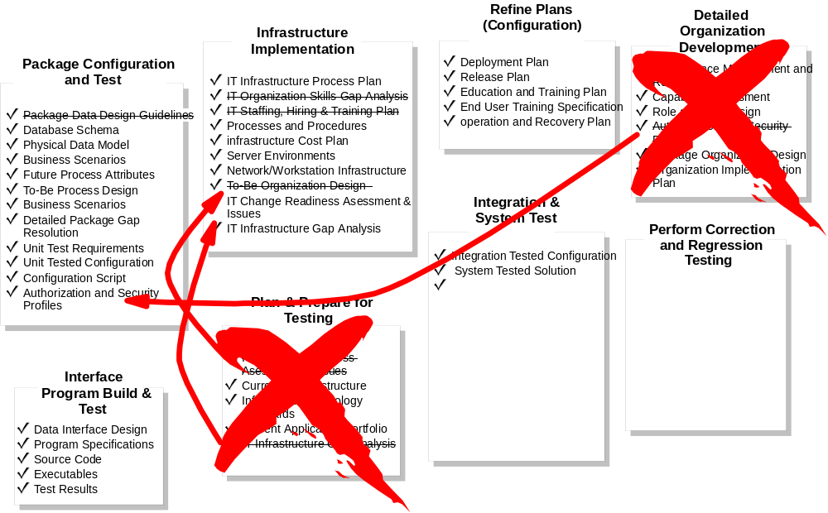
Example of modifying activities based on adoption

Slide 14

Things to consider when reviewing the initial WBS…
Are there any work products that are produced iteratively that we only need to review once?
Are there any activities we can eliminate?
Are there any activities or phases we need to add?
On iterative phases and activities, how many iterations are we going to perform?
x2
x3

Slide 15
Hints, tips, and cautions
Always keep deliverables in mind when adopting work products, don't miss the forest for the trees
Stakeholder involvement should be focused and guided by the delivery team
  Be careful not to present the catalog as a laundry list to choose from
Use SME's to help decide on work product adoptions- they know the process best
  However it can be difficult to make the "hard" decisions required to cut enough work products to stay on budget and on schedule if too many interests are represented
When working with a team it may be easier to work off of prepared materials and enter the tailoring results into RMC in a separate session
Always document decisions!

