Slide 1
Practice Based Approach to Tailoring in UMF
J. Todd Fredrickson - June 16, 2009

Slide 2
Practices are the next step in the evolution of method tailoring
Basic tailoring was based on the adoption and unadoption of individual work products
  Because of the difficulty in adding content, based on finding or writing the tasks necessary to support any additional work products, this approach relied on fairly large all inclusive delivery processes
  Users had to know the inter-dependencies between work products to make sure critical pieces were not removed or where to link in replacements
Capability patterns were attempt to provide larger grained building blocks that included chunks of process that could be inserted into a delivery process
  This was limited by the fact that inserting this content was a manual task requiring users know where to put each piece
  Once content was inserted it became part of the process and could not be removed as a unit
Practices extend the concept of capability patterns with well defined interfaces and pre-built hooks to automate their linkage to existing process

Slide 3
What is a Practice?
A practice is a component or aspect of a process that can be adopted independently to provide a set of capabilities, they are made up of:
  Detailed tasks for executing the work structured for reuse within a larger WBS
  Determination of work products that will be used to support that implementation
  Assignment of roles and guidance in support of those tasks and work products
  Packages and provides a well defined interface to the content
Practices provide a well defined interface that allow them to be treated as a “black box” and adopted in an automated fashion.
Practices become the primary building block for developing and tailoring content and driving reuse.
Practices are the major elements of a configuration. They are included or excluded based on whether the capabilities provided by that practices are needed.
Notes:
Provide tangible results (ideally, a work product in some state)
Provide a specific technique for producing a specific result, including specific tasks
Method Champions care about practices as they are the people that will be selecting practices to configure their process. Method Authors care about practices as they are the fundamental means to package and deploy methods.
Practices can be generic in nature or highly specialized for a particular context
Practices are not limited to a single domain or discipline. Practices can be part of a single domain (for example "automated testing" belongs to the testing domain) or cross multiple domains.
*Currently there are no examples of cross-domain practices

Slide 4
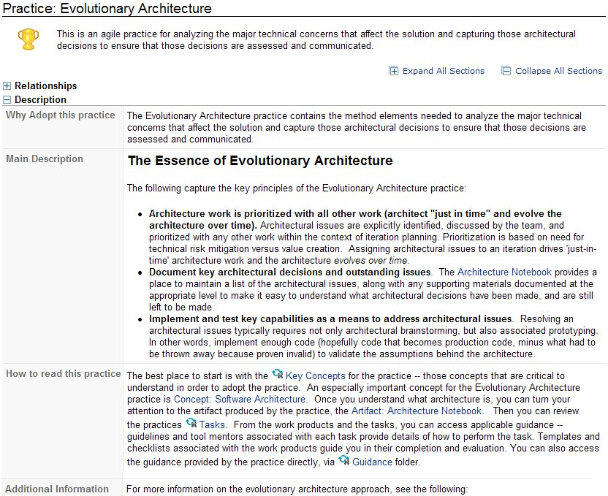
Practices are intended to be viewable, downloadable and adoptable by practitioners
Notes:
Includes fields relevant to the practitioner deciding whether to include the related content in their project
Why Adopt this Practice – Purpose
How to Read this Practice
Roadmaps on How to Adopt this Practice

Slide 5




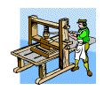
The role of practices in tailoring
Select and download the appropriate delivery process and desired practices from MethodWeb
Select and download the appropriate delivery process and desired practices from MethodWeb
Import the content into RMC
Select and download the appropriate delivery process and desired practices from MethodWeb
Import the content into RMC
Use process builder in RMC 7.5 to swap out, add or remove practices as needed
Select and download the appropriate delivery process and desired practices from MethodWeb
Import the content into RMC
Use process builder in RMC 7.5 to swap out, add or remove practices as needed
Load the resulting content into a tailoring session for further customization
Select and download the appropriate delivery process and desired practices from MethodWeb
Import the content into RMC
Use process builder in RMC 7.5 to swap out, add or remove practices as needed
Load the resulting content into a tailoring session for further customization
Publish results as HTML and/or export it to a scheduling tool
1
2
3
4
5

Slide 6
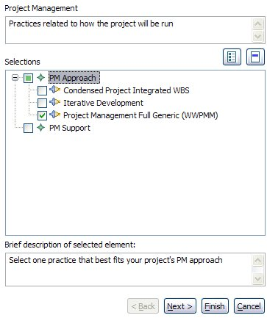
The selection of practices is handled via Process Builder in RMC 7.5
Page related guidance
The selection of practices is driven through a series of menus generated from the content with the appropriate instructions, descriptions and guidance to help make the proper choices prior to loading into a tailoring session
Each page/topic is broken into multiple sections for making selections
Brief description of selected section or practice
Notes:
Note: practices can still be added or removed once a tailoring session is started, but the tasks will no longer automatically be placed in the correct spots in the WBS

Slide 7
The selection of practices is handled via Process Builder in RMC 7.5
The selection of practices is driven through a series of menus generated from the content with the appropriate instructions, descriptions and guidance to help make the proper choices prior to loading into a tailoring session
Select
De-select
Practices can be removed, or replaced with other practices by making the appropriate selections. In this example we replace the Project Management Full Generic (WWPMM) practice with the Condensed Project Integrated WBS one.
Notes:
The selection of practices is driven through a series of menus generated from the content with the appropriate instructions, descriptions and guidance to help make the proper choices prior to loading into a tailoring session
Note: practices can still be added or removed once a tailoring session is started, but the tasks will no longer automatically be placed in the correct spots in the WBS

Slide 8
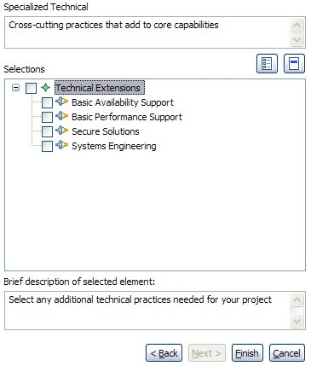
The selection of practices is handled via Process Builder in RMC 7.5
The selection of practices is driven through a series of menus generated from the content with the appropriate instructions, descriptions and guidance to help make the proper choices prior to loading into a tailoring session
Select
Likewise, we can add new practices via additional menus, such as this one for adding System Engineering.
Notes:
The selection of practices is driven through a series of menus generated from the content with the appropriate instructions, descriptions and guidance to help make the proper choices prior to loading into a tailoring session
Note: practices can still be added or removed once a tailoring session is started, but the tasks will no longer automatically be placed in the correct spots in the WBS

Slide 9
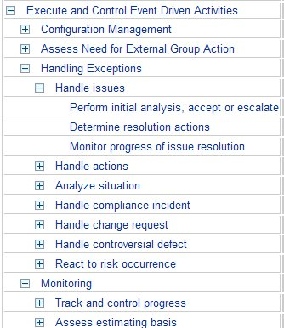
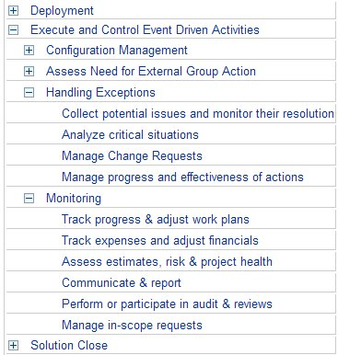
The change in PM practices results on the activities and tasks on the left being replaced with those on the right
Example above shows only a subset of the overall WBS, similar changes would be reflected throughout

Slide 10
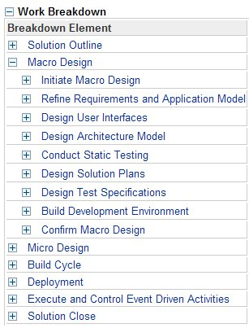
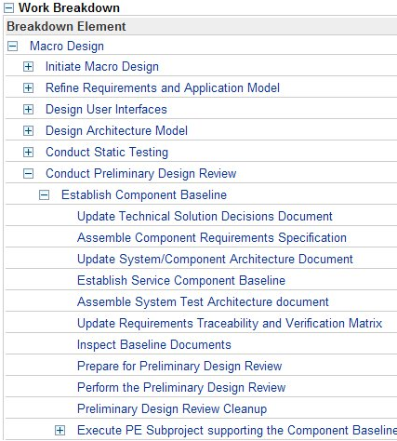
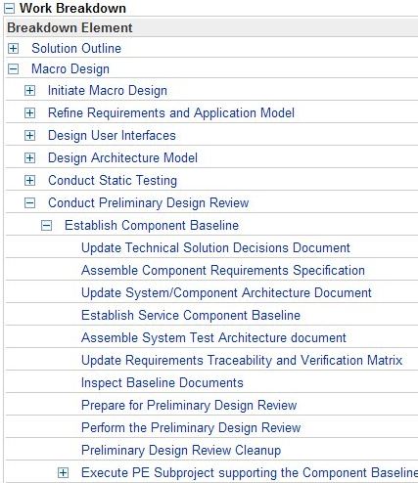
The addition of System Engineering inserts new activities and tasks (along with their work products and roles) in the proper location

Slide 11
Key benefits of a practice-based approach for practitioners
Reuse is achieved at a higher level (practice vs. work product) simplifying tailoring
  Entire practices can be included or excluded instead of having to determine what individual work products to add or remove to provide support for a particular capability
Practices are self contained, adopting a practice includes the required work products with their corresponding roles, tasks and guidance.
  No longer necessary to try and figure which set of tasks to include to support additional work products added to a process
Practices are designed so that their tasks can automatically be positioned in the proper locations in the overall WBS of a practice enable process
  This eliminates the manual copying and pasting of content from one process to another, as well as eliminating the need for practitioners to guess where new content should be inserted
Downstream inputs are handled through a layer of abstraction to eliminate hard dependencies on specific work products, but instead rely on the type of information needed
Notes:
Greater level of consistency achieved across processes (each process doesn’t create it’s own approach of how to develop common work products), while still allowing for alternate approaches to easily be swapped in and out of delivery processes

