Slide 1
Business Requirements Review (BRR) Template
Systems Engineering Architecture & Test
Version 5.0

Slide 2
Business Requirements Review (BRR) Template
Agenda
BRR goals and objectives
Ground rules
Scope and objectives validation and verification
Validate "as is" process flows exist and are complete
Review business requirements and acceptance criteria
Score the review
Review signoffs, plans, risk, issues, and dependencies
Project Name: <Replace by entering project name>
BRR Lead / SEA Contact: <Replace by entering contact name>
BRR Date: <Replace by entering date and time of review>

Slide 3
Business Requirements Review (BRR) Template
Goals and Objectives
GOAL:
Convey a clear understanding of the business scope, objectives, and requirements that pertain to this project, and associated acceptance / success criteria. Identify "as is" business processes that will be affected. The main output of this phase is a Business Requirements Review (BRR) that the business requirements and associated acceptance / success criteria are approved and baselined.
OBJECTIVES:
Review business requirements and acceptance criteria with customers and stakeholders
Establish traceability and set baseline
Verify and validate "as is" process flows exist and are complete
Review project plan milestones
Review known Risks (risk mitigation) / Issues / Dependencies / Defects
Capture new Risks / Issues / Dependencies / Defects

Slide 4
Business Requirements Review (BRR) Template
Ground Rules
The main ground rule for a BRR is that no solutions are allowed. The BRR focuses on reviewing and signing off of business requirements and validating that "as is" business process flows exist
Review issues and address concerns relative to:
  Identifying and reviewing gaps in "business process flows document"
    the "as is" end to end (e2e) business process flow that show all the business process threads that flow through the architecture if available
    "As is " architecture, any "as is" manual touch point desk-level procedures (for example: BPSO - business partner support organization)
    Document existing/current business process issues associated non-functional requirements (these may drive additional business requirements).
  Reviewing and approving business requirements that will drive the project
    identify and capture new business requirements
    eliminate any non-agreed upon business requirements
    modified business requirements
    check functional and non-functional requirements
    ensure map back to business scope and objectives (from top sheet used in Project charter)
    review problem/opportunity, issues, defects, risks, assumptions and constrains, dependencies, deliverables, cost and schedule projections (top sheet)
    review priority of requirements
    ensure clarity and avoiding ambiguity pertaining to business requirements
    review criteria and associated metrics that determine success for the project
Stakeholders, customers, and business process owners must be present during the sessions. They must sign off on business requirements and success criteria.
  Stakeholder owns the scope and business process flows documents
  SE will facilitate meetings to obtain agreements

Slide 5
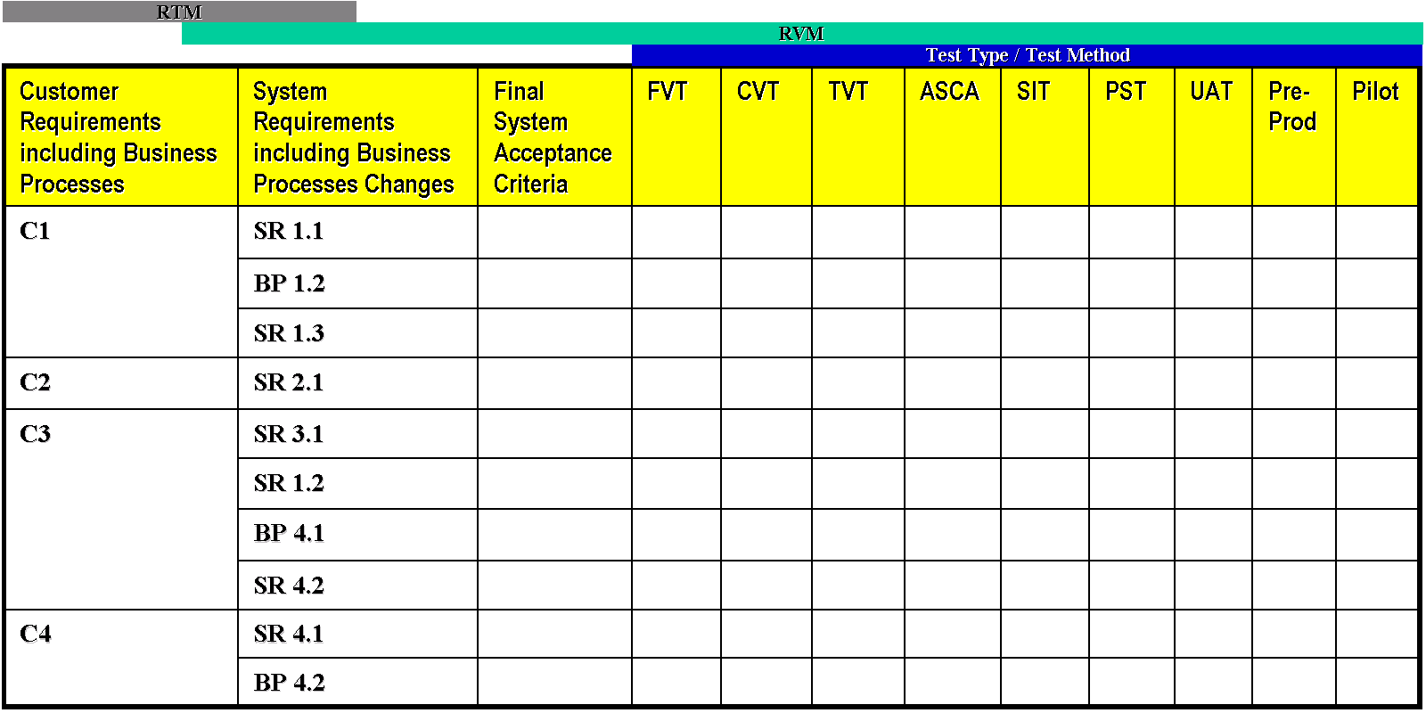
Business requirements are mapped to business scope and objectives. They are also linked to Requirements Traceability Matrix (IGAT555).
Business
Objectives
& Scope
used to charter project
BR1
BR2
BR3
Business
Requirement 1
Business
Requirement 2
...
BR4
System
Requirement 1.1
System
Requirement 1.2
Business Process
Requirement 1.3
...
Component
Requirement 1.1.1
Component
Requirement 1.1.2
Component
Requirement 1.1.3
...

Slide 6
Business Requirements Review (BRR) Template
Topic 1: Business Objectives and Scope
Entry Criteria:
There is a scope and objectives document
Top sheet
Presentation:
Present business scope and objectives
Present overview of business case
Exit Criteria:
Validated and verified business scope and objectives (identify defects, issues and risks)
Business case reviewed (top sheet, business case etc)
Identified dependencies that are causing defects, issues or risk related to business objectives and scope

Slide 7
Business Requirements Review (BRR) Template
Topic 2: "As is" Business Process Flows
Entry Criteria:
“As is” business process flows are defined and documented
Review processes that are required to be monitored, measured and managed
Presentation:
Present list of "as is" process flows
Present identified gaps in "as is" process flows
Present the plan to complete "to be" process flows
Exit Criteria:
Validated current (AS-IS) manual procedures (identify defects, issues, and risks)
Validated current (AS-IS) legacy business process scenarios – base functions, exceptions
Validated current (AS-IS) end to end legacy architecture – system, applications, interfaces
Validated gaps in process flows and ensured plans to address them
Validated that SMEs were involved in creation of “as is”
Identified dependencies that are causing defects, issues or risks related to business process flows and procedures
Reviewed Plan to complete solution process

Slide 8
Business Requirements Review (BRR) Template
Topic 3: Business Requirements
Entry Criteria:
Business requirements are defined, documented, and prioritized
Business requirements mapped to Scope and Objectives
Known issues, risks, and dependencies are defined and documented
Presentation:
Present business requirements
Present business requirements priorities
Present mapping of business requirements to scope and objectives
Present known issues, risks, and dependencies
Exit Criteria:
Validated that business functional /non functional requirements were defined
Ensured that agreed to business functional/non functional requirements are clear and unambiguous
Ensured Stakeholders and Customer signed off on functional/non functional requirements and associated priority
Ensured Business functional/non functional requirements are traceable to business scope and objectives
Identified dependencies that cause defects, issues or risks related to business functional/non functional requirements.

Slide 9
Business Requirements Review (BRR) Template
Topic 4: Success Criteria & Associated Metrics
Entry Criteria:
Success criteria and associated metrics are defined and documented
Presentation:
Present success criteria and associated metrics
Present measurement methodology
Exit Criteria:
Validated agreed to success criteria and associated metrics were defined (identify defects, issues and risks)
Ensured approval of acceptance / success criteria from customers and stakeholders
Ensured that acceptance / success criteria is clear and unambiguous
Identified dependencies that are causing defects, issues or risks related to success criteria and associated metrics

Slide 10
Business Requirements Review (BRR) Template
Review Log
Document risks/issues/defects that affect the Business Requirements Review (BRR) Score
Risk, Issue, or Defect ID | Date Opened | Description | Severity or Impact 1- Very High 2 - High 3 - Medium 4 - Low | Action to Close | Status (Open, Closed, Action Complete) | Comments
Note: It is recommended that all teams use the automated scorecard to record Review Log Items, and provide a link/directions with a reference to the Review Log tab.

Slide 11
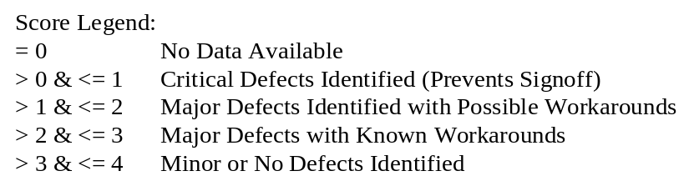
Business Requirements Review (BRR) Template
Scorecard
Topic | Recommended Weighting Factor | Score (0-4) | Total (weighting factor * score) | Comments
1. Business Objectives & Scope | 2.5
2. "As is" Business Process Flows | 5.0
3.0 Business Requirements | -
3.1 Functional Requirements | 7.5
3.2 Non-functional Requirements | 7.5
4. Success Criteria and Assocated Metrics | 3.25
Total Review Score (sum of individual totals) | Note: Sum of Weighting Factors Must = 25 |  |  | Red - <70 Amber - >=70 & <85 Green - >=85
Note: It is recommended that all teams use the automated scorecard, and provide a link/directions with a reference to the Scorecard tab.

Slide 12
Business Requirements Review (BRR) Template
Signoffs
Topic | Role | Signoff Organization(s) | Signoff Person(s) | Comments
Business requirements document (Assumes prioritization, mapping to objectives and scope, and success criteria are all contained in this document) | Stakeholder (Owner) Systems Engineer may present this on behalf of the Stakeholder, but the Stakeholder owns this | Customer
Business requirements document | Project Manager | PM
Note: It is recommended that all teams use the automated scorecard to record Stakeholder Approval, and provide a link/directions with a reference to the Stakeholders tab.

Slide 13
Business Requirements Review (BRR) Template
Template History
Date | Version | Name | Modification
June 20, 2003 | 1.0 | AMS MS Team | Initial AMS MS Release
June 25, 2007 | 5.0 | SEA&T | Updates to align standard criteria with Scorecard

