Slide 1

JPMorgan Chase & Co
Arturo Fraile Beltran, Angie Maya, Maria Fernanda Medina Barreda

Slide 2
Introduction
THESIS: JPMorgan Chase is a blue-chip financial powerhouse uniquely positioned to outperform due to its diversified revenue streams, technological innovation, and resilience in varying interest rate environments.This stock is a buy because it is currently undervalued in the market.
Notes:
A blue chip is a stock of a well-established corporation with a reputation for reliability, quality, and financial stability. Blue chip stocks are usually the market leaders in their sectors and have a market capitalization running into billions of dollars. - CFI
https://corporatefinanceinstitute.com/resources/equities/blue-chip/#:~:text=A%20blue%20chip%20is%20a,running%20into%20billions%20of%20dollars.

Slide 3
Table of contents
01
02
03
04
Company Overview
Company forecasted success (highlight potential risks and successes)
Financial Analysis
Valuation Method

Slide 4

01
Company Overview

Slide 5
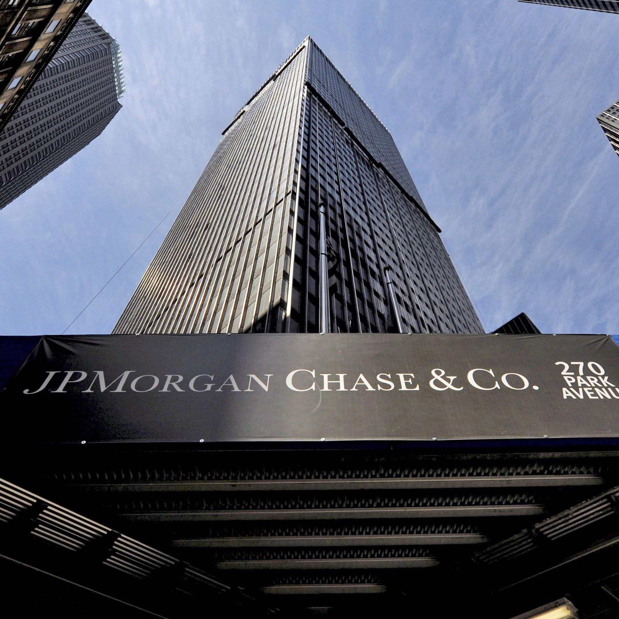
Company Overview
CEO: Jamie Dimon
Headquarters: New York City, United States
Brief History: Founded through mergers in 2000, with roots going back to the 18th century. Today, it's one of the world’s largest financial institutions.
Services: Investment banking, consumer banking, asset management, and commercial banking. Unlike other banks, JP Morgan stands out for its global scale, diverse services, and strong risk management.
Why It’s Beneficial: Helps consumers and businesses manage money, invest, and grow financially with trusted support.
Stock Price as of 4/25/25: $233.13
GOAL: Explain the company and what they sell and break down what their service or product(s) are

Slide 6
Industry Overview
Is the industry competitive?
The banking industry is highly competitive and JP Morgan operates in 100+ countries
Counter: JPMorgan thrives in this environment because they’re huge, smart, tech-forward, and have deep pockets.
What is the company's overall market share?
JPMorgan Chase's overall market share is 14.31% of total assets in the US as of December 2024. This makes them the leading bank in the country based on assets.
Is the industry that they are in reliable or, in other words, “here to stay?”
The banking industry has stayed despite the Great Depression, multiple recessions, the 2008 financial crisis, and years of regulation changes
Notes:
JPMorgan acquired Bear Stearns, a major investment bank, for $1.4 billion with the assistance of the Federal Reserve, preventing its complete collapse and a potential domino effect on other financial institutions.
Morgan also intervened during financial crises, like the Panic of 1907, by organizing a group of financiers to stabilize the American banking system, effectively bailing out failing banks

Slide 7
Recent News
Capital Expenditures.
$17B investment in technology. Highest ever from a financial firm.
This funding supports modernization
Upgrading infrastructures,
Integrating AI,
Developing digital platforms to work across different teams.
New Management
Michele G. Buck elected to its Board of Directors
President and CEO of The Hershey Company, she has over 30 years of experience in transforming businesses and engaging organizations to accelerate profitable growth
New market entry.
Planning to open 500 branches over the next five years
They want to increase their presence
Improve visibility in underserved areas for customers and small businesses
Product(s)
Private Equity & Venture Capital Funds: 15–30%+ annually (high net worth)
ETFs ranging from 4.5% to 20%. Different preferences such as short-term, long-term, lower, and higher risk
Notes:
1. On Trump’s Tariffs and Trade Tensions
Global Reach: JPM has diversified international exposure, but it’s not over-reliant on any one market.
Corporate Advisory Strength: Trade tensions can create M&A opportunities and drive corporate clients to seek JPM’s advisory, hedging, and financing services.
Market Volatility = Trading Revenue: Turbulent markets often boost trading volume, which JPM excels in (especially in fixed income and equity markets).
They’ve Been Here Before: JPM has already operated successfully through multiple trade-war cycles (2018-2019), and their risk management playbook is strong.
2. On a Potential Recession
Fortress Balance Sheet
JPM coined the term “fortress balance sheet” — over $1.3T in deposits and strong liquidity ratios.
Low Loan Delinquency
Conservative underwriting standards; they've been stress-tested.
Resilient Revenue Streams
In a recession, consumer lending might dip, but JPM has:
Investment banking
Wealth management
Fixed-income trading (often does well in volatility)

Slide 8
Risk Factors
Economic Problems A weaker economy may lead to lower demand for loans and investments, reducing the bank’s overall revenue.
Cyber Attacks Cyber attacks could compromise customer data, damaging the bank’s reputation and reducing customer trust.
Government Rules New or more stringent government regulations could increase operating costs or limit certain business activities.
Interest Rates Lower or unstable interest rates can decrease earnings from loans and increase costs related to deposits.
Stock Market Changes Uncertainty or instability in the stock market may negatively impact the bank’s investment and wealth management operations.
Global Conflicts Conflicts or political tensions in other countries can affect JPMorgan’s international operations and global strategy.
GOAL: It is important to highlight the risk factors so “investors” know your not completely biased in your thesis.

Slide 9
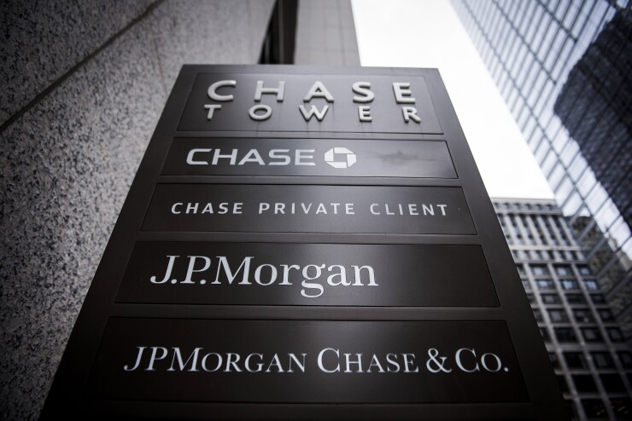
Competitive Advantages
Cost leadership
JPMorgan isn’t the “cheapest” option in retail banking but make up for it in competitive credit card offers and keep fees lower or waive them more easily for retail customers
Differentiation in service/products:
Chase credit card, private banking and wealth management services, investment banking division,
Kinexys is JPMorgan’s blockchain-based financial infrastructure ( founded in 2020)
Brand recognition
Customers feel safe parking their money with JPMorgan,
Chase is a household name in consumer banking
Operating efficiency
Economies of scale (massive customer base across divisions)
Heavy automation and AI for compliance, fraud detection, customer service
Notes:
-blockchain-based financial system that helps big banks and companies move money faster, more securely, and around the clock — using blockchain technology instead of the old-school banking systems.
- Companies like BlackRock are using it.
-Kinexys (JPMorgan’s blockchain platform)
Speed: Instant or near-instant
Hours: 24/7/365 — even on holidays
Settlement: Real-time, final
Technology: Private, permissioned blockchain (only trusted institutions can use it)
Trust: Backed by JPMorgan, used by large banks and corporations
Example: A bank in Germany can instantly settle a large USD payment with JPMorgan in New York, using JPM Coin

Slide 10
Financial Analysis
03

Slide 11
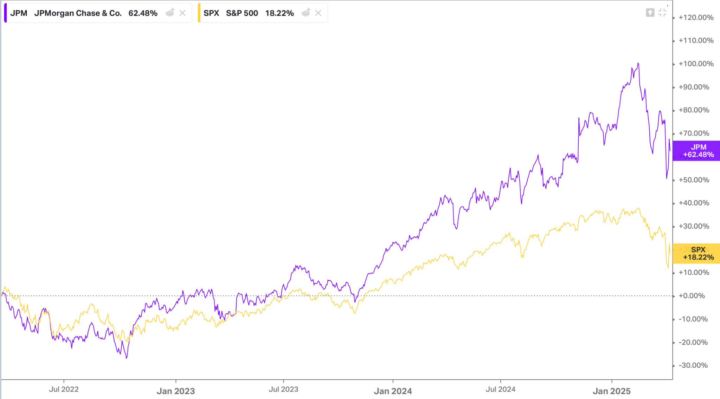
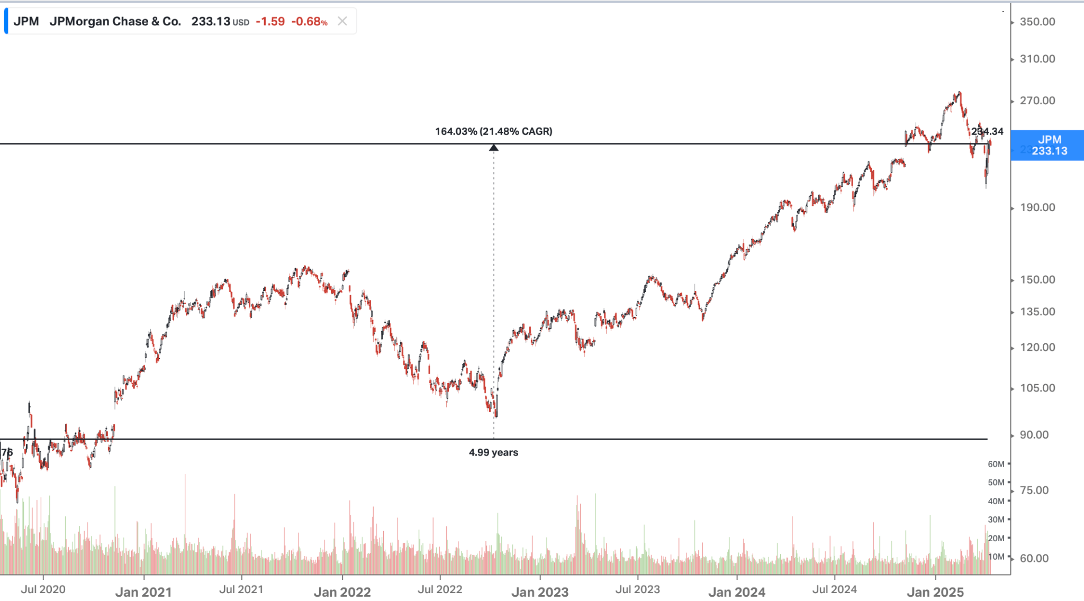
Historical stock price
How does the stock price shape against the S&P or the Dow Jones?
JPM has been outperforming the S&P since 2023
Volatility (1Y) = 28.76
Has the company been growing in stock price for the past 3-5 years?
The stock price has grown over 164% in the past 4.99 years
Notes:
Large diversified banks like JPM have a volitality of 18-25%, JPM is higher due to:
Broader exposure across finance
Market-based revenues
Global footprint
Being a proxy for the entire banking sector
Koyfin is a comprehensive financial analytics platform designed to provide investors with advanced tools for market research and analysis. It offers a Bloomberg-like experience, combining real-time data, customizable dashboards, and powerful charting capabilities to cater to both retail and institutional investors.​

Slide 12
02
Company’s Forecasted Success

Slide 13
Basic Financial Analysis
Total revenue brought in last year = 177,556 (in millions)
They kept (net income) = 58,471 (in millions)
Profit
They have a 33% profit margin (58,471 / 177,556)
Profit Margin for 2023 was 31%, and for 2022 it was 29%.
The average for the industry is 27.2%
Expected growth for the next 3 years
2026: $341
2027: $403
2028: $431
Data according to CoinPrice Forecast, they integrate data science and machine learning techniques.
CoinPrice
LiteFinance

Slide 14
Valuation
04

Slide 15
Basic Ratios
Price-to-earnings ratio (p/e) = Price per share/earning per share. It is valuable because it indicates the number of years of earnings to pay back the purchase price. In other words, it reveals how much more the investors are willing to pay compared to the earnings.
PPP = 236.20 (As of Sunday April 13th)
EPS (Net Income/Shares Outstanding)= 19.75
Calculation = 236.2 / 19.75 = 11.96
Average for the Investments & Asset Management industry is 53.45. According to NYU
Market-to-book ratio = Market value per share/book value per share. The PB ratio is measuring the difference between share price and the net book value per share.
Market value per share = 236.2
Book value per share (Equity/Shares Outstanding) = 116.07
Calculation = 2.03
Average for the Investments & Asset Management industry is 2.53. According to NYU

Slide 16
Bank-Specific Ratios
Profitability Ratios
Net Interest Margin = (Interest Income – Interest Expense) / Total Assets
It measures the difference between interest income generated and interest expenses. Itis basically the net benefit of lending.
3.84% | Average on the industry (next slide)
Efficiency Ratios
Efficiency = Non-Interest Expense / Revenue
A low ratio indicates that a bank is spending less to generate every dollar of income
Calculation = 91,797 / 177,556 = 51.7%
Average 58.7% according to the FDIC
Financial Strength Ratios
CET1 or Common Equity Tier 1 = Common Equity Tier 1 Capital / Risk-Weighted Assets
A measure of a bank’s financial strength by comparing its core equity capital with its total risk-weighted assets. The bigger the better it can absorb more loss without affecting solvency
Result = 15.7 %
Average in the U.S. is 12% according to the Federal Reserve Board

Slide 17
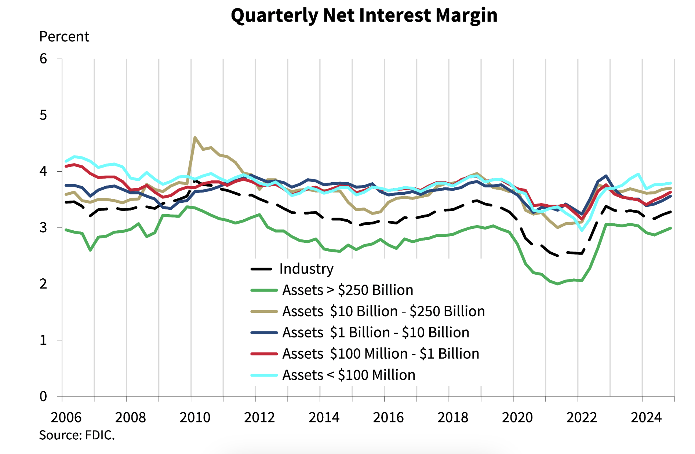
JP Morgan Chase Total Assets > 250 Billion
Federal Deposit Insurance Corporation

Slide 18
Philanthropy
“Giving back is often an essential part of a life plan—as well as a financial plan”
JP Morgan and Its Impact on the Community
Social Investment $30 billion committed to advancing racial equity Support for small businesses and minority-owned enterprises
Affordable Housing Financing for low-cost housing projects
Education & Employment Job training and workforce development programs Financial education for families
Local Engagement Partnerships with nonprofits

Slide 19
Thanks!
Q&A Session

