Slide 1

CELH
CURRENT SNAPSHOT
Price
~$35
Celsius Holdings, Inc.
Mkt Cap
$9.1B
STOCK PITCH — EQUITY RESEARCH PRESENTATION
52W Range
$32–$67
P/E (TTM)
~141x
BUY | Current Price ~35 | Target: $75–$85 | ~100% Upside
Secular growth in functional beverages — not cyclical
Fwd P/E
~38x
Beta
1.12
Revenue (2025)
$2.52B
As of April 2026

Slide 2
Current Environment Favors Secular Consumer Staples
RATE ENVIRONMENT
CONSUMER RESILIENCE
HEALTH & WELLNESS MEGA-TREND
As rates stabilize, fall, or rise. Stocks with predictable earnings streams like tobacco, alcohol, food, beverages, personal care, etc — not rate-sensitive cyclicals — benefit the most.
Energy drinks are an everyday affordable indulgence (~$2–4). Even in a downturn, consumers cut vacations before they cut their morning energy drink. Highly sticky demand.
Consumers are actively shifting to functional, better-for-you beverages. Celsius sits directly in the intersection of energy + health
↓ 10%
Drop in Youth Drinking
Adults under 35 who drink: 72% (2001) → 62% (2023) — Gallup
20%
Less Than Millennials
Gen Z drinks 20% less than millennials on average — World Finance
As alcohol loses ground with young adults, energy drinks, especially functional, better-for-you brands like Celsius, are filling the gap.
Unlike NVIDIA or MAG7, CELH is NOT a crowded trade — less analyst coverage, less institutional saturation, more room for re-rating

Slide 3
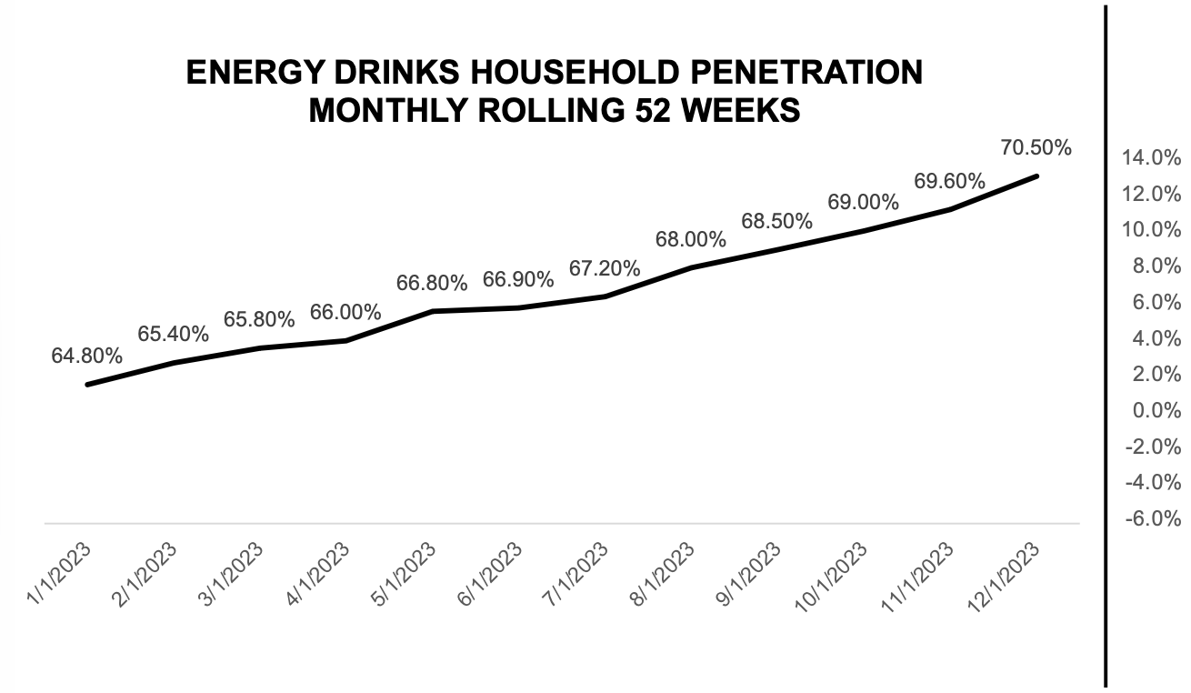
I N D U S T R Y O V E R V I E W
U.S. Energy Drink Market Continues to Grow
8.1%
70.5%
CAGR 2024–2032
Consistent outperformance vs. total beverage
Household Penetration
Up from 64.8% in Jan 2023 (Circana MULOC)
$45B
Projected Size by 2032
From $24B in 2024 — nearly 2× growth
Sources: Grand View Research · Custom Market Insights · Circana MULOC 2024

Slide 4
KEY CATALYSTS & RECENT NEWS
Major Strategic Moves
01
PepsiCo Distribution Lock-In
PepsiCo owns ~11% stake in CELH ($1.135B total invested)
ALL three brands now distributed via PepsiCo's DSD network
CELH becomes PepsiCo's 'energy category captain' in US
PepsiCo gets a board seat — deeply aligned incentives
Moat: independent distributors can't compete with Pepsi's reach
2022 → 2025 → Ongoing
02
Alani Nu Acquisition
Fastest-growing energy brand in the US (64% retail growth in 2024)
Female-first positioning fills a massive demographic gap
Generated $1B+ revenue in its first year under CELH
Cherry Bomb LTO sold out 'in record time' post-acquisition
Integrating into Pepsi DSD — distribution efficiency gains ahead
April 2025 · $1.8B
03
Rockstar Energy Acquisition
Acquired Rockstar US/Canada rights from PepsiCo in brand swap deal
Enters traditional/classic energy segment (~50% of category growth)
Completes the portfolio: health (CELH) + female (Alani) + classic (Rockstar)
Retail sales grew from $150M (2020) → $5B (2025) → projected $6B (2026)
37% increase in total distribution points in 2024 alone
September 2025

Slide 5
Female-focused. Influencer-led marketing. Distinctive flavors like Witches Brew & Sherbet Swirl. Generated $1B+ revenue in first year under CELH.
COMPANY OVERVIEW
Market Share %
CELSIUS
ALANI NU
ROCKSTAR
Core Brand
Acquired April 2025 · $1.8B
Acquired from PepsiCo, Sept 2025
Born in fitness. Targets health-conscious, active consumers. 'Better-for-you' energy with Essential Energy™ formula. ~98.7% ACV coverage.
Classic energy segment — male-skewed. Traditional flavors and formats. Broadens CELH's demographic reach to the other 50% of the market.
US Market Share
11.8%
US Market Share
~5%
US Market Share
~2-3%
COMBINED: ~17-20% US market share — #3 globally behind Red Bull (#1) and Monster (#2)

Slide 6
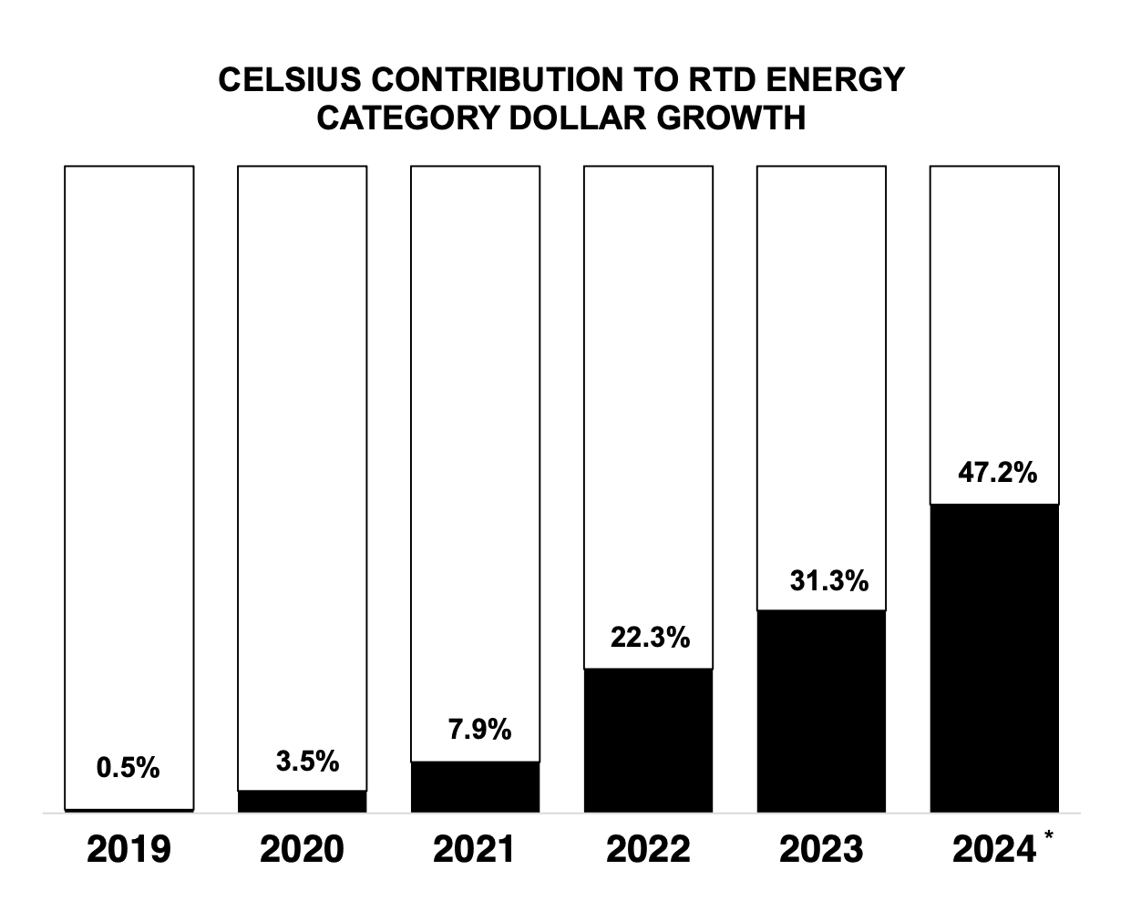
I N D U S T R Y T A I L W I N D S
Celsius drove 47% of all energy drink category growth
The energy drink market is huge and mostly locked up by Red Bull (37%) and Monster (28%)
Two giants have billions in existing sales, but they're relatively flat or declining.
Celsius is smaller in total size but growing explosively.
65%
Plan to Cut Back Further
Share of Gen Z planning to drink less rose 53% YoY in 2024 — NCSolutions
An example to make it click:
Red Bull does $100M → grows to $102M. That's $2M in new dollars.
Celsius does $20M → grows to $40M. That's $20M in new dollars.
Celsius is smaller in total size but it contributed more to growth of because it's the one adding new sales while the big guys stagnate.
↓ 10%
Drop in Youth Drinking
Adults under 35 who drink: 72% (2001) → 62% (2023) — Gallup
20%
Celsius controls 20% of the market share below Red Bull and Monster but 47% of all new growth.
Celsius is the only brand in the category with real momentum
Less Than Millennials
Gen Z drinks 20% less than millennials on average — World Finance
47%
Celsius Category Growth
Celsius drove 47% of all energy drink category growth YoY in Q1 2024 — Circana
As alcohol loses ground with young adults, energy drinks, especially functional, better-for-you brands like Celsius, are filling the gap.
Sources: Gallup 2023 · Cleveland Clinic · NCSolutions 2024 · World Finance · Circana MULOC Q1 2024

Slide 7
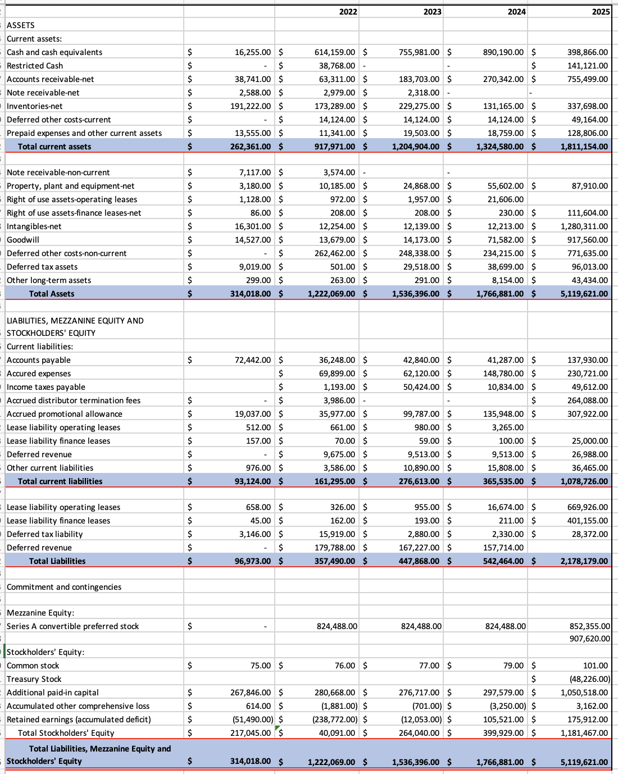
FINANCIAL OVERVIEW — IS, BS, CFFA
Balance Sheet
Strongest Points
TOTAL ASSETS (2025)
STOCKHOLDERS' EQUITY (2025)
TOTAL DEBT RATIO (2025)
$5.1B
$1.18B
Total Assets grow faster than Total Liabilities over the years
16× since 2021 ($314M)
5× since 2021 ($217M)
Red Flag
Acct. Rec: $755M
Alani Nu Acquisition
The combined balance sheet — this is structural, not a collection issue.
Cash Deployed Strategically — Not Lost
Cash fell from $890M to $399M as Celsius funded the Alani Nu deal. Total equity tripled to $1.18B, confirming value creation — not deterioration.
KEY FINANCIALS ($M)
Metric | 2023 | 2024 | 2025
Revenue | $1,318M | $1,356M | $2,515M
Gross Profit | $633M | $680M | $1,267M
Gross Margin | 48.0% | 50.2% | 50.4%
Op. Income | $266M | $156M | $469M
Net Income | $~200M | $~163M | $~64M*
EPS (diluted) | $0.83 | $0.54 | $0.25*
Current Ratio
Debt/Equity
*2025 EPS depressed by acquisition costs (Alani Nu $1.8B) — non-recurring. Forward EPS ~$0.91 consensus.
1.68x
Healthy liquidity
0.23x
Low leverage
ROE
ROIC
5.18%
Post-acq. normalization
12.92%
Improving with scale

Slide 8
FINANCIAL OVERVIEW — IS, BS, CFS
Income Statement
KEY FINANCIALS ($M)
Metric | 2023 | 2024 | 2025
Revenue | $1,318M | $1,356M | $2,515M
Gross Profit | $633M | $680M | $1,267M
Gross Margin | 48.0% | 50.2% | 50.4%
Op. Income | $266M | $156M | $469M
Net Income | $~200M | $~163M | $~64M*
EPS (diluted) | $0.83 | $0.54 | $0.25*
*2025 EPS depressed by acquisition costs (Alani Nu $1.8B) — non-recurring. Forward EPS ~$0.91 consensus.
Revenue (2025)
$2.5B
85% YoY Growth

Slide 9
FINANCIAL OVERVIEW — IS, BS, CFFA
Cash Flow from Assets
 | 2021 | 2022 | 2023 | 2024 | 2025
EBIT | $ (4,090.00) | $ (157,801.00) | $ 266,366.00 | $ 155,728.00 | $ 141,062.00
D&A | $ 1,916.00 | $ 1,917.00 | $ 3,226.00 | $ 7,274.00 | $ 7,275.00
OCF | $ 5,822.00 | $ (121,266.00) | $ 334,540.00 | $ 212,978.00 | $ 165,371.00
NCS |  | $ 8,922.00 | $ 17,909.00 | $ 38,008.00 | $ 39,583.00
NWC | $ 169,237.00 | $ 756,676.00 | $ 928,291.00 | $ 959,045.00 | $ 732,428.00
Change in NWC |  | $ 587,439.00 | $ 171,615.00 | $ 30,754.00 | $ (226,617.00)
CFFA |  | $ (717,627.00) | $ 145,016.00 | $ 144,216.00 | $ 352,405.00
CA | $ 262,361.00 | $ 917,971.00 | $ 1,204,904.00 | $ 1,324,580.00 | $ 1,811,154.00
CL | $ 93,124.00 | $ 161,295.00 | $ 276,613.00 | $ 365,535.00 | $ 1,078,726.00
NWC | $ 169,237.00 | $ 756,676.00 | $ 928,291.00 | $ 959,045.00 | $ 732,428.00
CFFA = Operating Cash Flow − Net Capital Spending − Change in NWC
This measure is basically Free Cash Flow to the firm, and it represents what's available to pay both debt holders and equity holders. It is the purest measure of whether a business is creating or destroying value.
OCF — cash the operations generate before reinvestment | OCF = EBIT+Depreciation -Tax
NCS — cash spent on new assets | NCS = Ending net fixed assets - beginning net fixed assets + depreciation
Change in NWC — cash tied up (or released) in day-to-day working capital
KEY FINANCIALS ($M)
Metric | 2023 | 2024 | 2025
Revenue | $1,318M | $1,356M | $2,515M
Gross Profit | $633M | $680M | $1,267M
Gross Margin | 48.0% | 50.2% | 50.4%
Op. Income | $266M | $156M | $469M
Net Income | $~200M | $~163M | $~64M*
EPS (diluted) | $0.83 | $0.54 | $0.25*
Current Ratio
Debt/Equity
*2025 EPS depressed by acquisition costs (Alani Nu $1.8B) — non-recurring. Forward EPS ~$0.91 consensus.
1.68x
Healthy liquidity
0.23x
Low leverage
ROE
ROIC
5.18%
Post-acq. normalization
12.92%
Improving with scale

Slide 10
RATIO ANALYSIS
 | 2021 | 2022 | 2023 | 2024 | 2025
CR | 2.82 | 5.69 | 4.36 | 3.62 | 1.68
QR | 0.76 | 4.62 | 3.53 | 3.26 | 1.37
Cash Ratio | 0.17 | 3.81 | 2.73 | 2.44 | 0.37
Total Debt Ratio | 0.31 | 0.29 | 0.29 | 0.31 | 0.43
Debt to Equity Ratio | 0.45 | 8.92 | 1.70 | 1.36 | 1.84
Inventory Turnover | 0.97 | 2.21 | 2.99 | 5.15 | 3.70
Days' Sales in Inventory | 375.04 | 165.26 | 122.19 | 70.88 | 98.77
Receivables Turnover | 8.11 | 10.32 | 7.17 | 5.01 | 3.33
Days' Sales in Receivables | 44.99 | 35.36 | 50.87 | 72.79 | 109.63
Total Assets Turnover Ratio | 1.00 | 0.53 | 0.86 | 0.77 | 0.49
Capital Intensity Ratio | 1.00 | 1.87 | 1.17 | 1.30 | 2.04
ROA | 1.25% | -15.32% | 14.76% | 8.21% | 2.11%
ROE | 1.81% | -467.14% | 85.90% | 36.27% | 9.14%
PM | 1.25% | -28.65% | 17.21% | 10.70% | 4.29%
Liquidity – moving from over liquid to a more efficient use of assets. Company is deploying cash instead of holding it.
Leverage – Total Debt Ratio very stable ~0.29 → rises to 0.43 (2025) financing more assets with debt
Efficiency – Days sales in Inventory is strongly decreased from 375 (2021) to 98 (2025).
Profitability – ROA, ROE, and PM all peaked in 2023 and have slowed a little bit since then. There’s room for improvement since they have to lower the cost of revenue.
PEER COMPARISON
Company | P/E (TTM) | Fwd P/E | Rev Growth | Gross Margin | Beta
CELH | 141x | 38x | +85.5% | 50.4% | 1.12
MNST (Monster) | 37x | 32x | +8% | 53.2% | 0.76
KDP (Keurig Dr Pepper) | 18x | 16x | +3% | 55.0% | 0.58
PEP (PepsiCo) | 22x | 19x | +2% | 54.3% | 0.55
Industry Median | ~18x | ~17x | ~5% | ~50% | ~0.65
HOW TO READ CELH's P/E
P/E = Stock Price / EPS. Higher P/E = more investor confidence in future earnings growth, NOT necessarily overvalued. CELH's TTM P/E (~141x) is distorted by Alani Nu acquisition costs. The Forward P/E (~38x) is the more meaningful signal here, reflecting expectations for normalized, growing earnings. EPS can grow via (1) net income increase or (2) share buybacks. Rising EPS alongside a stable/growing stock price = pure value creation.

Slide 11
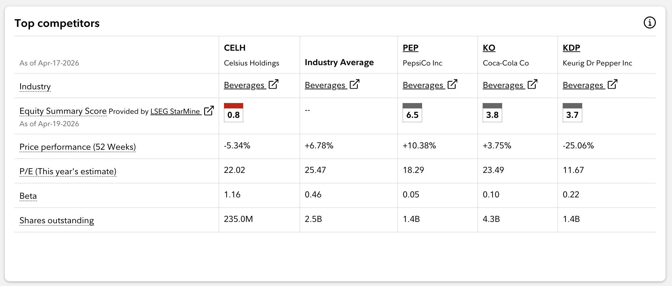
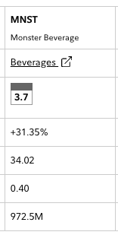
VALUATION RATIO — CELH vs PEERS
Higher P/E signals market confidence in future earnings growth
PEER COMPARISON
Company | P/E (TTM) | Fwd P/E | Rev Growth | Gross Margin | Beta
CELH | 141x | 38x | +85.5% | 50.4% | 1.12
MNST (Monster) | 37x | 32x | +8% | 53.2% | 0.76
KDP (Keurig Dr Pepper) | 18x | 16x | +3% | 55.0% | 0.58
PEP (PepsiCo) | 22x | 19x | +2% | 54.3% | 0.55
Industry Median | ~18x | ~17x | ~5% | ~50% | ~0.65
HOW TO READ CELH's P/E
P/E = Stock Price / EPS. Higher P/E = more investor confidence in future earnings growth, NOT necessarily overvalued. CELH's TTM P/E (~141x) is distorted by Alani Nu acquisition costs. The Forward P/E (~38x) is the more meaningful signal here, reflecting expectations for normalized, growing earnings. EPS can grow via (1) net income increase or (2) share buybacks. Rising EPS alongside a stable/growing stock price = pure value creation.

Slide 12
RISK & RETURN METRICS — CELH vs PEERS
CELH delivers superior risk-adjusted returns (Sharpe 0.97, Sortino 1.67) despite higher volatility — outperforming peers on an annualized basis
Risk Measures for Celsius
Return Annualized Average |  | 77.16%
Return Annualized (Geometric) |  | 115.1%
Annualized Volatility |  | 75.89%
Maximum Drawdown |  | -76.52%
Sharpe Ratio |  | 0.9680
Sortino Ratio |  | 1.6659
Correlation |  | 0.3959
BETA |  | 1.5550
Risk Measures for Monster
Return Annualized Average |  | 16.96%
Return Annualized (Geometric) |  | 18.4%
Annualized Volatility |  | 25.17%
Maximum Drawdown |  | -25.80%
Sharpe Ratio |  | 0.5271
Sortino Ratio |  | 0.7340
Correlation |  | 0.5534
BETA |  | 0.7209
Risk Measures for PepsiCo
Return Annualized Average |  | 4.34%
Return Annualized (Geometric) |  | 4.4%
Annualized Volatility |  | 21.08%
Maximum Drawdown |  | -34.19%
Sharpe Ratio |  | 0.0307
Sortino Ratio |  | 0.0426
Correlation |  | 0.5163
BETA |  | 0.5632
Risk Measures for Coca-Cola
Return Annualized Average |  | 38.56%
Return Annualized (Geometric) |  | 46.8%
Annualized Volatility |  | 39.40%
Maximum Drawdown |  | -33.51%
Sharpe Ratio |  | 0.8850
Sortino Ratio |  | 1.3214
Correlation |  | 0.3959
BETA |  | 0.8073
PEER COMPARISON
Company | P/E (TTM) | Fwd P/E | Rev Growth | Gross Margin | Beta
CELH | 141x | 38x | +85.5% | 50.4% | 1.12
MNST (Monster) | 37x | 32x | +8% | 53.2% | 0.76
KDP (Keurig Dr Pepper) | 18x | 16x | +3% | 55.0% | 0.58
PEP (PepsiCo) | 22x | 19x | +2% | 54.3% | 0.55
Industry Median | ~18x | ~17x | ~5% | ~50% | ~0.65
HOW TO READ CELH's P/E
P/E = Stock Price / EPS. Higher P/E = more investor confidence in future earnings growth, NOT necessarily overvalued. CELH's TTM P/E (~141x) is distorted by Alani Nu acquisition costs. The Forward P/E (~38x) is the more meaningful signal here, reflecting expectations for normalized, growing earnings. EPS can grow via (1) net income increase or (2) share buybacks. Rising EPS alongside a stable/growing stock price = pure value creation.

Slide 13
INVESTMENT CONCLUSION
BUY
Price Target: $75–$85 | ~90% Upside | 12–18 Month Horizon
Conviction: Secular growth story + distribution moat + multi-brand portfolio expansion + strong financials
1
Macro Fit
2
Not a Crowded Trade
3
Portfolio Architecture
Functional beverages are secular, not cyclical. Rate environment favors re-rating of durable growth names.
CELH is not NVIDIA or Mag-7. Low correlation (0.40) to S&P 500. Room for discovery and institutional accumulation.
Celsius + Alani Nu + Rockstar = ~17-20% of US market. Three distinct demographics. One platform.
4
PepsiCo Moat
5
Financials
6
Valuation Upside
Exclusive distribution via PepsiCo's network with a board seat and $1.1B invested. The distribution advantage is nearly irreplicable.
2025 revenue $2.5B (85% YoY). Forward P/E 38x reasonable. EPS to recover as acquisition costs normalize. Strong balance sheet (D/E 0.23x).
Strong Buy Rating from Analysts – $75–$85
Current price ~$35 representing good entry point.

