Slide 1
BUSI 246 - Data Analysis Project
S&P 500 and its 11 underlying industries within

Slide 2
Intro
For our project we looked at the closing price of the S&P 500 and compared it to the 11 different industries within the index. We took a sample of data starting on January 5, 2024 and ending on October 3, 2025.
We looked at descriptive statistics, correlation, and ANOVA.
Finally, we made a hypothetical chart showing what would have happen if someone invested $100 into each of the industries starting January 5, 2024.

Slide 3
Variables and research questions
Variables:
Output -
Descriptive Statistics
Anova Single Factor
Backtesting
Input - Data from the S&P 500 and the underlying indexes/industries
Research Question: How do the performance trends of individual industries within the S&P 500 correlate with the overall performance of the index, and which industries have the most significant impact on the index's movements? Finally, which industry we recommend given your risk profile.

Slide 4
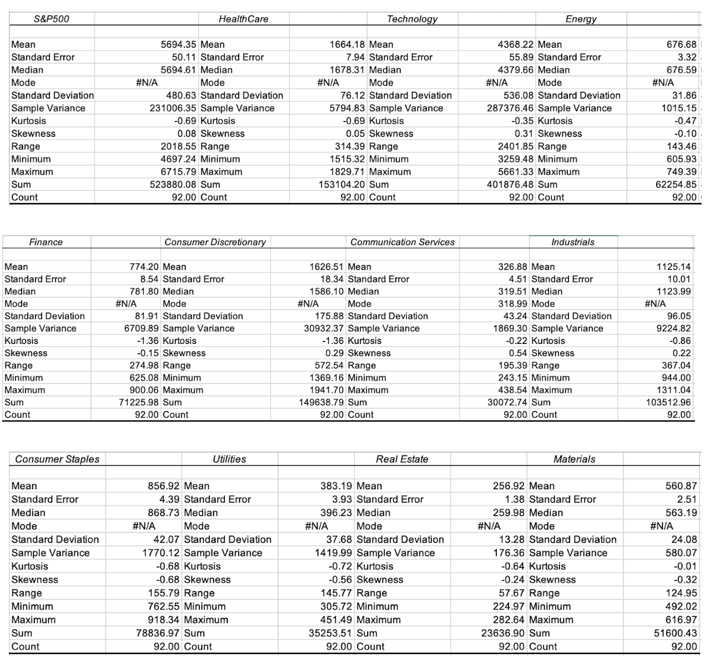
Descriptive Statistics
Based on the descriptive statistics, the S&P 500 and Technology sectors have the highest average values, suggesting stronger overall performance for this sector.
In addition looking at the Standard Deviation we can see how volatile each of these indexes are.
High -
Technology - 536
Consumer Discretionary- 175
Lowest -
Real Estate - 13
Materials - 24
Notes:
Based on the descriptive statistics, the S&P 500 and Technology sectors have the highest average values, suggesting stronger overall performance. Real Estate and Utilities, in contrast, show lower means, indicating more stable but slower growth sectors. The standard deviation reveals that Technology and Energy are the most volatile, meaning their performance fluctuates more significantly compared to others such as Real Estate or Materials, which display more stability. Across all sectors, skewness values close to zero and negative kurtosis suggest relatively balanced distributions without many extreme outliers. Overall, the data shows that higher-performing sectors tend to have higher volatility, while defensive sectors like Utilities and Consumer Staples remain more stable.

Slide 5
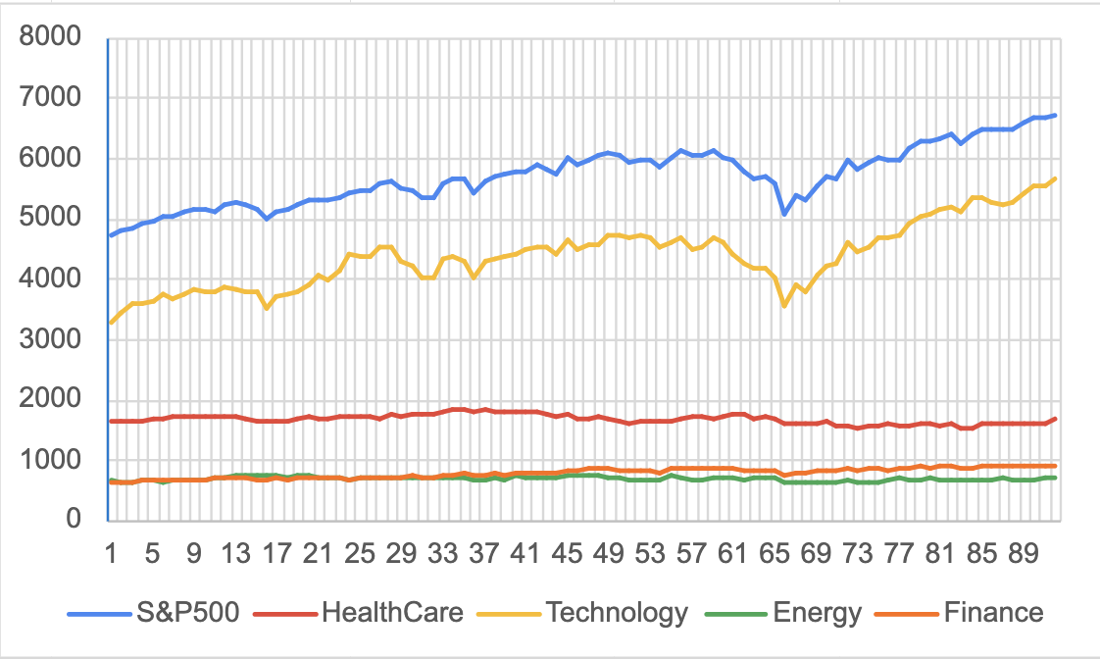
Price Fluctuations Over Time
Notes:
S&P 500 and technology are highly correlated
Others are more steady, do not contribute as much to the S&P

Slide 6
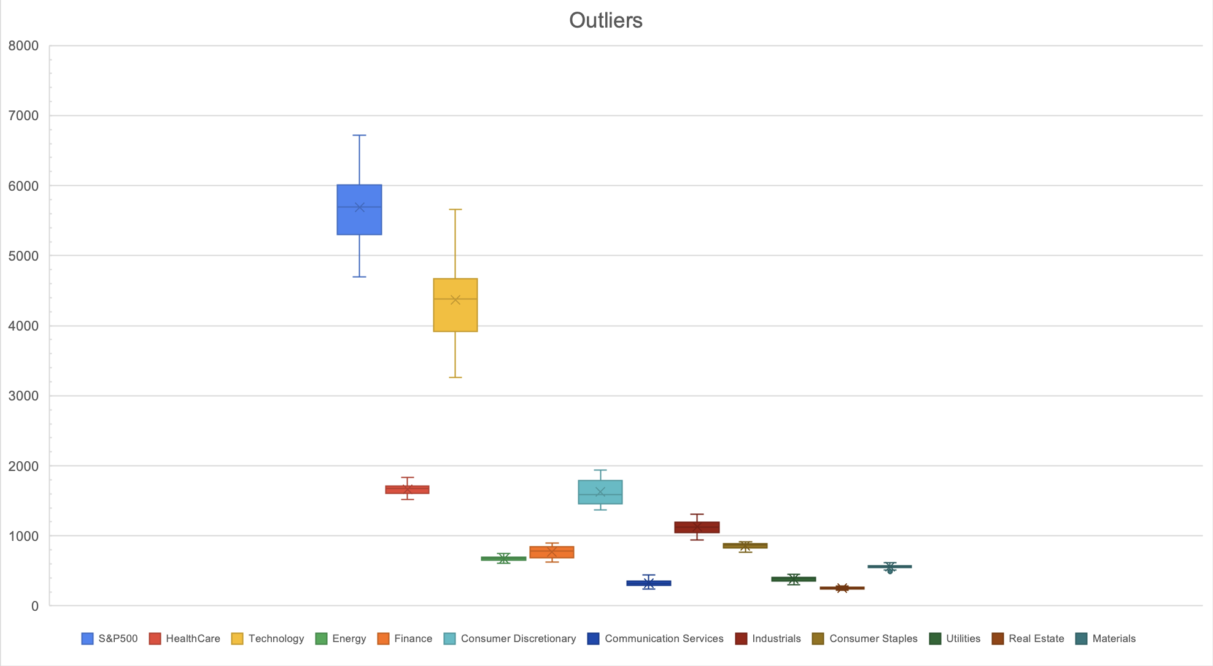
Notes:
S&P 500 and technology are more volatile

Slide 7
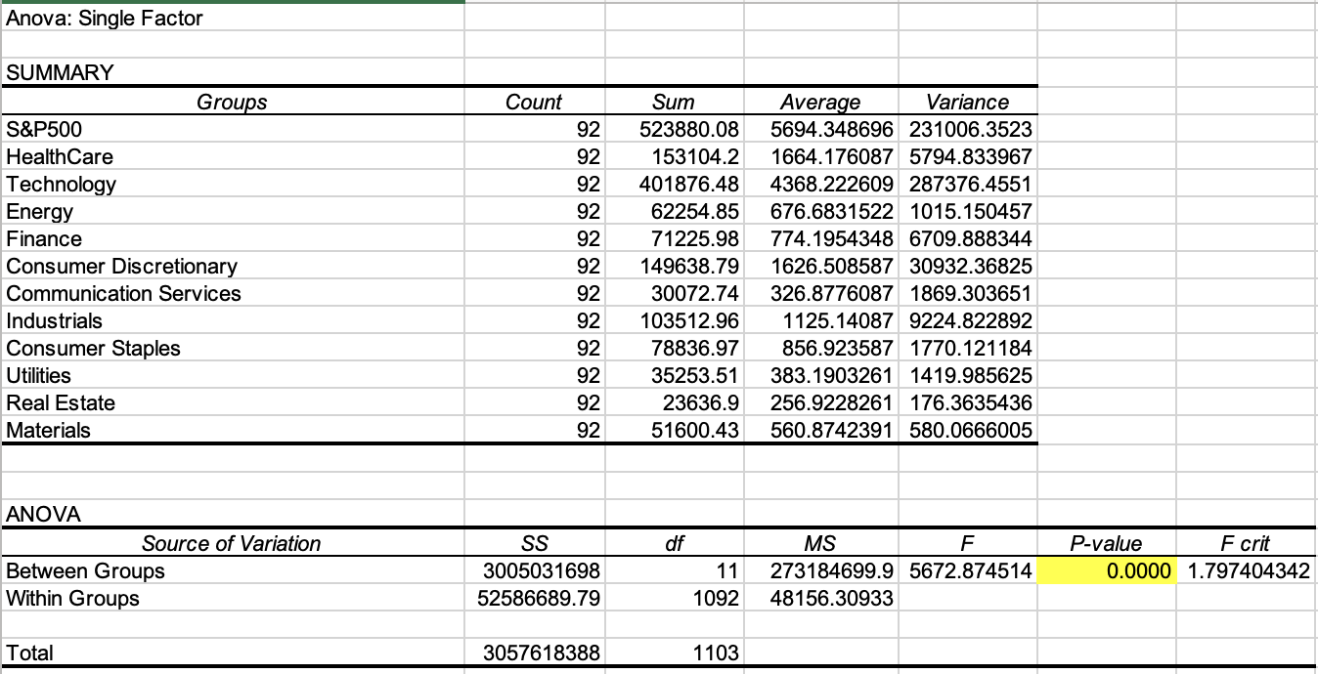

Slide 8
Anova Single Factor Hypothesis
We reject the null hypothesis because the p-value is zero.
We say that there is difference between industries.

Slide 9
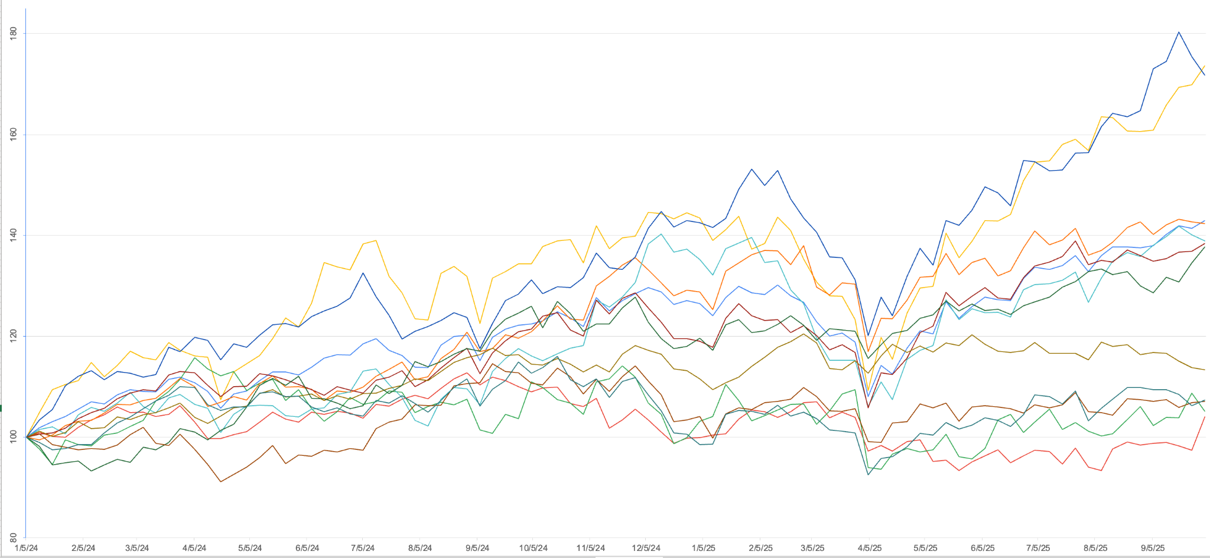

Slide 10
Industry Performance
The previous chart shows what happens when someone put $100 into each sector on January 5, 2024.
The highest performance would be for communication services and technology with technology giving a 73% return and communication services giving 71% return.
Then medium performance would be finance, industrials, utilities, as well as the whole S&P 500 overall.
Finally, the lowest performing sectors are consumer staples, materials, energy, healthcare, and real estate.

Slide 11
Conclusion
Research Question: How do the performance trends of individual industries within the S&P 500 correlate with the overall performance of the index, and which industries have the most significant impact on the index's movements? Finally, which industry we recommend given your risk profile.
As we can on the chart of price fluctuations, the technology industry is the one that is the most correlated to the S&P 500 and the rest industries don’t fluctuate as much over time, therefore contributing less to the overall performance of the S&P 500. We can agree that the S&P 500 growth is highly dependent on the performance of technology companies.
Risk profile:
Low: low volatility industries such as consumer staples (outperformed other peers: materials, energy, healthcare, and real estate)
Medium: medium volatility industries - finance (outperforming its other peers: industrials, utilities, S&P 500)
High: high risk tolerance - technology
However tech performance is very close to communication services, and communication services has less volatility

