Slide 1
Industrialization and Cancer in Louisiana
Arturo Altamirano
CMPS 3160: Intro to Data Science

Slide 2
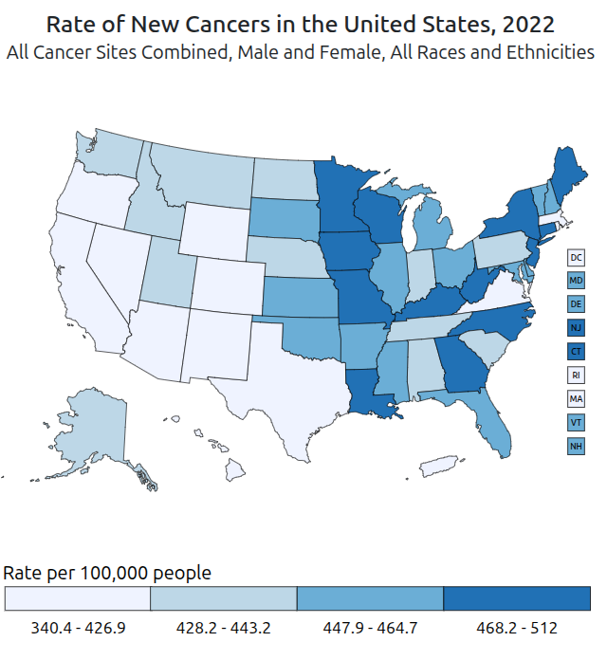
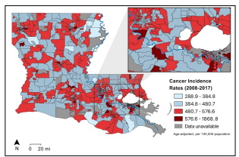
Motivations
“Air pollution is linked to higher cancer rates among black or impoverished communities in Louisiana” by Kimberly A Terrell and Gianna St Julien
Are these claims true? Can we visualize these claims and uphold them?
Our analysis contributes to the growing body of evidence that Black and Brown communities in Louisiana are overburdened with the negative effects toxic air pollution from petrochemical facilities and other sources...

Slide 3


Data Collection and ETL
Census Bureau’s Community Survey
Clinical Trials and Cancer Studies conducted by cancer.gov
Accumulated for analysis on data.world

Slide 4
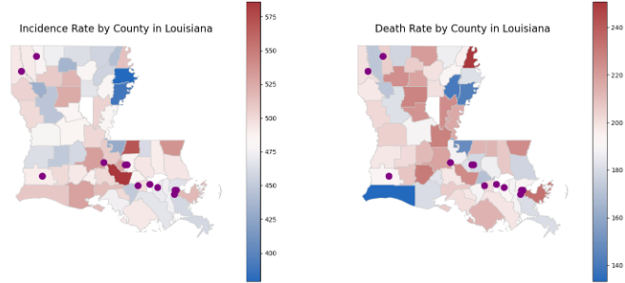
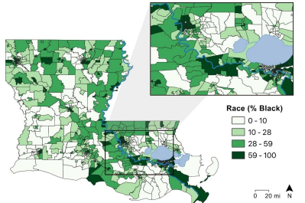
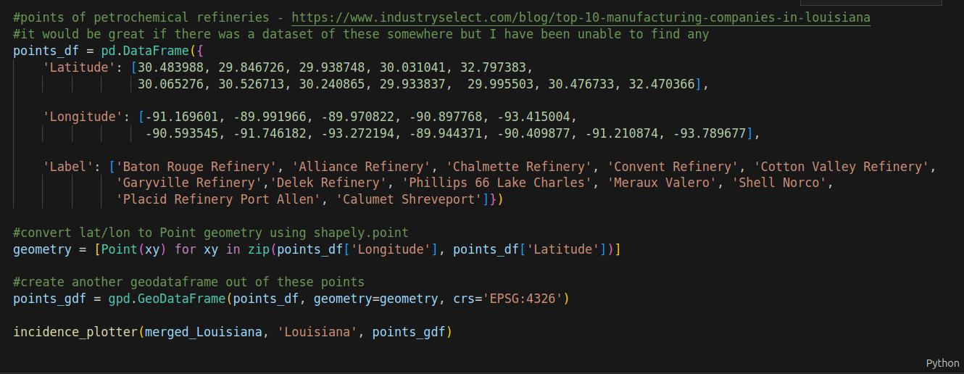
EDA – On The Right Track

Slide 5
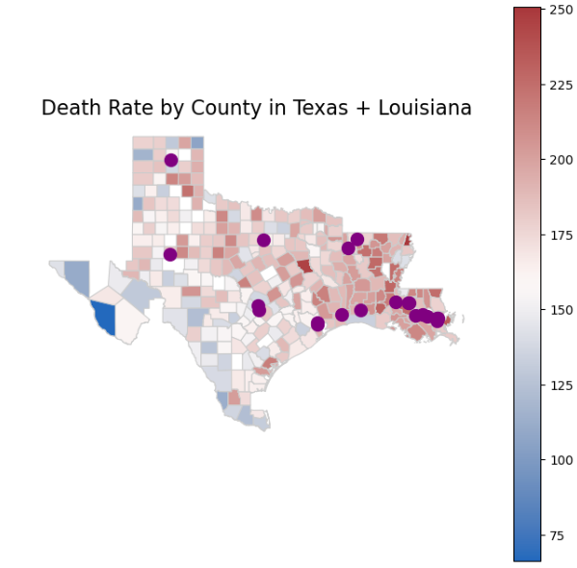
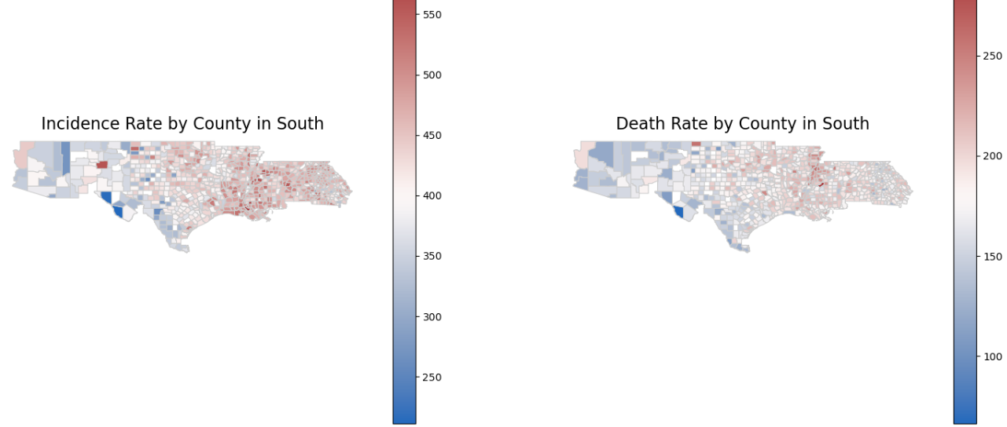
EDA - Expanded

Slide 6
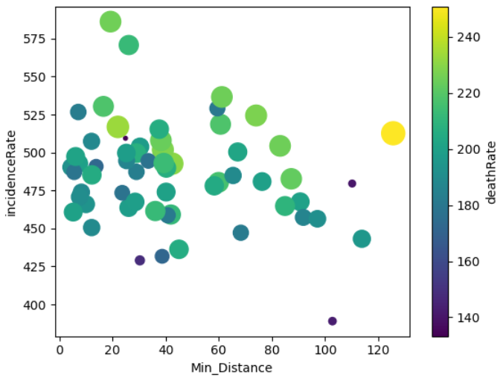
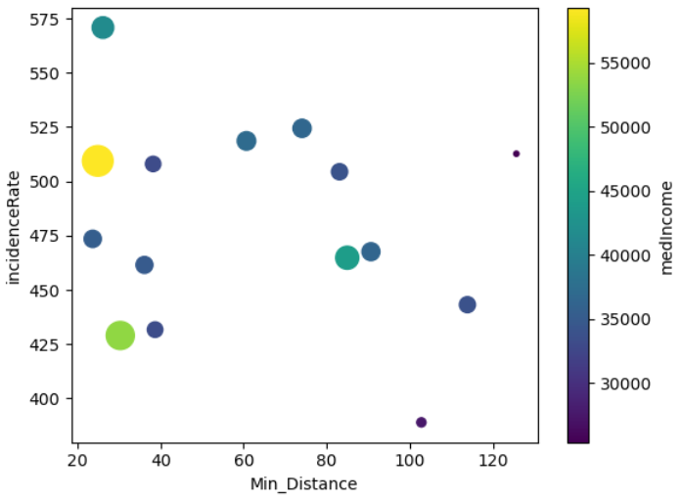
Correlation with Distance
Distance to Incidence Rate: Median Income below $20,000
Distance to Incidence Rate

Slide 7
Model Training

Slide 8

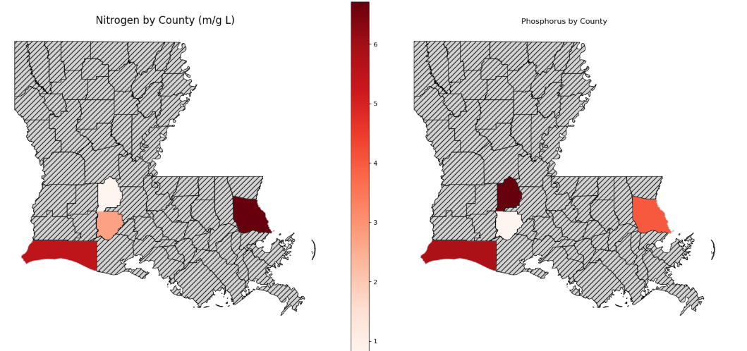
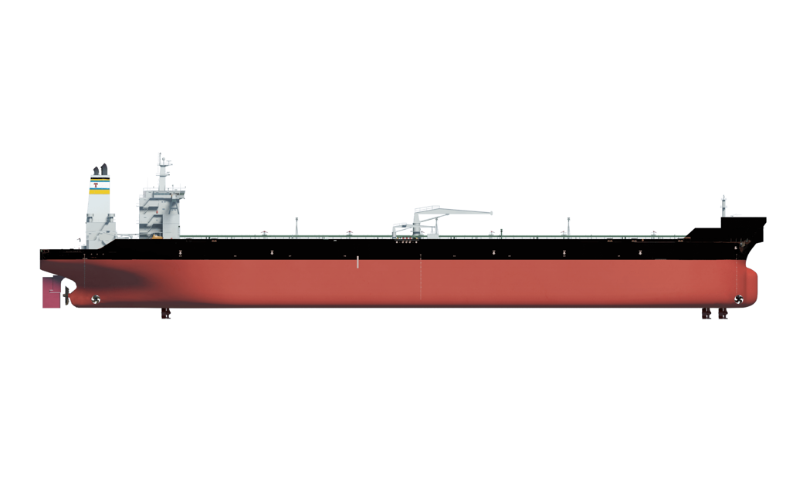
Future Work

Slide 9
Takeaways
Noticeable concentration near petrochemical plants and the Mississippi river
Findings of the Tulane paper are upheld
Insights gained from this data can be used to accurately predict trends elsewhere

