Slide 1

TAIL RISK BUDGETING
R. Douglas Martin*
Computational Finance Program Director
Applied Mathematics and Statistics
University of Washington
doug@stat.washington.edu
R-Finance Conference, Chicago, Ill., April 29-30, 2011
* Parts of this presentation are due to joint work with Yindeng Jiang (UW Endowment
Fund), Minfeng Zhu (Aegon USA), and Nick Basch (Ph.D. student UW Statistics Dept.)

Slide 2
Outline
Volatility Risk Budgeting
2. Post-Modern Portfolio Optimization
Tail Risk Budgeting
Factor Model Monte Carlo
Modern Portfolio Theory Inertia

Slide 3
1. Volatility Risk Budgeting
Litterman (1996), Grinold and Kahn, (2000), Sharpe (2002), Scherer(2002)
Portfolio construction that controls asset volatility risk contributions to total risk
Based on linear risk decompositions and reverse optimization
Useful graphical displays for allocation guidance
Well-suited to supporting investment committee decisions
Alternative to black-box optimizers
But can be used as constraints in optimization. See Scherer and Martin (2005); Boudt, Carl and Peterson (2010)
3

Slide 4
Uses “MPT” Mean-Variance Foundation
The Additive Decomposition
Implied Returns (“Reverse MV Optimization”)

Slide 5
EQUAL WEIGHTS: ORCL, MSFT, HON, LLTC , GENZ (20% EACH)

Slide 6
REBALANCED: ORCL 10%, MSFT 20%, HON 5%, LLTC 25% , GENZ 40%

Slide 7
2. POST-MODERN PORTFOLIO OPTIMIZATION
Mean-vs-ETL Optimization (Current leading choice)
Rockafellar and Uryasev (2000)
.
Martin et. al. (2003)
7

Slide 8
Choice of Tail Probability
Martin and Zhang (2008)
Guidance: Do not go too far into the tail, p not less than .05 to be safe!
Note: The above large-sample results are quite accurate for finite sample sizes down to T = 40 for p = .05 and df 5 (not terrible at df = 3).

Slide 9
Fund-of-Hedge Funds Example
Hedge Fund Universe
379 hedge funds selected from hedgefund.net*
Monthly returns 12/1991 to 11/2009
Portfolios
100 randomly selected with 20 hedge funds each
Portfolio optimization
Minimum VoL
Minimum ETL with 5% tail probability
Monthly rebalancing on 5 years of returns
* Thanks to hedgefund.net for providing the data

Slide 10
Mean of 100 Portfolio Values on a Monthly Basis
More detailed study: Martin and Zhu (2011) in preparation.

Slide 11
3. TAIL RISK BUDGETING
Q: What risk measures can give you an additive decomposition?
A: Euler: Any positive homogeneous risk measure
satisfies
Works for: - Semi-standard deviation(SSD)
- Value-at-Risk (VaR)
- Expected-tail-loss (ETL)
11

Slide 12
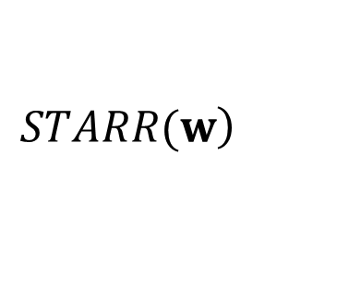
ETL Risk Decomposition
(Tasche, 2000)
Mean-ETL Implied Returns
$$\left.STARR(w\right)$$

Slide 13
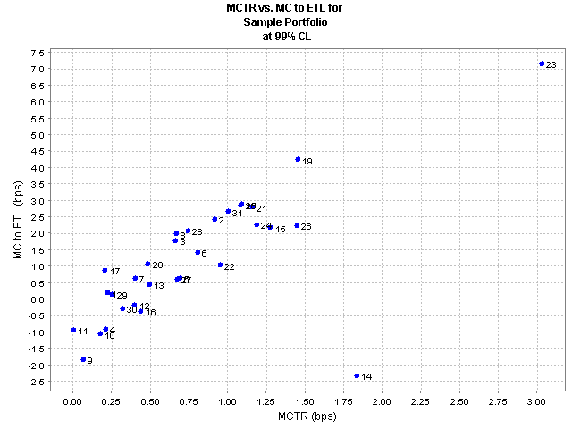
MCETL vs. MCVOL Diagnostic Plot (Cognity*)
* From FinAnalytica, Inc. with skewed t-distribution models

Slide 14
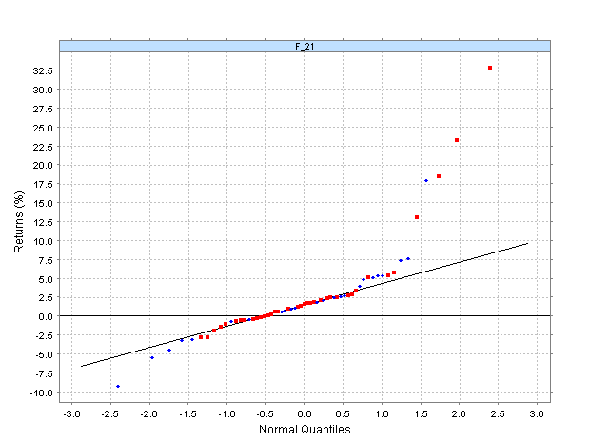
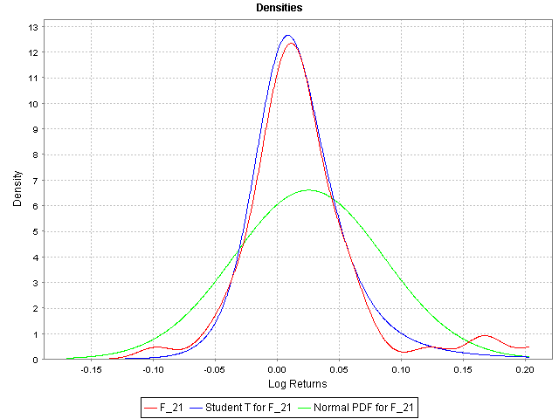
Reason for Differences (Cognity)
The fat right tail influences volatility but not ETL

Slide 15
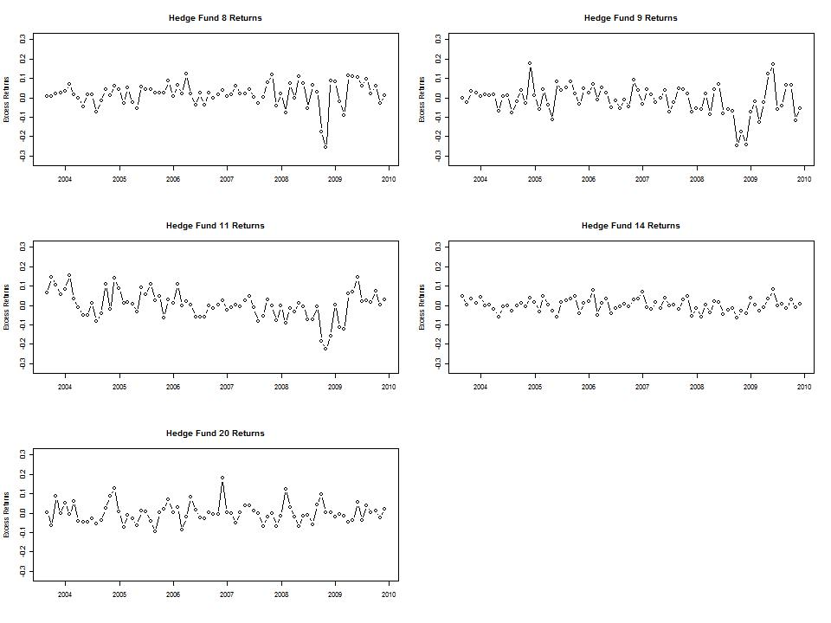
Example: Tail Risk Budget Rebalancing
5 years training, risk-budget guided rebalance once at end of July 2008.

Slide 16
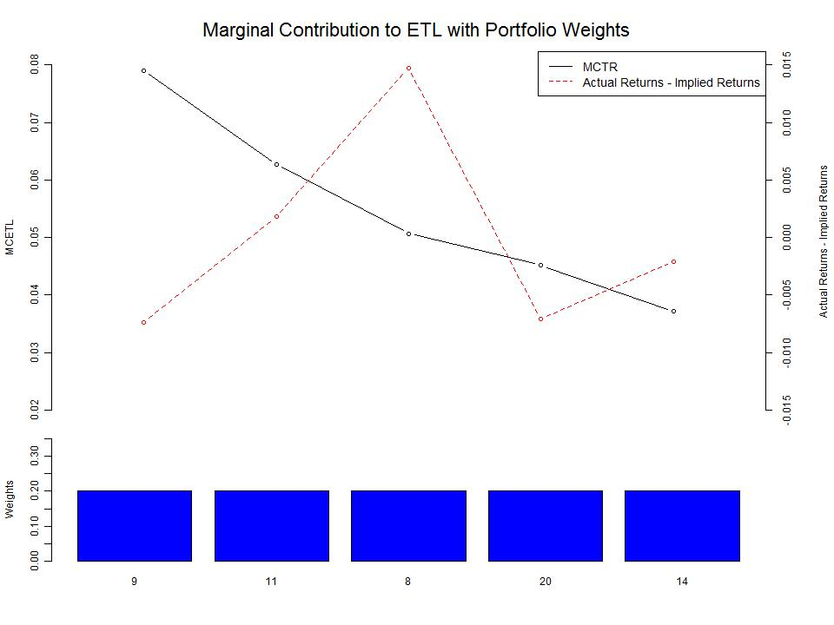

Slide 17
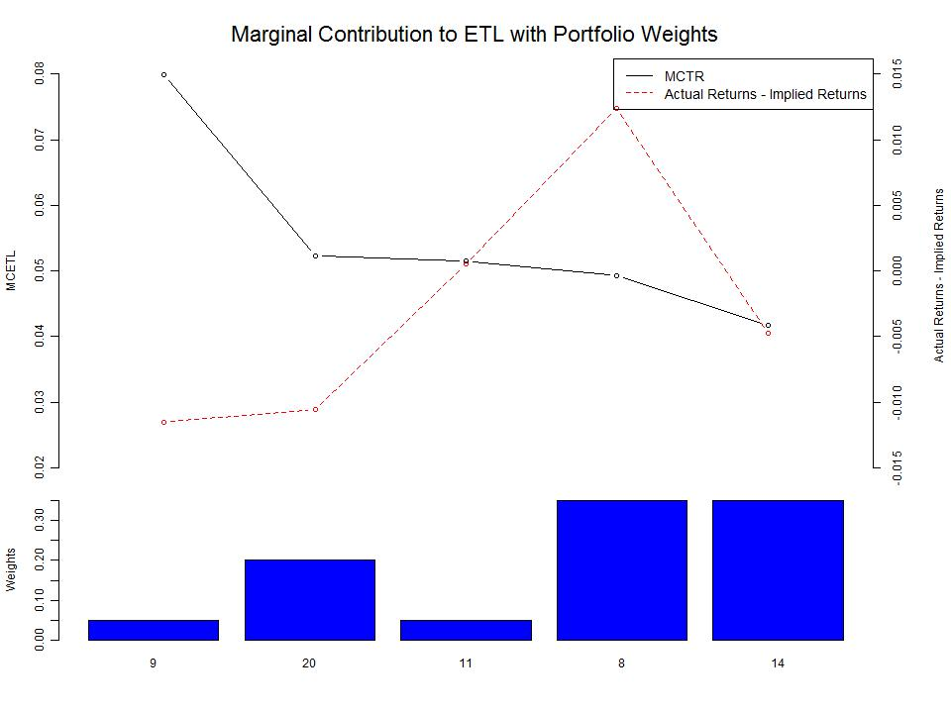

Slide 18
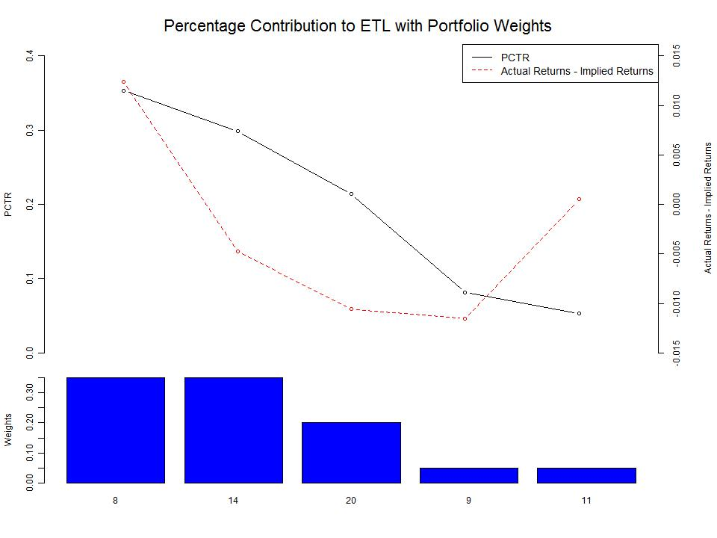

Slide 19
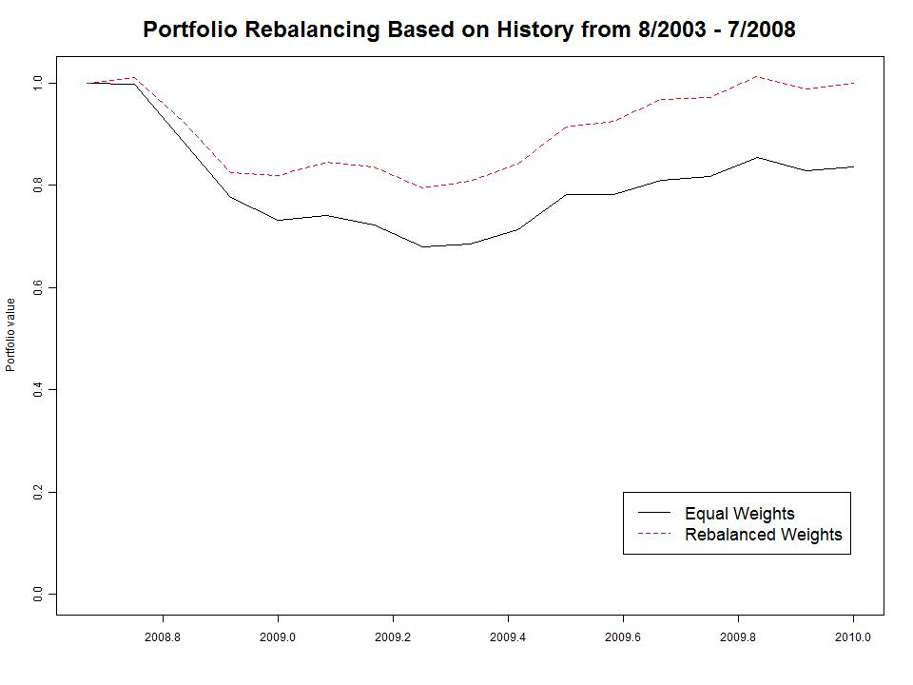

Slide 20
4. FACTOR MODEL MONTE CARLO
Need improved risk and performance estimates
For risk analysis and portfolio construction
Short and unequal histories of returns
Short training periods for dynamic models
Borrow strength from time series factor models
Use factor model Monte Carlo (FMMC)
Motivating work under normal distributions:
Stambaugh (1997)
Pastor and Stambaugh (2002)

Slide 21
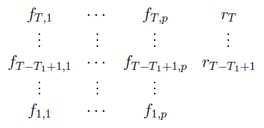


Single Asset and p Risk Factors
Time series factor model:
Normal distribution MLE’s (Anderson, 1957)
Can get any normal distribution parameterized risk or performance measure, BUT GOOD ONLY FOR VOL, SHARPE, IR FOR FAT-TAILED RETURNS!

Slide 22



The FMMC Method
Jiang (2009)
Jiang and Martin (2011)
Factor model fit (LS and robust):
Estimate distribution of (large T, e.d.f. will suffice)
Estimate distribution of
- Either fat-tailed skewed distribution fit, or e.d.f. (which?)
Large Monte Carlo of
large
Estimate risk and performance measures from

Slide 23
Simplest Version
Empirical Distributions Only
FMMC = all unique combinations of and
10 years of risk factor data and 3 years of hedge fund returns:
120 x 36 = 4320 samples (may often be good enough)
Key Ingredient
Very good factor models!
Need parsimonious from large universe with high predictive power
Looking into methods such as Lasso, LARS, etc.

Slide 24
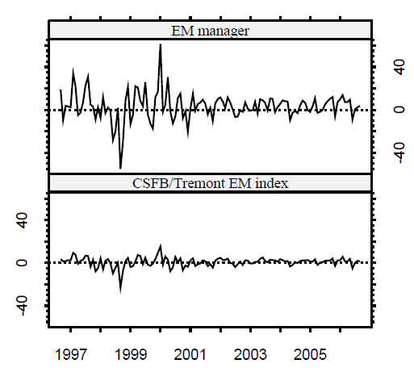
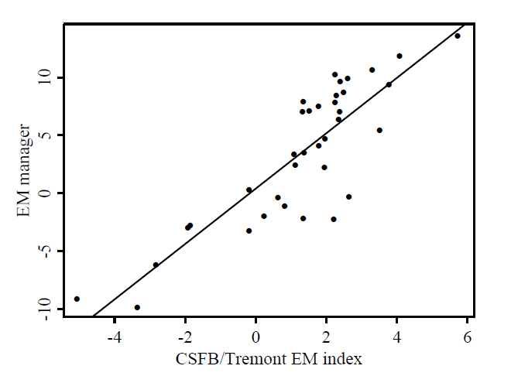
Hedge Fund and Single Risk Factor
R-squared = .86
Date range: 2003/9 to 2006/8

Slide 25
Risk Estimates and Bootstrap S.E.’s
 |  | Estimate | SE
Vol | Complete-data | 44.8% | 5.7%
 | Truncation | 20.5% | 10.2%
 | Stambaugh | 37.5% | 7.5%
 | FMMC | 37.5% | 7.5%
DVol | Complete-data | 7.8% | 1.8%
 | Truncation | 2.6% | 3.1%
 | Stambaugh | 12.6% | 8.1%
 | FMMC | 7.4% | 2.1%
VaR | Complete-data | 17.5% | 5.1%
 | Truncation | 9.0% | 10.1%
 | Stambaugh | 31.3% | 23.3%
 | FMMC | 14.9% | 3.6%
ETL | Complete-data | 28.5% | 7.3%
 | Truncation | 9.4% | 12.0%
 | Stambaugh | 47.0% | 25.2%
 | FMMC | 25.0% | 7.7%

Slide 27
Risk Estimates and Bootstrap S.E.’s
 |  | Estimate | SE
Sharpe | Complete-data | 0.9 | 0.35
 | Truncation | 2.13 | 0.65
 | Stambaugh | 0.81 | 0.5
 | FMMC | 0.81 | 0.5
Sortino | Complete-data | 0.43 | 0.29
 | Truncation | 1.38 | 0.69
 | Stambaugh | 2.41 | 11.72
 | FMMC | 0.34 | 0.35
STARR | Complete-data | 0.12 | 0.08
 | Truncation | 0.39 | 0.21
 | Stambaugh | 0.65 | 6.39
 | FMMC | 0.1 | 0.1
Omega | Complete-data | 2.15 | 0.75
 | Truncation | 4.19 | 1.78
 | Stambaugh | 7.86 | 402.03
 | FMMC | 1.88 | 0.94

Slide 29
MULTI-FACTOR MODELS FOR FMMC
Basch and Martin (2011 current work)
20 hedge funds 2000 through 2007
Hedgefund.net
19 risk factors
Market factors: SP500, DJIA, VIX, DAX, CAC 40, Nikkei 225
Hedge fund indexes: 12 DJ Credit Suisse
Both robust and least squares fits 2004-7
Initial universe reduction:
Top 5 factors by LS R-squared then best subset
R robust library model selection unreliable for larger p

Slide 30
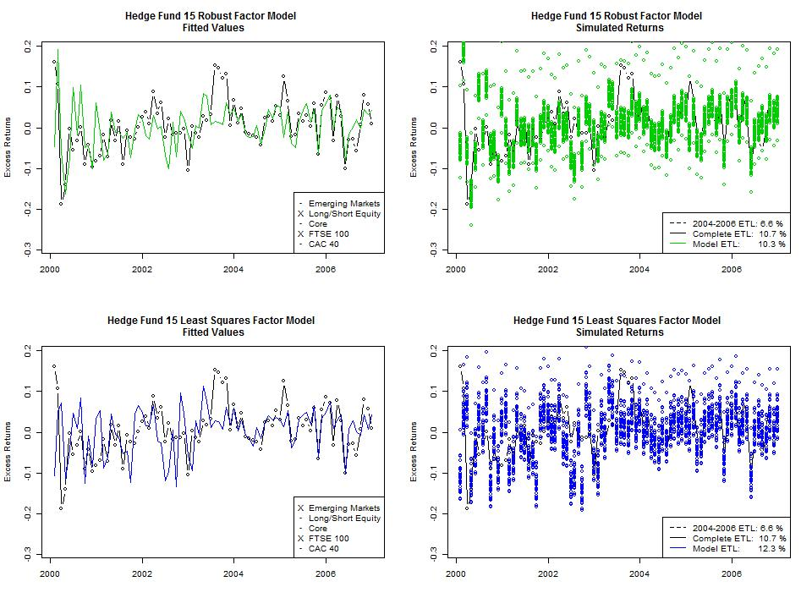

Slide 31
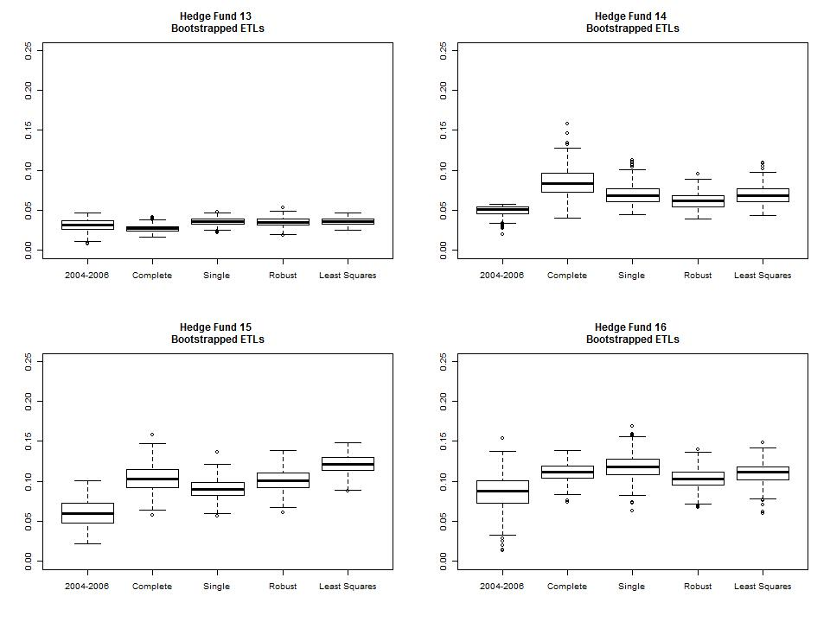

Slide 32
Model Comparisons Based on
Bootstrapped Mean ETL
Model | Average Absolute Difference | Average Standard Error
Complete | - | 1.53%
Truncated | 2.44% | 1.35%
Single Factor | 1.55% | 1.29%
Robust | 0.98% | 1.26%
Best Subset | 1.48% | 1.24%

Slide 33
5. MPT INERTIA
At 50+ years old why is it still the dominant paradigm?
Mathematically clean if no constraints (so what?)
Entrenched in MBA Investments 500 (see Bodie, Kane & Marcus)
Very costly for software vendors to change (R&D, education)
Markowitz knew better (SSD: but no nice math or easy compute)
The post-modern foundations are in place:
Artzner et. al. (1999) Coherent risk measures
Rockafellar and Uryasev (2000) Mean-ETL optimization
Considerable modern computing power
Superior performance examples But more are needed
It’s time to move on!

Slide 34
MS Degree and Two Affiliated Certificates
www.amath.washington.edu/studies/compfin
The Computational Finance Certificate

Slide 35
SAMPLE R CODE
MCETL and Implied Returns
mctr.etl = function(returns, wts, gamma)
{
returns.port = as.matrix(returns)%*%wts
mu.port = mean(returns.port)
VaR.port = quantile(returns.port, gamma)
index = which(returns.port <= VaR.port)
etl = -mean(returns.port[index])
mctr = -apply(returns[index,], 2, mean)
mu.imp = mu.port/etl*mctr
return(list(mctr = mctr, mu.imp = mu.imp))
}

Slide 36
Robust FM Fit: R package “robust”
library (robust)
model.data = as.data.frame(cbind(Returns,
Factors) )
mod = lmRob(Returns~., data = model.data)
#Stepwise selection
mod.step = step.lmRob(mod, trace = FALSE)
robust.coef= mod.step$coef
robust.resid = resid(mod.step)

Slide 37
Subset Model
library(glmnet)
mod = regsubsets(x=Factors,y=Returns, nvmax =
ncol(Factors))
subset = summary(mod)
best.mod = which(subset$bic == min(subset$bic))
subset.coef= as.vector(coef(mod,best.size))

Slide 38
Simulate returns
fitted = robust.coef%*%t(Factors.full)
#Factors.full is factor data for full time length
r.sim = rep(0, times = 84*36)
for(j in 1:84)
{
for(k in 1:36)
{
current = 36*(j-1) + k
r.sim[current] = fitted[j] + resid[k]
}
}

