Slide 1
Solutions from OneTick and R
Portfolio & Risk Analytics Business Cases
Maria Belianina, Ph.D.
Director, Pre-Sales Engineering Support

Slide 2
Contents
Data Management & Requirements for Portfolio & Risk Analytics
R and OneTick: Addressing the challenges
What is OneTick
R ↔ OneTick integration: 2 methods
Examples
Option pricing with OneTick and R RQuantLib functions
OneTick Value-At-Risk calculations → back to R
OneTick Portfolio Pricing → back to R

Slide 3
Portfolio & Risk Analytics
Data Requirements & Challenges:
Increasing data granularity
Daily to continuous intraday
Milli → Micro → Nano → Picoseconds…
Data cleansing challenges
Complexity of data and data consolidation
Consolidation across product types
Access to complex calculations
Increasing data volumes
Reference data (corporate actions, name changes, continuous contracts, etc)
Access to both High (e.g., Price) and Low (e.g., Volatility) frequency data
Security master maintenance
Database schema changes
… vs Consolidated Risk and Portfolio Analysis

Slide 4
R and OneTick: Addressing the challenges

Slide 5
What is OneTick: Business Cases
Our clients:
Business Cases:
Hedge Funds & Proprietary Trading Firms
Large Asset Managers
Banks / Brokers
Marketplaces
Technology & Information Providers
Backtesting & Quantitative Research
High frequency trading signal generation
Pre- & Post- Trade TCA
Backbone for Charting / Time and Sales
Compliance & Regulatory Reporting
Risk & Portfolio Analytics

Slide 6
What is OneTick: Overview
About data model:
Time series with customizable & flexible schema for any asset type
High and Low frequency
Reference data support (corp actions, continuous contracts, symbology, calendars, etc.)
About analytics:
Time series generic functions: Aggregation, filtering, signal generation, calculated fields, etc.
Time sensitive Joins & Merges across symbols, databases and tick types
Finance functions (order book snapshots and consolidation, statistics, pricing, portfolios)
Real-Time Feeds
OneTick Servers
Data collectors
In-memory intraday tick database[s]
Historical archives (file based, unlimited, distributed)
Analytical Engine for Historical, Intraday and CEP real-time queries. Extendable via: R, C++, C#, Java, Perl & Python
Consolidated (Reuters, Bloomberg, etc)
Exchanges
Custom feeds
Historical Data
Ascii
Proprietary binary
ODBC source
3rd party (NYSE TAQ, CME, etc)
Real-time Out-of-box or custom API
Batch Out-of-box or custom API

Slide 7
What is OneTick: Client Side
End Users & Client Apps:
OneTick GUI
Design & debug queries, view results, tune performance
Real-Time Feeds
OneTick Servers
Data collectors
In-memory intraday tick database[s]
Historical archives (file based, unlimited, distributed)
Analytical Engine for Historical, Intraday and CEP real-time queries. Extendable via: R, C++, C#, Java, Perl & Python
Consolidated (Reuters, Bloomberg, etc)
Exchanges
Custom feeds
OneTick API
C++, C#, Java, Perl, Python
Historical Data
R
MatLab
Ascii
Proprietary binary
ODBC source
3rd party (NYSE TAQ, CME, etc)
Excel
ODBC clients
Command Line Utility
Real-time Out-of-box or custom API
Batch Out-of-box or custom API
TCP/IP Real-time or on-demand

Slide 8
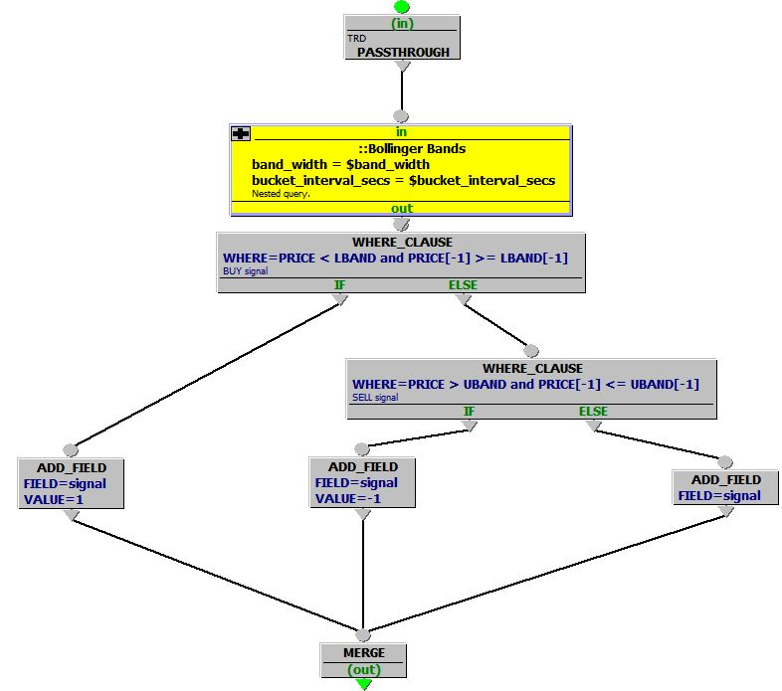
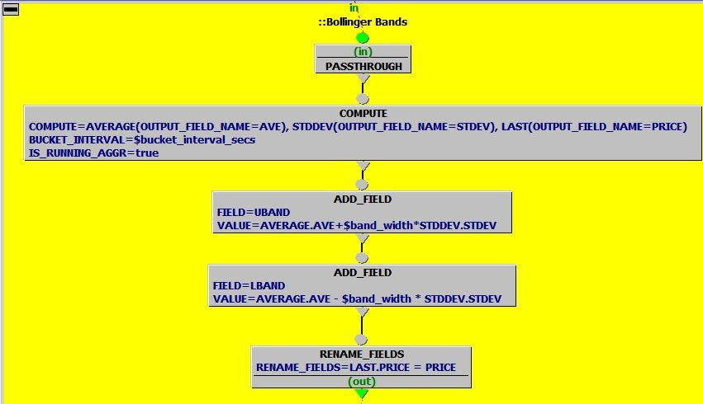
What is OneTick: GUI Analytics
Query Example: Bollinger Bands Buy/Sell Signals
A “Nested query” for Bollinger Bands calculations
NOTE: One of the nodes can be an R Event Processor calling R functions

Slide 9
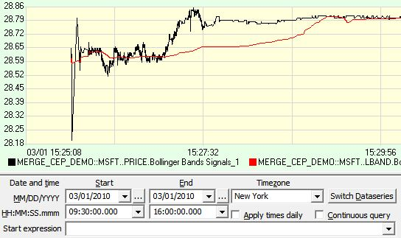
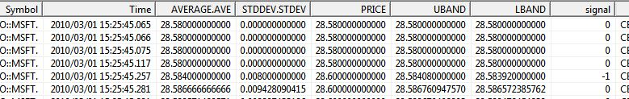
What is OneTick: View Results
Viewing Query Results in GUI: Bollinger Bands Buy/Sell Signals
NOTE: This query can be called from R
passing query output back to R vector

Slide 10
What is OneTick: Analytics + Financial Reference Data
Sample Functionality that can be* mixed with analytics:
Symbol Name History
Name changes
Continuous contracts
Symbology Mapping across databases (e.g., CUSIP to SEDOL)
Corporate Actions
Splits, dividends, etc
Continuous Contracts
E.g. query “ES**” futures as one contract: “ES”
Currency Conversion
With monthly, daily or intraday exchange rates
Market, Exchange & Symbol Calendars
* Note:
Market data is stored “as is”
Reference data is stored separately and can be applied as needed

Slide 11
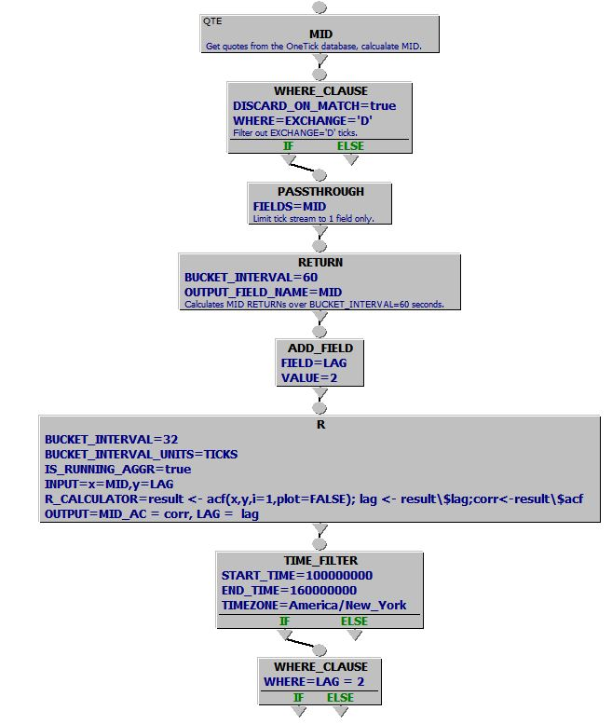
What is OneTick: GUI Analytics + R
Query Example: using R functions
Create running (a.k.a. sliding) aggregation of 32 ticks
Call R function acf(…) for each sliding group
Pass values of MID and LAG from tick fields or query parameters
Process the results of R function output

Slide 12
System Integration: OneTick and R
 | OneTick allows to: | R allows to:
If YOU work in R: | Store compressed fast access data Pre-process data: Normalize and clean Apply reference data Aggregate, intervalize, filter JOIN/MERGE trades vs order books, news, weather reports, etc. Set query parameters | Retrieve OneTick query output in R code via ODBC/OneTick SQL: Call tested OneTick query Pass parameters Process results in R as usual TIP: Limit amount of data processed within ODBC and R aggregating & filtering data in OneTick query
If YOU work in OneTick GUI: | [Above] + Call any number of OneTick or R functions Call separate R functions for a bucket entry or exit events Run historical or CEP queries View query results via GUI or API | Map OneTick fields to R input R scalar types or matrices Load required R libraries Specify R code to apply Specify OneTick aggregation parameters Map R output back to OneTick fields for further OneTick processing
TIP: Take full advantage of both packages.

Slide 13
OPTION PRICING in onetick with or without r functions
Example 1:

Slide 14
Example: Option Pricing in OneTick/R
Sample Business Case
Input:
OneTick archive or real-time market data for American equity options and underlying equities (optional)
Additional calculation parameters (e.g., underlyer volatility and interest rates) can be pre-calculated, pre-loaded from external sources or passed as query parameters
OneTick Query must produce
Option Values at a specified time interval (depends on the frequency of the available data)
Optional: Greeks
Optional: Apply corporate actions to the underlyers’ prices
Results
View in OneTick GUI in on-demand or continuous CEP mode
Bring back to R on demand for plotting and further processing

Slide 15
Example: Option Pricing in OneTick/R
Sample Business Case
Input:
OneTick archive or real-time market data for American equity options and underlying equities (optional)
Additional calculation parameters (e.g., underlyer volatility and interest rates) can be pre-calculated, pre-loaded from external sources or passed as query parameters
OneTick Query must produce
Option Values at a specified time interval (depends on the frequency of the available data)
Optional: Greeks
Optional: Apply corporate actions to the underlyers’ prices
Results
View in OneTick GUI in on-demand or continuous CEP mode
Bring back to R on demand for plotting and further processing
2 sample out-of-box solutions within OneTick query design:
Using OneTick OPTION_PRICE function
Using OneTick R function to call RQuantLib library, function AmericanOption

Slide 16
Example: Option Pricing in OneTick/R
OneTick Prep Steps Include:
Retrieve a list of underlying equities (csv, ODBC, OneTick archive or via GUI, other)
Retrieve, calculate or pass equity volatility as a parameter
Retrieve a list of options for the above Optional: Filter by the specified maturity and other parameters
Make sure each tick contains all the required attributes
Call OneTick R function (a.k.a. Event Processor)
Initialize RQuantLib library
Call AmericanOption function
Process R output

Slide 17
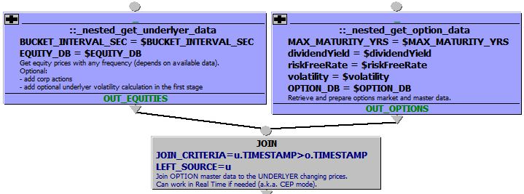
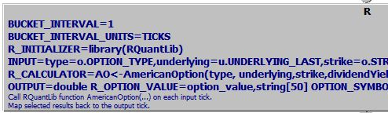
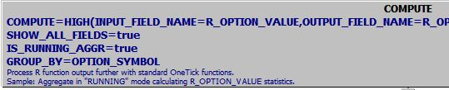
OneTick Sample Query Graph Design
Retrieve corresponding option master data and prices
OT Archive or CEP Engine
Retrieve equity prices
Tick Processing
JOIN equity and option data for each equity symbol
Call R code with R Event Processor
to calculate each option value
for the specified bucket interval
Calculate statistics based on R_OPTION_VALUEs
In “running” mode, re-calculating on each R output tick

Slide 18
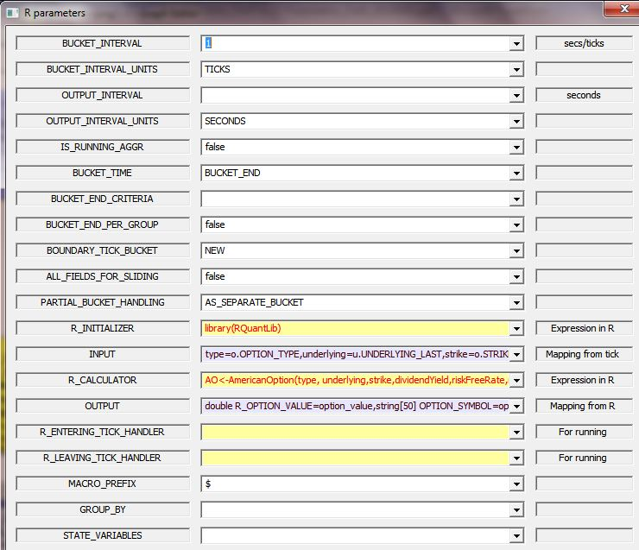
OneTick Sample Query: Calling R functions
Bucket interval aggregation for passing ticks to R
R call parameters: mapping fields, R code and special instructions

Slide 19
R Functions in OneTick: Parameters
2 subsets of parameters that work together:
OneTick aggregation | R function specifications
BUCKET_INTERVAL, UNITS and optional GROUP_BY to aggregate ticks into buckets | R_INITIALIZER to specify one time only initial command R_MACRO_PREFIX for naming
OUTPUT_INTERVAL and UNITS to define frequency of output for running calculations | INPUT, OUTPUT, R_CALCULATOR to map tick fields to R variables and specify R command. Note: A combination of BUCKET_INTERVAL and INPUT can be used to pass matrices into R
IS_RUNNING = true/false for running (a.k.a. sliding) calculations | R_ENTERING/LEAVING_ TICK_HANDLER to call different functions for BUCKET_INTERVAL entry and exit events in RUNNING aggregations
Other parameters for additional flexibility with aggregation

Slide 20

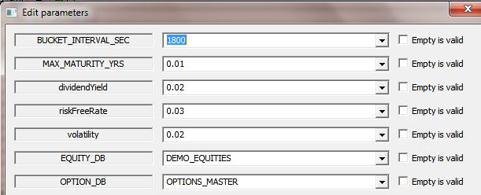
OneTick Sample Query: GUI Output
Query parameters (passed from GUI or any calling application):
Standard
Custom for each query
View results in OneTick GUI grid, debugger, profiler or chart:

Slide 21
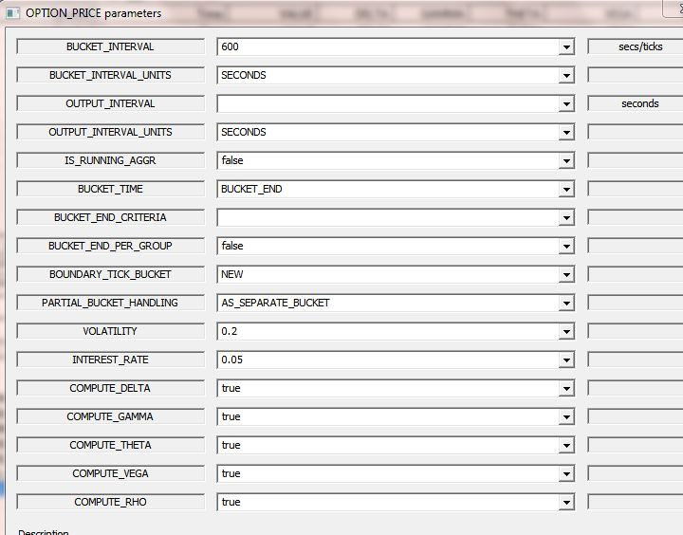
An alternative: OneTick OPTION_PRICE function
Description:
For each bucket, computes call/put option price and related Greeks based on the Black-Scholes option pricing model.
Bucket interval aggregation for passing ticks to R

Slide 22
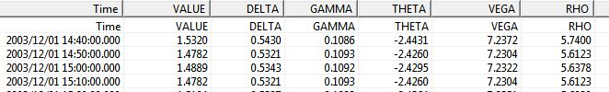
An alternative: OneTick OPTION_PRICE function
DESIGN STEPS:
Retrieve option info
Retrieve underlyer PRICE
Use OPTION_PRICE event processor
View results in OneTick GUI grid, debugger, profiler or chart:

Slide 23
- value-at-risk in onetick - Results → back to r
Example 2:

Slide 24
Example : Historical VAR in OneTick
Sample Business Case
Input:
Equity portfolio composition (from csv, ODBC or OneTick)
Historical daily prices for all portfolio constituents for the specified number of days (preferably 500+)
OneTick Query must produce For the past X days and Percent P
Historical Value-At-Risk 1-day values
Historical Value-At-Risk N-day values
Results → Back to R on demand for plotting and further processing

Slide 25
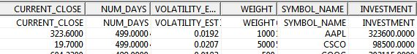
OneTick Sample Query Graph Design
Prep Steps – Query 1:
Get portfolio & calculate estimated volatility
This query is executed as an input to the main query
Notes:
We’re using definition of the daily volatility described by J.C.Hall in “Options, Futures and Other Derivatives”:
Daily Volatility = Standard Deviation ( Price Percentage Change in 1 Day )
Using OneTick:
Price Percentage Change in 1 day: PERC_CHANGE = (CLOSE-CLOSE[-1])/CLOSE[-1] where LAST is the closing PRICE for the trading day, and [-1] refers to the previous CLOSE tick
ESTIMATED_VOLATILITY = STDDEV(PERC_CHANGE) over a period of time specified as STDDEV aggregation function bucket interval

Slide 26
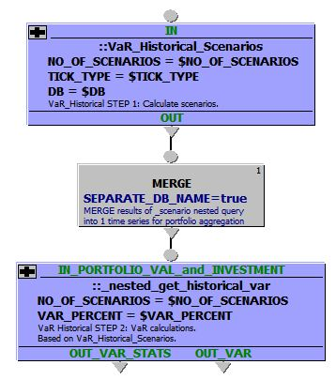
OneTick Sample Query Graph Design
Prep Steps – Query 1:
Get portfolio & calculate estimated volatility
Query 2
For each security from the list above
Retrieve daily or high frequency data
Calculate significant number of loss scenarios
MERGE all calculated timeseries for all securities into 1 for further portfolio level calculations
Calculate and rank portfolio LOSSES across scenarios
Calculate Value-At-Risk and Expected Shortfall

Slide 27
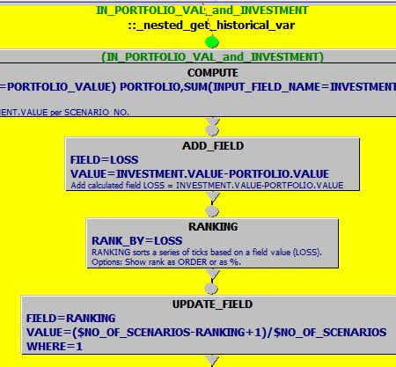
OneTick Sample Query: Nesting and Ranking
Prep Steps – Query 1:
Get portfolio & calculate estimated volatility
Nested Query: Use of aggregation and ranking
Query 2
Aggregate to get PORTFOLIO VALUE and INVESTMENT
Calculate LOSS
Rank ticks by LOSS
For each security from the list above
Retrieve daily or high frequency data
Calculate significant number of loss scenarios
MERGE all calculated timeseries for all securities into 1 for further portfolio level calculations
…

Slide 28
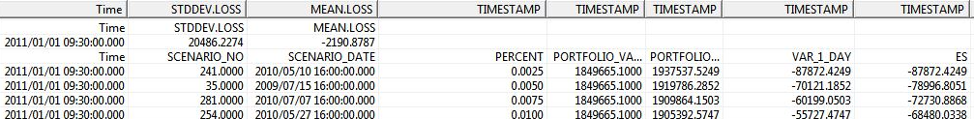
OneTick Sample Query Graph Output in GUI
Prep Steps – Query 1:
Get portfolio & calculate estimated volatility
Query 2
For each security from the list above
Retrieve market data
Calculate $NO_OF_SCENARIOS scenarios
Can use daily or high frequency data as a start
MERGE all calculated timeseries for all securities into 1 for further portfolio level calculations
Calculate and rank portfolio LOSSES across scenarios
Calculate Value-At-Risk and Expected Shortfall
Results: Summary and Detail
OneTick GUI Grid Output

Slide 29
OneTick Historical VaR Results Back to R
library(RODBC)
# Define function to create
# OneTick SQL string
omdBuildSQLQuery <- function(otq, start_time, end_time, tz, ...){
start_time_tz <- paste(start_time, tz)
end_time_tz <- paste(end_time, tz)
sql <- paste("SELECT * FROM OMD.OTQ_FILES.\"", otq, "\" otq ", sep="")
sql <- paste(sql, "WHERE ", sep="")
sql <- paste(sql, "(otq.TIMESTAMP>='", start_time_tz, "') ", sep="")
sql <- paste(sql, "AND (otq.TIMESTAMP<'", end_time_tz, "') ", sep="")
parms<-list(...)
for(n in attributes(parms)$names) {
sql <- paste(sql, "AND (param_assign('", n, "','", parms[[n]], "')=1) ", sep="")
}
# Open ODBC channel to connect to OneTick server[s]
channel <- odbcConnect("OMD_LOCAL_DSN")
# Call OneTick query VaR_Historical_ saved in the query file var_model_running.otq:
sql<-omdBuildSQLQuery("var_model_running::VaR_Historical_",
"2009-01-01 09:30:00",
"2011-01-01 09:30:00",
"EST5EDT"
); sql
results<-sqlQuery(channel, sql); results
Sample Code: R 2.10.1
Load RODBC library
Create an R function similar to omdBuildSQLQuery to build OneTick SQL string with parameters
Connect to OneTick & pass SQL
Get query results
Process as usual

Slide 30
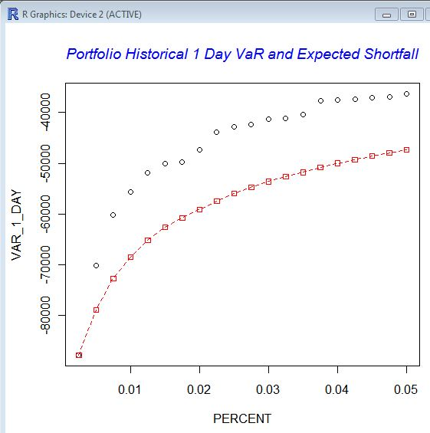
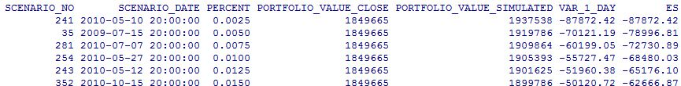
OneTick Historical VaR Results Back to R
…..
# Open ODBC channel to connect to OneTick server[s]
channel <- odbcConnect("OMD_LOCAL_DSN")
# Call OneTick query VaR_Historical_ saved in the query file var_model_running.otq:
sql<-omdBuildSQLQuery("var_model_running::VaR_Historical_",
"2009-01-01 09:30:00",
"2011-01-01 09:30:00",
"EST5EDT"
); sql
results<-sqlQuery(channel, sql); results
# Plot the results:
plot(results[, c("PERCENT","VAR_1_DAY")])
title(main="Portfolio Historical 1 Day VaR and Expected Shortfall", col.main="blue", font.main=3)
lines(results[, c("PERCENT","ES")], type="o", pch=22, lty=2, col="red")

Slide 31
Q&A
Notes:
All query samples are available on demand and for demos
VaR samples are for discussion only and are based on the calculations described in “Options, Futures and Other Derivatives” by J.C.Hull
Contacts:
maria.belianina@onetick.com
david.wilson@onetick.com
support@onetick.com

Slide 32
Additional details and Examples
Appendix:

Slide 33
OneTick / R Integration - Method 1: OneTick Query Results Back to R
Prerequisites: OneTick client setup
Connection: OneTick ODBC Driver
Syntaxes: OneTick SQL (based on SQL)
OneTick Query prep steps:
Design query graph with OneTick GUI
Create query parameters to be passed from R
Test and save the query
Results:
R vector
Retrieved via OneTick ODBC + OneTick SQL call with parameters

Slide 34
OneTick / R Integration - Method 2: R Functions in OneTick Queries
Prerequisites:
R or REvolution R installation on the OneTick server (depends on OS)
Connection: Using standard R DLL
Syntaxes: OneTick GUI analytics and R expressions
Input:
OneTick Archive, intraday or real-time tick timeseries from a single or multiple data sources
Additional external data sources retrieved by OneTick
Query parameters
Output:
OneTick query results (timeseries defined by the query analytics)
Query Types:
Historical on-demand or continuous CEP

Slide 35
- Portfolio pricing in onetick - Results → back to r
Example 3:

Slide 36
Portfolio Pricing in OneTick
Sample Business Case
Input:
Portfolio or Portfolio of Portfolios composition source (CSV, ODBC source or OneTick database); can include weight, side and any other attributes
Market data
OneTick Query must produce Portfolio Prices:
Long, Short and Total side by side
At a specified interval
Optional: With corporate actions applied to prices
Optional: In specified currency
Results → Back to R on demand for plotting and further processing

Slide 37
Portfolio Pricing in OneTick: Sample Input
#SYMBOL_NAME,WEIGHT
A,400
CSCO,-500
GS,600
IBM,-700
MSFT,-900

Slide 38
Portfolio Pricing in OneTick: Design
OneTick portfolio related aggregation event processors: PORTFOLIO_PRICE and MULTI_PORTFOLIO_PRICE
OneTick Query Design Steps:
Specify portfolio
Retrieve prices
Apply CORP_ACTIONS (make sure the corresponding reference data is loaded)
Use PORTFOLIO_PRICE event processor or Use COMPUTE “meta-aggregation” event processor to compute side by side:
LONG PORTFOLIO_PRICE
SHORT PORTFOLIO_PRICE
2-SIDED PORTFOLIO_PRICE
Bring results back to R

Slide 39
Q&A
Notes:
All query samples are available on demand and for demos
VaR samples are for discussion only and are based on the calculations described in “Options, Futures and Other Derivatives” by J.C.Hull
Contacts:
maria.belianina@onetick.com
david.wilson@onetick.com
support@onetick.com

