Slide 1
A Bayesian Interpretation of the Federal Reserve’s dual mandate and the Taylor Rule R/Finance 2013 The research views expressed herein are those of the author and do not necessarily represent the views of the CME Group or its affiliates. All examples in this presentation are hypothetical interpretations of situations and are used for explanation purposes only. This report and the information herein should not be considered investment advice or the results of actual market experience.
Samantha Azzarello
Economist, CME Group
May 2013

Slide 2
Risk Disclosures
Futures trading is not suitable for all investors, and involves the risk of loss. Futures are a leveraged investment, and because only a percentage of a contract’s value is required to trade, it is possible to lose more than the amount of money deposited for a futures position. Therefore, traders should only use funds that they can afford to lose without affecting their lifestyles. And only a portion of those funds should be devoted to any one trade because they cannot expect to profit on every trade.
The Globe Logo, CME®, Chicago Mercantile Exchange®, and Globex® are trademarks of Chicago Mercantile Exchange Inc. CBOT® and the Chicago Board of Trade® are trademarks of the Board of Trade of the City of Chicago. NYMEX, New York Mercantile Exchange, and ClearPort are trademarks of New York Mercantile Exchange, Inc. COMEX is a trademark of Commodity Exchange, Inc. CME Group is a trademark of CME Group Inc. All other trademarks are the property of their respective owners.
The information within this presentation has been compiled by CME Group for general purposes only. CME Group assumes no responsibility for any errors or omissions. Although every attempt has been made to ensure the accuracy of the information within this presentation, CME Group assumes no responsibility for any errors or omissions. Additionally, all examples in this presentation are hypothetical situations, used for explanation purposes only, and should not be considered investment advice or the results of actual market experience.
All matters pertaining to rules and specifications herein are made subject to and are superseded by official CME, CBOT, NYMEX and CME Group rules. Current rules should be consulted in all cases concerning contract specifications.

Slide 3
Outline
Objective
Taylor Rule
Econometrics – Why Bayesian Statistics?
Model
Other Applications

Slide 4
Contribution
To look at the Fed’s interest rate policy through the lens of the Taylor Rule.
Using a Dynamic Linear model with Bayesian Inference to update parameters over time.
Using only the information available to the Fed at each point in time.

Slide 5
Original Taylor Rule
Analyzes interest rate policy in the context of the Fed’s Dual Mandate:
Promoting price stability and encouraging full employment
Target Federal Funds Rate =
Actual Inflation Rate
- Short-Term Real Rate Assumption
+ 0.5 X (Actual Inflation – Desired Inflation)
+ 0.5 X (Output Gap in Percent)

Slide 6
Relative Influence of Inflation and Economic Growth
Adjusted Level of Federal Funds Rate =
+ β0 x Constant
+ β1 x (Inflation – Desired Inflation)
+ β2 x (Output Gap)
Broke down analysis into the Inflation and Output components
Are estimated β1and β2 stable over time?
Close to their expected values of 0.5 given the Taylor Rule?

Slide 7
Federal Reserve Policy Original Taylor Rule and Level of FFR

Slide 8
Estimated Beta Coefficient for the Target Rate Given by the Taylor Rule

Slide 9
Taylor Rule Adherence Analyzed by Components

Slide 10
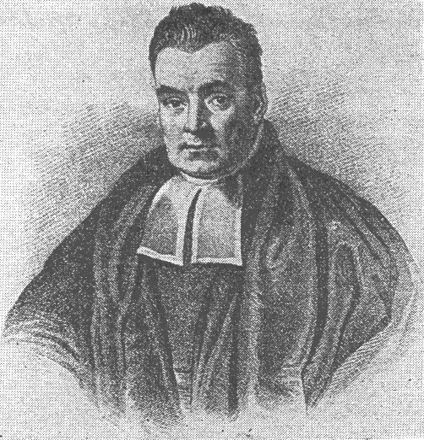
Why Bayes? Thought process is the same as in finance.
Develop a hypothesis based on available information/theories and assess one’s confidence.
Receive new information, evaluate errors in terms of previous hypothesis, then develop new hypothesis and new confidence assessment.
Photo Source: Public (Unknown)
10

Slide 11
Motivation Dynamic Linear Model
Dynamic allows time varying parameter estimates.
Sequential analysis allows for updating of estimates as new observations are observed.
Compare:
OLS - One set of Beta Estimates for whole time period.
DLM – Impact of variable X on Y can change and vary over time. DLM estimates capture this change.
Modified Kalman Filter
Notes:
-assume Normal distr of parameters, which is a fair assumption

Slide 12
Classical vs. Bayesian Statistics How uncertainty is treated
Classical:
Uncertainty about quantities or parameters estimated is captured by looking at how estimates would change in repeated sampling from the same population.
Bayesian:
Uncertainty is addressed by updating prior opinions about quantities and parameters estimated as new data is observed.

Slide 13
Bayesian Analysis
PRIOR x LIKELIHOOD → POSTERIOR
Prior – Initial probability distribution of parameters
Likelihood – Joint probability of observing the data given the parameters estimated
Posterior - Probability of parameters given the data
The process of moving from Prior to Posterior is called Bayesian Learning

Slide 14
Priors
Non-informative Priors:
Variance of 10,000 and mean of 0
Reflection of lack of knowledge
Informative Priors:
Controversy regarding use and variability of results

Slide 15
DLM Equations
The DLM is a two equation system estimated as:
Observation Equation
Y_{t}=(F_{t})’ β_{t} + v_{t} v_{t} ~ N[0,V_{t}]
Where F are the explanatory factors and β are the Beta parameter estimates
State Equation
β_{t} =G_{t} β_{t-1} + w_{t} w_{t} ~N[0,W_{t}]
Governs the path of Beta Estimates changing over time

Slide 16
DLM Iteration Steps
1. Posterior at t-1 (β_{t-1}|D_{t-1})~N[m_{t-1},C_{t-1}]
2. Prior at t (β_{t}|D_{t-1})~N[a_{t},R_{t}]
3. Next-step ahead forecast (Y_{t}|D_{t-1})~N[f_{t},Q_{t}]
4. Posterior at t (β_{t}|D_{t})~N[m_{t},C_{t}]

Slide 17
DLM Output
Update the Distribution of parameters, and hence update the 2 moments which characterize each distribution.
From the Posterior Distribution at time t:
Mean → Beta Coefficient
Standard Deviation → Standard Error

Slide 18
Applications
Federal Reserve Policy
Natural Gas Price and Power Price
GDP Forecasting
Trade Volume Models

Slide 19
References
Harrison, J. & West,M. (1997). Bayesian Forecasting and Dynamic Models. New York: Springer-Verlag.
Harrison, J., Pole, A., & West,M. (1994). Applied Bayesian Forecasting and time series analysis. New York: Chapman and Hall.
Orphanides, A. (2003). Historical monetary policy analysis and the Taylor Rule. Journal of Monetary Economics, 50(5), 983-1022.
Putnam, B. & Azzarello, S. (2012). A Bayesian interpretation of the Federal Reserve’s dual mandate and the Taylor Rule. Review of Financial Economics, 21, 111-119.
Taylor, J. (1993b). The use of new macroeconometrics for policy formation. American Economic Review, Papers and Proceedings, 83(2), (300-305).

Slide 20
A Bayesian Interpretation of the Federal Reserve’s dual mandate and the Taylor Rule R/Finance 2013 The research views expressed herein are those of the author and do not necessarily represent the views of the CME Group or its affiliates. All examples in this presentation are hypothetical interpretations of situations and are used for explanation purposes only. This report and the information herein should not be considered investment advice or the results of actual market experience.
Samantha Azzarello
Economist, CME Group
May 2013

