Slide 1

Predicting Exchange Rates Out of Sample:
Can Economic Fundamentals Beat the Random Walk?
Jiahan Li
Assistant professor of Statistics
University of Notre Dame
Joint work with Wei Wang and Ilias Tsiakas
R/Finance 2013

Slide 2

Asset price and economic Fundamentals
Asset Prices
Economic Fundamentals
Photo: http://oneinabillionblog.com/tag/green-economy/

Slide 3

Bond price and Economic Fundamentals
Mönch, E. (2008). Forecasting the yield curve in a data-rich environment: A no-arbitrage factor-augmented VAR approach. Journal of Econometrics, 146(1), 26-43.
Economic fundamentals can predict yield curve.
Economic fundamentals: more than 100 economic indicators, including industrial production, CPI, money supply, employment rate, …
Method:
No-arbitrage restrictions
PCA
VAR
All data
Factors
Short-term yield
Long- term yield

Slide 4
Stock price and Economic Fundamentals
Rapach, D. E., Strauss, J. K., & Zhou, G. (2010). Out-of-sample equity premium prediction: Combination forecasts and links to the real economy. Review of Financial Studies, 23(2), 821-862.
Economic fundamentals can predict S&P500.
Economic fundamentals: short-term yield, long-term yield, term spread, default spread, inflation, consumption/wealth, …
Method: combined forecasts.

Slide 5
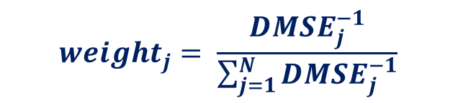
Combined forecasts
K predictive models give K forecasts.
Option 1 (simple combination): take the mean, median, or trimmed mean
Option 2: take their weighted average, with the weights being determined by the past performance of individual models, or Discounted Mean Squared Error (DMSE).
Benchmark: historical average (random model) by Campbell and Thompson, RFS, 2007.
$$weight_{j}= \frac{DMSE_{j}^{−1}}{\sum_{j=1}^{N}{DMSE_{j}^{−1}}}$$

Slide 6
Rapach, Strauss, and Zhou(2010)
Combined forecasts | Out-of-sample R-squared (%)
Mean | 3.58 **
Median | 3.04 **
Trimmed mean | 3.51 **
DMSE, θ=0.1 | 3.54 **
DMSE, θ=0.9 | 3.49 **
Model | Out-of-sample R-squared (%)
Dividend/price | 0.34
Dividend/lagged price | 0.26
Earnings/price | 0.36
Dividend/earnings | -1.42
Variance (daily) | -12.97
Book/market | -2.6
Net equity issuance | -0.91
Short-term yield | -2.78
Long-term yield | -3.09
Long-term bond return | 0.33
Term spread | -2.96
Default spread | -2.72
Default spread of returns | -1.1
Inflation | -0.84
Consumption/wealth | 1.44 *
DMSE: This forecasts combination is based on individual models’ past performance, measured by Discounted Mean Squared Error (DMSE). θ is the discounting factor.
Benchmark: random walk

Slide 7

Whether economic fundamentals can predict other asset prices?
(Photo: Guy Parsons)
Look abroad

Slide 8
Foreign exchange rates and Economic Fundamentals - Outline
Economic fundamentals
Forecasting method:
Individual models
“Kitchen-sink” model
Combined forecasts
Efficient “kitchen-sink” model
Predictability evaluation:
Statistical predictability
Portfolio returns

Slide 9

Economic fundamentals
Random Walk (RW): x_{t} = 0
r_{t+1} = α + e_{t+1}
$\hat{r}$_{t+1} = $\hat{α}$ = historical average

Slide 10
Economic fundamentals
Random Walk (RW): x_{t} = 0
Uncovered Interest Parity (UIP):
x_{t} = x_{1t} = Δ (interest rate)_{t}
The difference in interest rates between two countries is equal to the expected change in exchange rates between the countries' currencies.
Otherwise, arbitrage opportunity exists.
Most studies indicate the violation of this condition.
Carry trade strategy.

Slide 11
Economic fundamentals
Random Walk (RW): x_{t} = 0
Uncovered Interest Parity (UIP):
x_{t} = x_{1t} = Δ (interest rate)_{t}
Purchasing Power Parity (PPP):
x_{t} = x_{2t} = Δ (price level)_{t} – s_{t}
law of one price.
identical goods will have the same price in different markets.

Slide 12



Slide 13
Economic fundamentals
Random Walk (RW): x_{t} = 0
Uncovered Interest Parity (UIP):
x_{t} = x_{1t} = Δ (interest rate)_{t}
Purchasing Power Parity (PPP):
x_{t} = x_{2t} = Δ (price level)_{t} – s_{t}
Monetary Fundamentals (MF):
x_{t} = x_{3t} = Δ (money supply)_{t} – Δ (national income)_{t} – s_{t}
Taylor Rule (TR):
x_{t} = x_{4t} = 1.5 Δ (inflation)_{t} +0.1 Δ (output gap)_{t}
– 0.1 Δ (price level)_{t} – 0.1s_{t}

Slide 14
Model, Return and Econ Fundamentals
P_{t} : nominal exchange rate (domestic price of 1 foreign currency unit)
r_{t+1} = log(P_{t+1}) - log(P_{t}) is the foreign exchange rate return
Different models have different predictor, x_{t}, in the predictive regression
r_{t+1} = α + β x_{t} + e_{t+1}
Economic fundamentals: x_{t}

Slide 15
Foreign exchange rates and Economic Fundamentals - method
Individual models: r_{t+1} = α + β x_{t} + e_{t+1}
“Kitchen sink” regression: include x_{1t} , x_{2t} , x_{3t} , x_{4t} in a multiple regression
Combined forecasts: generate forecasts from individual models.
Simple combined forecasts: take the mean, median, or trimmed mean
Take their weighted average, with the weights are determined by the past performance of individual models (DMSE).

Slide 16
Data
Monthly FX data ranging from January 1976 to June 2012 (~ 35 years).
The 10 most liquid (G10) currencies in the world:
9 exchange rates.
Australian dollar
Canadian dollar
Swiss franc
Deutsche mark
British pound
Japanese yen
Norwegian kroner
New Zealand dollar
Swedish kronor
US dollar

Slide 17
Out-of-sample forecasts
Estimation window
Out-of-sample evaluation period
Jan 1976
Jan 1986
Jun 2012
The first FX return to be predicted is in January 1986 (using a 10 year estimation window)
Keep updating estimation window.

Slide 18
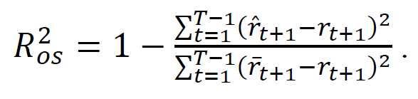
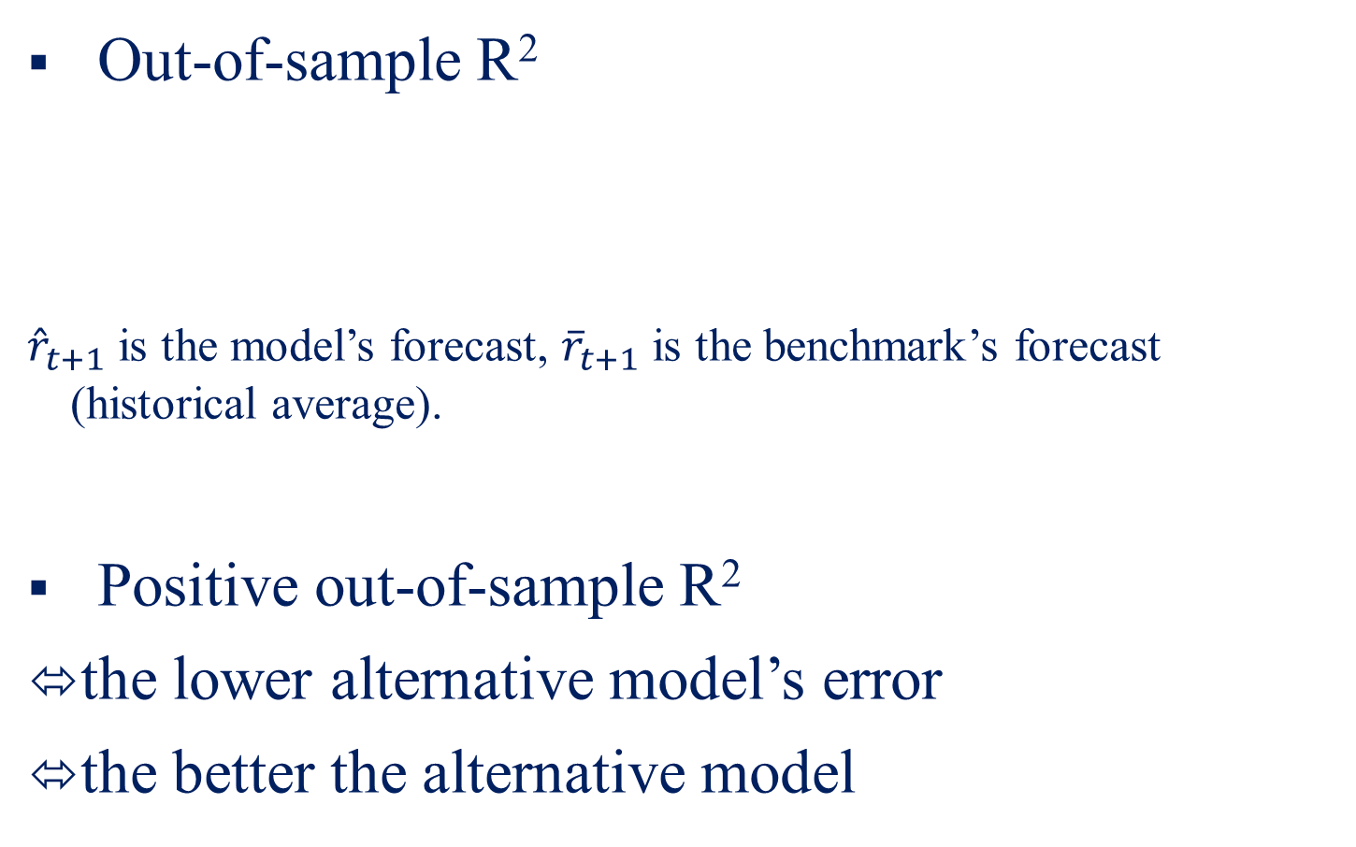
Statistical evaluation
Out-of-sample R²
${\hat{r}}_{t+1}$ is the model’s forecast, ${\overline{r}}_{t+1}$ is the benchmark’s forecast (historical average).
Positive out-of-sample R²
the lower alternative model’s error
the better the alternative model

Slide 19
Out-of-sample R square (benchmark: random walk)
 | AUD | CAD | CHF | EUR | GBP | JPY | NOK | NZD | SEK
Combined - DMSE(0.9) | -0.068 | 0.060 | 0.468 | -0.591 | 0.028 | 0.990 | -0.392 | -0.023 | -1.010
Combined - DMSE(1.0) | -0.403 | -0.196 | 0.605 | -0.429 | 0.244 | 0.777 | -0.495 | -0.137 | -0.915
Combined - Mean | -0.382 | -0.245 | 0.615 | -0.414 | 0.181 | 0.795 | -0.468 | -0.110 | -0.938
Combined - Median | -0.195 | 0.071 | -0.613 | -0.535 | -0.370 | 0.563 | -0.738 | 0.702 | -0.108
Uncovered interest rate parity | -0.968 | 0.528 | -1.806 | -3.337 | -3.387 | -0.417 | -2.736 | -0.851 | -6.376
Purchasing power parity | -1.831 | -1.308 | -0.964 | -1.380 | 0.490 | -0.110 | -1.336 | -1.550 | -0.443
Taylor rule | -1.553 | -2.115 | -2.385 | -2.134 | -2.959 | -1.019 | -1.745 | -0.543 | -1.671
Monetary fundamentals | -1.879 | -1.643 | -0.513 | -2.751 | -0.881 | -1.487 | -2.639 | -1.809 | -0.496
"Kitchen sink" | -11.226 | -13.052 | -15.918 | -22.587 | -9.579 | -18.812 | -14.267 | -22.109 | -16.433

Slide 20
Economic evaluation
Mean-variance strategy
Mean-variance strategy: target volatility (annualized) = 10%
Covariance estimates: sample covariance
We also implement 1/N strategy and momentum strategy
9 return forecasts
1 portfolio return
Mean-variance strategy
Predictive regression

Slide 21
Sharpe Ratio
 | Mean (%) | Volatility (%) | Sharpe Ratio | Performance Fee (bps)
Combined - DMSE(0.9) (the best one) | 11.083 | 12.761 | 0.498 | 71
Uncovered interest rate parity | 9.597 | 12.521 | 0.389 | -134
Purchasing power parity | 8.886 | 12.500 | 0.333 | -282
Taylor rule | 8.226 | 11.685 | 0.300 | -196
Monetary fundamentals | 9.851 | 12.328 | 0.416 | -102
"Kitchen sink" | 8.553 | 11.537 | 0.332 | -224
Random walk | 11.039 | 12.770 | 0.494
1/N strategy | 6.653 | 7.111 | 0.271 | -177
Momentum strategy | 6.867 | 7.897 | 0.271 | -177

Slide 22
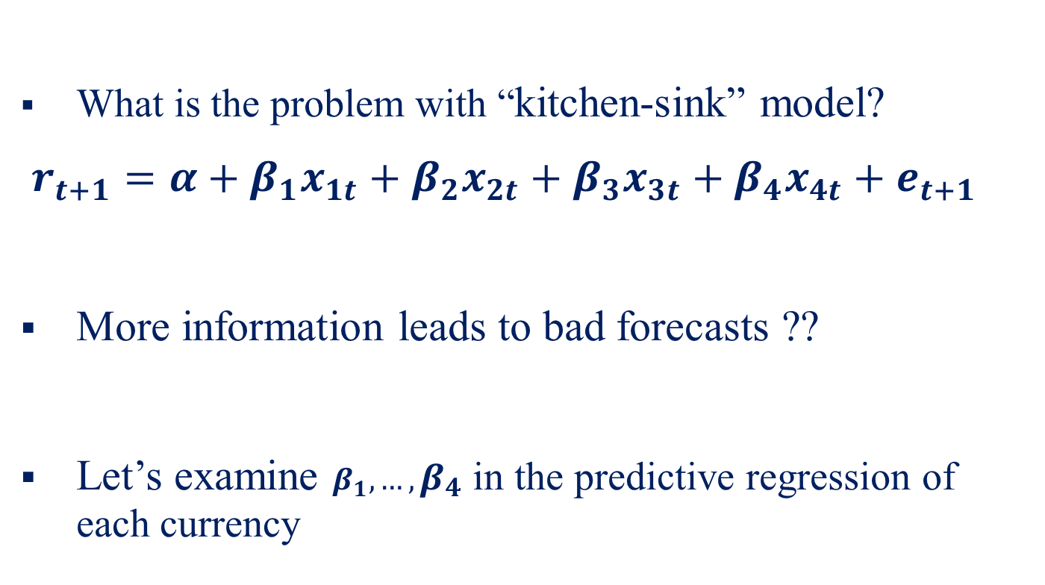
“Efficient kitchen-sink” model
What is the problem with “kitchen-sink” model?
$r_{t+1}=α+β_{1}x_{1t}+β_{2}x_{2t}+β_{3}x_{3t}+β_{4}x_{4t}+e_{t+1}$
More information leads to bad forecasts ??
Let’s examine $β_{1},…,β_{4}$ in the predictive regression of each currency

Slide 24
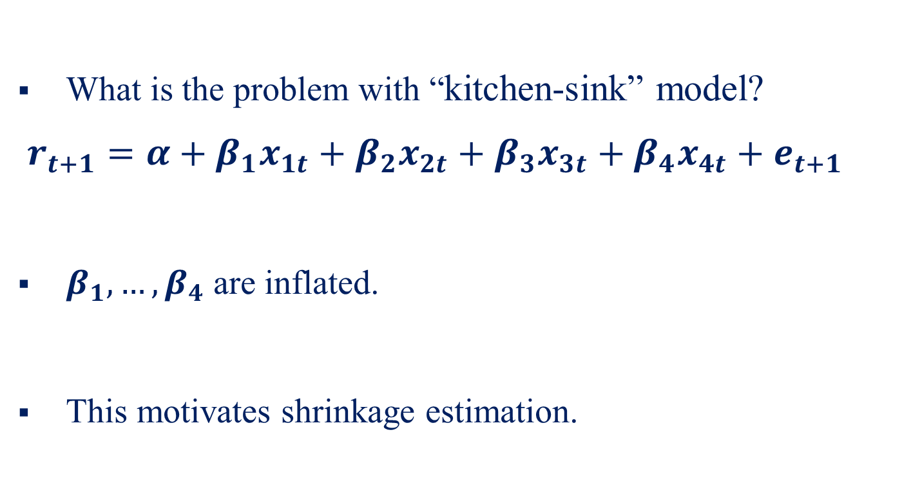
“Efficient kitchen-sink” model
What is the problem with “kitchen-sink” model?
$r_{t+1}=α+β_{1}x_{1t}+β_{2}x_{2t}+β_{3}x_{3t}+β_{4}x_{4t}+e_{t+1}$
$β_{1},…,β_{4}$ are inflated.
This motivates shrinkage estimation.

Slide 25
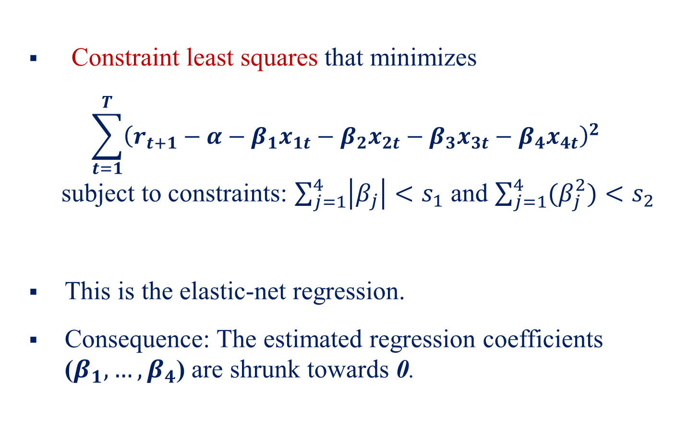
“Efficient kitchen-sink” model
Constraint least squares that minimizes
$$\sum_{t=1}^{T}{{\left(r_{t+1}−α−β_{1}x_{1t}−β_{2}x_{2t}−β_{3}x_{3t}−β_{4}x_{4t}\right)}^{2} }$$
subject to constraints: $\sum_{j=1}^{4}{\left|β_{j}\right|<s_{1}}$ and $\sum_{j=1}^{4}{(β_{j}^{2})<s_{2}}$
This is the elastic-net regression.
Consequence: The estimated regression coefficients ($β_{1},…,β_{4}$) are shrunk towards 0.

Slide 26
“Efficient kitchen-sink” model
More robust and stable compared to traditional ones
Forecasting error-oriented procedure
Linear model – consistent with many empirical models in economics and finance

Slide 28
Out-of-sample R square (benchmark: random walk)
 | AUD | CAD | CHF | EUR | GBP | JPY | NOK | NZD | SEK
Efficient "Kitchen sink" | 1.502 | 1.409 | 0.329 | 1.028 | 1.441 | 0.056 | 1.503 | 1.336 | 1.829
Combined - DMSE(0.9) | -0.068 | 0.060 | 0.468 | -0.591 | 0.028 | 0.990 | -0.392 | -0.023 | -1.010
Combined - DMSE(1.0) | -0.403 | -0.196 | 0.605 | -0.429 | 0.244 | 0.777 | -0.495 | -0.137 | -0.915
Combined - Mean | -0.382 | -0.245 | 0.615 | -0.414 | 0.181 | 0.795 | -0.468 | -0.110 | -0.938
Combined - Median | -0.195 | 0.071 | -0.613 | -0.535 | -0.370 | 0.563 | -0.738 | 0.702 | -0.108
Uncovered interest rate parity | -0.968 | 0.528 | -1.806 | -3.337 | -3.387 | -0.417 | -2.736 | -0.851 | -6.376
Purchasing power parity | -1.831 | -1.308 | -0.964 | -1.380 | 0.490 | -0.110 | -1.336 | -1.550 | -0.443
Taylor rule | -1.553 | -2.115 | -2.385 | -2.134 | -2.959 | -1.019 | -1.745 | -0.543 | -1.671
Monetary fundamentals | -1.879 | -1.643 | -0.513 | -2.751 | -0.881 | -1.487 | -2.639 | -1.809 | -0.496
"Kitchen sink" | -11.226 | -13.052 | -15.918 | -22.587 | -9.579 | -18.812 | -14.267 | -22.109 | -16.433

Slide 29
Sharpe Ratio
 | Mean (%) | Volatility (%) | Sharpe Ratio | Performance Fee (bps)
Efficient "Kitchen sink" | 15.527 | 12.455 | 0.867 | 546
Combined - DMSE(0.9) (the best one) | 11.083 | 12.761 | 0.498 | 71
Uncovered interest rate parity | 9.597 | 12.521 | 0.389 | -134
Purchasing power parity | 8.886 | 12.500 | 0.333 | -282
Taylor rule | 8.226 | 11.685 | 0.300 | -196
Monetary fundamentals | 9.851 | 12.328 | 0.416 | -102
"Kitchen sink" | 8.553 | 11.537 | 0.332 | -224
Random walk | 11.039 | 12.770 | 0.494
1/N strategy | 6.653 | 7.111 | 0.271 | -177
Momentum strategy | 6.867 | 7.897 | 0.271 | -177

Slide 30
Cumulative
Wealth:
what if you invested $1 in January 1976 ?

Slide 31
Cumulative
Wealth:
what if you invested $1 in January 1976 ?

Slide 32
Take-home message..
It’s all about how to process information.
Traditional regression is in-sample explanatory power-oriented, not forecasting-oriented.
Remedies: forecasts combinations; shrinkage estimation
R package: lars, elasticnet, glmnet, grpreg

Slide 33

Thank you!

