Slide 1

R/QuantLib Integration
A free/open-source library for quantitative finance
Klaus Spanderen, R/Finance 2013

Slide 2
The QuantLib Project Overview
A free/open source library for quantitative finance under a very liberal (modified) BSD license.
Project was started of in 2000 by Ferdinando Ametrano and Luigi Ballabio and is supported by the Italian consultancy StatPro.
QuantLib has 150+ contributors and is still growing.
SLOCCount: ~320T source lines of code.

Slide 3
The QuantLib Project Overview
QuantLib is written in C++ in a rigorous object oriented design.
QuantLib comes with over 500 detailed units tests using the Boost unit test framework.
Luigi Ballabio documentation “Implementing QuantLib“ is available: https://sites.google.com/site/luigiballabio/qlbook
Dimitri Reiswich provided the slides for his course “QuantLib Introduction”: http://quantlib.org/docs.shtml

Slide 4
The QuantLib Project Key Components
Asset classes: Interest Rates, Equities, FX, Inflation, Credit Derivatives and Commodities
Models: (snippet)
Interest Rates: Libor Market Model, Markov functional, SABR, bootstrapping a multi-curve set-up
Equity: Stochastic volatility with jump diffusion, local volatility
...
Methods: (snippet)
Monte-Carlo Framework, including Quasi-Monte-Carlo algorithms
Multi-dimensional finite difference framework
Trees
Calendars, day counters, math tools, design patterns,...

Slide 5
The QuantLib Project Interoperability
Interoperability with other languages and spread sheets was an important aspect right from the beginning.
QuantLibAddin exports a QuantLib interface to Excel and other end-user applications.
A subset of QuantLib can also be called from C#, Java/Scala, Python, Perl, Ocaml, .... and R.

Slide 6
SWIG-Interface Layer Overview
The Simplified Wrapper and Interface Generator (SWIG) connects C/C++ libraries to many other languages.
The developer has to provide an interface file for the classes and functions to be exported.
The SWIG tool will generate the glue code between C++ and the target languages.

Slide 7
SWIG-Interface Layer Example: Bates Stochastic Volatility Model (snipplet)
# Pricing engine for the Bates stochastic volatility model with jumps
batesEngine <- BatesEngine(BatesModel(BatesProcess(
riskFreeRate, dividendYield, underlying,
0.1, 1.5, 0.25, 0.75, -0.75, 0.75, -0.05, 0.3)), 128)
# calculate Black-Scholes implied volatility from the Bates model price
impliedVol <- function(strike, maturity) {
# option exercise
exercise <- EuropeanExercise(maturity)
# define payoff object
payoff <- PlainVanillaPayoff("Call", strike)
# plain vanilla european option with given maturity and strike
option <- VanillaOption(payoff, exercise)
# option should be priced using the Bates pricing engine
option$setPricingEngine(option, batesEngine)
option$impliedVolatility(option, targetValue=option$NPV(),
process=bsProcess, accuracy=1e-16,
maxEvaluations=100, minVol=0.1, maxVol=2.0)
}

Slide 8
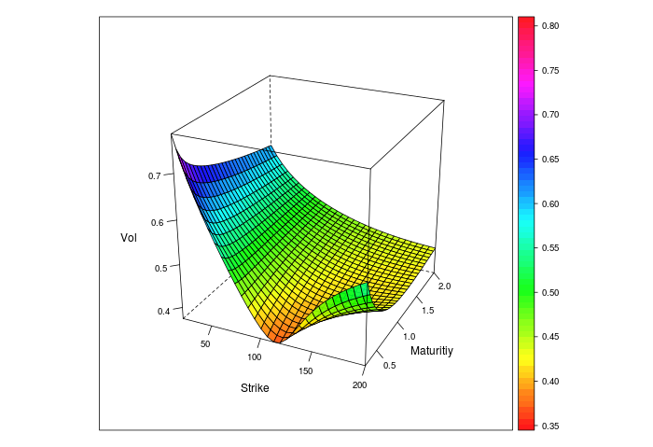
SWIG-Interface Layer Example: Bates Stochastic Volatility Model
r = 1%,q = 4%,v₀= 0.1, κ =1.5,Θ=0.25,σ = 0.75,ρ = −0.75,λ= 0.75,μ =−0.05,δ = 0.3

Slide 9
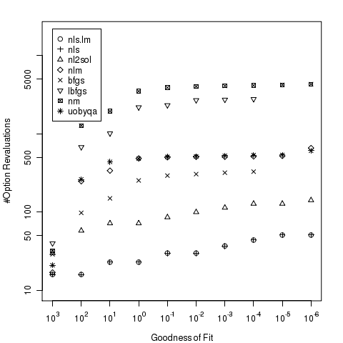
SWIG-Interface Layer Calibration of Stochastic Volatility Models
Case study: Choose the best local optimizer for the calibration of a stochastic volatility model.
nls.lm: Levenberg-Marquardt algorithm
nls: Gauss-Newton algorithm
nl2sol:based on the PORT library.
nlm:Newton style minizer
bfgs: quasi-Newton method
l-bfgs-b: limited memory BFGS algorithm
cg: conjugate gradient algorithm
nm: Nelder-Mead method
bobyqa:trust region method
newuoa: trust region method
uobyqa:trust region method

Slide 10
QuantLib Integration in R via Rcpp Overview
Rcpp (Dirk Eddelbuettel and Romain Francois) simplifies the integration of C++ code into R.
Rcpp maps various types of R objects to the corresponding C++ classes.
Data exchange between R and C++ is simple, flexible and supports STL-like idioms.
The “inline“ package compiles, links and loads a C/C++ function directly from the R-REPL.

Slide 11
QuantLib Integration in R via Rcpp Example: QuantLib‘s Black Formula
library(Rcpp)
library(inline)
# register QuantLib plugin with include helper and linker information
registerPlugin("QuantLib",
Rcpp:::Rcpp.plugin.maker(include.before='#include <ql/quantlib.hpp>',
libs="-lQuantLib"))
# define new R function, which invokes the QuantLib Black formula
blackFormulaCall <- cxxfunction(
signature(strike="numeric", fwd="numeric",
stdDev="numeric", discount="numeric"),
body='
// C++ body
using namespace QuantLib;
return wrap(blackFormula( // C++ to R using Rcpp::wrap
Option::Call,
as<Real>(strike), as<Real>(fwd), // R to C++ using Rcpp::as<>
as<Real>(stdDev), as<Real>(discount)));',
plugin="QuantLib")

Slide 12
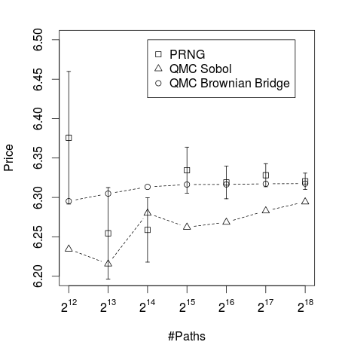
QuantLib Integration in R via Rcpp Quasi-Monte-Carlo with Brownian Bridges
Brownian Bridges are a useful tool to use Quasi-Monte-Carlo methods for high dimensional problems.
Mark Joshi: More Mathematical Finance
Price of an Asian Call Option
Rcpp Interface
CUDA Sobol Brownian Bridge
Thrust
cuRAND
QuantLib
CUDA

Slide 13
QuantLib Integration in R via Rcpp Quasi-Monte-Carlo with Brownian Bridges
#include <Rcpp.h>
#include <gpubrownianbridge.hpp>
using namespace QuantLib;
RcppExport SEXP sobolBrownianBridge(SEXP steps, SEXP factors, SEXP paths) {
const Size nSteps = Rcpp::as<Size>(steps)
const Size nFactors = Rcpp::as<Size>(factors);
const Size nPaths = Rcpp::as<Size>(paths);
// CUDA implementation of a Sobol Brownian Bridge algorithm
const std::vector<Real> results
= GPUBrownianBridge(nFactors, nSteps).getPaths(nPaths);
// prepare Quasi-Monte-Carlo paths as a R matrix
Rcpp::NumericMatrix m(nPaths, nSteps*nFactors);
std::copy(results.begin(), results.end(), m.begin());
return m;
}
path <- .Call("sobolBrownianBridge", steps=365, factors=1, paths=1023)

Slide 14
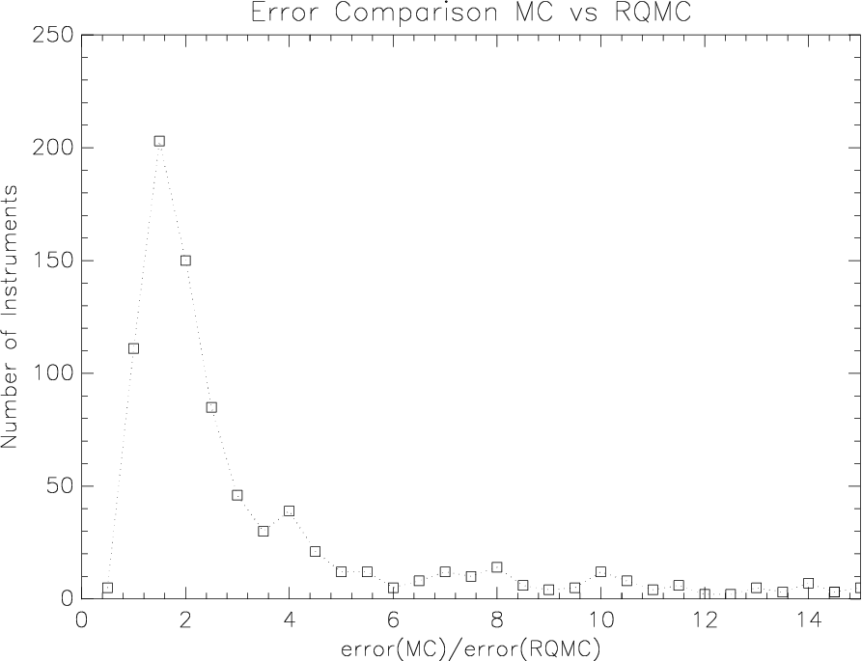
QuantLib Integration in R via Rcpp Quasi-Monte-Carlo with Brownian Bridges
Error reduction for a real portfolio of 835 structured equity linked notes.
Accelerating Exotic Option Pricing and Model Calibration Using GPUs, Bernemann et al in High
Performance Computational Finance (WHPCF), 2010, IEEE Workshop on, pages 1–7, Nov. 2010.

Slide 15
R Integration in QuantLib via RInside Overview
RInside makes it easy to embed R code in C++ applications.
The RInside constructor starts a regular R instance.
Commands are submitted via C++ strings, which are parsed and evaluated.
Higher-level abstractions from Rcpp keep it simple to get data in and out from the enclosing C++ application.

Slide 16
R Integration in QuantLib via RInside Using R as a Payoff Scripting Language (snippet)
RInside R(argc, argv); // create an embedded R instance
R.parseEvalQ(
"payoff <- function(path) {"
" max(0, path[length(path)] - strike);" // return call payoff value
"});
R["strike"] = 100.0; // assign value to R’s strike variable
for (Size i=0; i < nSimulations; ++i) {
// QuantLib path generator
const path_type& path = generator.next().value;
// assign path to R’s path variable
R["path"] = std::vector<Real>(path[0].begin(), path[0].end());
// execute payoff script
const Real npv = R.parseEval("payoff(path)");
stat.add(npv * discountFactor);
}
std::cout << stat.mean() << " " << stat.errorEstimate()) << std::endl;

Slide 17
R Integration in QuantLib via RInside RInside and Rcpp
Calling QuantLib methods from R within a C++ application.
#include <RInside.h>
#include <ql/quantlib.hpp>
int main(int argc, char* argv[])
{
RInside R(argc, argv); // create an embedded R instance
// assign the QuantLib betaFunction method to R’s ql_beta variable
R["ql_beta"] = Rcpp::InternalFunction( &QuantLib::betaFunction );
// evaluating the QuantLib beta function via R
const Real ql_beta = R.parseEval("ql_beta(2, 3)");
// evaluating R’s build-in beta function
const Real r_beta = R.parseEval("beta(2, 3)");
std::cout << r_beta << " " << ql_beta << std::endl;
return 0;
}

Slide 18
The RQuantLib Package Overview
The RQuantLib (Dirk Eddelbuettel) package exposes a subset of the QuantLib functionality to R.
Technically RQuantLib uses Rcpp to bridge between QuantLib‘s C++ world and R.
RQuantLib covers a number of option pricing functions, a broader range of fixed income functions and also calendar and holiday utilities.
RQuantLib is the easiest way to start with QuantLib in R.

Slide 19
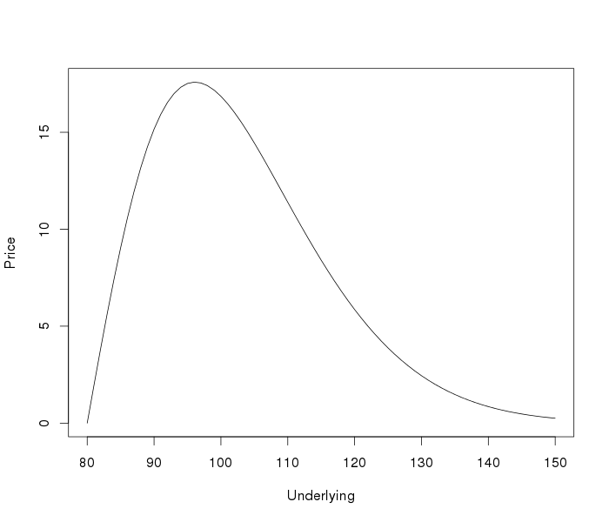
The RQuantLib Package Example: Down-and-Out Put
library(RQuantLib)
s <- seq(80, 150)
barrierPrice <- function(s) {
BarrierOption(
"downout", "put",
underlying=s,
strike=120,
dividendYield=0.01,
riskFreeRate=0.03,
maturity=0.1,
volatility=0.4,
barrier=80)$value
}
plot(s, sapply(s,barrierPrice),
ylab="Price",
xlab="Underlying",type="l")

Slide 20
Conclusion
R and QuantLib are complementing each other.
A subset of QuantLib can be accessed by R via the QuantLib-SWIG layer.
As for any other C/C++ library Rcpp together with RInsinde make it very easy to integrate QuantLib functionality in R or via versa.
RQuantLib makes parts of QuantLib visible in R using Rcpp.

