Slide 1

OneTick & R Handling High & Low Frequency Data Historical & Real-Time
Maria Belianina, Ph.D.
Director, Pre-Sales Engineering Support
6 Minute Crash Course

Slide 2

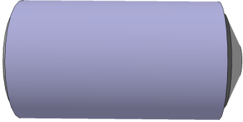
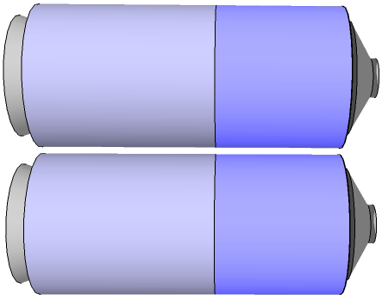
What is OneTick?
ONETICK time series database & analytics
Tick data management and super fast analytics for Finance. Capture, store, retrieve and analyze real-time and historical tick data for any asset class, any size & period of time, any granulairty
ONETICK CEP real-time analytics
Low latency Complex Event Processing seamlessly integrating the analysis of real-time streaming and historical market data
ONETICK reference data file - Smooth time series data with Corporate actions, symbol name changes and more
Markets
Collectors
Markets
Real-time market feeds
History
In-memory
Database:
Today’s
CEP Server
Analytics
Archives:
History
TAQ
History:
Data
Archives:
History
Tick Server
TAQ
Analytics
TAQ Loaders
Reference
Data

Slide 3
Who is using OneTick and why?
Our clients:
Business Cases:
Hedge Funds & Proprietary Trading Firms
Market Makers
Large Asset Managers
Banks & Brokers
Marketplaces / Exchanges
Technology & Information Providers
Universities
Backtesting & Quantitative Research
High frequency trading signal generation
Pre- & Post- Trade TCA
Venue Analysis
Backbone for Charting / Time and Sales
Compliance & Regulatory Reporting
Risk & Portfolio Analytics
Generic time series analysis

Slide 4
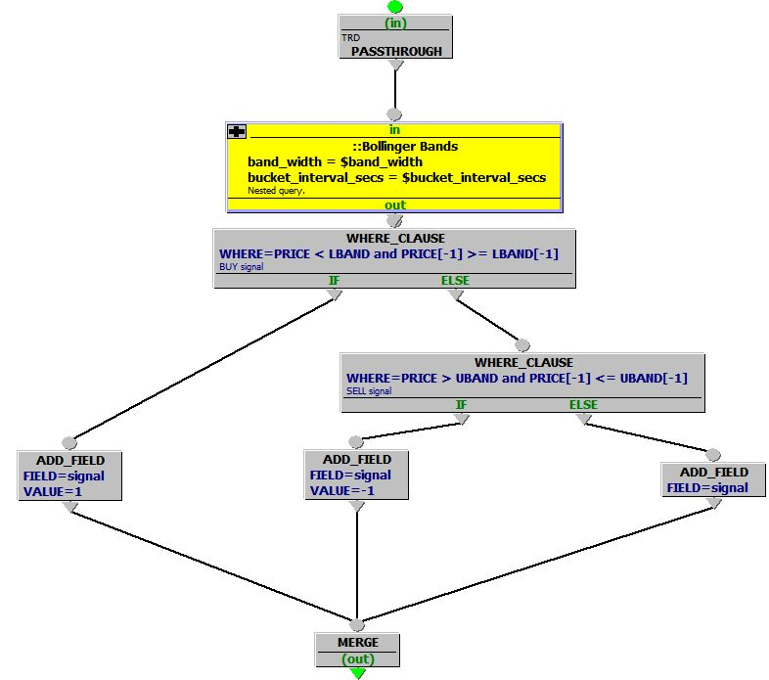
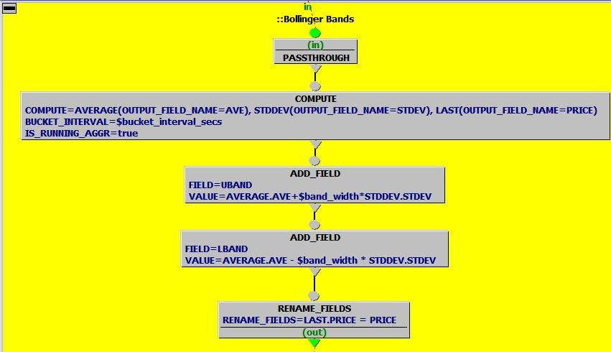
OneTick GUI: Query Language
Query Example: Bollinger Bands Buy/Sell Signals
Runs
Historical
(for research
& backtesting)
or
Real-Time
(alerts & signal generation)
Trades
A “Nested query”
for Bollinger Bands calculations
NOTE: One of the nodes can be a custom function coded in R or C++, C#, Java, Python, Perl
Notes:
Aggregations with many parameters:
Generic (HIGH, LOW, AVERAGE, etc)
Finance (VWAP, RETURN, OPTION_PRICE, etc)
Statistics (STDDEV, VARIANCE, RANKING, etc)
Order Book (Snapshots, Depth, VWAP, etc)
Joins and Merges for mixing & matching different tick type, different databases, different symbols
Filters (WHERE_CLAUSE, SKIP_BAD_TICK, etc)
Tick transformers (ADD/UPDATE fields, transpose, etc)
Input and output adapters and much more…

Slide 5
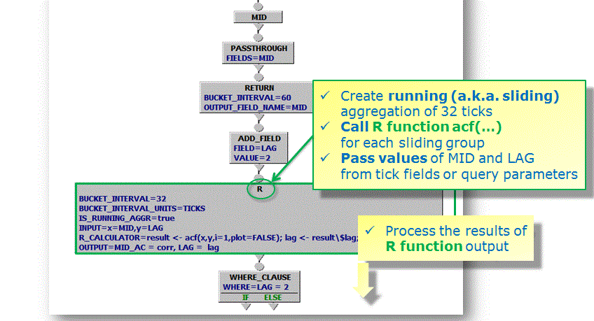
High Frequency Time Series? Yes.
Tick data with milli-, micro-, nano-second granularity
Trades, prices, orders, executions & any other time series
Aggregate, filter, adjust, join, compute in OneTick
Mix OneTick analytics with R code as needed (see below)
Historical & Real Time continuous queries
BBO
…
Some facts:
Processing rate – more than 6 million ticks/second/core
Ability to capture, store & analyze all ticks globally (currently over 7 billion ticks/day)
Linux, Windows, etc 64 or 32 bit
Multi-threaded processing
Notes:
Scalable multi-threaded 64bit server architecture
Single-digit microsecond latency of CEP adapter for PassThrough query
Bulk processing rate – more than 6 million ticks/second/core
Ability to capture all ticks globally (currently over 7 billion ticks/day)
Immediate access to the latest tick as well as years of history
Standard setup handles over 10 million data/analytics requests daily
Proprietary compression to optimize disk use and retrieval rates

Slide 6
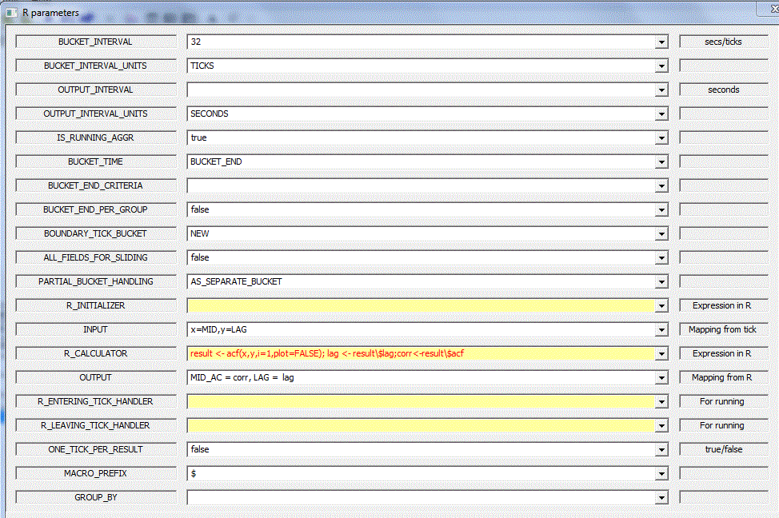
High Frequency Time Series? Yes.
Tick data with milli-, micro-, nano-second granularity
Trades, prices, orders, executions & any other time series
Aggregate, filter, adjust, join, compute in OneTick
Mix OneTick analytics with R code as needed (see below)
Historical & Real Time continuous queries
OneTick R Event Processor Parameters
Generic OneTick bucket aggregation parameters
R in-process call parameters
Notes:
Scalable multi-threaded 64bit server architecture
Single-digit microsecond latency of CEP adapter for PassThrough query
Bulk processing rate – more than 6 million ticks/second/core
Ability to capture all ticks globally (currently over 7 billion ticks/day)
Immediate access to the latest tick as well as years of history
Standard setup handles over 10 million data/analytics requests daily
Proprietary compression to optimize disk use and retrieval rates

Slide 7
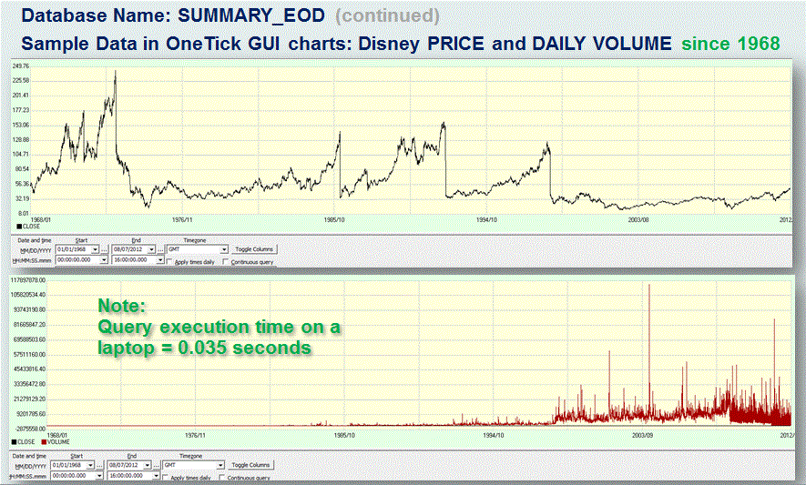
Low Frequency Time Series? Fine.
Load & store time series for unlimited range of dates
Enrich daily prices with corporate actions and more
Aggregate, filter, adjust and return results back to R

Slide 8
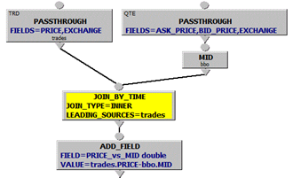
Stop by our stand for a live demo! Thank you
Contacts:
maria.belianina@onetick.com
info@onetick.com

