Slide 1
Factor Model Based Risk Measurement and Management
R/Finance 2011: Applied Finance with R
April 30, 2011
Eric Zivot
Robert Richards Chaired Professor of Economics
Adjunct Professor, Departments of Applied Mathematics, Finance and Statistics, University of Washington
BlackRock Alternative Advisors
Notes:
Do not say that I built this model for BlackRock openly. Bryan White does not want the « secret sauce » to get out and advertised. Talk about my research with Doug Martin at UW and work with students. Mention that I have consulted with BlackRock and others

Slide 2
Risk Measurement and Management
Quantify asset and portfolio exposures to risk factors
Equity, rates, credit, volatility, currency
Style, geography, industry, etc.
Quantify asset and portfolio risk
SD, VaR, ETL
Perform risk decomposition
Contribution of risk factors, contribution of constituent assets to portfolio risk
Stress testing and scenario analysis

Slide 3
Asset Level Linear Factor Model

Slide 4
Performance Attribution
Expected return due to systematic “beta” exposure
Expected return due to firm specific “alpha”

Slide 5
Factor Model Covariance
Note:

Slide 6
Portfolio Linear Factor Model

Slide 7
Risk Measures
Return Standard Deviation (SD, aka active risk)
Value-at-Risk (VaR)
Expected Tail Loss (ETL)

Slide 8
Risk Measures
5% ETL
5% VaR
± SD
Notes:
Give graphic depicting VaR and ES

Slide 9
Tail Risk Measures: Non-Normal Distributions
Asset returns are typically non-normal
Many possible univariate non-normal distributions
Student’s-t, skewed-t, generalized hyperbolic, Gram-Charlier, α-stable, generalized Pareto, etc.
Need multivariate non-normal distributions for portfolio analysis and risk budgeting.
Large number of assets, small samples and unequal histories make multivariate modeling difficult

Slide 10
Factor Model Monte Carlo (FMMC)
Use fitted factor model to simulate pseudo asset return data preserving empirical characteristics of risk factors and residuals
Use full data for factors and unequal history for assets to deal with missing data
Estimate tail risk and related measures non-parametrically from simulated return data
Notes:
Emphasize

Slide 11
Simulation Algorithm
Simulate B values of the risk factors by re-sampling from full sample empirical distribution:
Simulate B values of the factor model residuals from fitted non-normal distribution:
Create factor model returns from factor models fit over truncated samples, simulated factor variables drawn from full sample and simulated residuals:

Slide 12
What to do with ?
Backfill missing asset performance
Compute asset and portfolio performance measures (e.g., Sharpe ratios)
Compute non-parametric estimates of asset and portfolio tail risk measures
Compute non-parametric estimates of asset and factor contributions to portfolio tail risk measures

Slide 13
Factor Risk Budgeting
Given linear factor model for asset or portfolio returns,
SD, VaR and ETL are linearly homogenous functions of factor sensitivities . Euler’s theorem gives additive decomposition

Slide 14
Factor Contributions to Risk
Marginal Contribution to Risk of factor j:
Contribution to Risk of factor j:
Percent Contribution to Risk of factor j:

Slide 15
Factor Tail Risk Contributions
For RM = VaR, ETL it can be shown that
Notes:
Intuitive interpretations as stress loss scenarios
Analytic results are available under normality

Slide 16
Semi-Parametric Estimation
Factor Model Monte Carlo semi-parametric estimates

Slide 17
5% VaR
Factor marginal contribution to 5% ETL

Slide 18
Portfolio Risk Budgeting
Given portfolio returns,
SD, VaR and ETL are linearly homogenous functions of portfolio weights w. Euler’s theorem gives additive decomposition

Slide 19
Fund Contributions to Portfolio Risk
Marginal Contribution to Risk of asset i:
Contribution to Risk of asset i:
Percent Contribution to Risk of asset i:

Slide 20
Portfolio Tail Risk Contributions
For RM = VaR, ETL it can be shown that
Note: Analytic results are available under normality

Slide 21
Semi-Parametric Estimation
Factor Model Monte Carlo semi-parametric estimates

Slide 22
5% VaR
Fund marginal contribution to portfolio 5% ETL

Slide 23
Example FoHF Portfolio Analysis
Equally weighted portfolio of 12 large hedge funds
Strategy disciplines: 3 long-short equity (LS-E), 3 event driven multi-strat (EV-MS), 3 direction trading (DT), 3 relative value (RV)
Factor universe: 52 potential risk factors
R² of factor model for portfolio ≈ 75%, average R² of factor models for individual hedge funds ≈ 45%
Notes:
Jason will send over Excel file with hypothetical example using 10 large hedge funds

Slide 24
σ_{FM} = 1.42%
σ_{FM,EWMA} = 1.52%
VaR_{0.0167} = -3.25%
ETL_{0.0167} = -4.62%
50,000 simulations

Slide 25
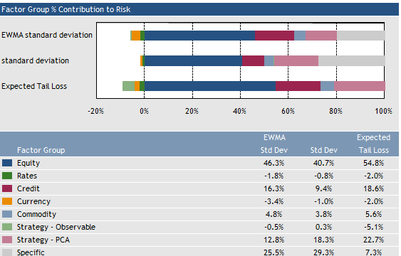
Factor Risk Contributions

Slide 26
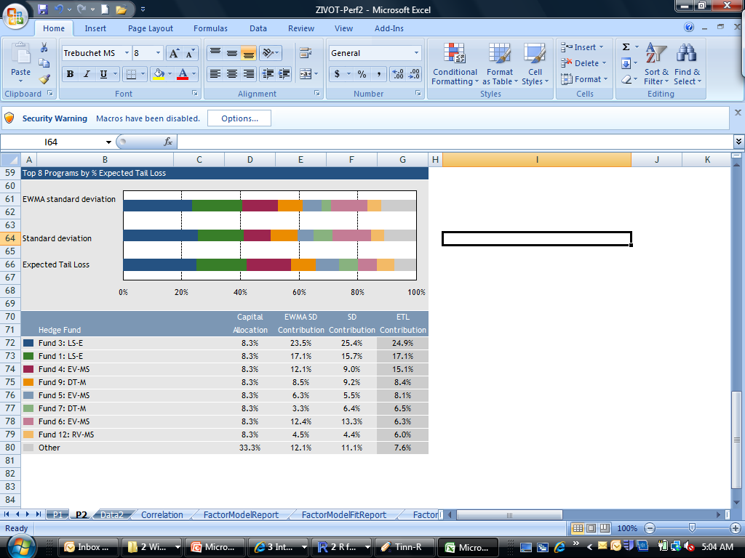
Hedge Fund Risk Contributions

Slide 27
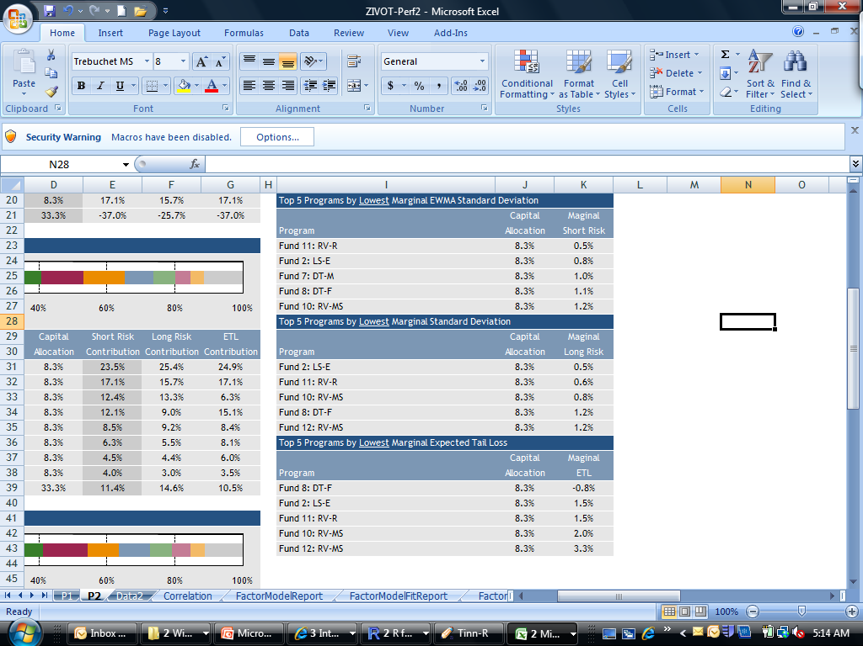
Hedge Fund Risk Contribution

Slide 28
Summary and Conclusions
Factor models are widely used in academic research and industry practice and are well suited to modeling asset returns
Tail risk measurement and management of portfolios poses unique challenges that can be overcome using Factor Model Monte Carlo methods

