Slide 1
R and proto
Louis Kates
GKX Associates Inc.
1-877-GKX-GROUP
Thomas Petzoldt
Technische Universitaet Dresden
http://r-proto.googlecode.com
Notes:
This is joint work with Thomas Petzoldt.

Slide 2
OO & Related in R
 | R Core | Package
Conventional | Reference Classes S4 | R.oo (5+9)
Prototype |  | proto (12+2) mutatr (0+2)
Other | S3 | futile.paradigm (0+2)
(m+n) = number of CRAN packages using it not by any of the same authors or maintainer + number by any of the same authors or maintainer

Slide 3
Simplicity
Less is more.
- Ludwig Mies van der Rohe
Inside every large program there is a small program trying to get out.
- CAR Hoare
Notes:
The motivating theme of prototype programming.

Slide 4
The aim of prototype programming is OO with fewer basic structures.
Notes:
Minimum axioms in math, unified theory of everything in physics, estimating functions in statistics unify Least Squares and Maximum Likelihood.

Slide 5
Conventional OO = objects + classes
Prototype OO = objects
Difference = classes
Notes:
Even though prototype programming has no classes its just as powerful as conventional OO.

Slide 6
Classes vs. Objects
Abstract vs. Concrete
Notes:
Classes are abstractions whereas objects are concrete.

Slide 7
Philosophers
Plato
Aristotle
Wittgenstein
Notes:
Plato/forms, Aristotle/biological taxonomy

Slide 8
Wittgenstein - Classification is Hard
enumeration impractical
identifying properties difficult
some classes particularly hard to define
Notes:
Clyde/Fred, art

Slide 9
Prototypes
Advantages:
no need to create classifications
Disadvantages:
classes work better for stacks, queues, etc.
incremental knowledge is more natural
fewer building blocks
what is the prototypical integer?

Slide 10
Prototype Programming
Prototype-based programming is a type of object oriented programming in which classes are not a primitive notion though its suﬃciently powerful to encompass them.

Slide 11
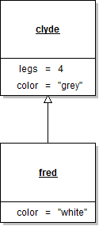
Modeling with Prototypes
Notes:
clyde, the elephant and fred, the elephant.

Slide 12
Lists & Environments
List:
contents = identity
Environment:
contents ≠ identity
Notes:
R has two container objects: lists & environments

Slide 13
Lists vs. Environments
# lists: identity defined by contents
L <- list(a = 1, b = 2)
f <- function(x) { x$a <- 3 }
f(L) # L not changed
# environments: separation of identity and contents
e <- as.environment(L)
f(e) # contents of e are changed

Slide 14

Modeling with Prototypes - II
clyde <- new.env()
clyde$legs <- 4
clyde$color <- "grey"
fred <- new.env(parent = clyde)
fred$color <- "white"
with(fred, color) # "white"
with(fred, legs) # 4

Slide 15
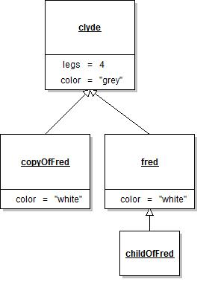
# shallow copy
copyOfFred <- list2env(as.list(fred),
parent = parent.env(fred))
# delegation
childOfFred <- new.env(parent = fred)
with(childOfFred, legs) # 4
with(childOfFred, color) # white
with(copyOfFred, legs) # 4
With(copyOfFred, color) # white
Notes:
If we change fred’s color that will change childOfFred’s color but not copyOfFred’s color.

Slide 16
UML, Environments, Proto
environments
clyde <- new.env()
clyde$color <- "grey"
clyde$legs <- 4
fred <- new.env(parent = clyde)
fred$color <- "white"
with(fred, legs)
proto
clyde <-proto(color = "grey", legs = 4)
fred <- clyde$proto(color = "white")
fred$legs
Notes:
The primary function in the proto package is the proto constructor which creates new proto objects.

Slide 17
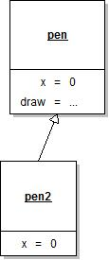
pen <- local({ x <- 0
draw <- function(this, newx) {
cat("from", with(this, x), "to",newx, "\n")
this$x <- newx }
environment()})
pen2 <- new.env(parent = pen); pen2$x <- 0
with(pen2, draw)(pen2, 1)
pen <- proto(x = 0,
draw = function(this, newx) {
cat("from", this$x, "to",newx, "\n")
this$x <- newx })
pen2 <- pen$proto(x = 0)
pen2$draw(1)
Notes:
A pen has a location, x, on the X axis. The draw method causes a line segment to be drawn from x to the argument newx. The blue part cannot be reduced to x since this is not necessarily pen. draw is delegated to pen2 so this might be pen2.

Slide 18
Syntax
 | Environments | proto
Get x from p. | with(p, x) | p$x
Get x from p but not parent. | p$x or p[[“x”]] | p[[“x”]]
Invoke method f of p. | with(p, f)(p, x) | p$f(x)
List elements. | ls(p) | p$ls()
Create child object with two properties. | ch <- local({x <- 0; y <- 0 environment()}, new.env(parent = p)) | ch <- p$proto(x = 0, y = 0)
Same but in steps. | ch <- new.env(parent = p) ch$x <- 0 ch$y <- 0 | ch <- p$proto() ch$x <- 0 ch$y <- 0

Slide 19
S3 Classes of proto
> class(pen2)
[1] "proto" "environment"
> class(pen2$draw)
[1] "instantiatedProtoMethod" "function"
Notes:
Proto and instantiatedProtoMethod are the two classes in the proto package.

Slide 20
instantiatedProtoMethod S3 class
Automatically curried. Defined with 2 arguments but called
with 1:
> pen2$draw
proto method (instantiated with 02af32ac):
function(this, newx) {
cat("from", this$x, "to", newx, "\n")
this$x <- newx }
<environment: 02afcb40>
pen2$draw(1) # or with(pen2, draw)(pen2, 1)
pen2$ls() # or with(pen2, ls)(pen2).
environment(pen2) is 02af32ac
environment(pen) is 02afcb40
draw delegated from pen to pen2
ls(pen2) gives same answer but lacks capability of overriding ls
Notes:
Although an instantiated proto method is defined using 2 arguments here one calls it with one since the first is curried. Instantiated proto methods can also be created from ordinary R functions like ls. pen2$ls first looks for ls in pen2 so R’s ls could be overridden. Ditto for p$proto.

Slide 21
Currying ordinary functions
pen2$ls()
pen2$str()
pen2$print()
pen2$as.list()
pen2$parent.env()
pen2$eapply(length)
Notes:
ls, str, print, as.list, parent.env, length are NOT defined in proto.

Slide 22
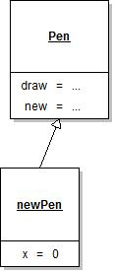
Traits
An object which contains only methods and variables that are intended to be shared by all its children (as opposed to an object whose purpose is to have its own methods and variables) is known as a trait (Agesen et al ’92, SELF manual)
Pen <- proto(draw = ..as before..,
new = function(this, x) this$proto(x = x))
newPen <- Pen$new(0)

Slide 23
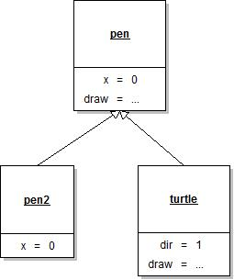
.super
environments
turtle <- local({ dir <- 1
.that <- environment(); .super <- parent.env(.this)
draw <- function(this, d)
with(.super, draw)(this, with(this, x) + d * this$dir )
environment()
}, new.env(parent = pen))
with(turtle, draw)(turtle, 1) # from 0 to 1
with(turtle, draw)(turtle, 10) # from 1 to 11
proto
turtle <- pen$proto(dir = 1,
draw = function(this, d = 1)
.super$draw(this, this$x + d* this$dir)
)
turtle$draw(1) # from 0 to 1
turtle$draw(10) # from 1 to 11
.that and .super automatically inserted into turtle
No currying with .super
Notes:
A turtle advanced d units in the direction dir where dir is typically +1 or -1.

Slide 24
Typical Applications
User interfaces
Graphics
Reporting
General container objects
Logging

Slide 25
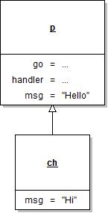
GUI
library(proto)
library(gWidgets)
p <- proto(
go = function(this) {
w <- gwindow(); g <- ggroup(container = w)
g.i <- ggroup(horizontal=FALSE, container = g)
glabel(this$msg, container = g.i, expand = TRUE)
g.i.b <- ggroup(container = g.i); addSpring(g.i.b)
gbutton("ok", handler = with(this, handler), action = this, container = g.i.b)
gbutton("cancel", handler = function(h, ...) dispose(w), container = g.i.b)
},
handler = function(h, ...) { cat("\n", h$action$msg, "\n"); dispose(h$obj) },
msg = "Hello"
)
ch <- p$proto(msg = "Hi")
ch$go() # press ok button on generated GUI & on R console we see: Hi
Notes:
GUIs tend to involve global variables that can be cleaned up.

Slide 26
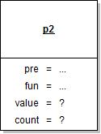
gsubfn
gsubfn is like gsub except the replacement string can be a proto object which supplies a fun method and optionally pre and post methods.
The fun method accepts the match and produces the replacement. It can use the properties of the proto object to carry state between function invocations.
> library(gsubfn)
> p2 <- proto(pre = function(this) this$value <- 0,
+ fun = function(this, x) this$value <- this$value + as.numeric(x))
> gsubfn("[0-9]+", p2, "12 3 11, 25 9")
[1] "12 15 26, 51 60”

Slide 27
http://r-proto.googlecode.com

